Slide 1
INGI2145: CLOUD COMPUTING (Fall 2014)
Cloud basics
9 October 2014
Certain lecture slides adapted from Upenn NETS212 by A. Haeberlen, Z. Ives and from Cornell CS5412 by K. Birman Reproduced with permission

Slide 2
Announcements
First homework assignment will be announced next week
You will need to be setup with AWS
Next week’s lab (17 Oct) will cover important background for this assignment
Tomorrow’s lab session is about Amazon Storage Services
Bring your own laptop
We will try to use the Intel rooms again for better connectivity

Slide 3
Plan for today
Parallel programming and its challenges
Parallelization and scalability, Amdahl's law
Network partitions, CAP theorem, relaxed consistency
Cloud basics
Anatomy of Cloud applications
Scaling: stateless, caching, and sharding
Example components
Application server: Node.js
In-memory cache: Memcached
Scaling memcache at Facebook
NEXT

Slide 4





Network partitions
What if this link breaks?
Server A
Bob
Alice
Server B
Network can partition
Hardware fault, router misconfigured, undersea cable cut, ...
Result: Gobal connectivity is lost
What does this mean for the properties of our system?

Slide 5
The CAP theorem
What we want from a web system:
Consistency: All clients single up-to-data copy of the data, even in the presence of concurrent updates
Availability: Every request (including updates) received by a non-failing node in the system must result in a response, even when faults occur
Partition-tolerance: Consistency and availability hold even when the network partitions
Can we get all three?
CAP theorem: We can get at most two out of the three
Which ones should we choose for a given system?
Conjecture by Brewer; proven by Gilbert and Lynch

Slide 6
Visual CAP
A
Availability: Each client can always read and write despite node failures
C&A
A&P
Pick Two
C
P
C&P
Consistency: All clients always have the same view of the data at the same time
Partition-tolerance: The system continues to operate despite arbitrary message loss

Slide 7
Common CAP choices
Example #1: Consistency & Partition tolerance
Many replicas + consensus protocol
Do not accept new write requests during partitions
Certain functions may become unavailable
Example #2: Availability & Partition tolerance
Many replicas + relaxed consistency
Continue accepting write requests
Clients may see inconsistent state during partitions

Slide 8
“2 of 3” view is misleading
Meaning of C&A over P is unclear
If a partition occurs, the choice must be reverted to C or A
No reason to forfeit C or A when system is not partitioned
Choice of C and A can occur many times within the same system at fine granularity
Three properties are more of a continuous
Availability is 0 to 100
Many levels of consistency
Disagreement within the system whether a partition exists
The modern CAP goal should be to maximize application-specific combinations of C and A

Slide 9
Dealing with partitions
Detect partition
Enter an explicit partition mode that can limit some operations
Initiate partition recovery when communication is restored
Restore consistency and compensate for mistakes made while the system was partitioned
State: S
State: S1
State: S’
Partition recovery
Operations on S
State: S2
Time
Partition mode

Slide 10
Which operations should proceed?
Depends primarily on the invariants that the system intends to maintain
If an operation is allowed and turns out to violate an invariant, the system must restore the invariant during recovery
Example: 2 objects are added with the same (unique) key; to restore, we check for duplicate keys and merge objects
If invariant cannot be violated, system must prohibit or modify the operation (e.g. record the intent and execute it after)
Example: delay charging the credit card; user does not see system is not available

Slide 11


Eventual consistency
Server A
Server B
Alice
Idea: Optimistically allow updates
Don't coordinate with ALL replicas before returning response
But ensure that updates reach all replicas eventually
What do we do if conflicting updates were made to different replicas?
Good: Decouples replicas. Better performance, availability under partitions
(Potentially) bad: Clients can see inconsistent state

Slide 12
Partition recovery
State on both sides must become consistent
Compensation for mistakes during partition
Start from state at the time of the partition and roll forward both sets of operations in some way, maintaining consistency
The system must also merge conflicts
constraint certain operations during partition mode so that conflicts can always be merged automatically
detect conflicts and report them to a human
use commutative operations as a general framework for automatic state convergence
commutative replicated data types (CRDTs)

Slide 13
Compensate for mistakes
Tracking and limitation of partition-mode operations ensures the knowledge of which invariants could have been violated
trivial ways such as “last writer wins”, smarter approaches that merge operations, and human escalation
For externalized mistakes typically requires some history about externalized outputs
System could execute orders twice
If the system can distinguish two intentional orders from two duplicate orders, it can cancel one of the duplicates
If externalized, send an e-mail explaining the order was accidentally executed twice but that the mistake has been fixed and to attach a coupon for a discount

Slide 14
Relaxed consistency: ACID vs. BASE
Classical database systems: ACID semantics
Atomicity
Consistency
Isolation
Durability
Modern Internet systems: BASE semantics
Basically Available
Soft-state
Eventually consistent

Slide 15
Recap: Consistency and partitions
Use replication to mask limited # of faults
Can achieve strong consistency by having replicas agree on a common request ordering
Even non-crash faults can be handled, as long as there are not too many of them (typical limit: 1/3)
Partition tolerance, availability, consistency?
Can't have all three (CAP theorem)
Typically trade-off between C and A
If service works with weaker consistency guarantees, such as eventual consistency, can get a compromise (BASE)

Slide 16

Plan for today
Parallel programming and its challenges
Parallelization and scalability, Amdahl's law
Network partitions, CAP theorem, relaxed consistency
Cloud basics
Anatomy of Cloud applications
Scaling: stateless, caching, and sharding
Example components
Application server: Node.js
In-memory cache: Memcached
Scaling memcache at Facebook
NEXT

Slide 17
Recap: Cloud benefits
Elastic, just-in-time infrastructure
More efficient resource utilization
Pay for what you use
Potential to reduce processing time
Parallelization
Leverage multiple data centers
High availability, lower response times
How do applications exploit these benefits?

Slide 18
Today’s Cloud applications
Web applications
Client/server paradigm
Request/response messaging pattern
Interactive communication
Processing pipelines
Examples: Indexing, data mining, image processing, video transcoding, document processing
Batch processing systems
Example: report generation, fraud detection, analytics, backups, automated testing

Slide 19
Many styles of system
Near the edge of the application focus is on vast numbers of clients and rapid response
Inside we find data-intensive services that operate in a pipelined manner, asynchronously
Deep inside the application we see a world of virtual computer clusters that are scheduled to share resources and on which applications like MapReduce (Hadoop) are very popular

Slide 20
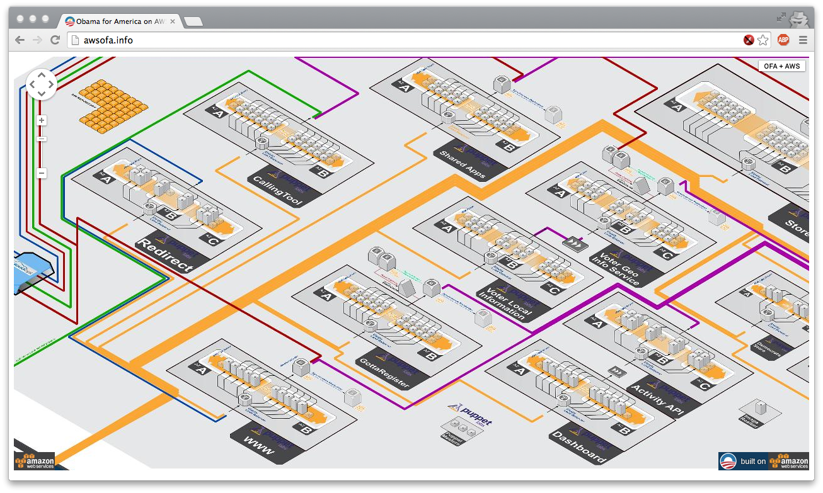
Example: Obama for America AWS
http://awsofa.info/

Slide 21
How are Cloud apps structured?
Clients talk to application using Web browsers or the Web services standards
But this only gets us to the outer “skin” of the data center, not the interior
Consider Amazon: it can host entire company web sites (like Netflix.com), data (S3), servers (EC2), databases (RDS) and even virtual desktops!

Slide 22

Big picture overview
Client requests are handled in by front-end Web servers
Application servers are invoked for dynamic content generation and run app logic
PHP, Java, Python, …
Back-end databases manage and provide access to data
Web
Web
App
Web
Web
App
App
Web
App
Shards
App
Cache
Cache
DB
DB
Index

Slide 23
Applications with multiple tiers
Web servers
Application servers
Data store (or database)

Slide 24
Redundancy at each tier
Web servers
Application servers
Data store

Slide 25
Load balancer
Load balancer
Web servers
Application servers
Data store

Slide 26
Plan for today
Parallel programming and its challenges
Parallelization and scalability, Amdahl's law
Network partitions, CAP theorem, relaxed consistency
Cloud basics
Anatomy of Cloud applications
Scaling: stateless, caching, and sharding
Example components
Application server: Node.js
In-memory cache: Memcache
Scaling memcached at Facebook
NEXT

Slide 27
Stateless servers are easiest to scale
Views a client request as an independent transaction and responds to it
Advantages:
Simpler and easier to scale: does not maintain state
More robust: tolerating instance failures does not require overheads restoring state
Stateless servers

Slide 28
Caching
Load balancer
Web servers
Application servers
Caching
Data store

Slide 29
Caching
Caching is central to responsiveness
Basic idea is to always used cached data if at all possible, so the inner services (data stores) are shielded from “online” load
Caching is only temporary storage, hence it is stateless
We can add multiple cache serves to spread loads
Must think hard about patterns of data access
Some data needs to be heavily replicated to offer very fast access on vast numbers of nodes
In principle the level of replication should match level of load and the degree to which the data is needed

Slide 30
Stateful servers require attention
Scaling a relational database is challenging
Traditional approach is replication
Data is written to a master server and then replicated to one or more slave servers (synchronously or asynchronously)
Read operations can be handled by the slaves
All writes happen on the master
Master
Slave
Data store

Slide 31
Stateful servers require attention
Scaling a relational database is challenging
Traditional approach is replication
Data is written to a master server and then replicated to one or more slave servers (synchronously or asynchronously)
Read operations can be handled by the slaves
All writes happen on the master
Cons:
Master becomes the write bottleneck
Master is a single point of failure
As load increases, cost of replication increases
Slaves may fall behind and serve stale data

Slide 32
Sharding
Data partitioning strategy
Basic idea: split data between multiple machines and have a way to make sure you always access data from the right place
Typically define a sharding key and create a shard mapping (e.g., consistent hashing: shard_idx = hash(key) mod N)
Other partitioning schemes exist: e.g., allocate whole tables on the same machine
Partition 1
Partition 2
Partition 3

Slide 33
Benefits of sharding
Increased read and write throughput
High availability
Possibility of doing more work in parallel within the application server
Challenge: picking a good partitioning scheme
Otherwise risk of having hotspots in the system due to load imbalance

Slide 34
Sharding used in many ways
Sharding is not only for partitioning data within a database
Applies essentially to every application tier
Notion of sharding is cross-cutting
Example: partition data across caching servers
Two popular in-memory caching systems:
memcached: distributed object caching system
redis: distributed data structure server (also works as store)

Slide 35
And it isn’t just about updates
Should also be thinking about patterns that arise when doing reads (“queries”)
Some can just be performed by a single representative of a service
But others might need the parallelism of having several (or even a huge number) of machines do parts of the work concurrently
The term sharding is used for data, but here we might talk about “parallel computation on a shard”

Slide 36
First-tier parallelism
Parallelism is vital for fast interactive services
Key question:
Request has reached some service instance X
Will it be faster…
… For X to just compute the response
… Or for X to subdivide the work by asking subservices to do parts of the job?
Glimpse of an answer
When you make a search on Bing, the query is processed in parallel by even 1000s of servers that run in real-time on your request!
Parallel actions must focus on the critical path

Slide 37
What does “critical path” mean?
Focus on delay until a client receives a reply
Critical path are actions that contribute to this delay
Request
Service instance
Response delay seen by end-user would include Internet latencies
Service response delay
Response

Slide 38
Parallel speedup
In this example of a parallel read-only request, the critical path centers on the middle “subservice”
Request
Service instance
Critical path
Response delay seen by end-user would include Internet latencies
Service response delay
Critical path
Critical path
Response

Slide 39
With replicas we just load balance
Request
Service instance
Response delay seen by end-user would include Internet latencies
Service response delay
Response

Slide 40
What if a request triggers updates?
If updates are done “asynchronously” we might not experience much delay on the critical path
Cloud systems often work this way
Avoids waiting for slow services to process the updates but may force the tier-one service to “guess” the outcome
For example, store in the master database and replicate to the slave in the background
Many cloud systems use these sorts of “tricks” to speed up response time

Slide 41
What if we send updates without waiting?
Several issues now arise
Are all the replicas applying updates in the same order?
Might not matter unless the same data item is being changed
But then clearly we do need some “agreement” on order
What if the leader replies to the end user but then crashes and it turns out that the updates were lost in the network?
Data center networks can be surprisingly lossy at times
Also, bursts of updates can queue up
Such issues result in inconsistency

Slide 42
Is inconsistency a bad thing?
How much consistency is really needed in the first tier of the cloud?
Think about YouTube videos. Would consistency be an issue here?
What about the Amazon “number of units available” counters. Will people notice if those are a bit off?
Puzzle: can you come up with a general policy for knowing how much consistency a given thing needs?

Slide 43


eBay’s Five Commandments
As described by Randy Shoup at LADIS 2008
Thou shalt…
1. Partition Everything
2. Use Asynchrony Everywhere
3. Automate Everything
4. Remember: Everything Fails
5. Embrace Inconsistency

Slide 44
Recap
Cloud applications are multi-tiered systems
Caching can enable significant speedups for read-heavy workloads
Sharding provides opportunities for parallelization and improve read/write throughputs
Asynchronous operations decouple systems and enable quicker responses at the expense strong consistency

Slide 45
Plan for today
Parallel programming and its challenges
Parallelization and scalability, Amdahl's law
Network partitions, CAP theorem, relaxed consistency
Cloud basics
Anatomy of Cloud applications
Scaling: stateless, caching, and sharding
Example components
Application server: Node.js
In-memory cache: Memcached
Scaling memcache at Facebook
NEXT

Slide 46
Application server
Provides an environment where Web applications can run
Many application server frameworks exists
Support different programming languages
At the core they support dynamic Web page generation
Differentiated by functionality and features (runtime libraries, database connectors, fail-over, load balancing, etc.)
Let’s consider an example: Node.js

Slide 47


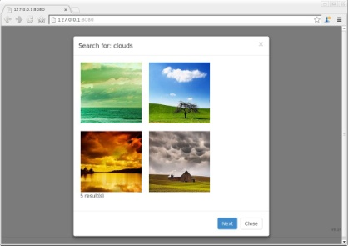
How does a Web application work?
Server
require('http'); http.createServer (…)
Internet
Web page
<html><head> <body>…
Document Object Model
(DOM) accesses
function foo() { $("#id").html("x"); }
Browser
Script
Data store

Slide 48
What is JavaScript?
A widely-used programming language
Started out at Netscape in 1995
Widely used on the web; supported by every major browser
Also used in many other places: PDFs, certain games, ...
... and now even on the server side (Node.js)!
What is it like?
Dynamic typing, duck typing
Object-based, but associative arrays instead of 'classes'
Prototypes instead of inheritance
Supports run-time evaluation via eval()
First-class functions

Slide 49



Running JavaScript in the browser
<html><head><script> function update(){ document.getElementById("color"). innerHTML = "Green"; } </script></head><body> <div id="color">Red</div><br> <input onclick="update()" type="button" value="Change color"> </body></html>
Uses DOM to change text on page
Event handler
Web pages can contain JavaScript code
Example: Pop up a dialog box when user clicks a button
The code can receive user inputs (e.g., clicks) and produce outputs, e.g., by changing the web page in which it runs
This is done via the DOM (Document Object Model)
Not just a toy language: Entire applications are being written in it (think Google Apps!)

Slide 50
What is jQuery?
<html><head> <script src="jquery.min.js"></script> <script src="app.js"></script> </head><body> <p id="test">This is some <b>bold</b> text in a paragraph.</p> <button id="btn1">Show Text</button> <button id="btn2">Show HTML</button> </body> </html>
$(document).ready(function(){ $("#btn1").click(function(){ alert("Text: " + $("#test").text()); }); $("#btn2").click(function(){ alert("HTML: " + $("#test").html()); }); });
test.html
app.js
A lightweight JavaScript library
Makes many common functions, such as DOM manipulation or AJAX, much easier to implement (typically single line)
Examples: $("#id").html(), $("#id").click(), $.getJSON(), ...
Widely used (Google, Microsoft, IBM, Netflix, ...)

Slide 51

What is Node.js?
A platform for JavaScript-based network apps
Based on Google's JavaScript engine from Chrome
Comes with a built-in HTTP server library
Lots of libraries and tools available; even has its own package manager (npm)
Event-driven programming model
There is a single "thread", which must never block
If your program needs to wait for something (e.g., a response from some server you contacted), it must provide a callback function

Slide 52

"Hello World" with Node.js
var http = require('http');
http.createServer( function (request, response) { response.writeHead(200, {'Content-Type': 'text/plain'}); response.end('Hello World\n'); } ).listen(8080); console.log('Server running' + ' at http://localhost:8080/');
Callback function
GET / HTTP/1.1
HTTP/1.1 200 OK Content-Type: text/plain Hello World
Uses built-in HTTP library to create a server
The server will listen on port 8080
createServer() is given a callback function that is called whenever someone requests a web page
Callback writes the required HTTP header followed by "Hello World"
To view the result, open http://localhost:8080/ in a browser

Slide 53
What is JSON?
{ "firstName": "John", "lastName": "Smith", "age": 25, "address": { "streetAddress": "21 2nd Street", "city": "New York",
"state": "NY",
"postalCode": 10021 },
"phoneNumber": [
{ "type": "home", "number": "212 555-1234" },
{ "type": "fax", "number": "646 555-4567" } ] }
"Object": Unordered collection of key-value pairs
Array (ordered sequence of values; can be different types)
A standard format for data interchange
"JavaScript Object Notation"; MIME type application/json
Basically legal JavaScript code; can be parsed with eval()
Often used in AJAX-style applications
Data types: Numbers, strings, booleans, arrays, "objects"

Slide 54
Calling the server
Status: 5 result(s)
Waiting...
Web page (in your browser)
$.getJSON('/search/' + $("#inputfield").val(), function(data) { $("#status").html(data.num_results+" result(s)"); } );
Client code (in your browser)
GET /search/clouds HTTP/1.1
{ num_results: 5, foo: 123 }
var express = require('express'); var app = express(); ... app.get('/search/:word', function(req, res) { var n = findResults(req.params.word); res.send(JSON.stringify({num_results: n, foo: 123})); });
Server code (Node.js)

Slide 55
Plan for today
Parallel programming and its challenges
Parallelization and scalability, Amdahl's law
Network partitions, CAP theorem, relaxed consistency
Cloud basics
Anatomy of Cloud applications
Scaling: stateless, caching, and sharding
Example components
Application server: Node.js
In-memory cache: Memcached
Scaling memcache at Facebook
NEXT

Slide 56
Memcached
Very simple concept:
High-performance distributed in-memory caching system that manages “objects”
Essentially a network-attached in-memory hash table
Implementations in many programming languages
Run as a distributed service implemented using a cluster of machines
Developed by Brad Fitzpatrick for LiveJournal in 2003
Now used by Facebook, Flickr, Twitter, Youtube, Wikipedia, Netlog, …

Slide 57
Memcached API
Memcached defines a standard API
Defines the calls the application can issue to the library or the server (either way, it looks like library)
In theory, this means an application can be coded and tested using one version of memcached, then migrated to a different one
function get_foo(foo_id)
foo = memcached_get("foo:" + foo_id)
if foo is not None return foo
foo = fetch_foo_from_database(foo_id)
memcached_set("foo:" + foo_id, foo)
return foo end

Slide 58
Memcached cluster
Memcache 1
App
Memcache 2
Memcache 3
Servers can run in pools
Example: 3 servers with 1 TB RAM each give you a single pool of 3 TB storage for caching (in principle)
Servers are independent, clients manage the pool
Trivial approach just hashes the a certain key to a certain server
If a server goes down, all keys will now be queried on other serves
But this could lead to load imbalances, plus some objects are probably more popular than others
Would prefer to replicate the hot data to improve capacity
But this means we need to track popularity…

Slide 59
What to store in memcache?
High demand
often used
Expensive
hard to compute
Common
shared across users
Best? All three
Example:
User sessions
Database results

Slide 60
Memcached principles
Fast network access
memcached server close to application servers
No persistency
if a server goes down, the data in memcached is gone
No redundancy / fail-over
No replication
single item in cache lives only on one server
No enumeration of keys
thus no list of valid keys in cache at a certain time

Slide 61
Plan for today
Parallel programming and its challenges
Parallelization and scalability, Amdahl's law
Network partitions, CAP theorem, relaxed consistency
Cloud basics
Anatomy of Cloud applications
Scaling: stateless, caching, and sharding
Example components
Application server: Node.js
In-memory cache: Memcached
Scaling memcache at Facebook
NEXT

Slide 62
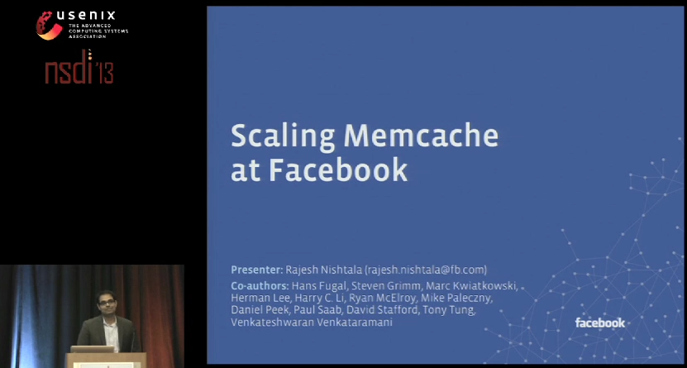
Scaling Memcache at Facebook [NSDI ’13]
https://www.usenix.org/conference/nsdi13/technical-sessions/presentation/nishtala

Slide 63

Stay tuned
Next time you will learn about: A programming model for the Cloud

