Slide 1
INGI2145: CLOUD COMPUTING (Fall 2014)
The Cloud
25 September 2014
Lecture slides adapted from Upenn NETS212 by A. Haeberlen, Z. Ives Reproduced with permission

Slide 2

Announcements
Course slides published in the git repo at
https://github.com/mcanini/INGI2145-2014/
Sign presence sheet
Will create AWS logins based on it
First lab session is tomorrow (26th September)
Introduction to Amazon Web Services
Provision of INGI2145 VM (grab handout on course website)
Bring your own laptops
Please install VirtualBox, Vagrant and Puppet
Please don't forget to sign up for the discussion group
https://piazza.com/uclouvain.be/fall2014/ingi2145/home

Slide 3
INGI2145 mandatory conventions
AWS instances live in a single namespace ☹
We need a convention that everyone must follow to share the AWS resources
1. Your login on AWS is:
ingi2145-<username>
2. Tag each virtual machine with a tag
key=user
value=<username>
3. Name your key-pair name as your login
ingi2145-<username>
NOTE: you need one key-pair in each region!

Slide 4
INGI2145 mandatory conventions
Use only the following AWS regions
us-west-2
us-west-1
us-east-1
Never terminate a virtual machine that you do not own!
Always terminate instances that you don’t need!
Remember each of you has about $100 of credit!

Slide 5
Plan for today
Computing at scale
The need for scalability; scale of current services
Scaling up: From PCs to data centers
Problems with 'classical' scaling techniques
Utility computing and cloud computing
What are utility computing and cloud computing?
Evolution of software business models
What kinds of clouds exist today?
What kinds of applications run on the cloud?
Virtualization: How clouds work 'under the hood'
Some cloud computing challenges

Slide 6
How many users and objects?
Flickr has >6 billion photos
Facebook has 1.15 billion active users
Google is serving >1.2 billion queries/day on more than 27 billion items
>2 billion videos/day watched on YouTube

Slide 7
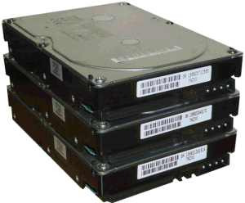
How much data?
Modern applications use massive data:
Rendering 'Avatar' movie required >1 petabyte of storage
eBay has >6.5 petabytes of user data
CERN's LHC will produce about 15 petabytes of data per year
In 2008, Google processed 20 petabytes per day
German Climate computing center dimensioned for 60 petabytes of climate data
Google now designing for 1 exabyte of storage
NSA Utah Data Center is said to have 5 zettabyte (!)
How much is a zettabyte?
1,000,000,000,000,000,000,000 bytes
A stack of 1TB hard disks that is 25,400 km high
25,400 km

Slide 8
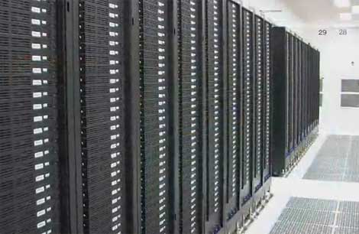
How much computation?
No single computer can process that much data
Need many computers!
How many computers do modern services need?
Facebook is thought to have more than 60,000 servers
1&1 Internet has over 70,000 servers
Akamai has 95,000 servers in 71 countries
Intel has ~100,000 servers in 97 data centers
Microsoft reportedly had at least 200,000 servers in 2008
Google is thought to have more than 1 million servers, is planning for 10 million (according to Jeff Dean)

Slide 9
Why should I care?
Suppose you want to build the next Google
How do you...
... download and store billions of web pages and images?
... quickly find the pages that contain a given set of terms?
... find the pages that are most relevant to a given search?
... answer 1.2 billion queries of this type every day?
Suppose you want to build the next Facebook
How do you...
... store the profiles and photos of over 1 billion users?
... avoid losing any of them?
... find out which users might want to be friends?
Stay tuned!

Slide 10

Plan for today
Computing at scale
The need for scalability; scale of current services
Scaling up: From PCs to data centers
Problems with 'classical' scaling techniques
Utility computing and cloud computing
What are utility computing and cloud computing?
Evolution of software business models
What kinds of clouds exist today?
What kinds of applications run on the cloud?
Virtualization: How clouds work 'under the hood'
Some cloud computing challenges
NEXT

Slide 11
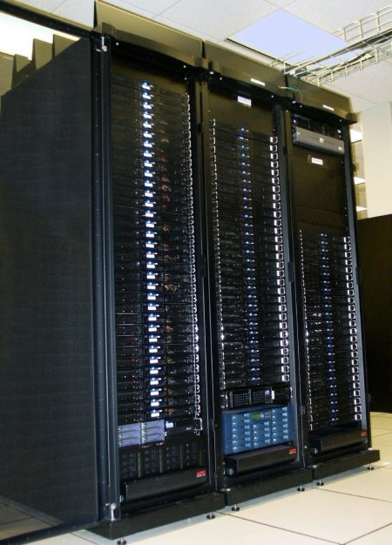
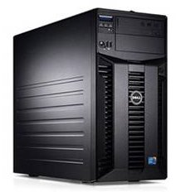
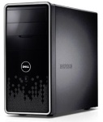
Scaling up
PC
Server
Cluster
What if one computer is not enough?
Buy a bigger (server-class) computer
What if the biggest computer is not enough?
Buy many computers

Slide 12
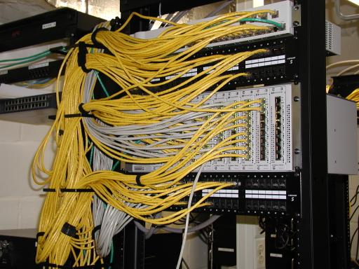
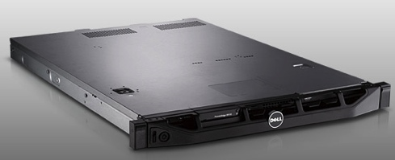
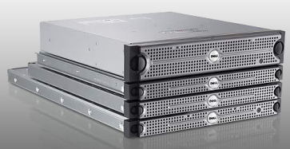
Clusters
Network switch (connects nodes with each other and with other racks)
Rack
Many nodes/blades (often identical)
Storage device(s)
Characteristics of a cluster:
Many similar machines, close interconnection (same room?)
Often special, standardized hardware (racks, blades)
Usually owned and used by a single organization

Slide 13
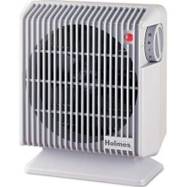
Power and cooling
Clusters need lots of power
Example: 140 Watts per server
Rack with 32 servers: 4.5kW (needs special power supply!)
Most of this power is converted into heat
Large clusters need massive cooling
4.5kW is about 3 space heaters
And that's just one rack!

Slide 14
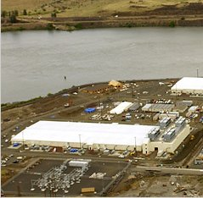
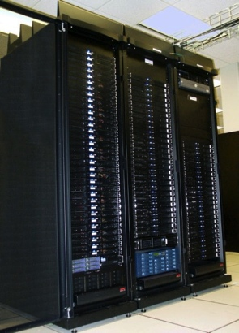
Scaling up
PC
Server
Cluster
Data center
What if your cluster is too big (hot, power hungry) to fit into your office building?
Build a separate building for the cluster
Building can have lots of cooling and power
Result: Data center

Slide 15
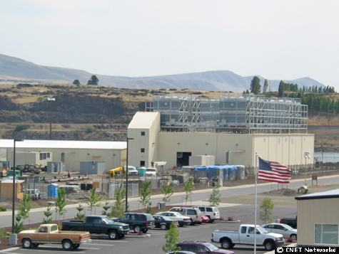
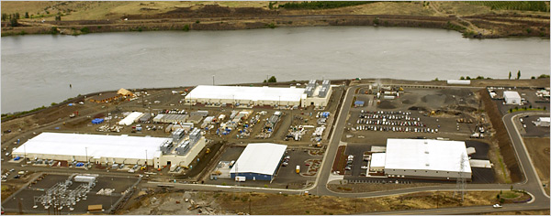
What does a data center look like?
Cooling plant
Data centers (size of a football field)
Google data center in The Dalles, Oregon
A warehouse-sized computer
A single data center can easily contain 10,000 racks with 100 cores in each rack (1,000,000 cores total)

Slide 16
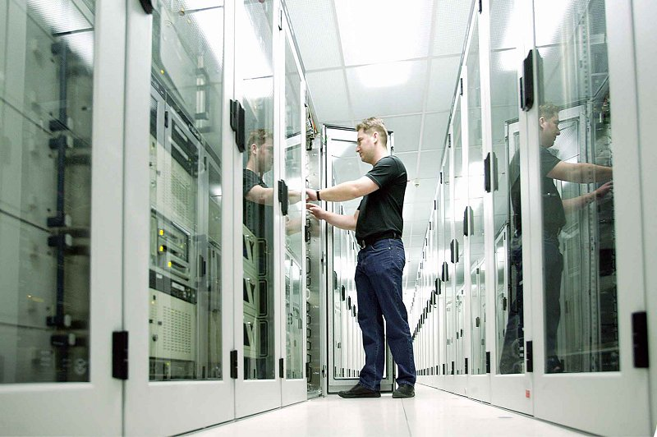
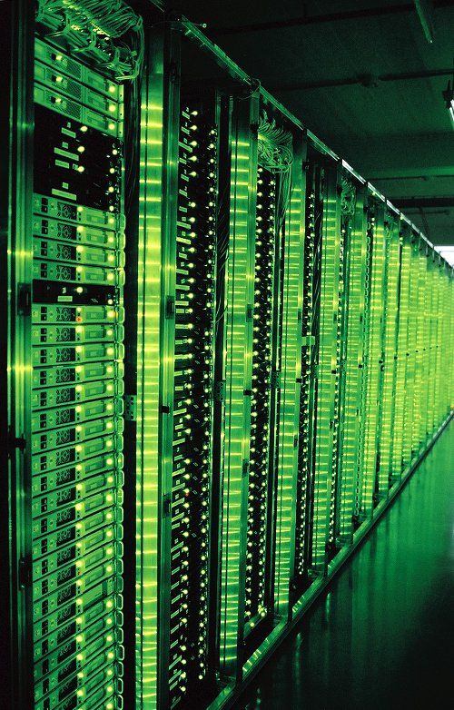
What’s in a data center?
Source: 1&1
Hundreds or thousands of racks

Slide 17
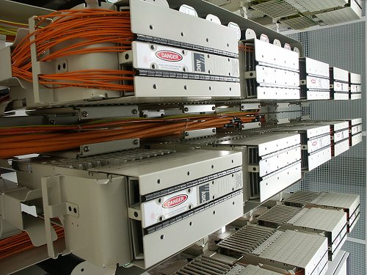
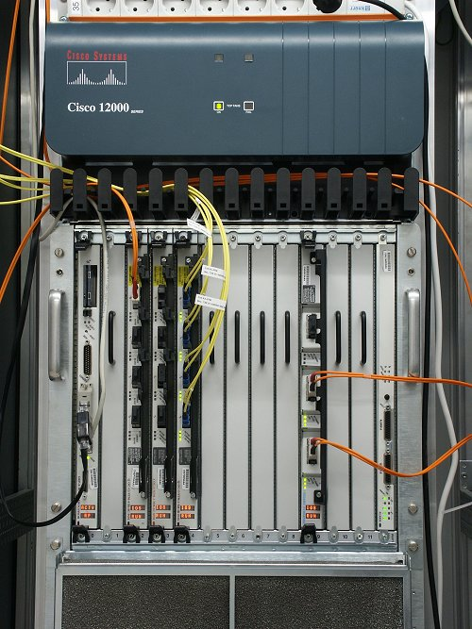
What’s in a data center?
Source: 1&1
Massive networking

Slide 18
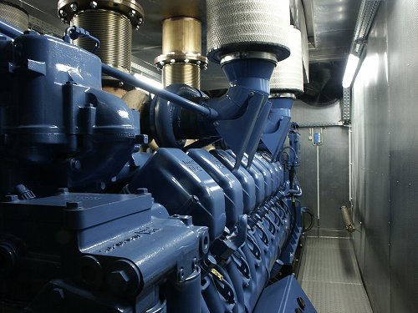
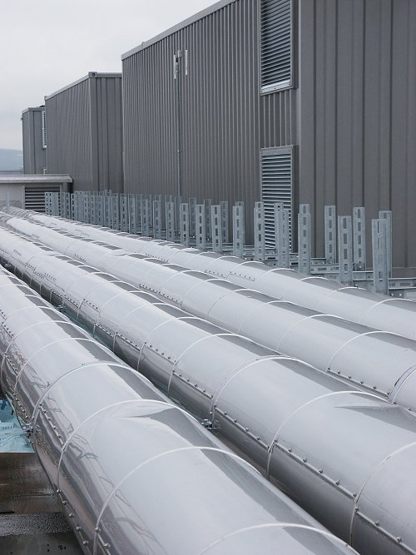
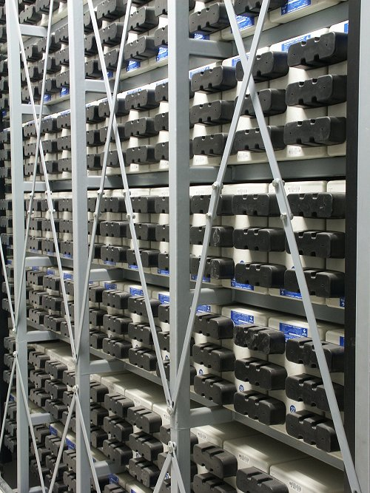
What’s in a data center?
Source: 1&1
Emergency power supplies

Slide 19
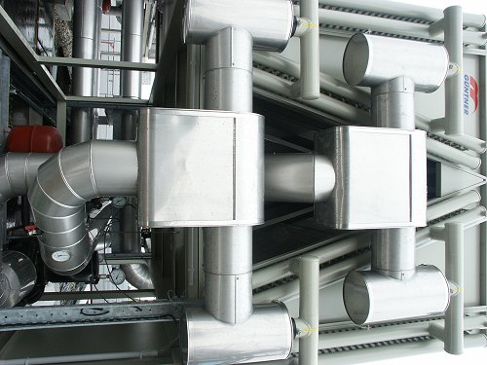
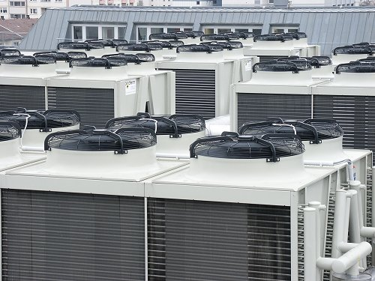
What’s in a data center?
Source: 1&1
Massive cooling

Slide 20
Energy matters!
Company | Servers | Electricity | Cost
eBay | 16K | ~0.6*10⁵ MWh | ~$3.7M/yr
Akamai | 40K | ~1.7*10⁵ MWh | ~$10M/yr
Rackspace | 50K | ~2*10⁵ MWh | ~$12M/yr
Microsoft | >200K | >6*10⁵ MWh | >$36M/yr
Google | >500K | >6.3*10⁵ MWh | >$38M/yr
USA (2006)
10.9M
610*10⁵ MWh
$4.5B/yr
Source: Qureshi et al., SIGCOMM 2009
Data centers consume a lot of energy
Makes sense to build them near sources of cheap electricity
Example: Price per KWh is 3.6ct in Idaho (near hydroelectric power), 10ct in California (long distance transmission), 18ct in Hawaii (must ship fuel)
Most of this is converted into heat → Cooling is a big issue!

Slide 21

Scaling up
PC
Server
Cluster
Data center
Network of data centers
What if even a data center is not big enough?
Build additional data centers
Where? How many?

Slide 22
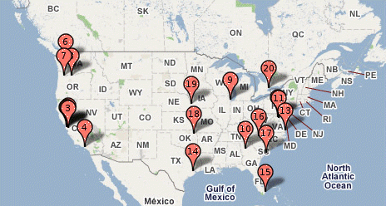
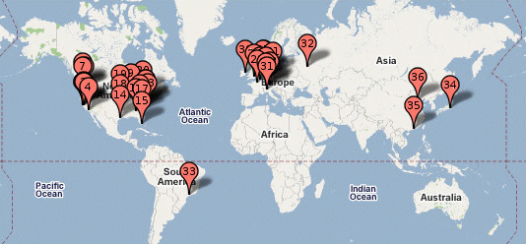
Global distribution
Data centers are often globally distributed
Example above: Google data center locations (inferred)
Why?
Need to be close to users (physics!)
Cheaper resources
Protection against failures

Slide 23
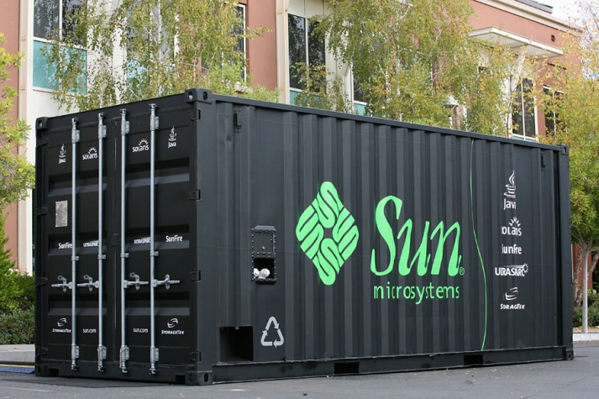
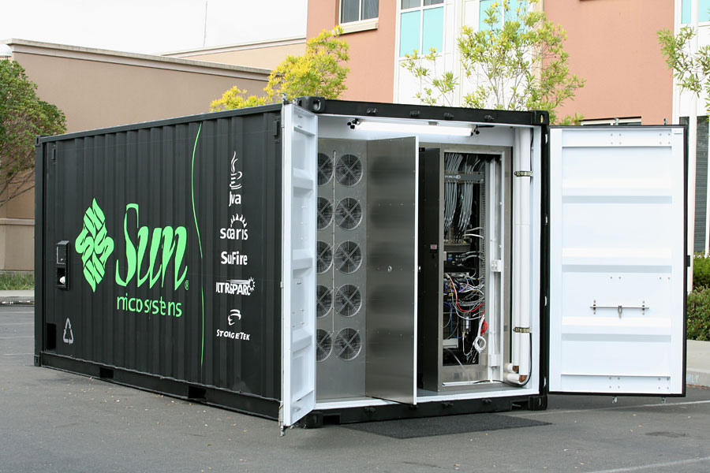
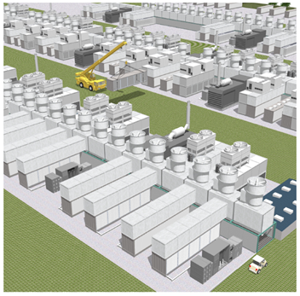
Trend: Modular data center
Need more capacity? Just deploy another container!

Slide 24
Plan for today
Computing at scale
The need for scalability; scale of current services
Scaling up: From PCs to data centers
Problems with 'classical' scaling techniques
Utility computing and cloud computing
What are utility computing and cloud computing?
Evolution of software business models
What kinds of clouds exist today?
What kinds of applications run on the cloud?
Virtualization: How clouds work 'under the hood'
Some cloud computing challenges
NEXT

Slide 25
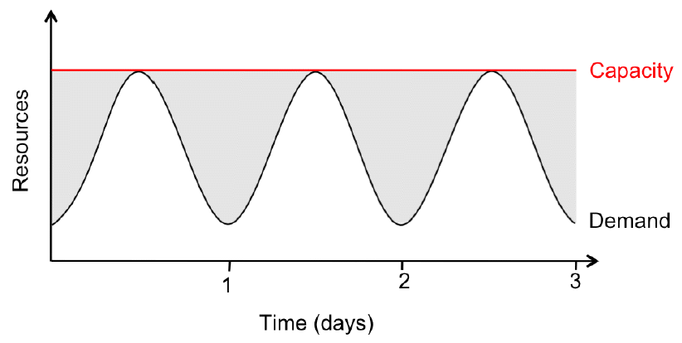
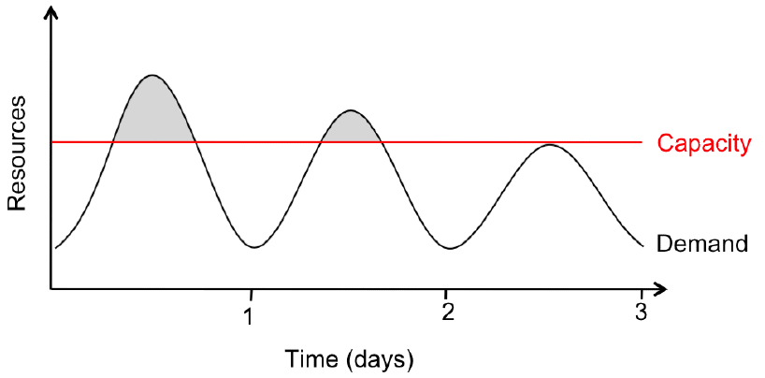
Problem #1: Difficult to dimension
Jobs cannot be completed
Dissatisfied customers leave
2x-10x
Provisioning for the peak load
Provisioning below the peak
Problem: Load can vary considerably
Peak load can exceed average load by factor 2x-10x [Why?]
But: Few users deliberately provision for less than the peak
Result: Server utilization in existing data centers ~5%-20%!!
Dilemma: Waste resources or lose customers!

Slide 26
Problem #2: Expensive
Need to invest many $$$ in hardware
Even a small cluster can easily cost $100,000
Microsoft recently invested $499 million in a single data center
Need expertise
Planning and setting up a large cluster is highly nontrivial
Cluster may require special software, etc.
Need maintenance
Someone needs to replace faulty hardware, install software upgrades, maintain user accounts, ...

Slide 27
Problem #3: Difficult to scale
Scaling up is difficult
Need to order new machines, install them, integrate with existing cluster - can take weeks
Large scaling factors may require major redesign, e.g., new storage system, new interconnect, new building (!)
Scaling down is difficult
What to do with superfluous hardware?
Server idle power is about 60% of peak → Energy is consumed even when no work is being done
Many fixed costs, such as construction

Slide 28
Recap: Computing at scale
Modern applications require huge amounts of processing and data
Measured in petabytes, millions of users, billions of objects
Need special hardware, algorithms, tools to work at this scale
Clusters and data centers can provide the resources we need
Main difference: Scale (room-sized vs. building-sized)
Special hardware; power and cooling are big concerns
Clusters and data centers are not perfect
Difficult to dimension; expensive; difficult to scale

Slide 29
Plan for today
Computing at scale
The need for scalability; scale of current services
Scaling up: From PCs to data centers
Problems with 'classical' scaling techniques
Utility computing and cloud computing
What are utility computing and cloud computing?
Evolution of software business models
What kinds of clouds exist today?
What kinds of applications run on the cloud?
Virtualization: How clouds work 'under the hood'
Some cloud computing challenges
NEXT

Slide 30
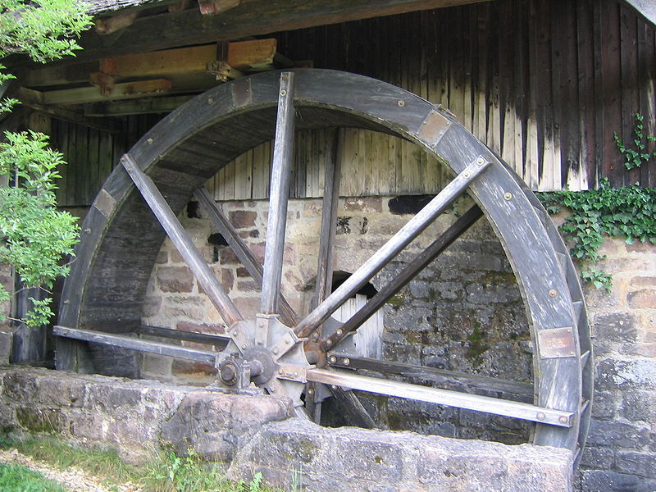
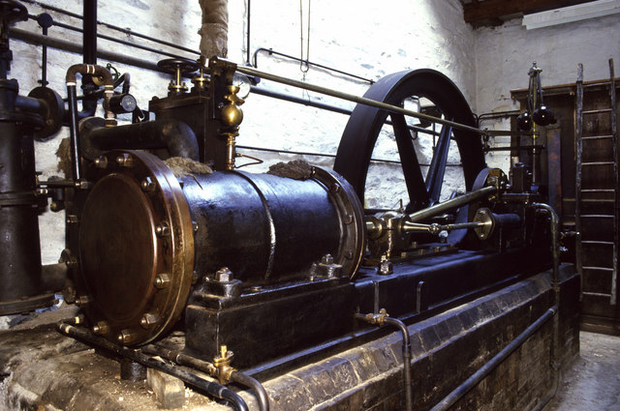
The power plant analogy
Steam engine at Stott Park Bobbin Mill
Waterwheel at the Neuhausen ob Eck Open-Air Museum
It used to be that everyone had their own power source
Challenges are similar to the cluster: Needs large up-front investment, expertise to operate, difficult to scale up/down...

Slide 31
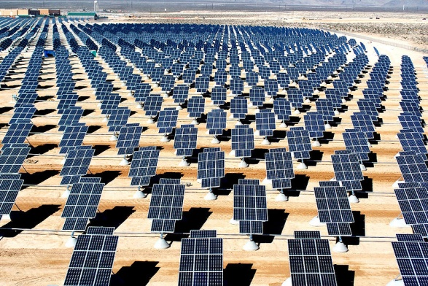
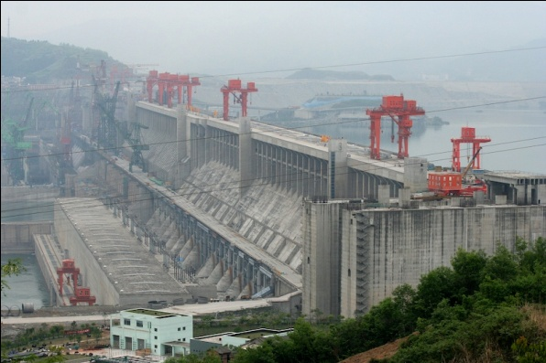
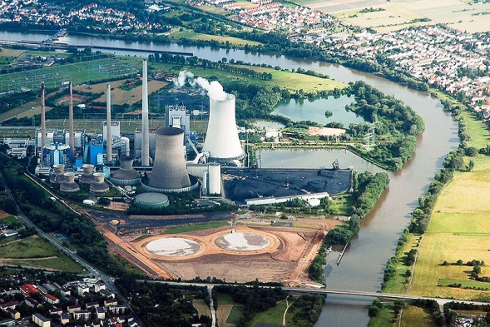
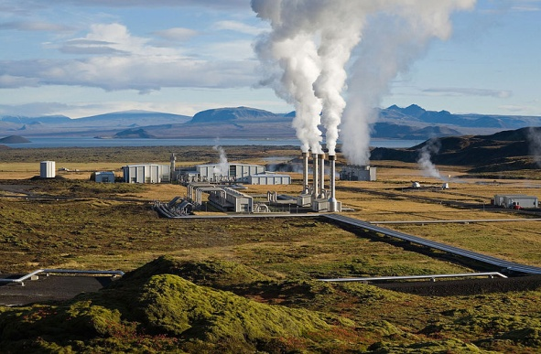
Scaling the power plant
Then people started to build large, centralized power plants with very large capacity...

Slide 32
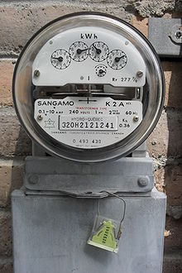
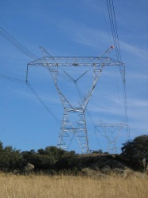
Metered usage model
Power source
Network
Metering device
Customer
Power plants are connected to customers by a network
Usage is metered, and everyone (basically) pays only for what they actually use

Slide 33

Why is this a good thing?
Electricity
Computing
Economies of scale
Cheaper to run one big power plant than many small ones
Statistical multiplexing
High utilization!
No up-front commitment
No investment in generator; pay-as-you-go model
Scalability
Thousands of kilowatts available on demand; add more within seconds
Cheaper to run one big data center than many small ones
High utilization!
No investment in data center; pay-as-you-go model
Thousands of computers available on demand; add more within seconds

Slide 34
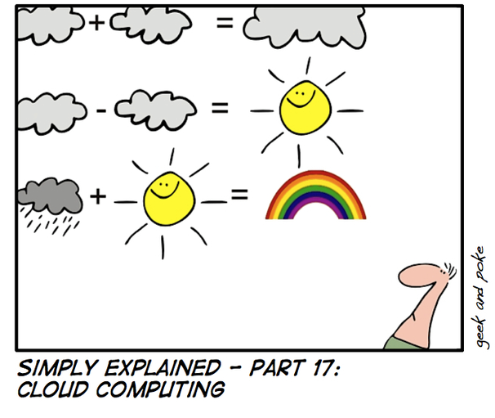
What is cloud computing?
http://geekandpoke.typepad.com/geekandpoke/images/2008/05/16/se17.jpg

Slide 35
What is cloud computing?
The interesting thing about Cloud Computing is that we've redefined Cloud Computing to include everything that we already do.... I don't understand what we would do differently in the light of Cloud Computing other than change the wording of some of our ads. Larry Ellison, quoted in the Wall Street Journal, September 26, 2008
A lot of people are jumping on the [cloud] bandwagon, but I have not heard two people say the same thing about it. There are multiple definitions out there of "the cloud". Andy Isherwood, quoted in ZDnet News, December 11, 2008

Slide 36
So what is it, really?
According to NIST:
Essential characteristics:
On-demand self service
Broad network access
Resource pooling
Rapid elasticity
Measured service
Cloud computing is a model for enabling convenient, on-demand network access to a shared pool of configurable computing resources (e.g., networks, servers, storage, applications, and services) that can be rapidly provisioned and released with minimal management effort or service provider interaction.

Slide 37
Other terms you may have heard
Utility computing
The service being sold by a cloud
Focuses on the business model (pay-as-you-go), similar to classical utility companies
The Web
The Internet’s information sharing model
Some web services run on clouds, but not all
The Internet
A network of networks
Used by the web; connects (most) clouds to their customers

Slide 38
Plan for today
Computing at scale
The need for scalability; scale of current services
Scaling up: From PCs to data centers
Problems with 'classical' scaling techniques
Utility computing and cloud computing
What are utility computing and cloud computing?
Evolution of software business models
What kinds of clouds exist today?
What kinds of applications run on the cloud?
Virtualization: How clouds work 'under the hood'
Some cloud computing challenges
NEXT

Slide 39
Model 1
1
Traditional
$4000/user
(one time)
SW
$800/user/year
Support
For large software companies (MS, SAP, Oracle) is a good model
Buy perpetual license, and upgrades, bug fixes, phone support

Slide 40
Model 2
1
Traditional
2
Open Source
$4000/user
(one time)
$0/user
SW
$800/user/year
$1600/user/year
Support
Not as many success stories (biggest one probably RedHat)
But open source is fueling much success for cloud computing

Slide 41
Management Costs
1
Traditional
$4000/user
(one time)
SW
$800/user/year
Support
$16,000/user/year
($1300/user/year)
To manage the security, availability, performance, problems and change
Mgmt
Cost to manage software is 4x the purchase price per year

Slide 42
Model 3
1
Traditional
2
Open Source
3
Outsourcing
$4000/user
(one time)
$0/user
$4000/user
(one time)
SW
$800/user/year
$1600/user/year
$800/user/year
Support
Bid
<1300/user/month
Mgmt
At home / at customer
Outsourcing became popular in the ’90s as Internet got widespread
Cost reduction through low-cost labor is hard to sustain
Human error is #1 cause of computer system failures

Slide 43
Model 4
1
Traditional
2
Open Source
3
Outsourcing
4
Hybrid
$4000/user
(one time)
$0/user
$4000/user
(one time)
$4000/user
(one time)
SW
$800/user/year
$1600/user/year
$800/user/year
$800/user/year
Support
Bid
<1300/user/month
$150/user/month
Mgmt
At home / at customer
At home / at customer
How to decrease costs by 10x?
Standardization, specialization, repetition → in time automate

Slide 44
Model 5
1
Traditional
2
Open Source
3
Outsourcing
4
Hybrid
5
Hybrid+
$4000/user
(one time)
$0/user
$4000/user
(one time)
$4000/user
(one time)
$300/user/month
SW
$800/user/year
$1600/user/year
$800/user/year
$800/user/year
Support
Bid
<1300/user/month
$150/user/month
Mgmt
At home / at customer
At home / at customer
At home / at customer
Pure subscription model
Simply a change of the payment term compared to Model 4

Slide 45
Model 6
1
Traditional
2
Open Source
3
Outsourcing
4
Hybrid
5
Hybrid+
6
Cloud
$4000/user
(one time)
$0/user
$4000/user
(one time)
$4000/user
(one time)
$300/user/month
<$100/user/month
SW
$800/user/year
$1600/user/year
$800/user/year
$800/user/year
Support
Bid
<1300/user/month
$150/user/month
Mgmt
At home / at customer
At home / at customer
At home / at customer
Software companies gone public since 2000 deliver Cloud services
10x cost reduction in exchange for higher degree of standardization

Slide 46
Model 7
1
Traditional
2
Open Source
3
Outsourcing
4
Hybrid
5
Hybrid+
6
Cloud
7
Internet
$4000/user
(one time)
$0/user
$4000/user
(one time)
$4000/user
(one time)
$300/user/month
<$100/user/month
Ads
Transactions
Embedded
(<$10/user/month)
SW
$800/user/year
$1600/user/year
$800/user/year
$800/user/year
Support
Bid
<1300/user/month
$150/user/month
Mgmt
At home / at customer
At home / at customer
At home / at customer
No direct charge; monetization model is asymmetric
Software is paid through ads, transactions fees, …
Consumer apps have dramatically lower costs than enterprise apps

Slide 47
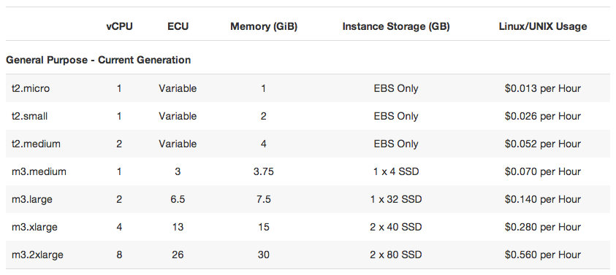
Cloud computing is a business model
AWS
us-west-2
prices
Compute
Per service hour
$0.16/hour
(averaged on instance sizes)
Storage
Per GB stored
$0.10 GB/month

Slide 48
Plan for today
Computing at scale
The need for scalability; scale of current services
Scaling up: From PCs to data centers
Problems with 'classical' scaling techniques
Utility computing and cloud computing
What are utility computing and cloud computing?
Evolution of software business models
What kinds of clouds exist today?
What kinds of applications run on the cloud?
Virtualization: How clouds work 'under the hood'
Some cloud computing challenges
NEXT

Slide 49
Everything as a Service
What kind of service does the cloud provide?
Does it offer an entire application, or just resources?
If resources, what kind / level of abstraction?
Three types commonly distinguished:
Software as a service (SaaS)
Analogy: Restaurant. Prepares&serves entire meal, does the dishes, ...
Platform as a service (PaaS)
Analogy: Take-out food. Prepares meal, but does not serve it.
Infrastructure as a service (IaaS)
Analogy: Grocery store. Provides raw ingredients.
Other *aaS types have been defined, but are less common
Desktop, Backend, Communication, Network, Monitoring, ...

Slide 50




Software as a Service (SaaS)
User
Application
Middleware
Hardware
Cloud provider
Cloud provides an entire application
Word processor, spreadsheet, CRM software, calendar...
Customer pays cloud provider
Example: Google Apps, Salesforce.com, Concur, Doodle

Slide 51



Platform as a Service (PaaS)
SaaS provider
User
Application
Middleware
Hardware
Cloud provider
Cloud provides middleware/infrastructure
For example, Microsoft Common Language Runtime (CLR)
Customer pays SaaS provider for the service; SaaS provider pays the cloud for the infrastructure
Example: Windows Azure, Google App Engine, Heroku

Slide 52

Infrastructure as a Service (IaaS)
SaaS provider
User
Application
Middleware
Hardware
Cloud provider
Cloud provides raw computing resources
Virtual machine, blade server, storage, network, ...
Customer pays SaaS provider for the service; SaaS provider pays the cloud for the resources
Examples: Amazon Web Services, DigitalOcean, Joyent

Slide 53




Private/hybrid/community clouds
Company A
Company B
Public
Community
Private
Who can become a customer of the cloud?
Public cloud: Commercial service; open to (almost) anyone. Example: Amazon AWS, Microsoft Azure, Google App Engine
Community cloud: Shared by several similar organizations. Example: Google’s “Gov Cloud”
Private cloud: Shared within a single organization. Example: Internal datacenter of a large company.
Focus of this course
Is this a 'real' cloud?

Slide 54
Plan for today
Computing at scale
The need for scalability; scale of current services
Scaling up: From PCs to data centers
Problems with 'classical' scaling techniques
Utility computing and cloud computing
What are utility computing and cloud computing?
Evolution of software business models
What kinds of clouds exist today?
What kinds of applications run on the cloud?
Virtualization: How clouds work 'under the hood'
Some cloud computing challenges
NEXT

Slide 55
Examples of cloud applications
Application hosting
Backup and Storage
Content delivery
E-commerce
High-performance computing
Media hosting
On-demand workforce
Search engines
Web hosting
If interested, glance through http://aws.amazon.com/solutions/case-studies/ for a list of many use cases

Slide 56

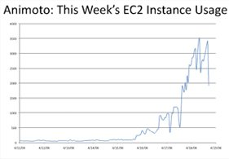
Case study:
Animoto: Lets users create videos from their own photos/music
Auto-edits photos and aligns them with the music, so it "looks good"
Built using Amazon EC2+S3+SQS
Released a Facebook app in mid-April 2008
More than 750,000 people signed up within 3 days
EC2 usage went from 50 machines to 3,500 (x70 scalability!)
http://animoto.com/blog/company/amazon-com-ceo-jeff-bezos-on-animoto/
Source: Jeff Bezos' talk at Stanford on 4/19/08
http://aws.amazon.com/solutions/case-studies/animoto/

Slide 57

Case study:
Novartis Institutes for Biomedical Research is focused on the drug discovery phase of the ~10 year / $1 billion drug development process
In 2013, NIBR ran a project to screen 10 M compounds against a common cancer target
Compute requirements >> internal capacity / $
The project ran across 10,500 EC2 Spot instances (~87,000 cores) for $4,232 in 9 hours
Equiv. of 39 years of computational chemistry
http://aws.amazon.com/solutions/case-studies/novartis/

Slide 58

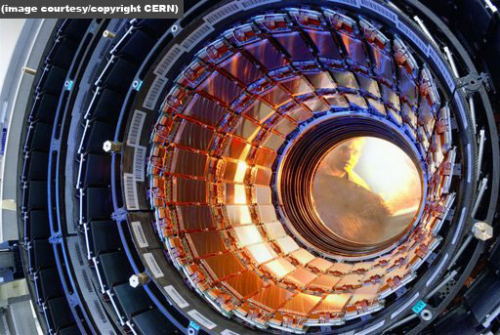

Other examples
DreamWorks is using the Cerelink cloud to render animation movies
Cloud was already used to render parts of Shrek Forever After and How to Train your Dragon
CERN is working on a "science cloud" to process experimental data
Virgin atlantic is hosting their new travel portal on Amazon AWS

Slide 59
Recap: Utility/cloud computing
Why is cloud computing attractive?
Analogy to 'classical' utilities (electricity, water, ...)
No up-front investment (pay-as-you-go model)
Low price due to economies of scale
Elasticity - can quickly scale up/down as demand varies
Different types of clouds
SaaS, PaaS, IaaS; public/private/community clouds
What runs on the cloud?
Many potential applications: Application hosting, backup/storage, scientific computing, content delivery, ...
Not yet suitable for certain applications (sensitive data, compliance requirements)

Slide 60
Is the cloud good for everything?
No.
Sometimes it is problematic
Auditability requirements
Legislative frameworks
Example: Personal data privacy
EU Data Protection law
Example: Processing medical records (US)
HIPAA (Health Insurance Portability and Accountability Act) privacy and security rule

Slide 61
Recap: Cloud applications
Clouds are good for many things...
Applications that involve large amounts of computation, storage, bandwidth
Especially when lots of resources are needed quickly (Novartis example) or load varies rapidly (Animoto example)
... but not for all things
and might not be the cheapest solution either

Slide 62
Plan for today
Computing at scale
The need for scalability; scale of current services
Scaling up: From PCs to data centers
Problems with 'classical' scaling techniques
Utility computing and cloud computing
What are utility computing and cloud computing?
Evolution of software business models
What kinds of clouds exist today?
What kinds of applications run on the cloud?
Virtualization: How clouds work 'under the hood'
Some cloud computing challenges
NEXT

Slide 63

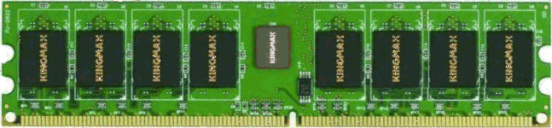

What is virtualization?
Bob
Charlie
Alice
Physical machine
Daniel
Suppose Alice has a machine with 4 CPUs and 8 GB of memory, and three customers:
Bob wants a machine with 1 CPU and 3GB of memory
Charlie wants 2 CPUs and 1GB of memory
Daniel wants 1 CPU and 4GB of memory
What should Alice do?

Slide 64


What is virtualization?
Bob
Virtual machine monitor
Charlie
Alice
Physical machine
Virtual machines
Daniel
Alice can sell each customer a virtual machine (VM) with the requested resources
From each customer’s perspective, it appears as if they had a physical machine all by themselves (isolation)

Slide 65
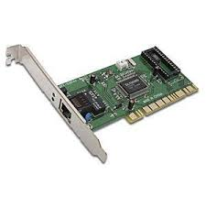
How does it work?
App
VM 1
VM 2
VM | Virt | Phys
1 | 0-99 | 0-99
1 | 299-399 | 100-199
2 | 0-99 | 300-399
2 | 200-299 | 500-599
2 | 600-699 | 400-499
App
App
OS 1
OS 2
VMM
Translation table
Physical machine
Resources (CPU, memory, ...) are virtualized
VMM ("Hypervisor") has translation tables that map requests for virtual resources to physical resources
Example: VM 1 accesses memory cell #323; VMM maps this to memory cell 123.
For which resources does this (not) work?
How do VMMs differ from OS kernels?

Slide 66
Benefit: Migration
Bob
Virtual machine monitor
Alice
Charlie
Virtual machines
Daniel
Physical machines
What if the machine needs to be shut down?
e.g., for maintenance, consolidation, ...
Alice can migrate the VMs to different physical machines without any customers noticing

Slide 67
Benefit: Time sharing
Emil
Bob
Virtual machine monitor
Charlie
Alice
Physical machine
Virtual machines
Daniel
What if Alice gets another customer?
Multiple VMs can time-share the existing resources
Oversubscription: Alice has more virtual CPUs and virtual memory than physical resources (but not all can be active at the same time)

Slide 68




Benefit and challenge: Isolation
Emil
Bob
VMM
Charlie
Alice
Physical machine
Virtual machines
Daniel
Good: Emil can't access Charlie's data
Bad: What if the load suddenly increases?
Example: Emil's VM shares CPUs with Charlie's VM, and Charlie suddenly starts a large compute job
Emil's performance may decrease as a result
VMM can move Emil's software to a different CPU, or migrate it to a different machine

Slide 69
Recap: Virtualization in the cloud
Gives cloud provider a lot of flexibility
Can produce VMs with different capabilities
Can migrate VMs if necessary (e.g., for maintenance)
Can increase load by overcommitting resources
Provides security and isolation
Programs in one VM cannot influence programs in another
Convenient for users
Complete control over the virtual 'hardware' (can install own operating system own applications, ...)
But: Performance may be hard to predict
Load changes in other VMs on the same physical machine may affect the performance seen by the customer

Slide 70
Plan for today
Computing at scale
The need for scalability; scale of current services
Scaling up: From PCs to data centers
Problems with 'classical' scaling techniques
Utility computing and cloud computing
What are utility computing and cloud computing?
Evolution of software business models
What kinds of clouds exist today?
What kinds of applications run on the cloud?
Virtualization: How clouds work 'under the hood'
Some cloud computing challenges
NEXT

Slide 71
10 obstacles and opportunities
Availability
What happens to my business if there is an outage in the cloud?
Data lock-in
How do I move my data from one cloud to another?
Data confidentiality and auditability
How do I make sure that the cloud doesn't leak my confidential data?
Can I comply with regulations?
Service | Duration | Date
S3 | 6-8 hrs | 7/20/08
AppEngine | 5 hrs | 6/17/08
Gmail | 1.5 hrs | 8/11/08
Azure | 22 hrs | 3/13/09
Intuit | 36 hrs | 6/16/10
EBS | >3 days | 4/21/11
ECC | ~2 hrs | 6/30/12
Some recent cloud outages

Slide 72
10 obstacles and opportunities
Data transfer bottlenecks
How do I copy large amounts of data from/to the cloud?
Example: 10 TB from UC Berkeley to Amazon in Seattle, WA
Motivated Import/Export feature on AWS
Performance unpredictability
Example: VMs sharing the same disk → I/O interference
Example: HPC tasks that require coordinated scheduling
Method | Time
Internet (20Mbps)
FedEx
45 days
1 day
Time to transfer 10TB [AF10]
Primitive | Mean perf. | Std dev
Memory bandwidth | 1.3GB/s | 0.05GB/s (4%)
Disk bandwidth | 55MB/s | 9MB/s (16%)
Performance of 75 EC2 instances in benchmarks

Slide 73
10 obstacles and opportunities
Scalable storage
Cloud model (short-term usage, no up-front cost, infinite capacity on demand) does not fit persistent storage well
Bugs in large distributed systems
Many errors cannot be reproduced in smaller configs
Scaling quickly
Problem: Boot time; idle power
Fine-grain accounting?

Slide 74
10 obstacles and opportunities
Reputation fate sharing
One customer's bad behavior can affect the reputation of others using the same cloud
Example: Spam blacklisting, FBI raid after criminal activity
Software licensing
What if licenses are for specific computers?
Example: Microsoft Windows
How to scale number of licenses up/down?
Need pay-as-you-go model as well

Slide 75
Plan for today
Scalable computing
The need for scalability; scale of current services
Scaling up: From PCs to data centers
Problems with 'classical' scaling techniques
Utility computing and cloud computing
What are utility computing and cloud computing?
Evolution of software business models
What kinds of clouds exist today?
What kinds of applications run on the cloud?
Virtualization: How clouds work 'under the hood'
Some cloud computing challenges

Slide 76
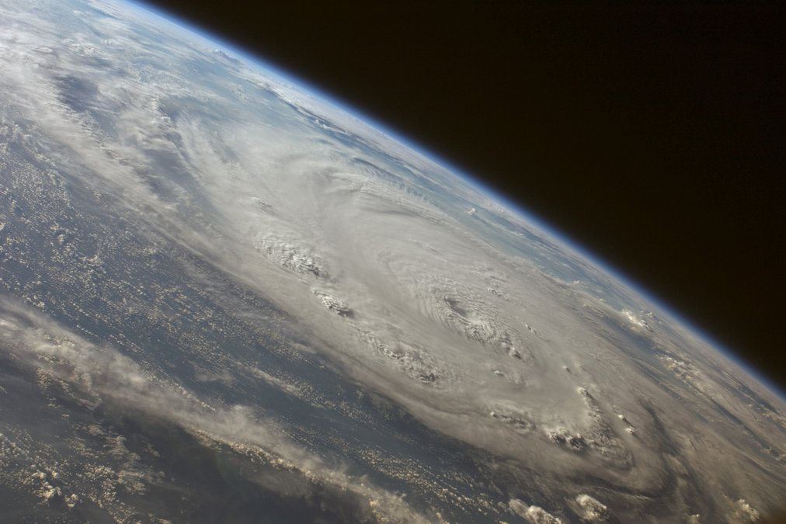
Stay tuned
Next time you will learn about: Design for large scale; Concurrency, consistency, fault tolerance Assigned reading: "Eventually Consistent" by Werner Vogels, http://queue.acm.org/detail.cfm?id=1466448

