Slide 1
Spark
Fast, Interactive, Language-Integrated Cluster Computing
Waleed F. Reda
*Adapted from ampLabs introductory Spark slides

Slide 2
Why go Beyond MapReduce?
Complex jobs and interactive queries both need one thing that MapReduce lacks:
Efficient primitives for data sharing
Stage 1
Stage 2
Stage 3
Query 1
Query 2
Query 3
Iterative algorithm
Interactive data mining

Slide 3
Why go Beyond MapReduce?
Complex jobs and interactive queries both need one thing that MapReduce lacks:
Efficient primitives for data sharing
Stage 1
Stage 2
Stage 3
Query 1
In MapReduce, the only way to share data across jobs is stable storage (e.g. HDFS) -> slow!
Query 2
Query 3
Iterative algorithm
Interactive data mining

Slide 4
Spark - Features
Extends MapReduce model to better support two common classes of analytics apps:
Iterative algorithms (machine learning, graphs)
Interactive data mining
Enhance programmability:
Integrate into Scala programming language
Allow interactive use from Scala interpreter
Notes:
Point out that Scala is a modern PL etc
Mention DryadLINQ (but we go beyond it with RDDs)
Point out that interactive use and iterative use go hand in hand because both require small tasks and dataset reuse

Slide 5
Examples
HDFS read
HDFS write
HDFS read
HDFS write
iter. 1
iter. 2
. . .
Input
HDFS read
query 1
result 1
query 2
result 2
query 3
result 3
Input
. . .
I/O and serialization can take 90% of the time
Notes:
Each iteration is, for example, a MapReduce job

Slide 6
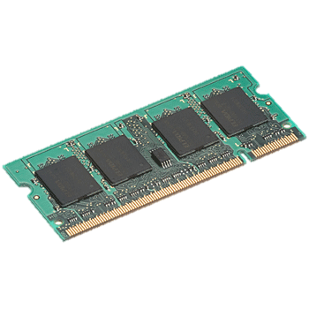
Goal: In-Memory Data Sharing
iter. 1
iter. 2
. . .
Input
query 1
one-time processing
query 2
query 3
Input
Distributed memory
. . .
10-100× faster than network and disk

Slide 7
Solution: Resilient Distributed Datasets (RDDs)
Distributed collections of objects that can be stored in memory for fast reuse
Automatically recover lost data on failure
Support a wide range of applications
RDDs maintain lineage information that can be used to reconstruct lost partitions
Notes:
RDDs = first-class way to manipulate and persist intermediate datasets

Slide 8
RDD Operations
Transformations (define a new RDD) | map filter sample groupByKey reduceByKey sortByKey | flatMap union join cogroup cross mapValues
Actions (return a result to driver program) | collect reduce count save lookupKey

Slide 9
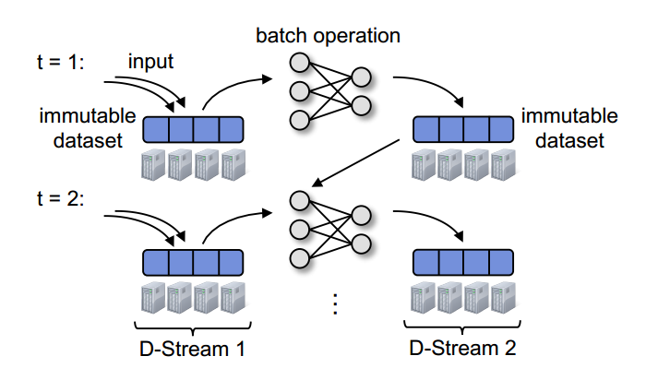
Discretized Streams
A streaming computation as a series of very small, deterministic batch jobs
immutable dataset (output or state); stored in memory
as Spark RDD
Notes:
So the authors started to look back at batch processing system.like MapReduce. They have a very clear and efficient fault-tolerant strategies.
…………
So the idea for Discretized Stream is to chop live stream of data into very small batch of data. So imagine you are processing a stream of data. Instead of processing a data record each at a time, what we’d like to do is to divide the whole tweet stream into say like one-second batches, collect all the tweet received in one second, treat that tweet like a Hadoop file and run MapReduce on it. And what comes out is immutable datasets. as they called them RDD. I will talk what is RDD is within 2 slides. Now you can view them as the state data as the tranditional stream processing system have. Now in the next sec, this state data is combined with the input data and batch operation apply on them again. To create next version of state data. So these continuous sequence of batches and state data or RDD actually form a stream. Left is an input stream. And right is the stream of state data.

Slide 10
Discretized Streams
Faults/Stragglers recovery without replication
State between batches kept in memory
Deterministic operations→ fault-tolerant
Second-scale performance
Try to make batch size as small as possible
Smaller batch size → lower end-to-end
latency
A rich set of operations
Combined with historical datasets
Interactive queries
live data stream
DStream
Processing
batches of X seconds
Spark
processed results
Notes:
A rich set of operators
Interactive query model
Integrated with historical dataset
( And now since we are doing these batch jobs, we are deterministicly batch job on 1 sec batch, we are automatically get the fault tolerant properties that computation have. )
Now the challenge is how to achieve as low as end-to-end latency as possilble by this process. To achieve that, it is important to understand that end-to-end latency directly depends on batch size. Lower the batch size, lower the end-to-end latency is. So if you processing 10 second batches, then you have to wait the whole 10 seconds for the whole batch to be collected. You have to wait at least 10 sec, But if you do 1 sec batch, then you only have to wait 1 sec for the data to be collected. So the challenging to make this batch as small as possible. That is one. Now the mutable state between batches we are talking about is the data need to be in memory, and operator that produce this state data, is expressed as deterministic stateful operations. Because it is deterministic, these stateful data is also fault-tolerant. Which I will explain it later.
….

Slide 11
DStream Operations
Dstream Object: A stream of RDDs
Transformations
Map, filter, groupBy, reduceBy, sort, join…
Windowing
Incremental aggregation
Output operator
Save RDDs to outside systems(screen, external storage… )
Notes:
Let’s look at the programming interface. I want to show you how intuitive and easy to program on this platform. So similar to RDDs, the abstraction we have here is Dstream which is nothing but a sequence of RDDs. The API is very similar to RDDs, it has the same map reduce that you have seen in RDDS. Similar to RDDs, Dstream can be created from either the data source which in this case is a live stream from network, or hard disk or a sequence of iterated files, or by transforming other DStream. Lets look more details into the operator. Again, just like RDDS there are 2 sets of operations we can do, one is transformation which create new streams from existing streams. These transformation include the existing RDD operations, plus we have introduced a new set of operations we called the stateful operators which we will talk details very soon. Then there are output operators which allow data can be sent out to the external world.either saving to external storage or print to screem. Whatever you want to do with it.

Slide 12
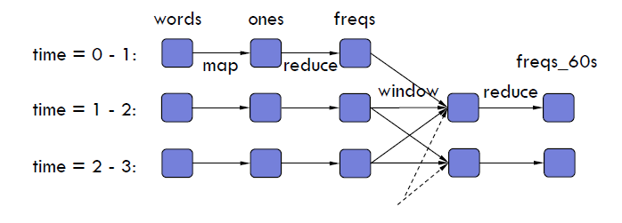
Windowing
Count frequency of words received in last 5 seconds
words = createNetworkStream("http://...”)
ones = words.map(w => (w, 1))
freqs_5s = ones.reduceByKeyAndWindow(_ + _, Seconds(5), Seconds(1))
DStream
Transformation
Sliding Window Ops
freqs_5s
Notes:
So let us start with a very simple example of how windowing works
Imgine there is a stream of words coming in from a particular url.and you want to count the frequency of each word. You want to see the frequency of the word in last 5 second. So what you can do is you can use operator called window which essentially aggregate all the words,all the frequency it received, all the 1-sec frequency into a 5-sec-frequency. To explain the detail of the operator, this window is a sliding window. The size of the window is 5 sec. and it moves every sec. it will aggregate the frequency in last 60 seconds every sec. and once again you are doing reducebykey on them, to get the final aggregate frequency. And what happen essentially is all the 1-second freqeuency are aggregated together within the window created by redcued. This is very common operation that stream processing would like to do.

Slide 13
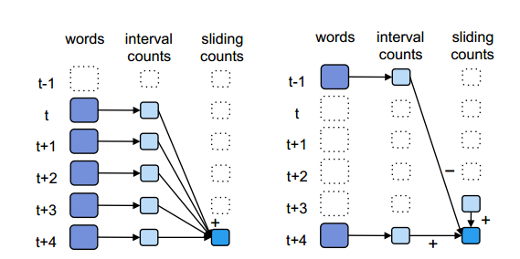
Incremental aggregation
Aggregation Function
freqs = ones.reduceByKeyAndWindow
(_ + _, Seconds(5), Seconds(1))
Invertible aggregation Function
freqs = ones.reduceByKeyAndWindow
(_ + _, _ - _, Seconds(5), Seconds(1))
Notes:
This reducebywindow operation can be implemented in incremental fashion. So for example, the window operation that I showed si very native in a sence that all previous 1-second frequency are added together to get the 5 second frequency. A optimal way to calculate the aggregated frequency, take the previous 5 second frequency, add the new 1 sec frequency that got introduced to the window and substract the privous 1 second frequency. This reduce the amount of operation you need to do significantly. But it also require a constraint. Not all aggregation operation can be implemented in this manner. It requires a invertible function which in this case is a substration, substract the previous frequency. So only aggregation invertible can be implement in this way. But in the api, we allow this function as specified as well. We allow programmer create aggregation as well as invertible aggregation. This give more control for developer to optimize the stream processing.

Slide 14
Tutorial Exercises
Refer to the Lab 4 handout
Machine learning and Streaming exercises
You can reference Spark’s programming guides for extra help:
https://spark.apache.org/docs/1.1.0/programming-guide.html

