Slide 1
Streptococcus Suis
A Phylogenetic Study
Aviva Englander, PhD Student, Mathematics

Slide 2
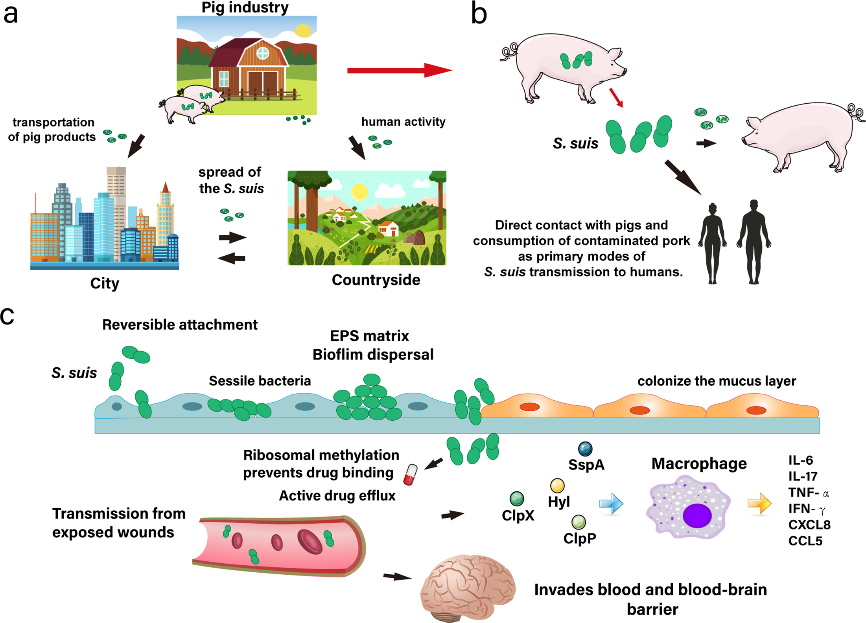
Streptococcus Suis
The streptococcus genus contains a wide variety of pathogenic bacteria and non-pathogenic bacteria which live on the skin and mucosal surfaces of the human body
They are known to quickly build antibiotic resistance and adapt to new hosts
Some species within the genus like streptococcus thermophilius are used as starter cultures in yogurt, while others like streptococcus pyogenes typically live on the skin and on mucosal surfaces of the human body, but can also cause necrotizing fasciitis
I will be focusing on streptococcus suis which is a pathogen that can spread from pigs to humans
Streptococcus suis was first linked to Streptococcal meningitis and arthritis in piglets in 1954
Human cases of streptococcus suis were first reported in Denmark and the Netherlands
My 35 samples from the NICB database were mostly collected from diseased pigs, but also some lambs and calves and humans. My data also comes from several countries including Denmark, The Netherlands, The US and Canada
Figure from reference [2]

Slide 3
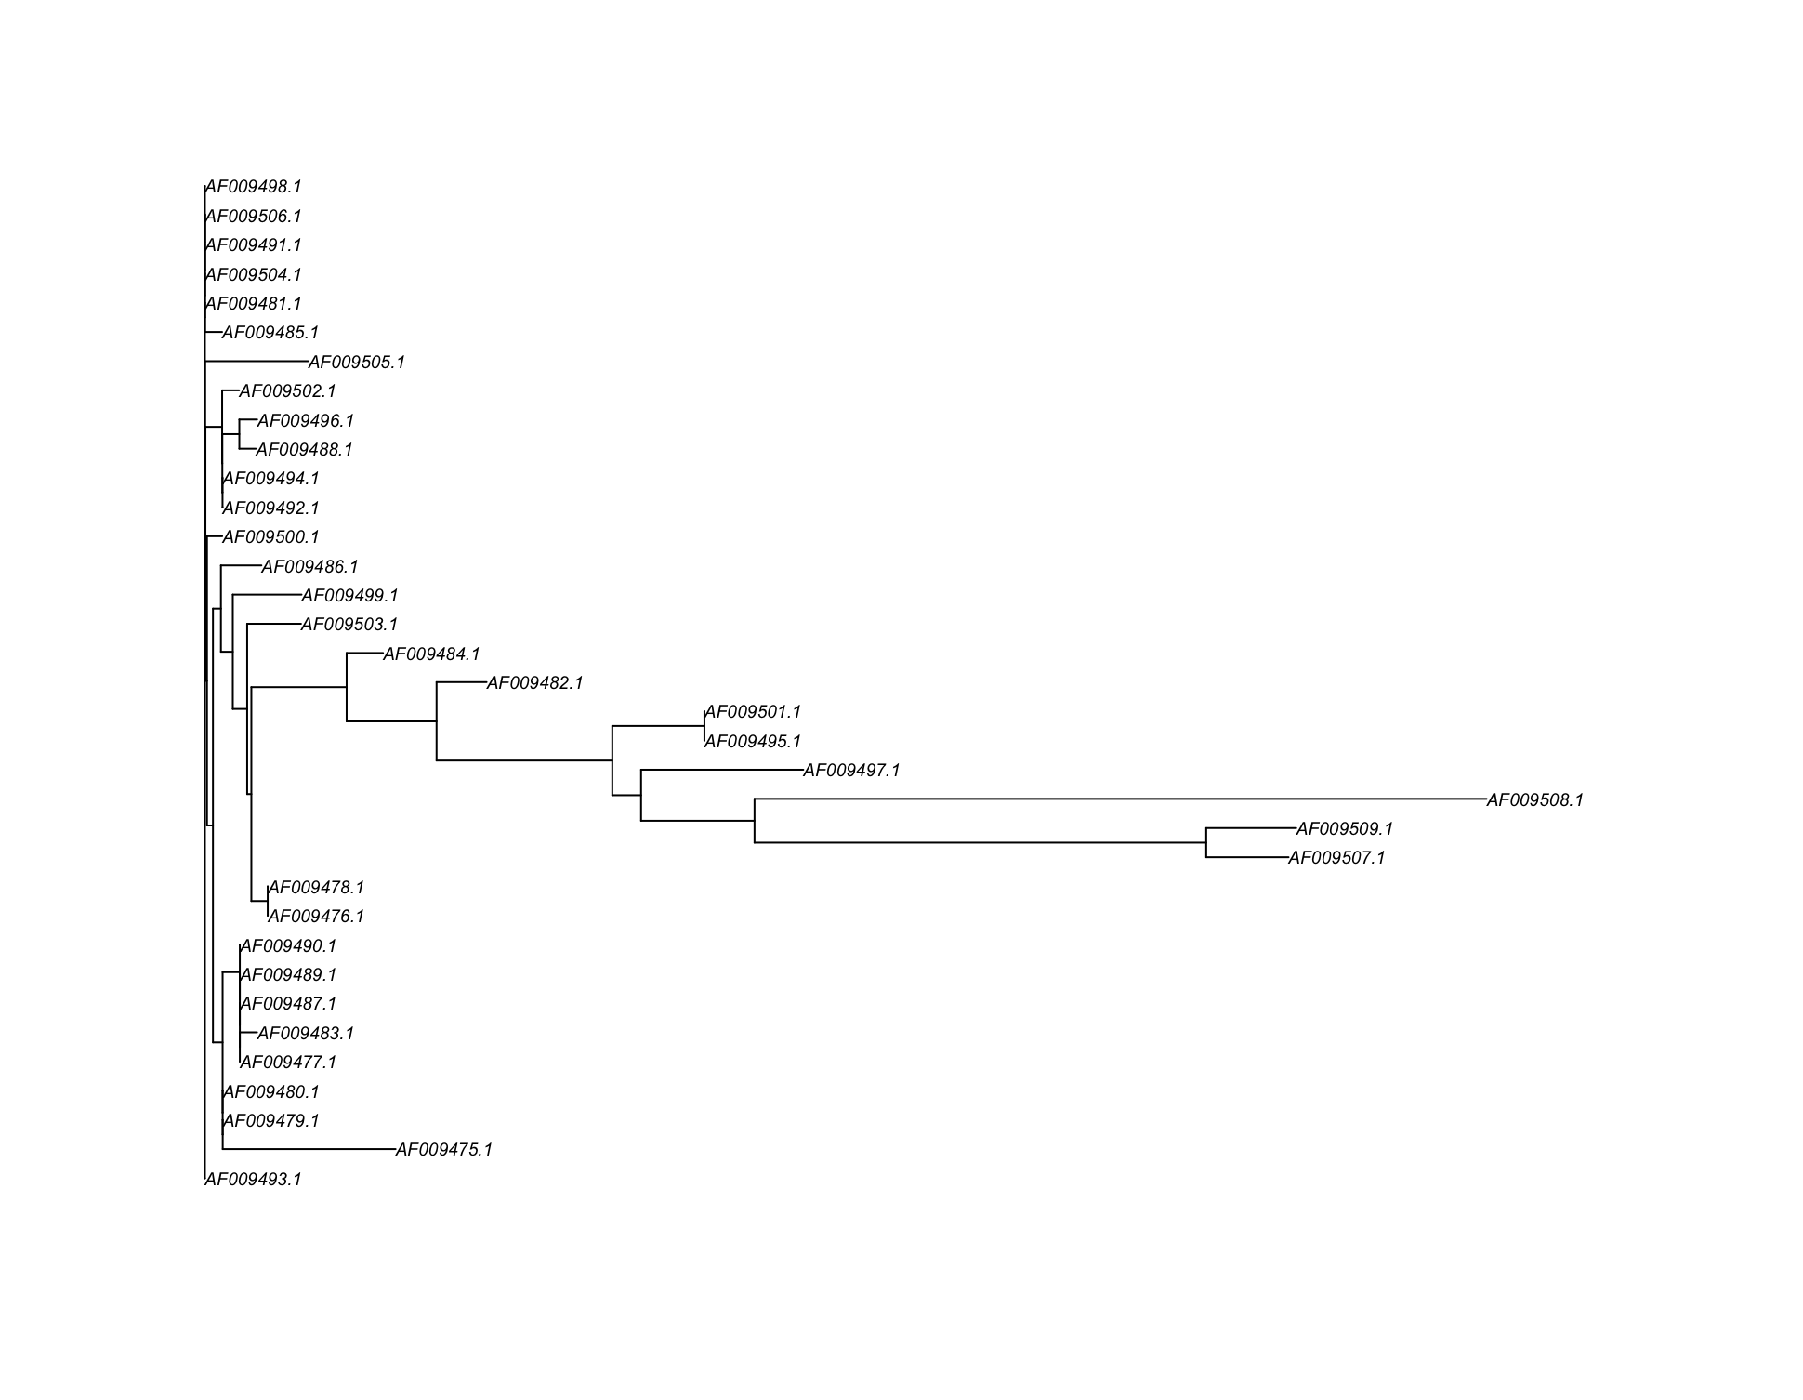
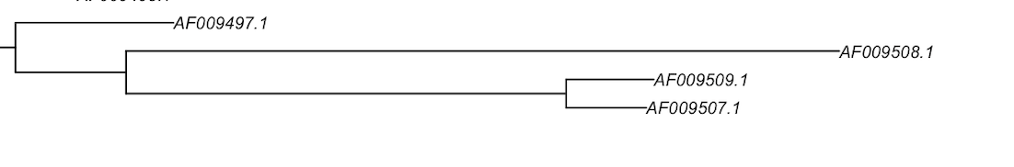
Alignment and Distance Based Comparison
The original study[1] noted that the following three clustered together particularly far from the other samples when forming a tree from the distance matrix
The original study[1] used clustal for their alignment, so I used clustal for this tree diagram
Tcoffee gave me the same distance based outgroup, but it changed the relationships between the sequences that were closer together
Alignment Results Vary Between Tcoffee and Clustal for Close Sequences

Slide 4
Software Methodology
IQ-tree
Maximum Likelihood tree construction method
Uses hill climbing method with stochastic element to escape local optima
I assumed that default parameters are best
Someone with better biological knowledge might make changes to parameters to get better results
Mr Bayes
Bayesian inference method
Uses Markov chain Monte Carlo(MCMC) to escape local minima
Assumed equal rate of evolution across sites
Results can depend on substitution model chosen
Figure from reference [2]

Slide 5
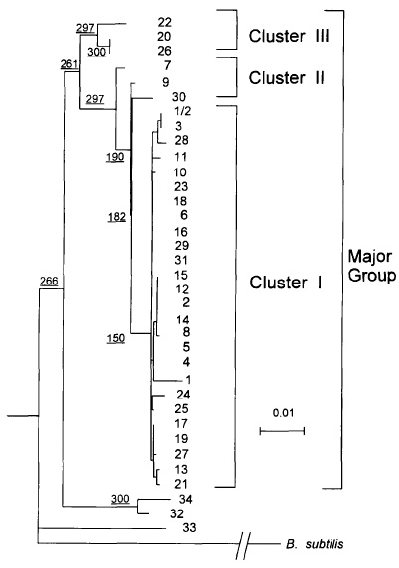
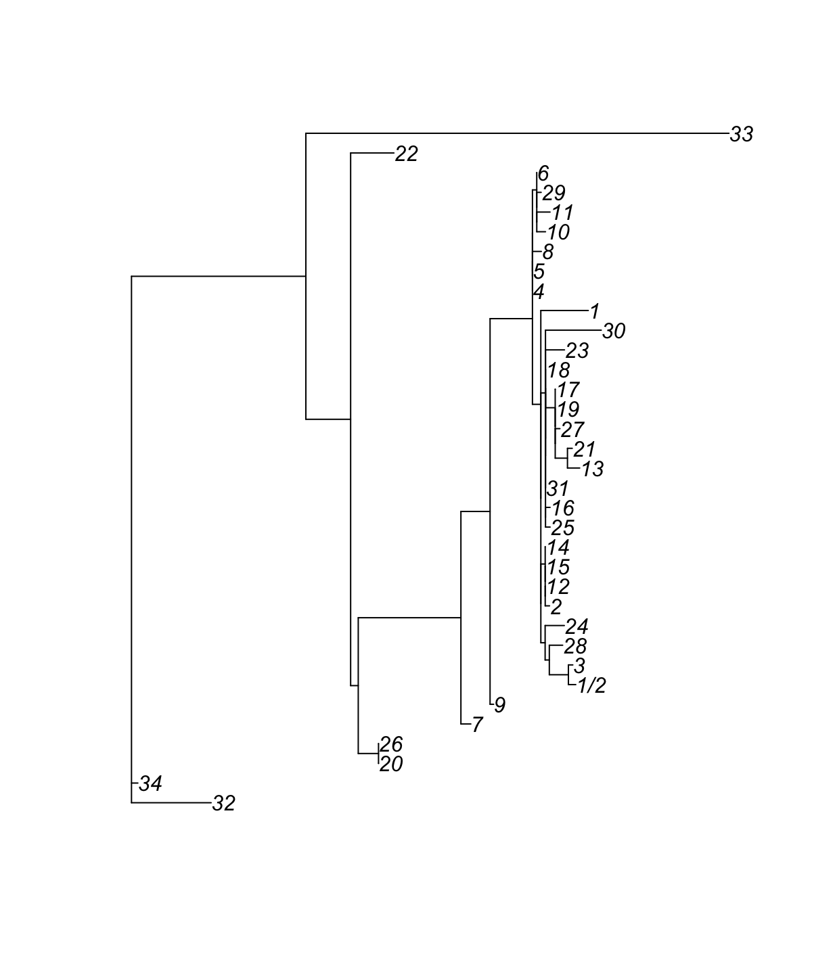
IQ Tree ML Tree vs Original Study[1]
Clustering of IQTree has some similarities with unrooted tree constructed by the neighbor-joining method

Slide 6
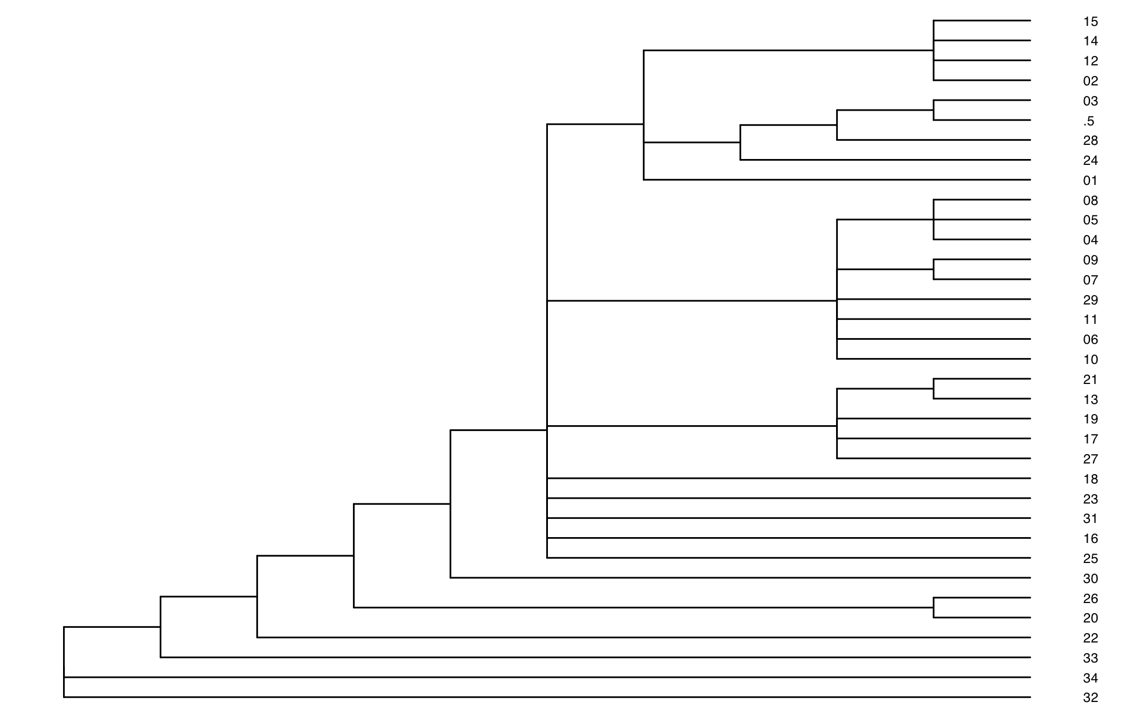
Bayesian Inference vs Original Study[1]
Mr Bayes Concensus Tree compared with unrooted tree constructed by the neighbor-joining method

Slide 7
Discussion and Future Work
Overall my phylogenetic analysis seemed to mostly reproduce the original analysis with the same or very close clades when I used the same alignment method(clustalw) but different tree generation methods (IQTree, MrBayes)
Original Analysis[1] was published in 1998
Would like to compare to Coalescent Based Methods
Would like to compare trees generated by Tcoffee alignment to the original analysis to see how much the differing distance matrix changes our resulting trees

Slide 8
References
Chatellier S, Harel J, Zhang Y, Gottschalk M, Higgins R, Devriese LA, Brousseau R. Phylogenetic diversity of Streptococcus suis strains of various serotypes as revealed by 16S rRNA gene sequence comparison. Int J Syst Bacteriol. 1998 Apr; 48 Pt 2:581-9. doi: 10.1099/00207713-48-2-581. PMID: 9731300.
Lv R, Zhang W, Sun Z, Si X, Dong H, Liu X.2025.Current prevalence and therapeutic strategies for porcine Streptococcus suis in China. Appl Environ Microbiol91:e02160-24.https://doi.org/10.1128/aem.02160-24

