Slide 1
RDBMS, SQL, MySQL
PHP with MySQL
60-307
On-Line Development

Slide 2
What is a database?
There are many types of databases.
The ones traditionally used for Web development are Relational Database Management Systems (RDBMS)
Populate RDBMS'es: MySQL, Microsoft SQL Server, Postgres, Oracle, Maria
It is a separate server and/or program from the Web server.
Persistent and consistent storage of information in data structures.

Slide 3
Separation of Web and Database
Allows you to mix and match programming languages and database servers.
Large databases are maintained by specialists.
Additional coding is required to connect, send, and retrieve data between application and database.
Database access control, security features, and error messages need to be handled.
Notes:
Eg. Apache with PHP and MS SQL Server, or Java with Oracle. Programmers and system administrators are usually different skillsets in large organizations. User accounts and access control

Slide 4
Basic RDBMS Structure
A database server is a program that accepts connections to provide data management.
The server can store many databases.
A database has a set of defined database users.
A database consists of tables

Slide 5
A Typical Table
user_id | first_name | last_name | email | reg_status
346 | Sam | Smith | s.smith@gmail.com | A
348 | Mary | Jones | jones@outlook.com | A
350 | David | Freedman | daf@facebook.com | P
Notes:
Lets reason about this

Slide 6
A Typical Table
user_id | first_name | last_name | email | reg_status
346 | Sam | Smith | s.smith@gmail.com | A
348 | Mary | Jones | jones@outlook.com | A
350 | David | Freedman | daf@facebook.com | P
A table has a unique name in the database.
In this case, we will call it students
Notes:
Lets reason about this

Slide 7
A Typical Table
user_id | first_name | last_name | email | reg_status
346 | Sam | Smith | s.smith@gmail.com | A
348 | Mary | Jones | jones@outlook.com | A
350 | David | Freedman | daf@facebook.com | P
Column names
Are these part of the table?
YES – They are part of the structure.
Notes:
Lets reason about this

Slide 8
A Typical Table
user_id | first_name | last_name | email | reg_status
346 | Sam | Smith | s.smith@gmail.com | A
348 | Mary | Jones | jones@outlook.com | A
350 | David | Freedman | daf@facebook.com | P
Row
A single row represents a set of data that is related
Notes:
Lets reason about this

Slide 9
A Typical Table
user_id | first_name | last_name | email | reg_status
346 | Sam | Smith | s.smith@gmail.com | A
348 | Mary | Jones | jones@outlook.com | A
350 | David | Freedman | daf@facebook.com | P
Column
What are the characteristics of a column?
It has a name
It has a type
Notes:
Look on textbook page 115 for a list of types. What are the types of data in this table?

Slide 10
A Typical Table
user_id | first_name | last_name | email | reg_status
346 | Sam | Smith | s.smith@gmail.com | A
348 | Mary | Jones | jones@outlook.com | A
350 | David | Freedman | daf@facebook.com | P
Integer Type
Character Type
Enumeration
reg_status ENUM ('A', 'P', 'G')
We establish a meaning to this:
A = active student,
P = prospective student,
G = graduated
Notes:
An enumeration can take one of the values in the list. A set can take more than one of the values from the list of possible values.

Slide 11
A Typical Table
user_id | first_name | last_name | email | reg_status
346 | Sam | Smith | s.smith@gmail.com | A
348 | Mary | Jones | jones@outlook.com | A
350 | David | Freedman | daf@facebook.com | P
The PK is not required, but is a good idea:
  Allows us to reference a row
  Must be a unique value
  Must never change
  Must be present
Primary Key Column
PRIMARY KEY AUTO_INCREMENT
Notes:
Why should we have a column be the key?

Slide 12
Other Considerations
Default values
NULL values
Data type options (signed, length, etc.)

Slide 13
Database Differences
In our course we will be using the MySQL database server.
Some data types, features and commands may not be available or handled differently in other databases.
Notes:
We are not going to speak about the different databases – all of our discussion here will be MySQL centred.

Slide 14
Accessing the Database
Using DirectAdmin and phpMyAdmin
  Create and manipulate databases and tables
  Change data values
  Create and change database users
  Grant permissions to tables to DB users
Using MySQL commands
  SQL Language
  Queries

Slide 15
Demo
DirectAdmin to create a database
  name user_test1
  new user user_testdbu
phpMyAdmin to create a table
  name the table
  Columns (names and types are required)
phpMyAdmin to add and edit data

Slide 16
Structured Query Language
You can enter SQL commands through phpMyAdmin or the SQL console.
Your PHP scripts will generate SQL commands and send them to the server for execution.
SQL commands can be used to create and change table structure. (DDL)
SQL queries are used to retrieve and update data in tables.

Slide 17
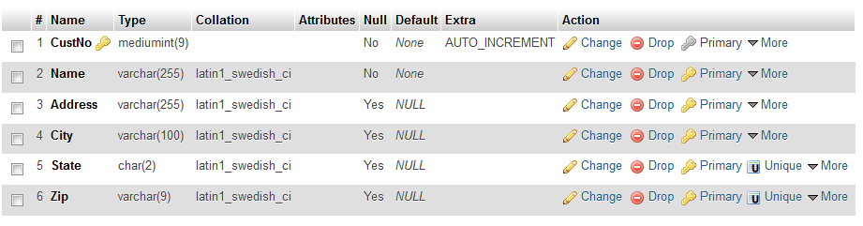
SQL to Create a Table
Why is it not desirable to create and maintain table structures in phpMyAdmin?

Slide 18
SQL to Create Table
CREATE TABLE `customers` (
`CustNo` mediumint(9) NOT NULL AUTO_INCREMENT,
`Name` varchar(255) NOT NULL,
`Address` varchar(255) DEFAULT NULL,
`City` varchar(100) DEFAULT NULL,
`State` char(2) DEFAULT NULL,
`Zip` varchar(9) DEFAULT NULL,
PRIMARY KEY (`CustNo`)
);
Notes:
Notice the back ticks around all identifiers.

Slide 19
SQL to Insert a Row
INSERT INTO `customers`
(`Name`, `Address`, `City`, `State`, `Zip`)
VALUES
('Emma Brown', '1565 Rainbow Road', 'Los Angeles', 'CA', '90014');
What is the CustNo field going to be?
Notes:
READ CHAPTER 5 FOR MORE EXAMPLES. I AM NOT GOING TO REPEAT EVERY DETAIL FROM THE BOOK.

Slide 20
Selecting Data
The SELECT command
  Columns (or * for all)
  Table name (FROM)
  Conditionals (WHERE)
  Sort order (ORDER BY)
  Limiting Results (LIMIT)

Slide 21
Additional SQL Commands
UPDATE
DELETE

Slide 22
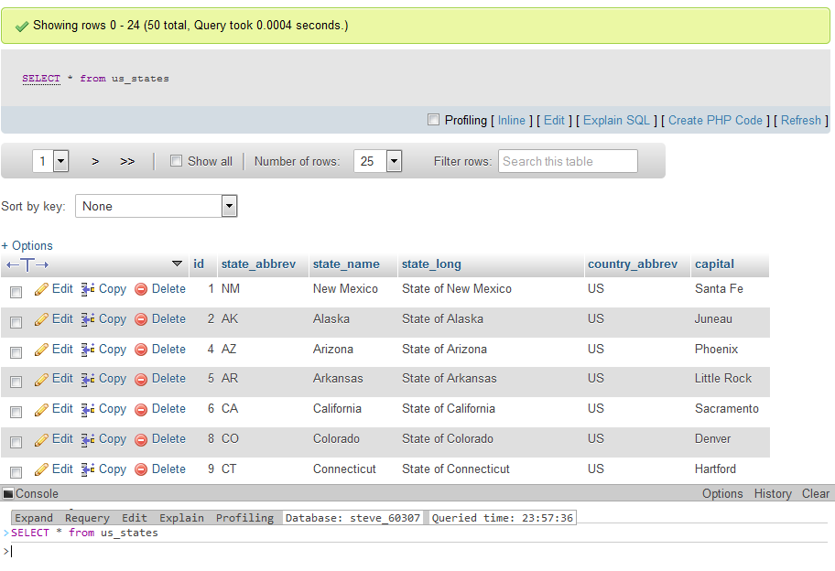
Issue SQL Commands with phpMyAdmin

Slide 23
Live Demo

Slide 24
Connect PHP with MySQL
The textbook uses the mysqli functions. See chapter 9 for details.
It is preferred to the objects as described in chapter 16.
The classes to build your objects from:
  MySQLi
  MySQLi_Result
  MySQLi_STMT
Notes:
We will use MySQLi_STMT later when we discussed prepared statements for better security.

Slide 25
Basic Flow for Using MySQL
Connect to database
Build the query string
Send the query to the database server
Retrieve the results
  Loop through the result set and store them in an array, or do something with them

Slide 26
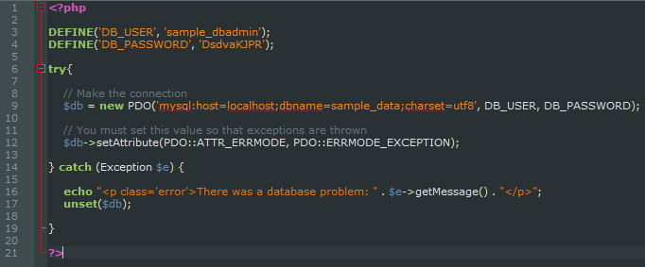
Connecting with mysqli object
Notes:
You must set MYSQLI_REPORT_STRICT for exceptions to be thrown

Slide 27
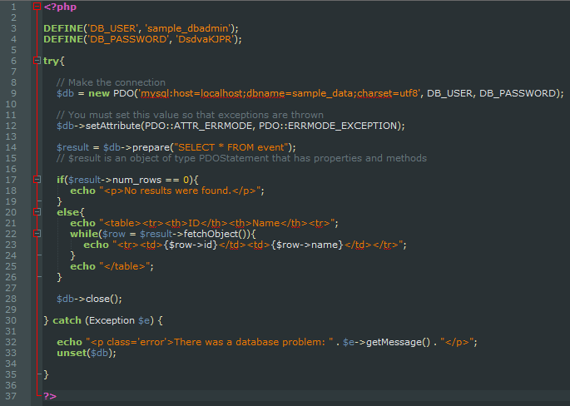
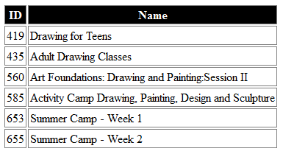
Putting it All Together – Simple SELECT

Slide 28
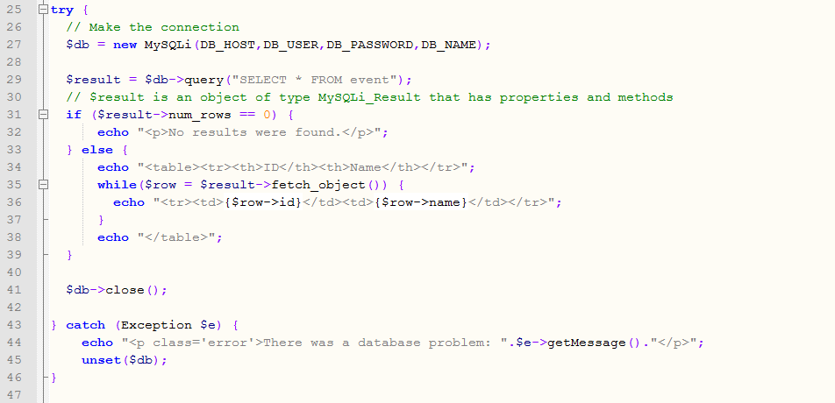
Putting it All Together – Simple SELECT

Slide 29
Putting it All Together – Simple SELECT

Slide 30
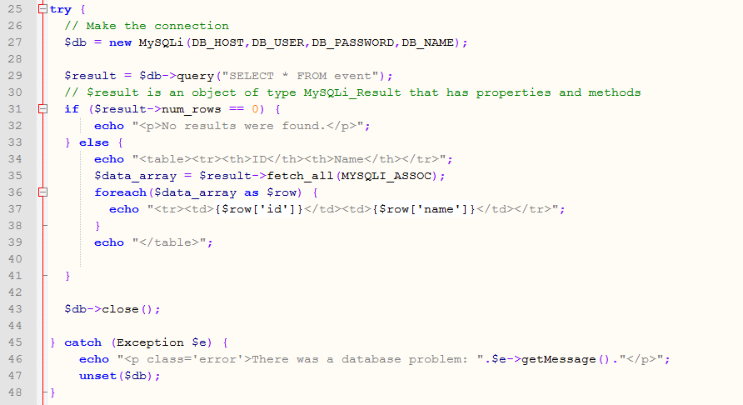
Fetch into a 2-D Array

Slide 31
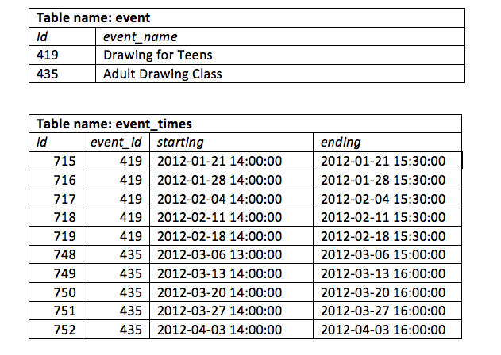
Table Design
Notes:
Why are the event times stored in a separate table?
What is the type of relationship between the event and the times?

Slide 32
Using SELECT in PHP
Simple Example

Slide 33
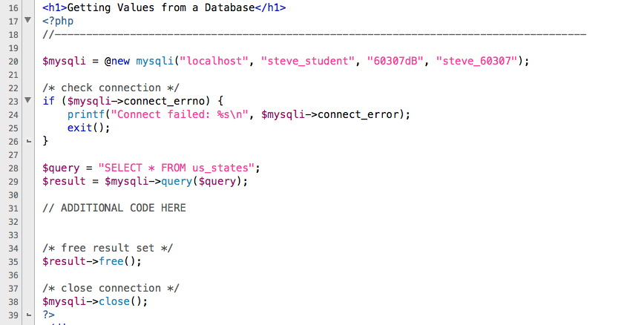
Template for Reading
Creates a new instance of class mysqli and stores it in $mysqli variable.

Slide 34
Template for Reading
Check for connection errors. Note the @ will suppress errors at time of object creation

Slide 35
Template for Reading
Frees up allocated memory. This is not necessary, but nice.

Slide 36
Template for Reading
This will send the query (a string) to the database for processing

Slide 37
Architecture Overview
Web Browser
Web Server
Database Server
PHP Script
Table
SQL
Notes:
It is very important that you understand the interaction between the various components of the “three-tiered” application environment.,

Slide 38
Template for Reading
The SQL is being generated from PHP and will
be sent to the database server.

Slide 39
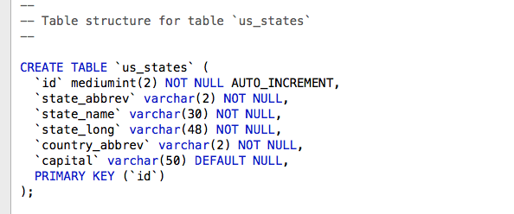
SQL Table Creation Command

Slide 40
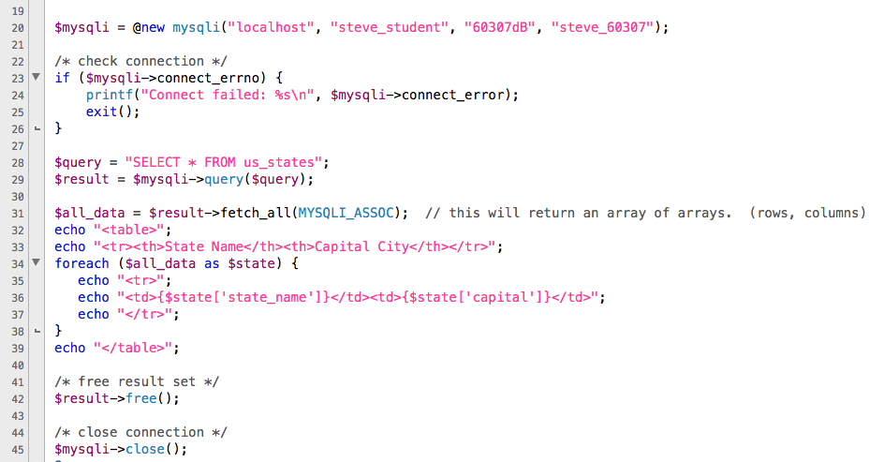
Working With Results

Slide 41
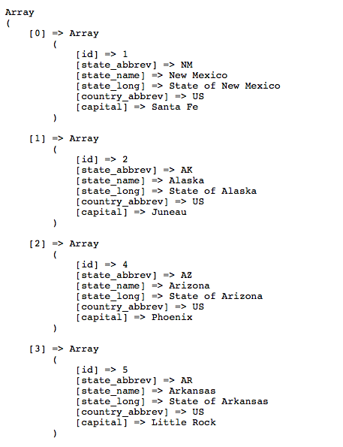
Working With Results
$all_data

Slide 42
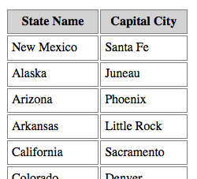
Working With Results

Slide 43
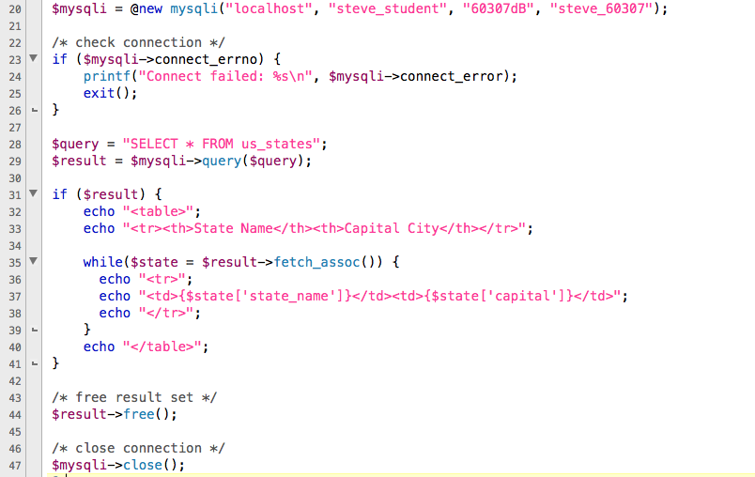
One Row At a Time

Slide 44
One Row At a Time

Slide 45
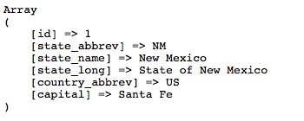
One Row At a Time
First time in loop…

Slide 46
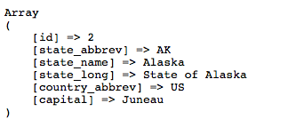
One Row At a Time
Second time in loop…

Slide 47
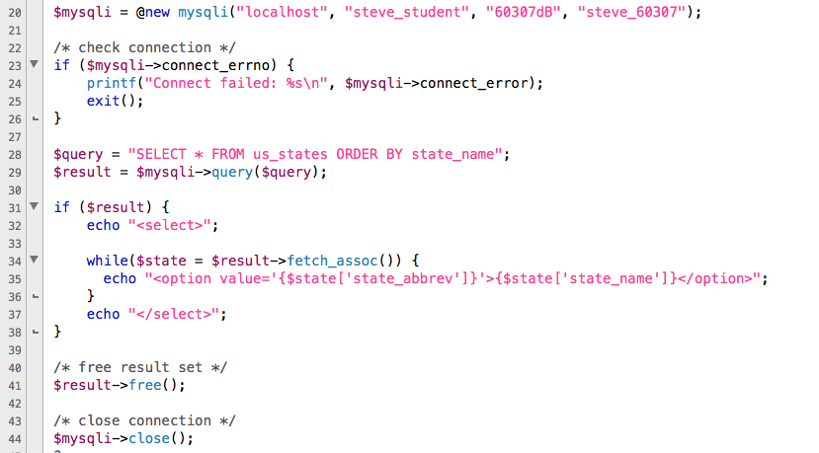
Other Things You Can Do

Slide 48
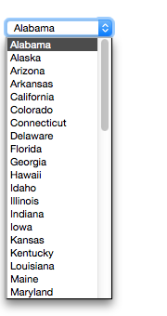
Other Things You Can Do

Slide 49
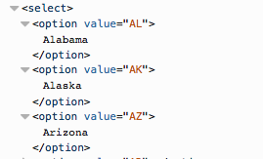
Other Things You Can Do

Slide 50
Assignment #1
Now would be a good time to work on assignment #1 and submit it if you haven't done so already.

Slide 51
Fast MySQL Command Access
PHPMyAdmin has become very large recently.
As an alternative:
miniadmin.cs.uwindsor.ca

