Slide 1

Mission Earth
“A Compassionate Awareness Project

Slide 2

What is Mission Earth?

Slide 3

Mission Earth is a animal cruelty awareness website is a dedicated online platform designed to educate, inform, and raise awareness about the various forms of animal cruelty and promote animal welfare.

Slide 4

Why Raising awareness ?

Slide 5
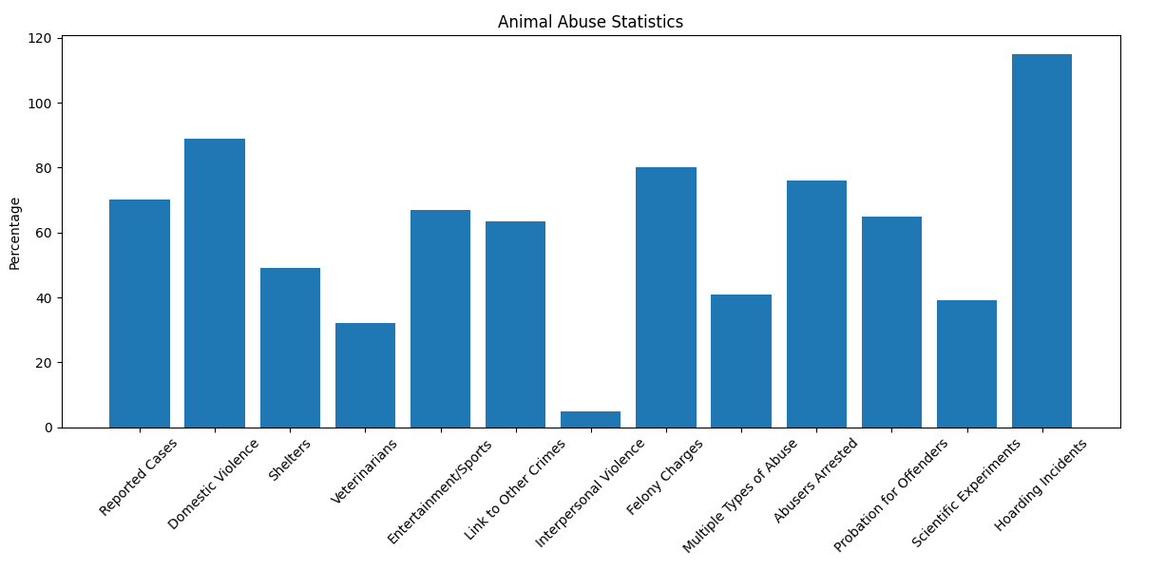
According to the petfinder report, This data shows that most cases of animal abuse are either hoarding incidents or domestic violence. This shows the lack of knowledge in society .

Slide 6
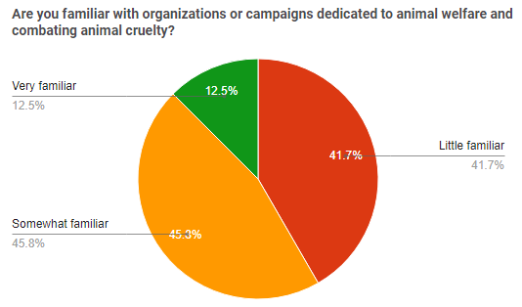
Also our survey show that only 12 % people are familiar to these type of campaigns and awareness organizations.
This explains the reason behind the lack of knowledge in peoples .

Slide 7

What are the effects of awareness ?

Slide 8

Prevention:
Increased awareness helps prevent animal cruelty by enabling people to recognize and report instances of abuse, leading to early intervention and the prevention of further harm to animals.

Slide 9
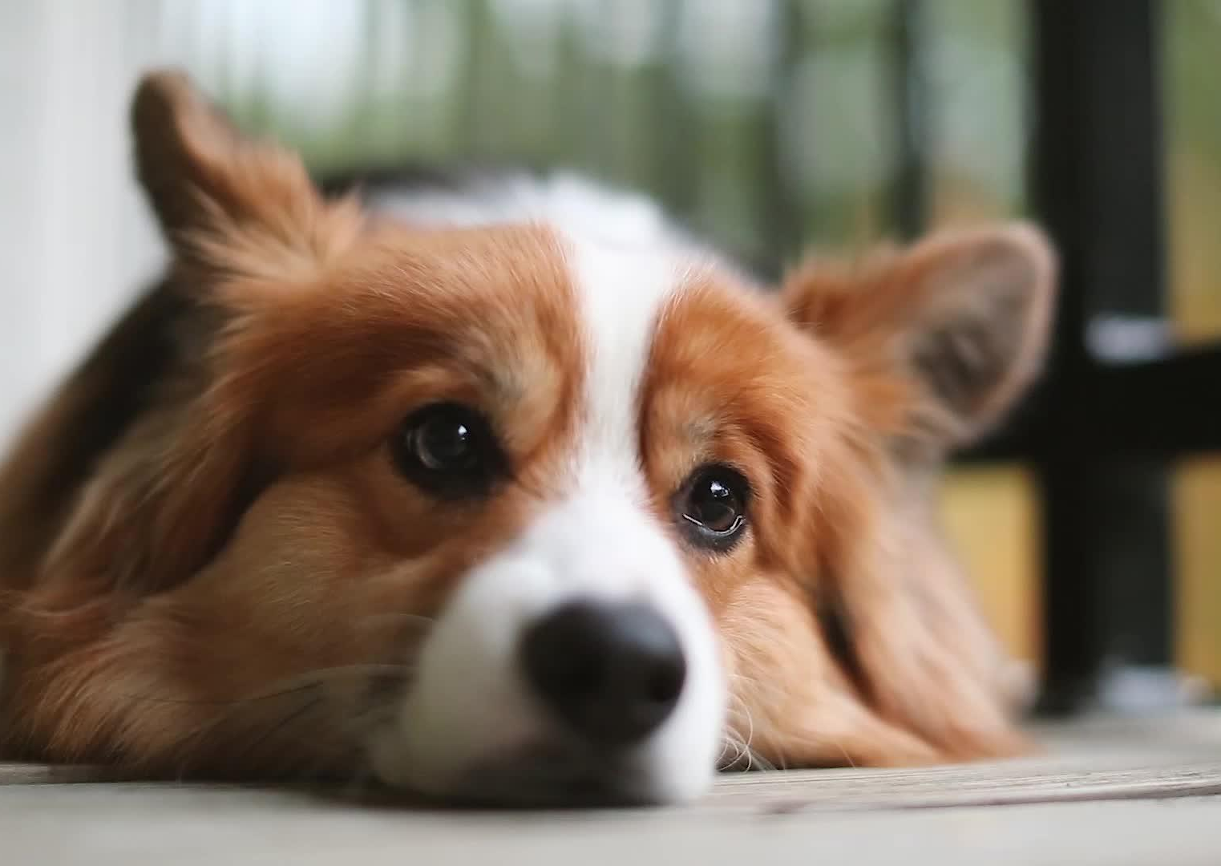
Policy Changes:
Awareness drives changes in laws and policies, as the public becomes more informed and vocal about animal cruelty, leading to improved animal welfare standards and stronger penalties for offenders.

Slide 10
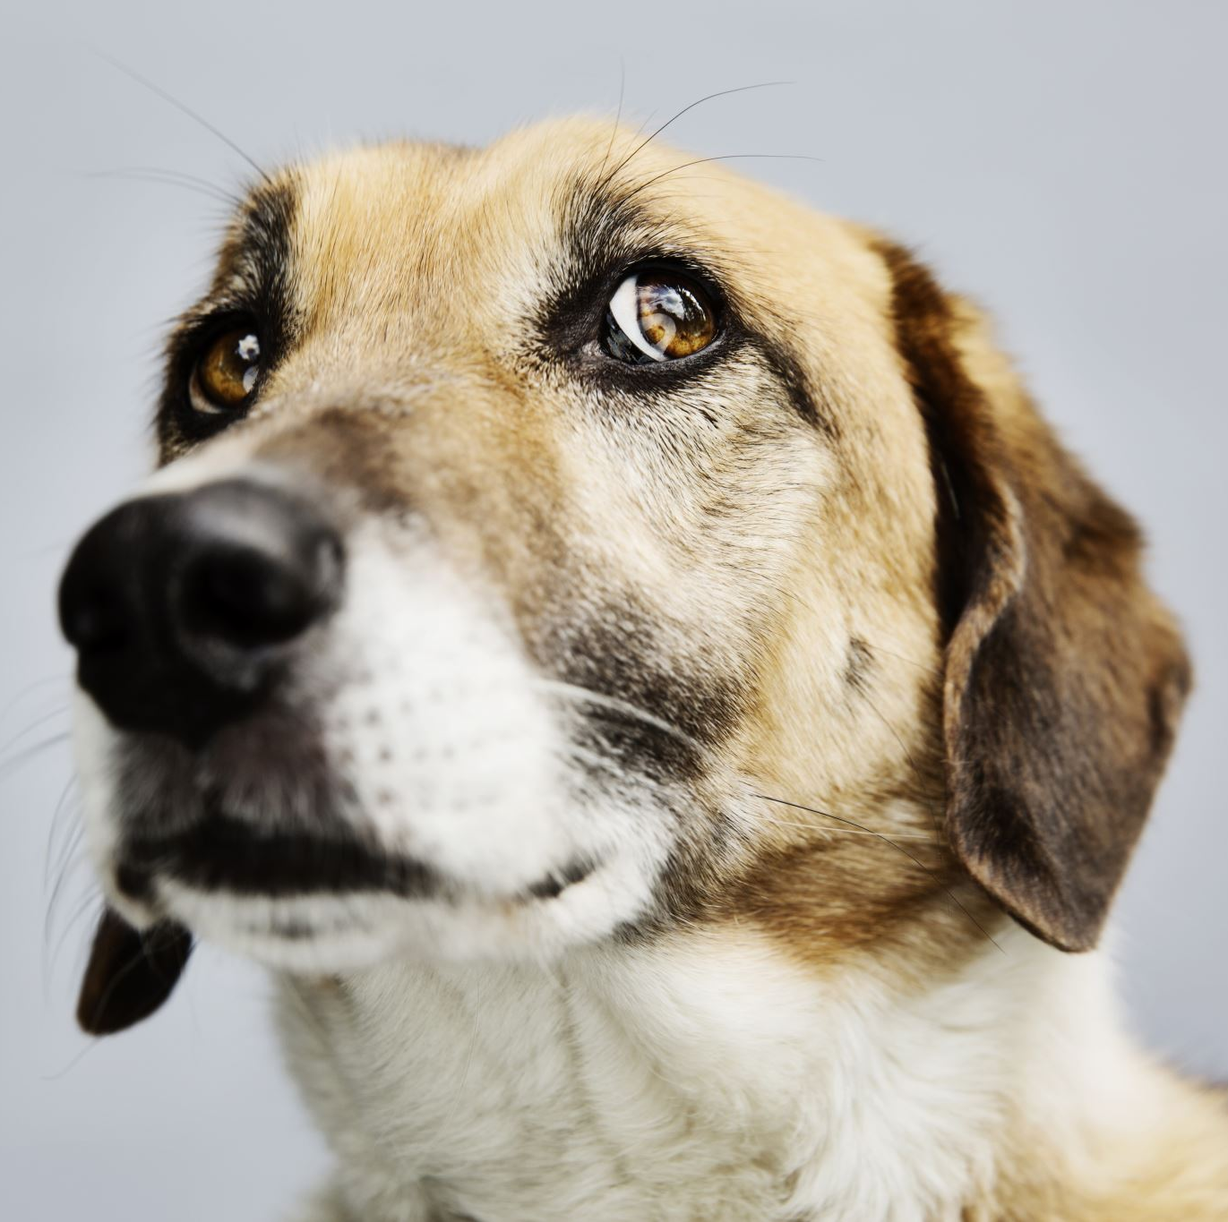
Adoption and Rescue:
Awareness campaigns promote adoption and rescue of abused animals, increasing adoption rates, reducing shelter overcrowding, and improving the lives of rescued animals.
Also We say “ adopt ! Buy don’t.

Slide 11
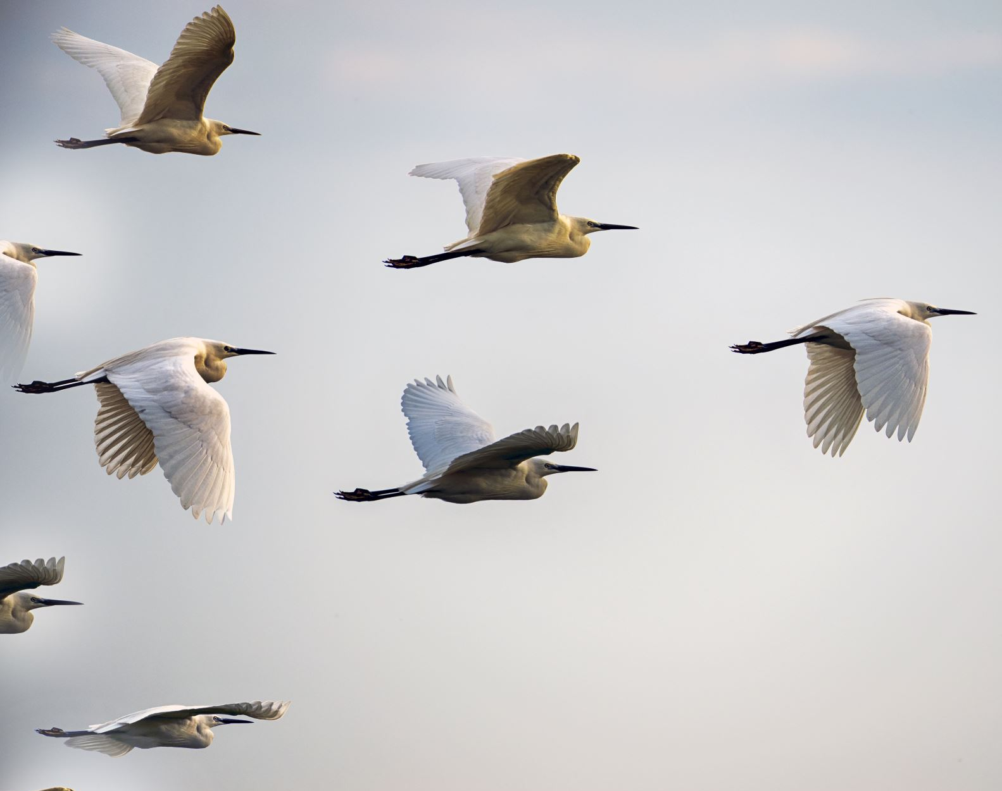
Support for Organizations:
Increased awareness results in greater support for animal welfare organizations, enabling them to provide essential care, rescue services, and advocacy for animals in need.

Slide 12

What is the Aim of system ?

Slide 13

Change the status and perception of animals, from 'objects' to sentient individuals deserving of respect.

Slide 14
How can system achieve this initiative?

Slide 15

Engaging Content:
Develop compelling and informative content, including statistics, case studies, and real-life stories, to capture the audience's attention and evoke empathy towards animals.

Slide 16

User-Friendly Interface:
Create an intuitive and visually appealing website interface that ensures ease of navigation, accessibility, and encourages users to explore and engage with the content.

Slide 17

Collaborations and Partnerships:
Forge partnerships with animal welfare organizations, influencers, and relevant stakeholders to maximize the impact and reach of the awareness campaign, tapping into existing networks and resources.

Slide 18

Interactive Features:
Include interactive elements, such as quizzes, surveys, and interactive maps, to enhance user engagement, facilitate learning, and encourage active participation in the awareness campaign.

Slide 19

Continuous Updates and Engagement:
Regularly update the website with fresh content, news, and success stories to maintain visitor interest and provide ongoing opportunities for engagement and learning.

Slide 20

Social Media Integration:
Utilize popular social media platforms to amplify the reach of the awareness campaign, sharing powerful messages, images, and stories to create a viral impact and engage a wider audience

Slide 21

Methodology

Slide 22



Research Design:
The project utilized a descriptive research design to gather information and analyse data related to animal cruelty awareness.
Both quantitative and qualitative research methods were employed to obtain a comprehensive understanding of the topic.

Slide 23
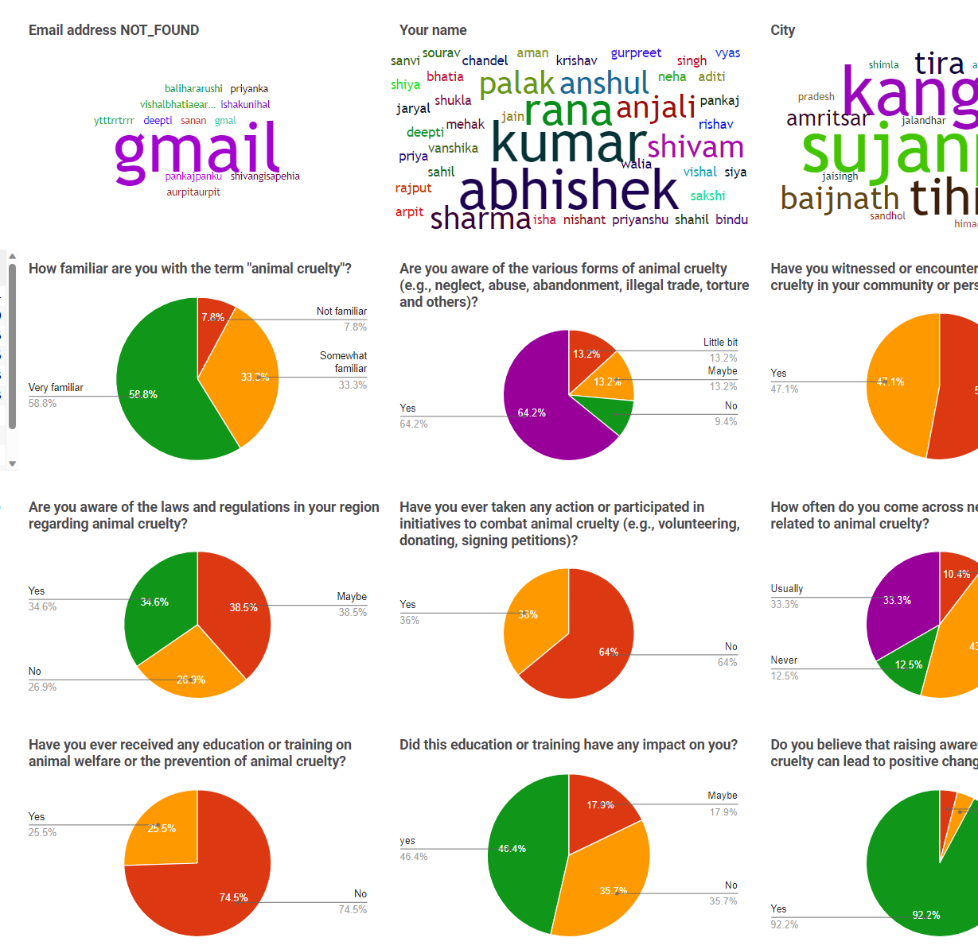
Data Collection:
Primary data was collected through a survey questionnaire, supplemented by manual research such as public interviews and social experimentation.
Secondary data from literature and reports were also utilized.

Slide 24
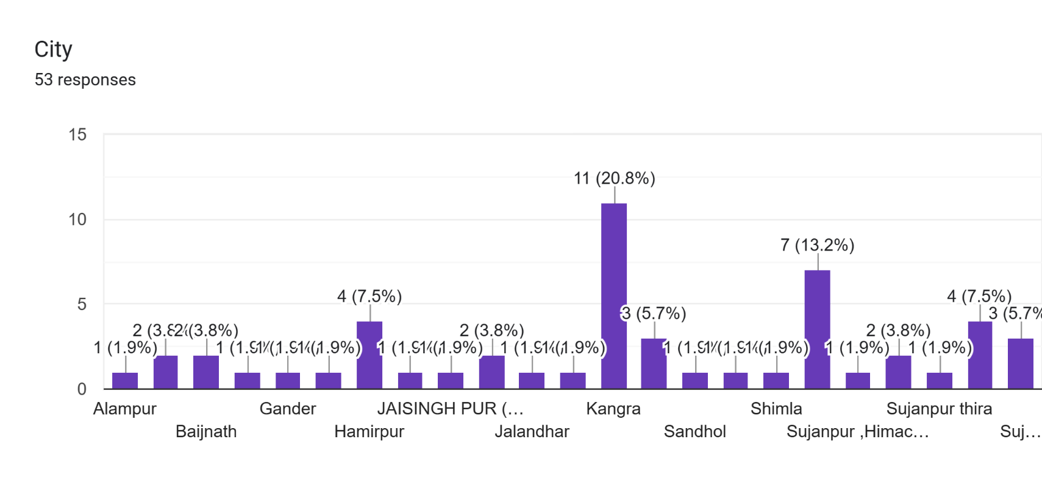
Sampling:
Convenience sampling method was employed, targeting a diverse sample of 50+ participants from various locations to ensure a broader perspective.

Slide 25

Data analysis :
Quantitative data: The collected survey and manual research data were analyzed. Descriptive statistics such as frequencies, means, and percentages were computed to summarize the data.
Qualitative data: Thematic analysis was employed to analyze qualitative data gathered from open-ended survey questions and literature reviews.

Slide 26

Validity and Reliability:
Measures were taken to enhance the data collected. The survey questionnaire was pre-tested with a small sample to ensure clarity and accuracy of the questions.
The researcher-maintained consistency in data collection and analysis procedures to enhance reliability.

Slide 27

Data Interpretation:
Findings were interpreted in the context of research objectives and existing literature, providing insights into awareness and attitudes towards animal cruelty.

Slide 28

Findings and Discussions

Slide 29
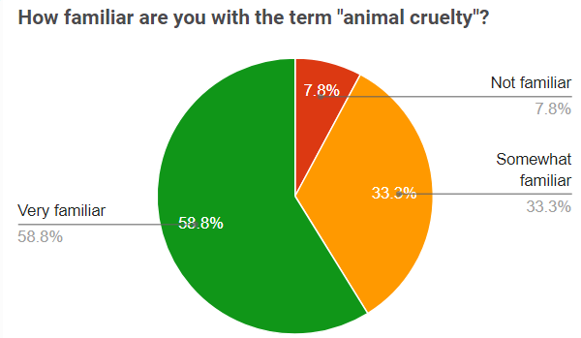
Understanding of Animal Cruelty:-
59% of participants had a basic understanding of animal cruelty.
33% of participants had limited knowledge on the topic.

Slide 30
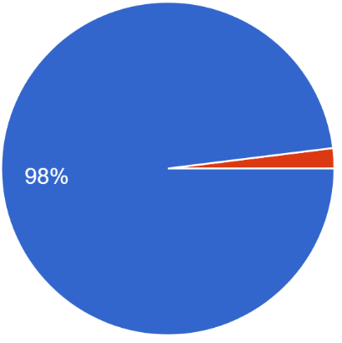
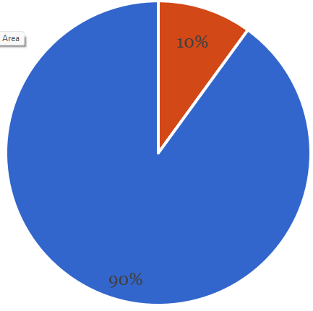
Attitudes towards Animal Cruelty:-
Approximately 98% of participants expressed strong negative attitudes towards animal cruelty
90% of participants desired stricter laws and penalties for offenders.

Slide 31
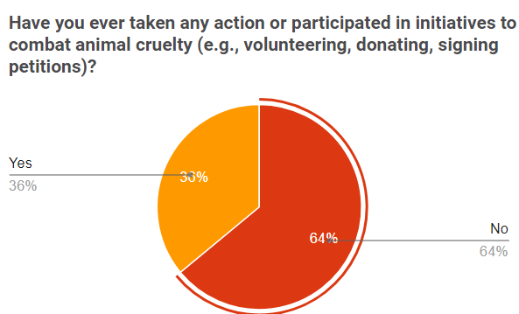
Behaviors and Actions:-
Only 36% of participants reported taking direct action against animal cruelty
Limited engagement was primarily due to a lack of knowledge on effective ways to address and combat animal cruelty.

Slide 32
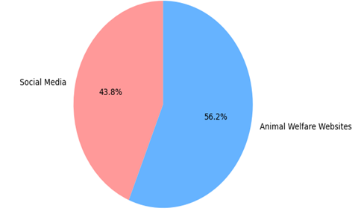
Sources of Information
Social media platforms (65%) were the most common source of information about animal cruelty.
Animal welfare websites (45%) and news articles (35%) were also significant sources of information.

Slide 33
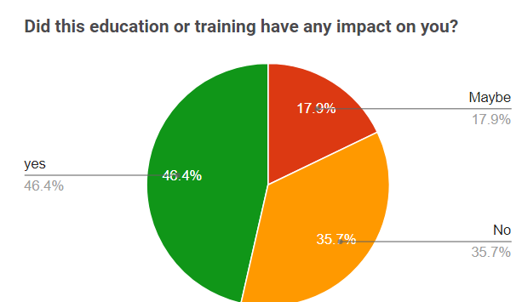
Impact of Awareness Campaigns:
48% of participants reported being positively influenced by animal cruelty awareness campaigns.
Increased empathy, behavioral changes, and a greater willingness to support animal welfare organizations were cited as outcomes of these campaigns.

Slide 34
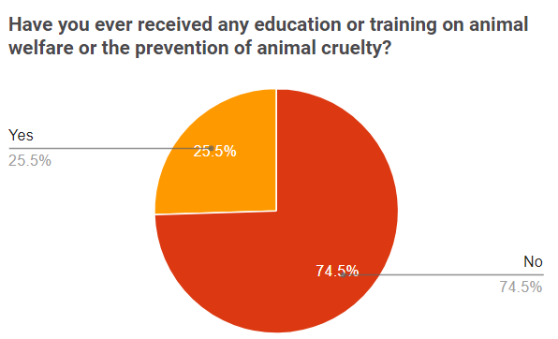
Barriers to Awareness
Lack of widespread media coverage and education programs were identified as significant barriers to raising awareness about animal cruelty.
Only 25% of participants had received education or training on animal welfare or the prevention of animal cruelty.
Participants emphasized the need for more educational initiatives in schools and community settings.

Slide 35

What are the functionalities of system ?

Slide 36

User Registration and Authentication for secure access to personalized content.

Slide 37

Content Management by administrator and sub administrators for easy updating and organization of website content.

Slide 38
Robust Search functionality for quick and precise information retrieval.

Slide 39

Highlighting Trending and Popular Posts to keep users informed about the latest news and trends.

Slide 40

Commenting and Feedback system to encourage user engagement and constructive discussions.

Slide 41

Social Media Integration for easy content sharing and wider reach.

Slide 42

Donation and Sponsorship options to support animal welfare initiatives.

Slide 43

Collaboration and Adoption opportunities with animal welfare organizations.

Slide 44



Mobile Responsiveness for seamless access on different devices.

Slide 45

Front-End Technologies:
HTML
CSS
JavaScript
jQuery
Bootstrap

Slide 46

2. Back-End Technologies:
PHP
MySQL

Slide 47
3. Other Technologies:
Deployment Tools: Apache
Text formatter: Bootstrap Summer note 0.8.14
Tools to convert descriptive data of surveys into visual representation : Google collab

Slide 48
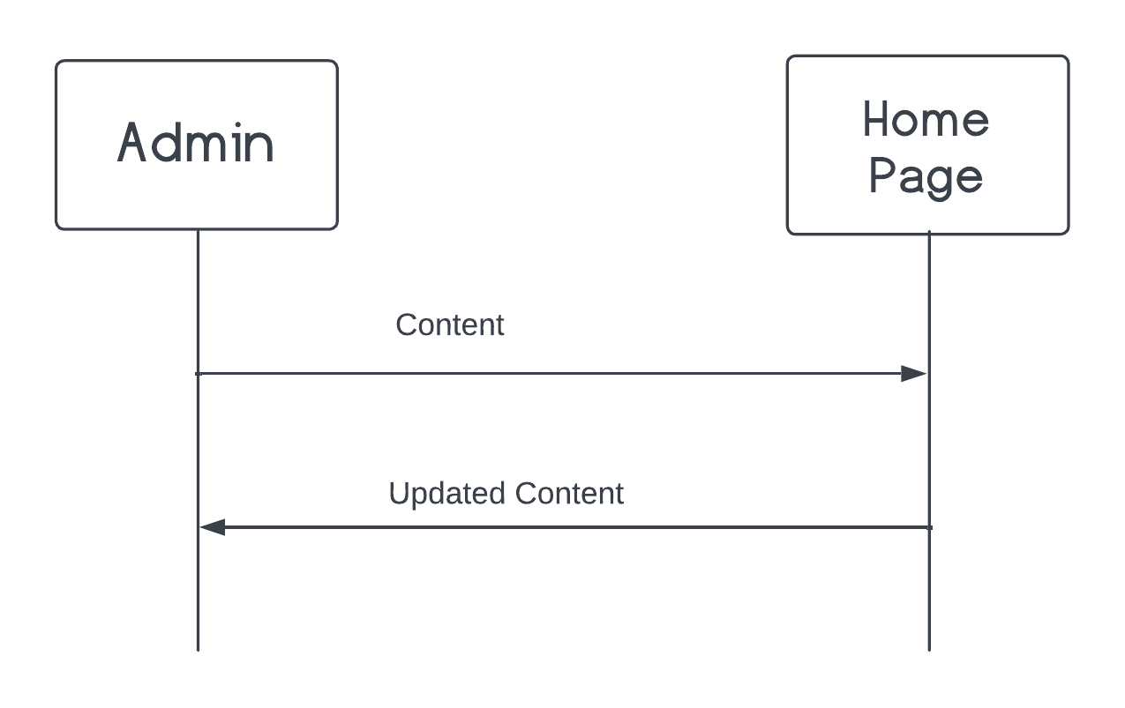
DATA FLOW DIAGRAMS
Process of posting content from the admin page to the home page of a website:

Slide 49
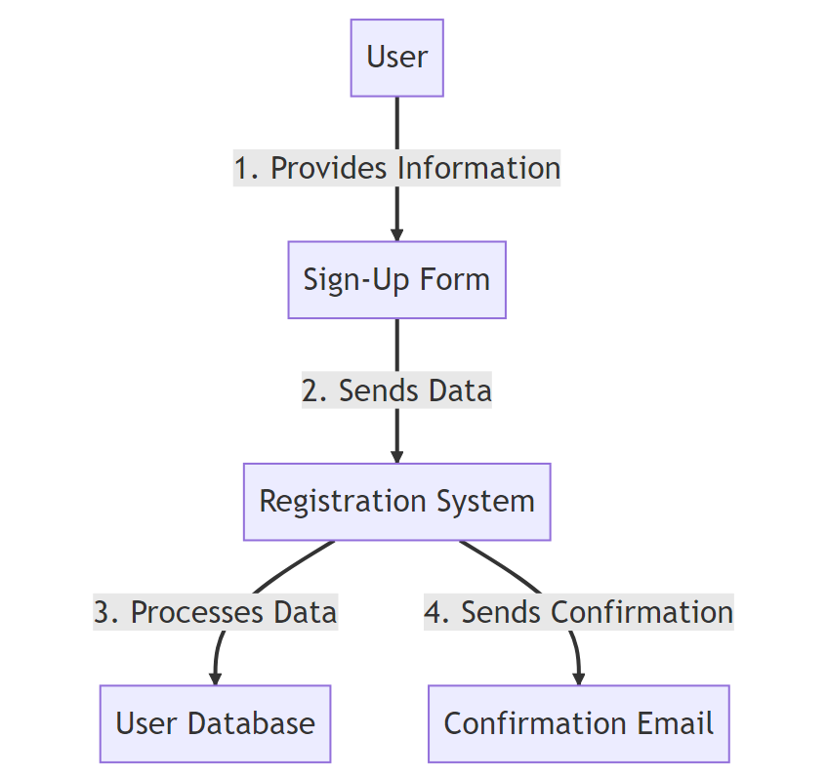
User sign-up process with the given signup options:

Slide 50
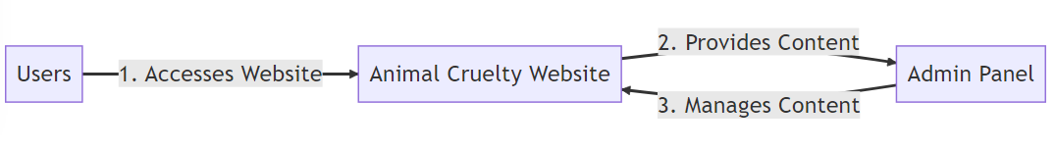
Context diagram

Slide 51
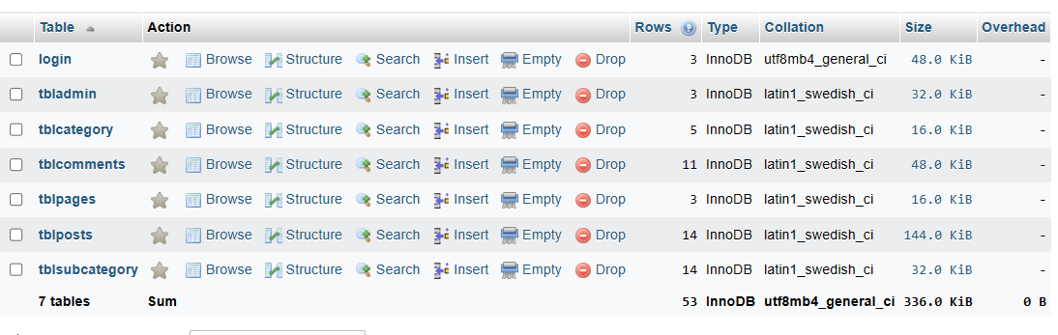
Data base Tables

Slide 52

Testing

Slide 53

Testing Approach:
Comprehensive testing approach with manual and automated testing for functionality, usability, performance, and security of the Animal Cruelty Awareness website.

Slide 54
Test Plan:
Encompassed functional, usability, performance, and security testing with dedicated resources, milestones, and test case creation, execution, tracking, and analysis.

Slide 55
Functional Testing and Unit Testing:
Extensive testing of user registration, login, content creation and management, user interactions, and roles/permissions.

Slide 56
Performance Testing:
Load testing, response time analysis, and scalability testing to assess website responsiveness and stability under different conditions.

Slide 57
Security Testing:
Testing user authentication, authorization, and protection against vulnerabilities.

Slide 58
Conclusion
The project objectives were successfully achieved by creating a centralized platform for users to navigate through different categories of content related to animal welfare. The website features separate sections for trending, popular, and recent posts, enabling users to stay up-to-date with the latest content and explore popular topics.

