Slide 1
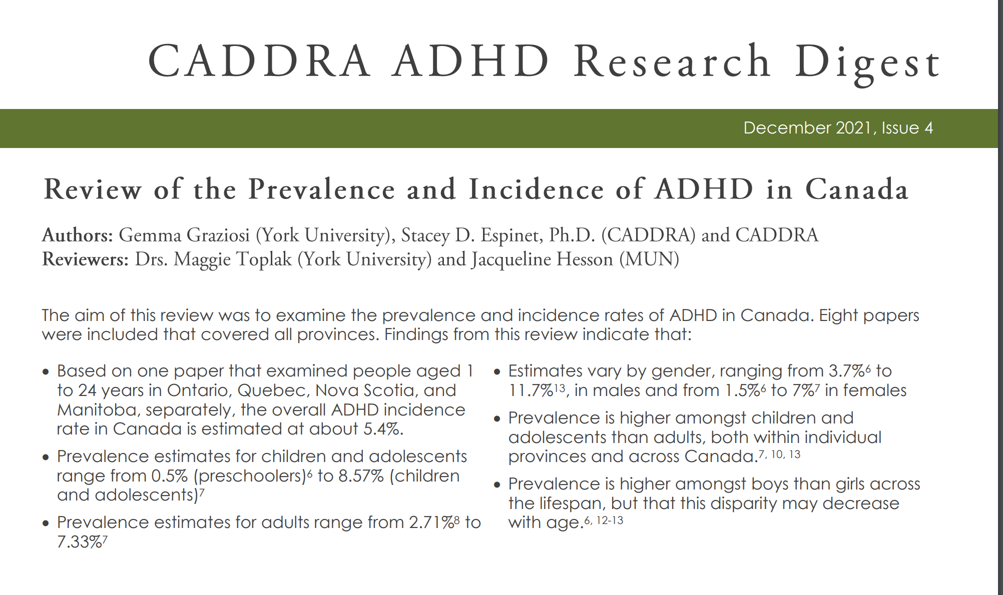
Source: https://www.caddra.ca/wp-content/uploads/Research-Digest_Dec-2021_FINAL.pdf

