Slide 1
Crop Care
Presented by, Akhi, Issaq, Samuel, Abdulrazig and Ismaeel

Slide 2
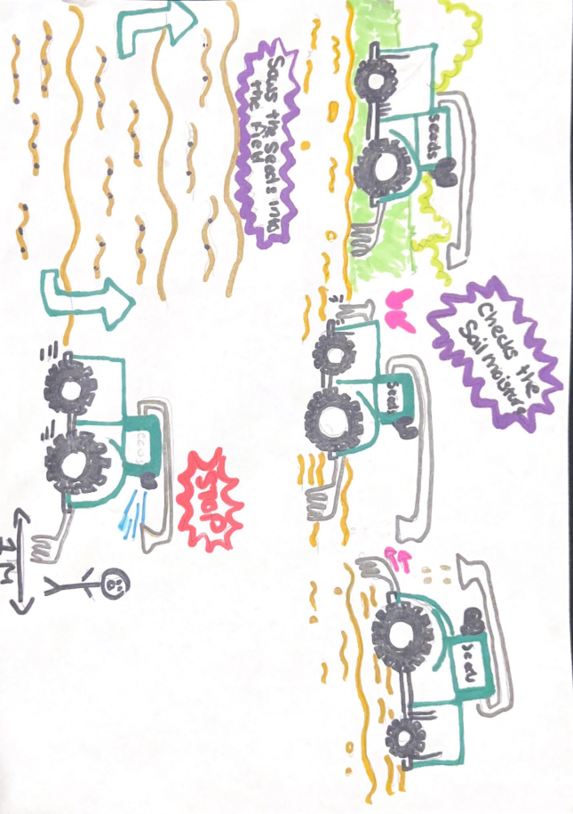
CropCare StoryBoard
CropCare is a 4 wheeled autonomous robot that is powered by solar energy, it utilizes GPS tracking following specific paths. It can dispense and sow seeds into the soil as well as check the soil moisture.

Slide 3
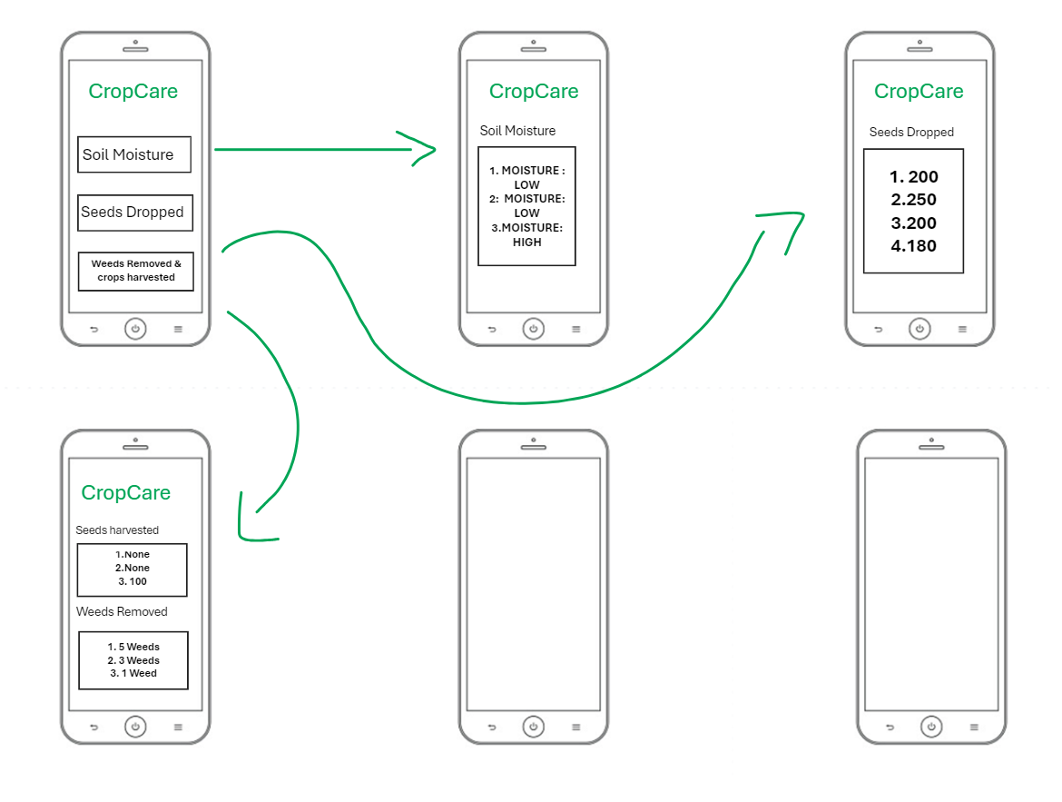
User Interface
Document that stores data from the robots sensors

Slide 4
Hardware Components
01
02
03
04
05
06
Arduino UNO
Ultrasonic sensor
SG90 Micro servo
Main processing unit for the robot – will be used to integrate the sensors , actuators and other componenets.
Used to measure the distances and avoid any obstacles.
Installed in the robots wheels provides precise control over its movements.
Physical Components
Soil Moisture Sensor
DC Motor & L293DModule
Checks the moisture level of the soil based on resistance, the lower the resistance indicates high soil moisture.
3D printed rake and a seed dispenser, wheels
Provides the driving motion in the robots wheels. L2939 controls the direction and speed of the motor.

Slide 5
Software Components
01
02
03
04
05
Arduino IDE Software
Emergency Stop
Seed Dispensing & Rake Logic
Software used to program the code into the Arduino
Uses Data from ultrasonic Sensor – if it detects a person or object within 1 meter, it emergency stops.
Code responsible for coordinating specific drops from the seeds dispenser with the dc motor.
GPS Navigation
Store data from sensors
Robot programmed to follow a specific path and if it come across an object (fence) the robot changes directions.
Data from the sensors (ultrasonic distance and soil moisture) is to be stored in a document that can be viewed by user.

Slide 6
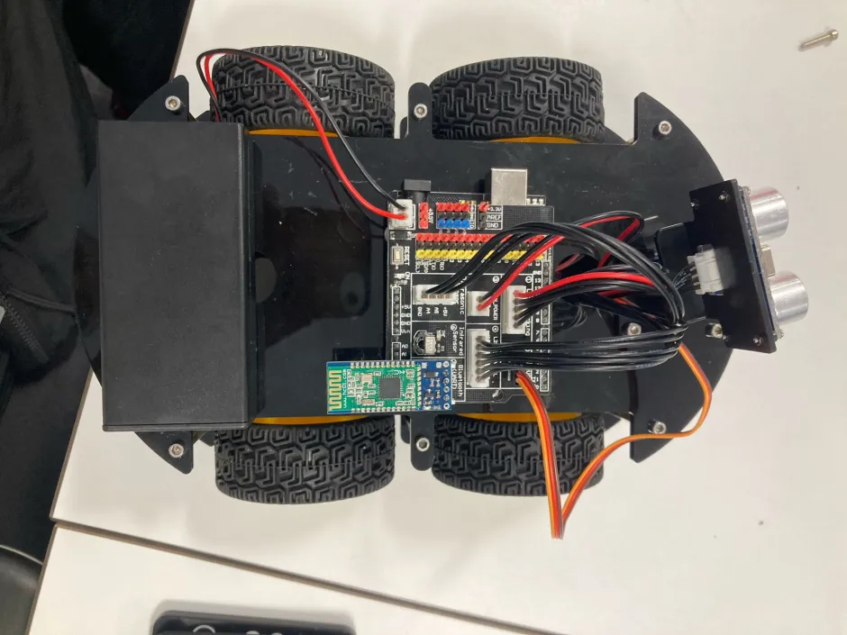
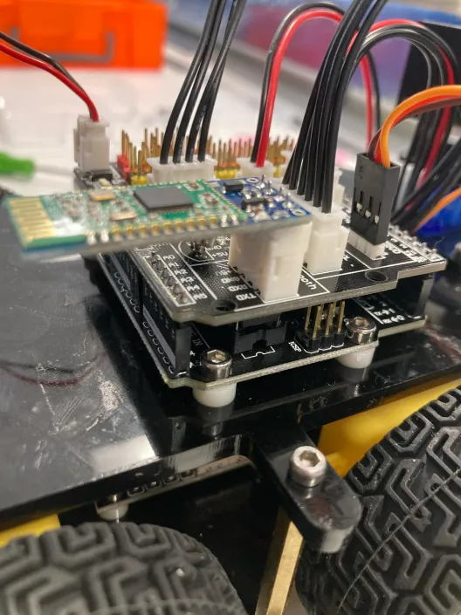
Progress so far
Over the recent weeks Issaq has been developing the foundation of the robot, it has been programmed to change its direction when an object is placed in front of it.
Our next step is to design and incorporate the 3D components of the robot.

Slide 7
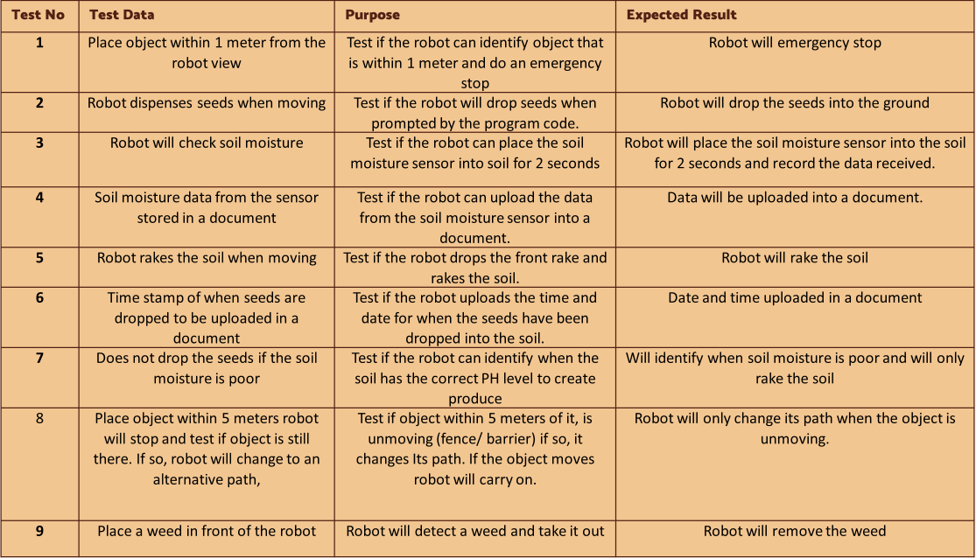
Test Data

Slide 8
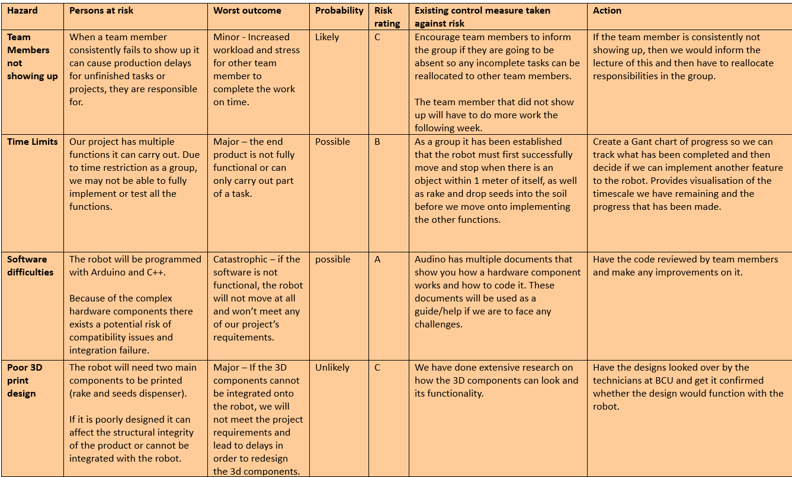
Risk Assessment

Slide 9
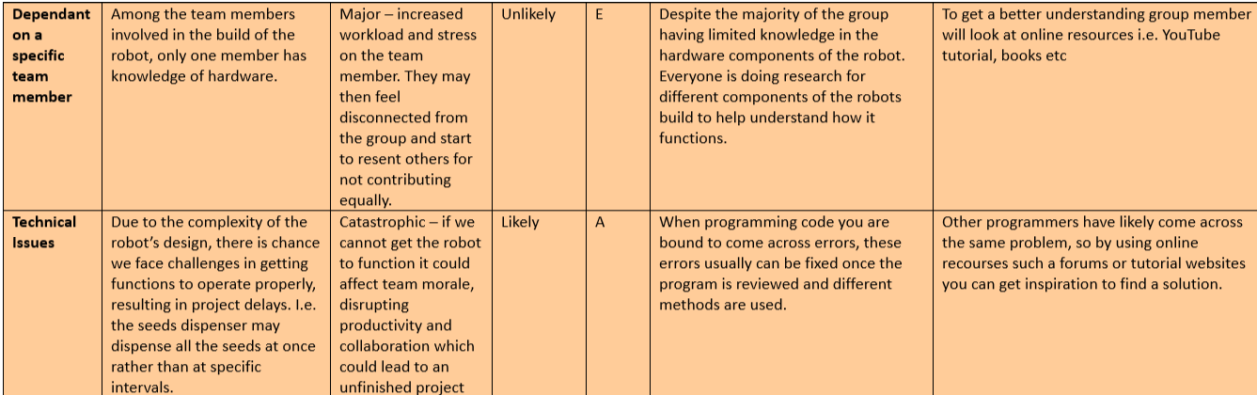
Risk Assessment

Slide 10
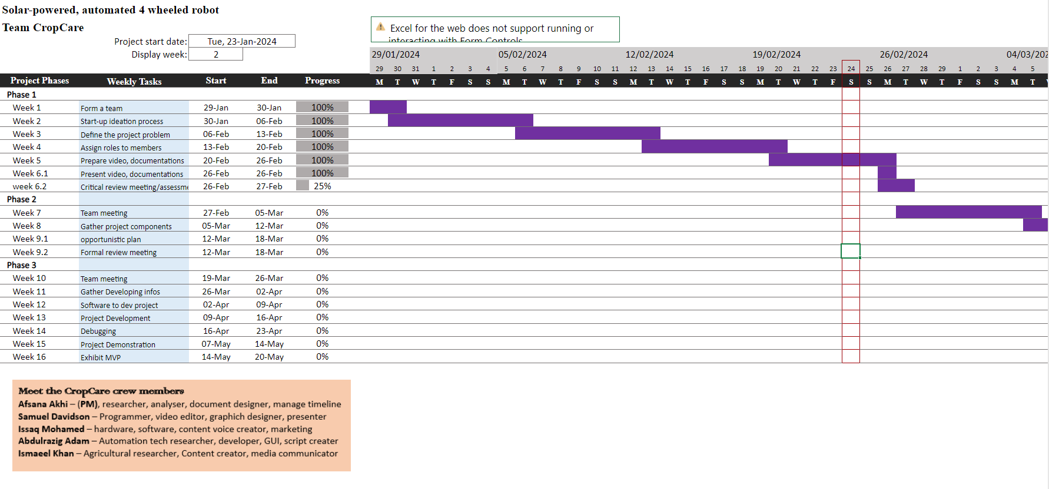


The Project Timeline

Slide 11
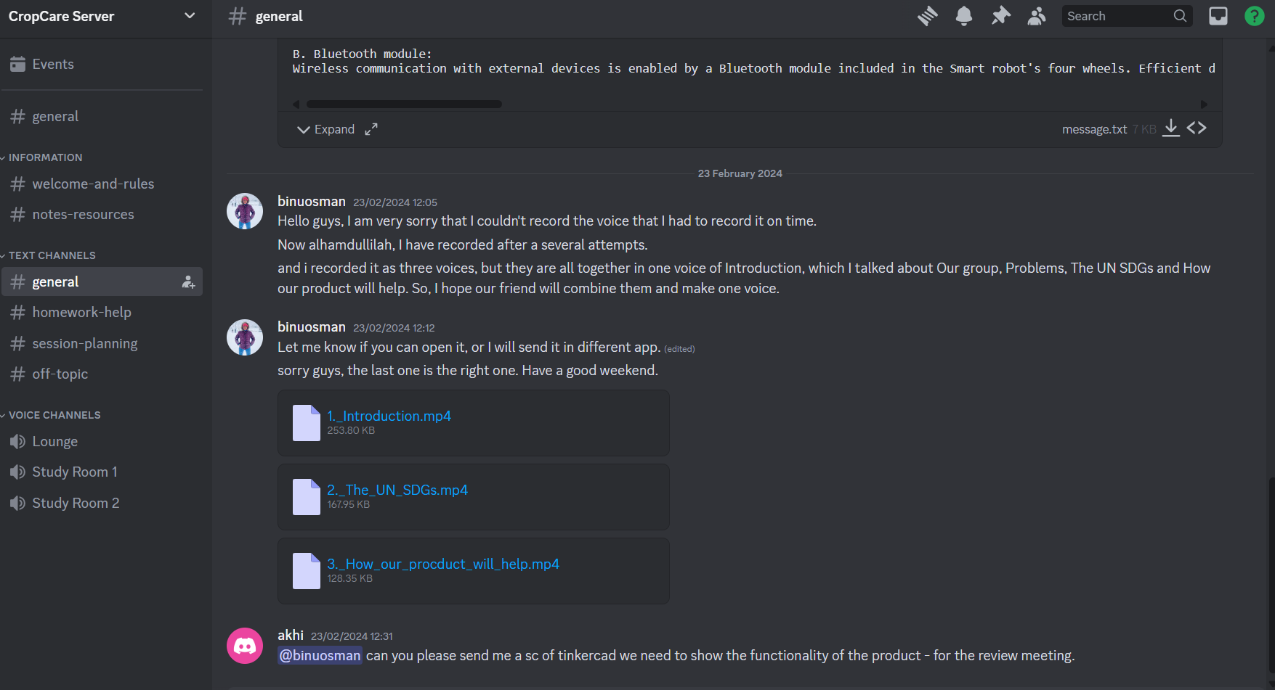
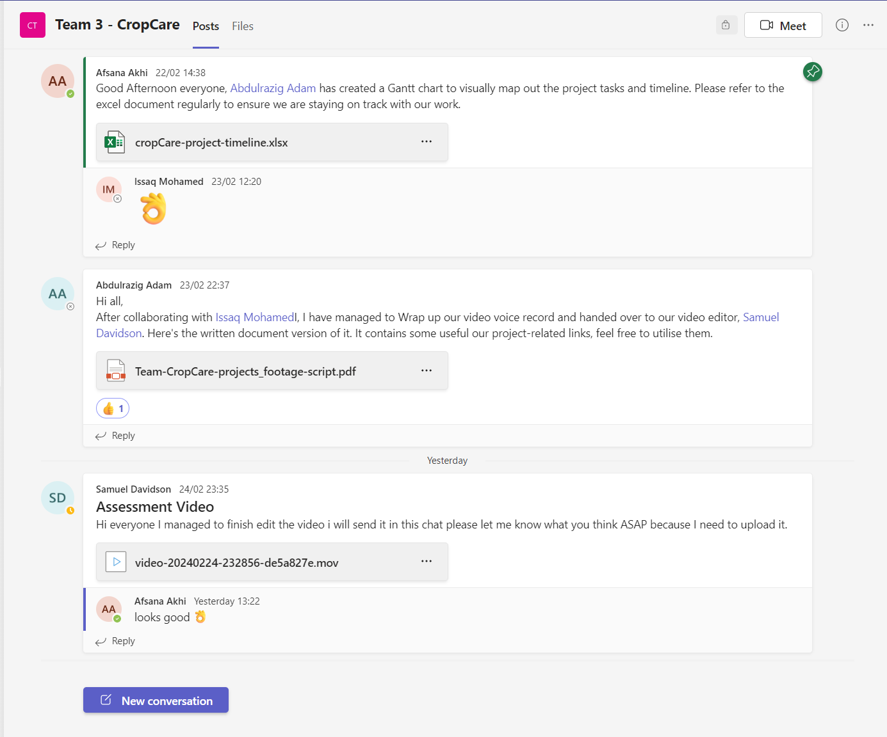

Collabration
As a group we use Microsoft teams, discord and the labs to discuss the project and its requirements. Microsoft teams is mainly used to send across documents regarding the project and any work completed during the labs or sessions outside of it.
Discord is used if we have any question regarding the project or need to reach out to a team member.

