Slide 1
WRF Cloud Water Content

Slide 2
Index
Part 1: Calculate Liquid Cloud Water (LCW)
Part 2: Calculate Cloud Water Flux (CWF)
Part 3: Calculate Cloud Water Content (CWI)

Slide 3
Part 1: Calculate Liquid Cloud Water (LCW)

Slide 4
2st 3D level
1st 3D level
Qcloud: Assumption: Mean value from surface to 1st level boundary
WRF units: kg / kg
EQN units: g / m^3
Ground
(sloped terrain)

Slide 5
2st 3D level
1st 3D level
Qcloud: Assumption: Mean value from surface to 1st level boundary
WRF units: kg / kg
EQN units: g / m^3
Convert using Temperature and Pressure.
Ideally: use mean temperature and pressure from surface to 1st level boundary
Ground
(sloped terrain)

Slide 6
2st 3D level
1st 3D level
Qcloud: Assumption: Mean value from surface to 1st level boundary
WRF units: kg / kg
EQN units: g / m^3
Convert using Temperature and Pressure.
Ideally: use mean temperature and pressure from surface to 1st level boundary
Ground
(sloped terrain)
Assume: Temperature for 1st level can be approximated by 2 m air temperature (T2) and surface pressure (PSFC)

Slide 7


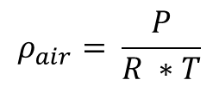

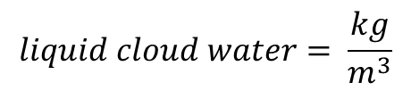
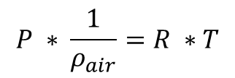

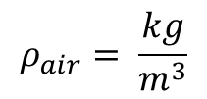
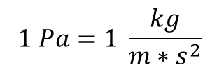
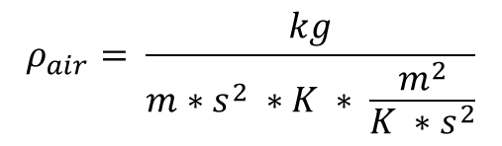
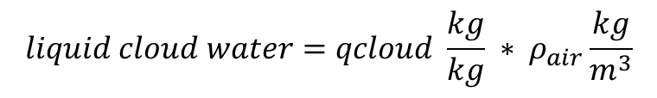

$$P ∗ \frac{1}{ρ_{air}}=R ∗T$$
$$1 Pa=1 \frac{kg}{m∗s^{2}}$$
$$ρ_{air}= \frac{P}{R ∗T}$$
$$R=287 \frac{J}{kg ∗K}$$
$$1 J=1 \frac{kg ∗m^{2}}{s^{2}}$$
Add in units:
$$R=287 \frac{\frac{kg ∗m^{2}}{s^{2}}}{kg ∗K}$$
$$ρ_{air}= \frac{kg}{m∗s^{2} ∗K ∗ \frac{m^{2}}{K ∗s^{2}}}$$
$$R=287 \frac{m^{2}}{K ∗s^{2}}$$
$$ρ_{air}= \frac{kg}{m^{3}}$$
$$liquid cloud water=qcloud \frac{kg}{kg} ∗ ρ_{air}\frac{kg}{m^{3}}$$
$$liquid cloud water= \frac{kg}{m^{3}}$$
Multiply by 1000 to convert from kg to g
$$liquid cloud water = \frac{g}{m^{3}}$$

Slide 8
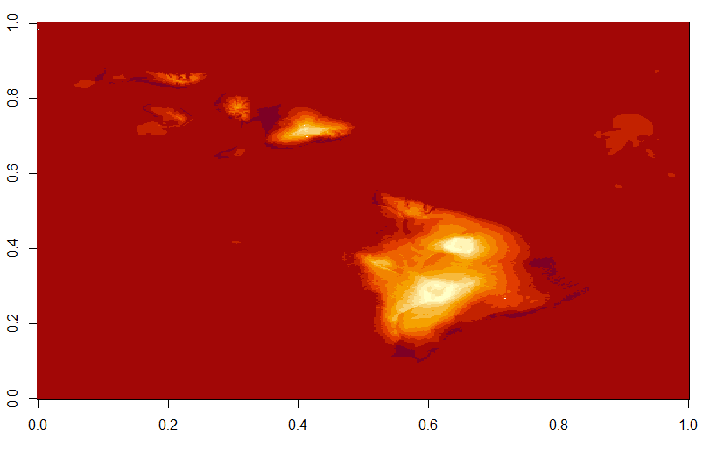
Han’s locations*
T2 temperature to show location of islands
* Please check for accuracy. One is not in this domain. Yellow is the one used in the following worked example

Slide 9
Worked Example
3D data file: "wrfout_d01_2006-01-03_000000“
Location: Nakula (20.674650 °N, 156.233308 W)
Data grid indices*: 189, 303, 1, 1
(longitude index, latitude index, layer, hour)
* I think I’ve got the indexing correct, but still need to confirm this more carefully. Does not matter for testing calculations, but does matter for comparison to field measurements.

Slide 10
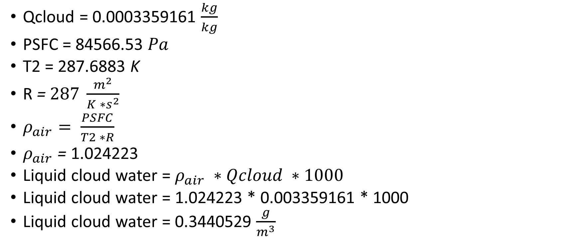
Worked Example
Qcloud = 0.0003359161 $\frac{kg}{kg}$
PSFC = 84566.53 $Pa$
T2 = 287.6883 K
R = $287 \frac{m^{2}}{K ∗s^{2}}$
$ρ_{air}= \frac{PSFC}{T2 ∗R}$
$ρ_{air}$ = 1.024223
Liquid cloud water = $ρ_{air} ∗Qcloud ∗1000$
Liquid cloud water = 1.024223 * 0.003359161 * 1000
Liquid cloud water = 0.3440529 $\frac{g}{m^{3}}$

Slide 11
Considerations
This calculation does not include an integral over the thickness of the layer

Slide 12
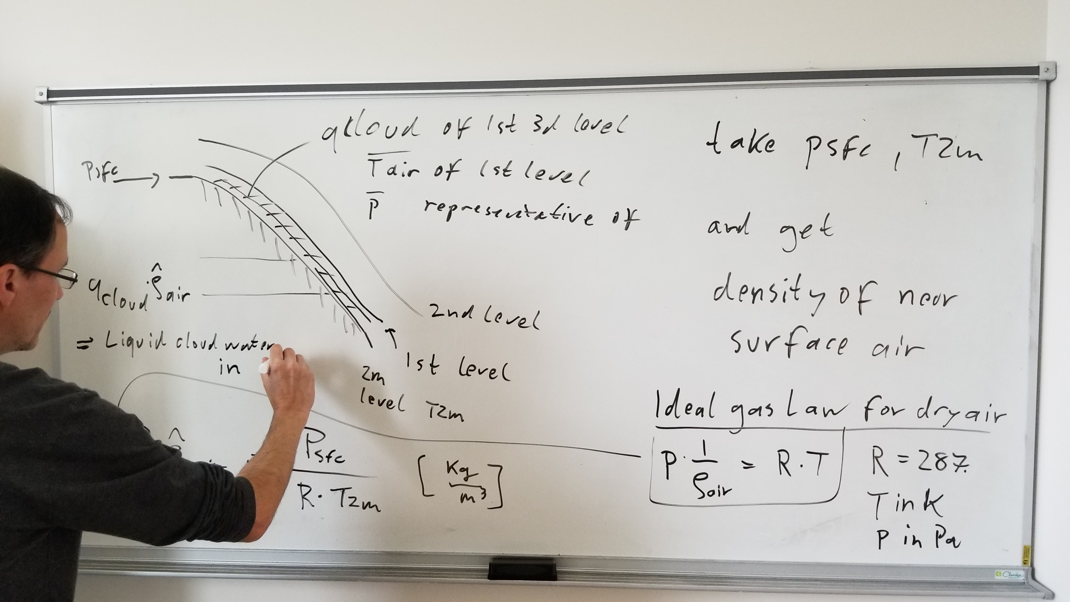

Slide 13
Part 2: Calculate CWF

Slide 14
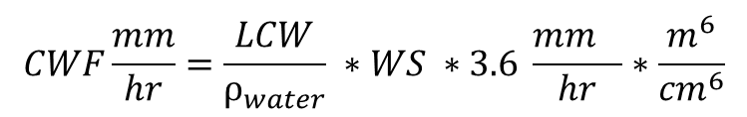
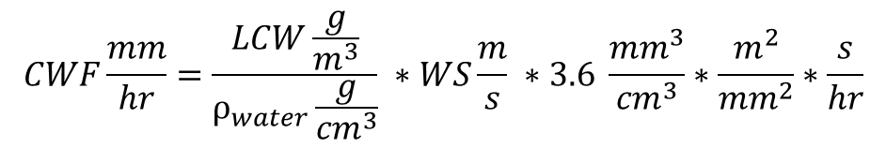
$$CWF\frac{mm}{hr}=\frac{LCW\frac{g}{m^{3}}}{ρ_{water}\frac{g}{{cm}^{3}}} ∗WS\frac{m}{s} ∗3.6 \frac{{mm}^{3}}{{cm}^{3}}∗\frac{m^{2}}{{mm}^{2}}∗\frac{s}{hr}$$
$$CWF\frac{mm}{hr}=\frac{LCW}{ρ_{water}} ∗WS ∗3.6 \frac{{mm}^{}}{hr}∗\frac{m^{6}}{{cm}^{6}}$$
* Looks like we need a conversion from m6 to cm6
LCW: Liquid Cloud Water(calculated in Part 1)
ρ_{water}: density of water, g/cm3, 0.997045
WS: Wind Speed (m/s)
Do you want ρ_{water} to be calculated as a function of temperature and pressure?

Slide 15
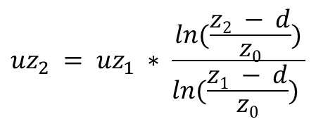
Calculate Wind Speed
Adjust wind speed to canopy height
$${uz}_{2} = {uz}_{1} ∗ \frac{ln(\frac{z2 − d}{z0})}{ln(\frac{z1 − d}{z0}) }$$
uz₁ = wind speed at height z₁
uz₂ = wind speed at height z₂
d = zero plane displacement (height in meters above the ground at which zero mean speed is achieved, approximated as 0.65 * canopy height)
z₀ = surface roughness (either 0.1 * canopy height or from WRF model)

Slide 16
z₁ = 10 m
z₂ = 35 m
uz₁ = sqrt(U₁₀² + V₁₀²) # Convert to wind speed
uz₁ = 3.850759
Vegetation category: 13 (evergreen broadleaf forest)
d = 0.65 * 35 = 22.75
roughness = 0.5 (from WRF, 3.5 if using 0.1 * canopy height)
Problem: 10 m height is BELOW assumed 0 wind speed height!

Slide 17
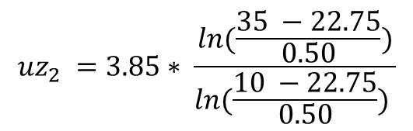
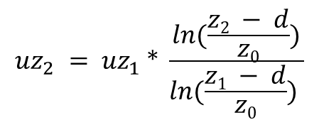

$${uz}_{2} = {uz}_{1} ∗ \frac{ln(\frac{z2 − d}{z0})}{ln(\frac{z1 − d}{z0}) }$$
$${uz}_{2} =3.85∗ \frac{ln(\frac{35 −22.75}{0.50})}{ln(\frac{10 −22.75}{0.50}) }$$
$${uz}_{2} =NA$$
Problem: 10 m height is BELOW assumed 0 wind speed height!
$${uz}_{2} =3.85 \# Placeholder, use 10 m wind height for purposes of remaining calculations for now$$

Slide 18
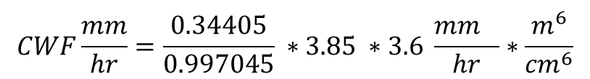
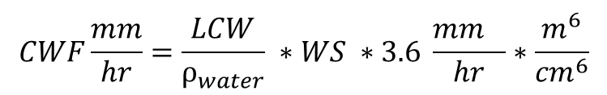
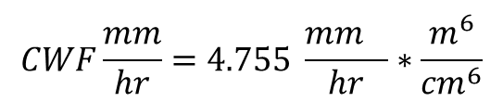
$$CWF\frac{mm}{hr}=\frac{LCW}{ρ_{water}} ∗WS ∗3.6 \frac{{mm}^{}}{hr}∗\frac{m^{6}}{{cm}^{6}}$$
$$CWF\frac{mm}{hr}=\frac{LCW}{ρ_{water}} ∗WS ∗3.6 \frac{{mm}^{}}{hr}∗\frac{m^{6}}{{cm}^{6}}$$
$$CWF\frac{mm}{hr}=\frac{0.34405}{0.997045} ∗3.85 ∗3.6 \frac{{mm}^{}}{hr}∗\frac{m^{6}}{{cm}^{6}}$$
$$CWF\frac{mm}{hr}=4.755 \frac{{mm}^{}}{hr}∗\frac{m^{6}}{{cm}^{6}}$$
Is this times 100⁶ to get the units correct?
The current value seems plausible, so I suspect there is a mistake somewhere in the units

Slide 19
Part 3

Slide 20








$$LAD=\frac{LAI}{Canopy Height}$$
$$A=0.0164 ∗{LAD}^{−0.5}$$
$$A=0.0164 ∗{0.1691240}^{−0.5}$$
$$LAD=\frac{5.919342}{35}$$
$$A=0.03987872$$
$$CWI=A ∗cloud.water.flux$$
$$CWI=0.03987872 ∗4.755$$
$$CWI=0.18964002$$

Slide 21
Discussion
WRF model has a minimum and a maximum roughness – would you like me to use those?
Chunxi said it changes by season (but for forest, min and max are the same).
Still need to look into getting higher wind layers
Downscaling calculation does not work if d is greater than 10 m!
I had assumed the problem was downscaling

