Slide 1
2st 3D level
1st 3D level
Qcloud: Assumption: Mean value from surface to 1st level boundary
WRF units: kg / kg
EQN units: g / m^3
Ground
(sloped terrain)

Slide 2
2st 3D level
1st 3D level
Qcloud: Assumption: Mean value from surface to 1st level boundary
WRF units: kg / kg
EQN units: g / m^3
Convert using Temperature and Pressure.
Ideally: use mean temperature and pressure from surface to 1st level boundary
Ground
(sloped terrain)

Slide 3
2st 3D level
1st 3D level
Qcloud: Assumption: Mean value from surface to 1st level boundary
WRF units: kg / kg
EQN units: g / m^3
Convert using Temperature and Pressure.
Ideally: use mean temperature and pressure from surface to 1st level boundary
Ground
(sloped terrain)
Assume: Temperature for 1st level can be approximated by 2 m air temperature (T2) and surface pressure (PSFC)

Slide 4


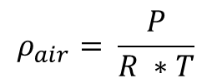

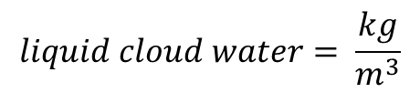
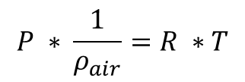

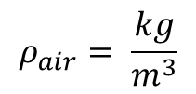
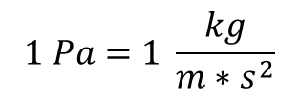
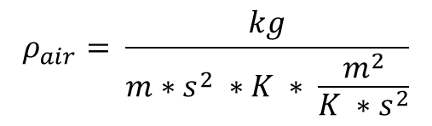
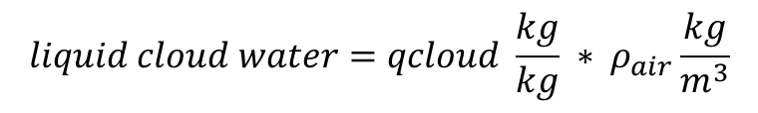

$$P ∗ \frac{1}{ρ_{air}}=R ∗T$$
$$1 Pa=1 \frac{kg}{m∗s^{2}}$$
$$ρ_{air}= \frac{P}{R ∗T}$$
$$R=287 \frac{J}{kg ∗K}$$
$$1 J=1 \frac{kg ∗m^{2}}{s^{2}}$$
Add in units:
$$R=287 \frac{\frac{kg ∗m^{2}}{s^{2}}}{kg ∗K}$$
$$ρ_{air}= \frac{kg}{m∗s^{2} ∗K ∗ \frac{m^{2}}{K ∗s^{2}}}$$
$$R=287 \frac{m^{2}}{K ∗s^{2}}$$
$$ρ_{air}= \frac{kg}{m^{3}}$$
$$liquid cloud water=qcloud \frac{kg}{kg} ∗ ρ_{air}\frac{kg}{m^{3}}$$
$$liquid cloud water= \frac{kg}{m^{3}}$$
Multiply by 1000 to convert from kg to g
$$liquid cloud water = \frac{g}{m^{3}}$$

Slide 5
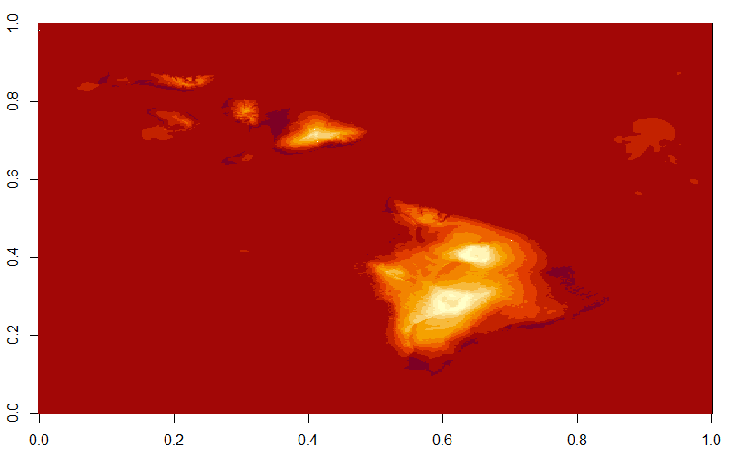
Han’s locations*
T2 temperature to show location of islands
* Please check for accuracy. One is not in this domain. Yellow is the one used in the following worked example

Slide 6
Worked Example
3D data file: "wrfout_d01_2006-01-03_000000“
Location: Nakula (20.664650 °N, 156.233308 W)
Data grid indices*: 189, 303, 1, 1
(longitude index, latitude index, layer, hour)
* I think I’ve got the indexing correct, but still need to confirm this more carefully. Does not matter for testing calculations, but does matter for comparison to field measurements.

Slide 7
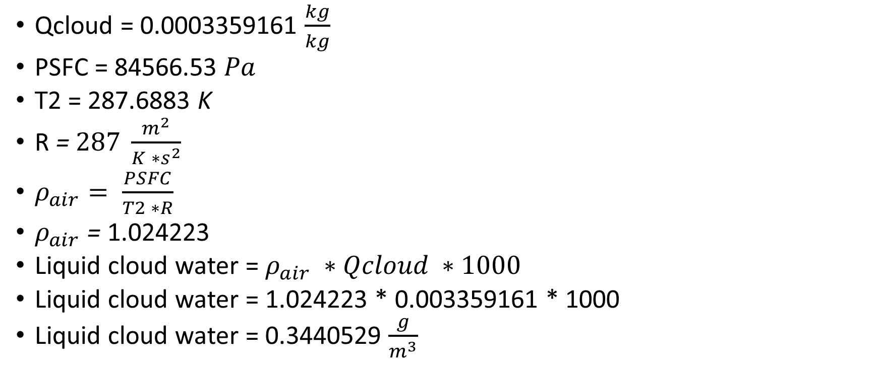
Worked Example
Qcloud = 0.0003359161 $\frac{kg}{kg}$
PSFC = 84566.53 $Pa$
T2 = 287.6883 K
R = $287 \frac{m^{2}}{K ∗s^{2}}$
$ρ_{air}= \frac{PSFC}{T2 ∗R}$
$ρ_{air}$ = 1.024223
Liquid cloud water = $ρ_{air} ∗Qcloud ∗1000$
Liquid cloud water = 1.024223 * 0.003359161 * 1000
Liquid cloud water = 0.3440529 $\frac{g}{m^{3}}$

Slide 8
Considerations
This calculation does not include an integral over the thickness of the layer

Slide 9
