Slide 1
WRF Cloud Water Content

Slide 2
Index
Part 1: Calculate Liquid Cloud Water (LCW)
Part 2: Calculate Cloud Water Flux (CWF)
Part 3: Calculate Cloud Water Content (CWI)

Slide 3
Part 1: Calculate Liquid Cloud Water (LCW)

Slide 4
2st 3D level
1st 3D level
Qcloud: Assumption: Mean value from surface to 1st level boundary
WRF units: kg / kg
EQN units: g / m^3
Ground
(sloped terrain)

Slide 5
2st 3D level
1st 3D level
Qcloud: Assumption: Mean value from surface to 1st level boundary
WRF units: kg / kg
EQN units: g / m^3
Convert using Temperature and Pressure.
Ideally: use mean temperature and pressure from surface to 1st level boundary
Ground
(sloped terrain)

Slide 6
2st 3D level
1st 3D level
Qcloud: Assumption: Mean value from surface to 1st level boundary
WRF units: kg / kg
EQN units: g / m^3
Convert using Temperature and Pressure.
Ideally: use mean temperature and pressure from surface to 1st level boundary
Ground
(sloped terrain)
Assume: Temperature for 1st level can be approximated by 2 m air temperature (T2) and surface pressure (PSFC)

Slide 7


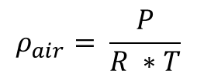

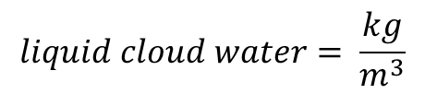
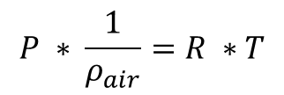

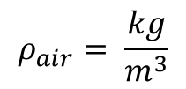
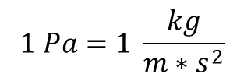
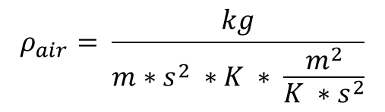
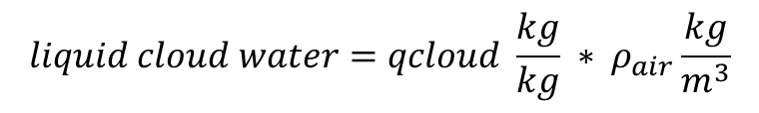

$$P ∗ \frac{1}{ρ_{air}}=R ∗T$$
$$1 Pa=1 \frac{kg}{m∗s^{2}}$$
$$ρ_{air}= \frac{P}{R ∗T}$$
$$R=287 \frac{J}{kg ∗K}$$
$$1 J=1 \frac{kg ∗m^{2}}{s^{2}}$$
Add in units:
$$R=287 \frac{\frac{kg ∗m^{2}}{s^{2}}}{kg ∗K}$$
$$ρ_{air}= \frac{kg}{m∗s^{2} ∗K ∗ \frac{m^{2}}{K ∗s^{2}}}$$
$$R=287 \frac{m^{2}}{K ∗s^{2}}$$
$$ρ_{air}= \frac{kg}{m^{3}}$$
$$liquid cloud water=qcloud \frac{kg}{kg} ∗ ρ_{air}\frac{kg}{m^{3}}$$
$$liquid cloud water= \frac{kg}{m^{3}}$$
Multiply by 1000 to convert from kg to g
$$liquid cloud water = \frac{g}{m^{3}}$$

Slide 8
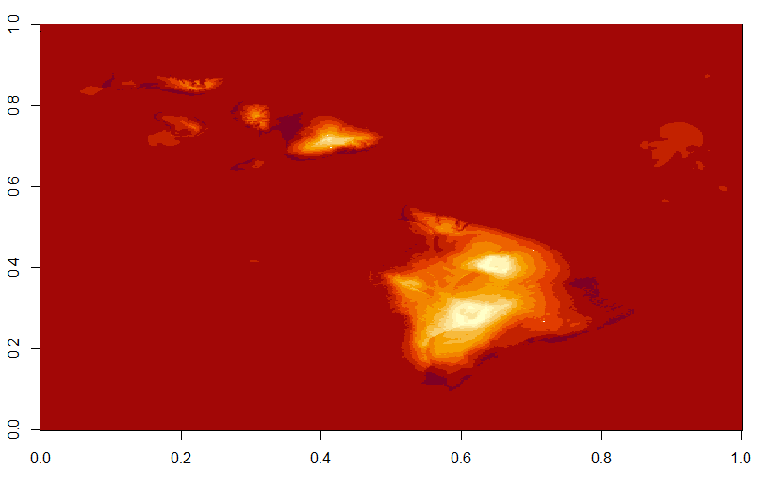
Han’s locations*
T2 temperature to show location of islands
* Please check for accuracy. One is not in this domain. Yellow is the one used in the following worked example

Slide 9
Worked Example
3D data file: "wrfout_d01_2006-01-03_000000“
Location: Nakula (20.664650 °N, 156.233308 W)
Data grid indices*: 189, 303, 1, 1
(longitude index, latitude index, layer, hour)
* I think I’ve got the indexing correct, but still need to confirm this more carefully. Does not matter for testing calculations, but does matter for comparison to field measurements.

Slide 10
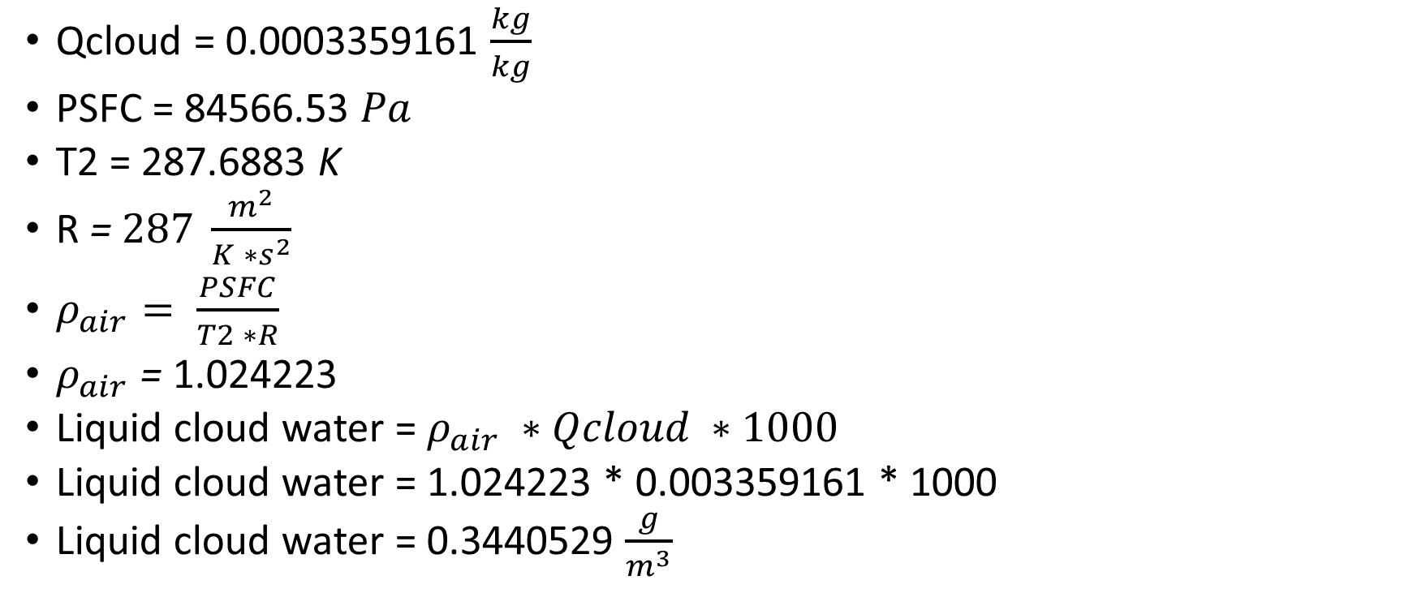
Worked Example
Qcloud = 0.0003359161 $\frac{kg}{kg}$
PSFC = 84566.53 $Pa$
T2 = 287.6883 K
R = $287 \frac{m^{2}}{K ∗s^{2}}$
$ρ_{air}= \frac{PSFC}{T2 ∗R}$
$ρ_{air}$ = 1.024223
Liquid cloud water = $ρ_{air} ∗Qcloud ∗1000$
Liquid cloud water = 1.024223 * 0.003359161 * 1000
Liquid cloud water = 0.3440529 $\frac{g}{m^{3}}$

Slide 11
Considerations
This calculation does not include an integral over the thickness of the layer

Slide 12
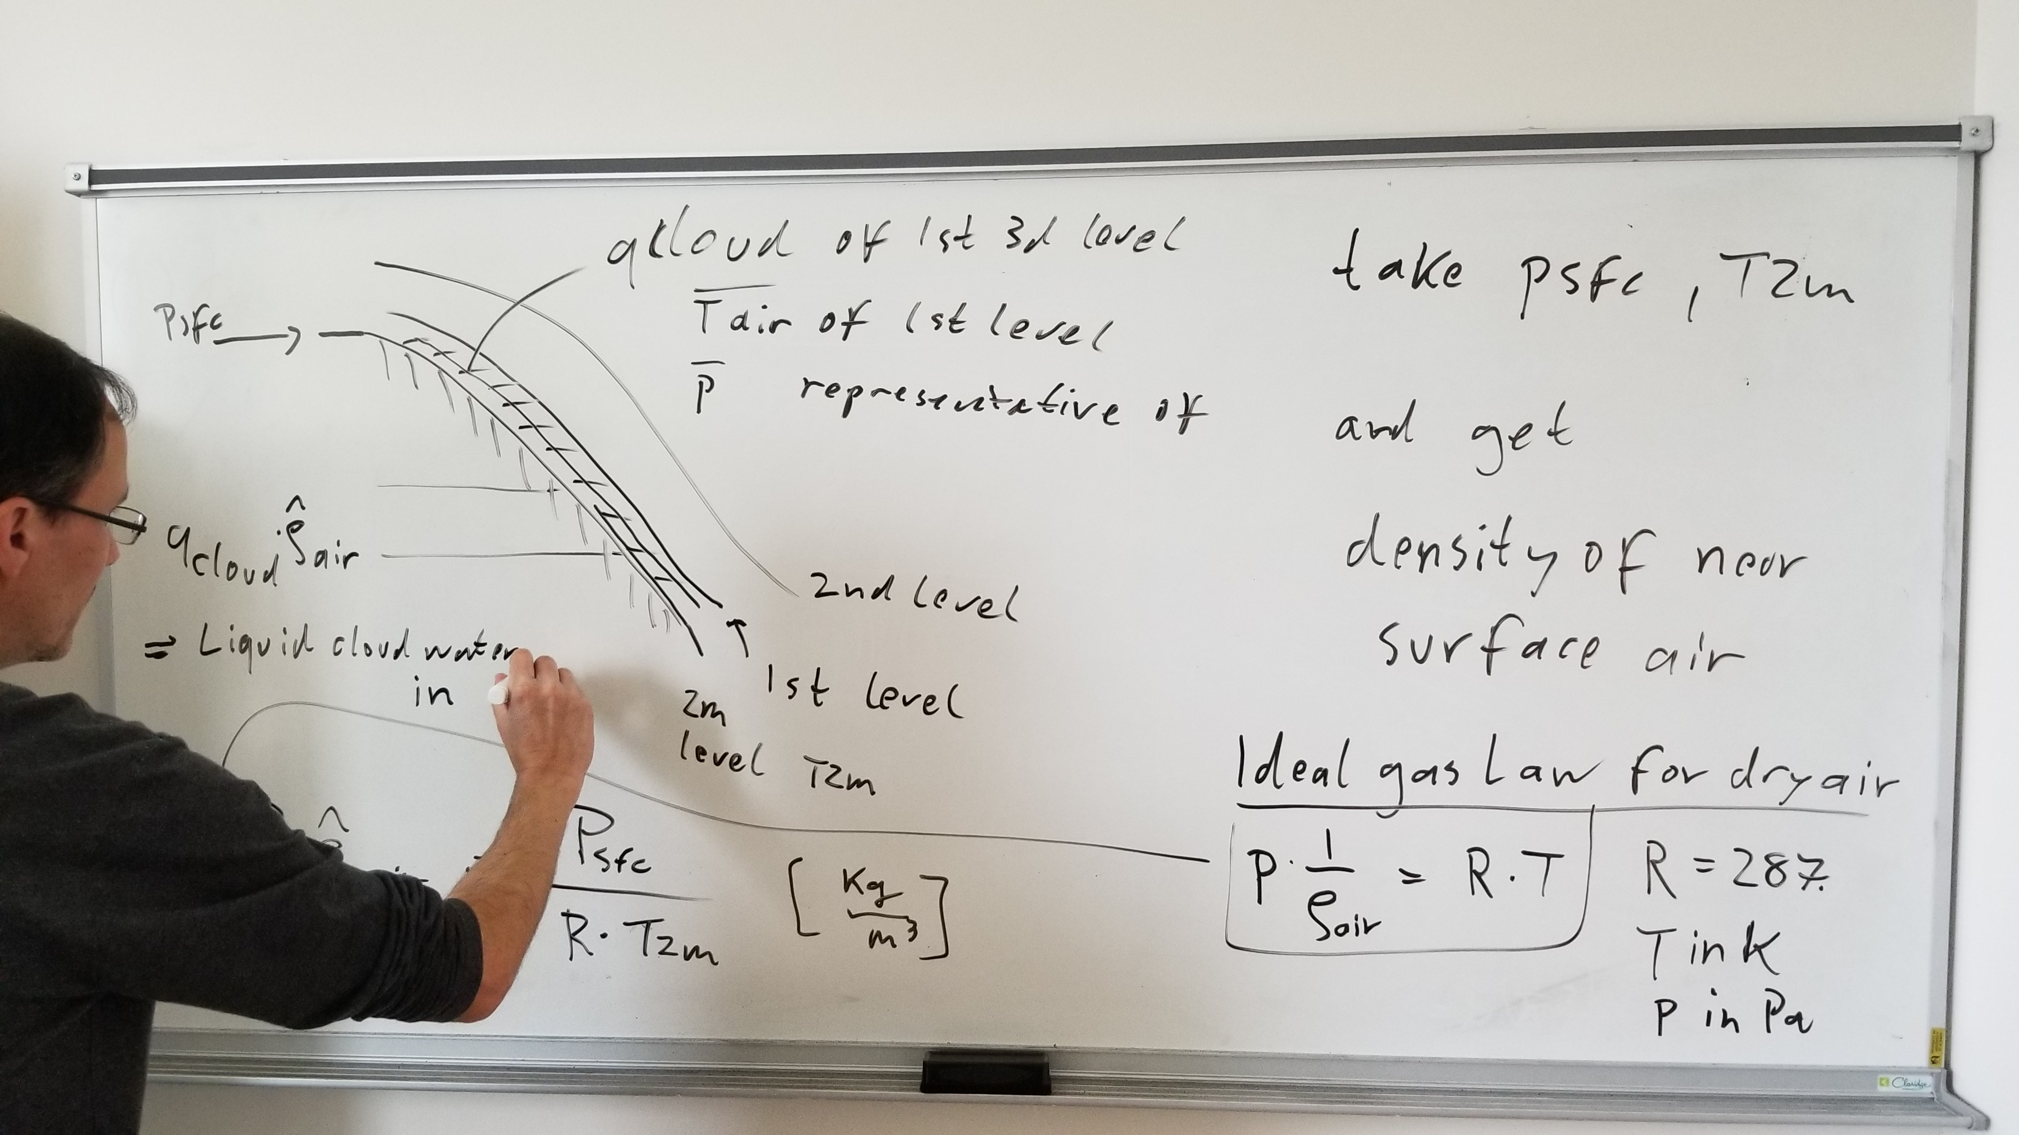

Slide 13
Part 2: Calculate CWF

Slide 14
CURRENT PROBLEMS!!!
The current version of the calculations require surface roughness and canopy height.
BUT the current version is not giving the right relationship, so there is a bug somewhere.
These should be inputs to the WRF model, and therefore should already be defined, but I can’t find them.
For the worked example, I used placeholder values

Slide 15
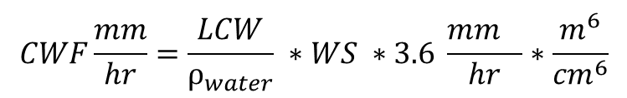
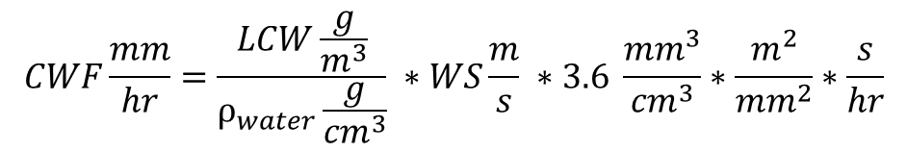
$$CWF\frac{mm}{hr}=\frac{LCW\frac{g}{m^{3}}}{ρ_{water}\frac{g}{{cm}^{3}}} ∗WS\frac{m}{s} ∗3.6 \frac{{mm}^{3}}{{cm}^{3}}∗\frac{m^{2}}{{mm}^{2}}∗\frac{s}{hr}$$
$$CWF\frac{mm}{hr}=\frac{LCW}{ρ_{water}} ∗WS ∗3.6 \frac{{mm}^{}}{hr}∗\frac{m^{6}}{{cm}^{6}}$$
* Looks like we need a conversion from m6 to cm6
LCW: Liquid Cloud Water(calculated in Part 1)
ρ_{water}: density of water, g/cm3, 0.997045
WS: Wind Speed (m/s)
Do you want ρ_{water} to be calculated as a function of temperature and pressure?

Slide 16
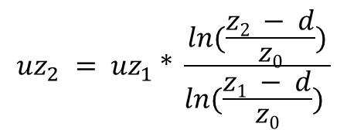
Calculate Wind Speed
Is this the downscaling equation we want to use???
Source: Wikipedia!!! (via a ResearchGate answer)
$${uz}_{2} = {uz}_{1} * \frac{ln(\frac{z2 − d}{z0})}{ln(\frac{z1 − d}{z0}) }$$
uz₁ = wind speed at height z₁
uz₂ = wind speed at height z₂
d = zero plane displacement (height in meters above the ground at which zero mean speed is achieved, Wikipedia says it can be approximated as 2/3 to ¾ of the average height of the obstacles)
z₀ = surface roughness #**# ADD DETAILS

Slide 17
z₁ = 10 m
z₂ = 2 m
uz₁ = mean(sqrt(U₁₀² + V₁₀²)) # Convert to a daily mean wind speed
uz₁ =
Vegetation category: 13 # not currently linked to anything
d = 2/3 * 1 # Placeholder – assume 2/3 and 1 m height.
roughness = 0.75 # Placeholder.
Why daily here??? (Artifact – calculated daily lcw earlier, but that was the last step at that point.
There is a vegetation category for every hour – does this parameter change?
10 m canopy height for 0 wind speed does not work
2 m wind speed would be below the 0 wind height!

Slide 18
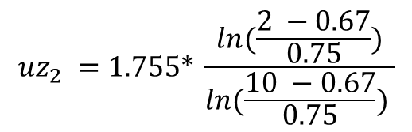
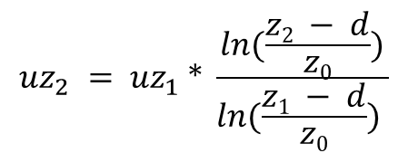

$${uz}_{2} = {uz}_{1} * \frac{ln(\frac{z2 − d}{z0})}{ln(\frac{z1 − d}{z0}) }$$
$${uz}_{2} =1.755* \frac{ln(\frac{2 −0.67}{0.75})}{ln(\frac{10 −0.67}{0.75}) }$$
$${uz}_{2} =7.69$$
* Well, that’s most likely wrong!
0.40 if Wikipedia transposed the numerator and denominator
Changing roughness to 0.001 gives 2.23 (1.38 if transposed)
Wikipedia cites: Holmes JD. Wind Loading of Structures. 3rd ed. Boca Raton, Florida: CRC Press; 2015.

Slide 19
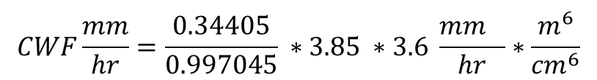
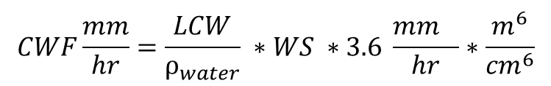
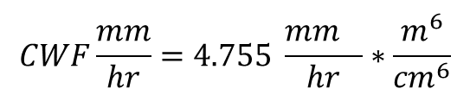
$$CWF\frac{mm}{hr}=\frac{LCW}{ρ_{water}} ∗WS ∗3.6 \frac{{mm}^{}}{hr}∗\frac{m^{6}}{{cm}^{6}}$$
$$CWF\frac{mm}{hr}=\frac{LCW}{ρ_{water}} ∗WS ∗3.6 \frac{{mm}^{}}{hr}∗\frac{m^{6}}{{cm}^{6}}$$
$$CWF\frac{mm}{hr}=\frac{0.34405}{0.997045} ∗3.85 ∗3.6 \frac{{mm}^{}}{hr}∗\frac{m^{6}}{{cm}^{6}}$$
$$CWF\frac{mm}{hr}=4.755 \frac{{mm}^{}}{hr}∗\frac{m^{6}}{{cm}^{6}}$$
Is this times 100⁶ to get the units correct?
The current value seems plausible, so I suspect there is a mistake somewhere in the units

Slide 20
Is 2 m height correct? Does the height for cloud water interception need to be adjusted based on vegetation canopy height?
Tree height can be 30 m in Hawaii
https://www.google.com/url?sa=t&rct=j&q=&esrc=s&source=web&cd=&ved=2ahUKEwjm-sbRyJKCAxUtFzQIHaDNBEcQFnoECBEQAw&url=https%3A%2F%2Fwww.ctahr.hawaii.edu%2Fgsp%2Fdoc%2FForestry%2FLittle_Skolmen_CFT%2FCFT_Acacia_koa.pdf&usg=AOvVaw2Td9d_est5q_LfzyyAB6XO&opi=89978449

Slide 21
Part 3

Slide 22







$$LAD=\frac{LAI}{Canopy Height}$$
$$A=0.0164 ∗{LAD}^{−0.5}$$
$$A=0.0164 ∗{5.919342}^{−0.5}$$
$$LAD=\frac{5.919342}{1}$$
$$A=0.006740733$$
$$CWI=A ∗cloud.water.flux$$
$$CWI=0.006740733 ∗4.755$$
$$CWI=0.032055$$

