Slide 1

DevOps & Cloud Infrastructure SEIS 615 AWS VPC, Databases & Security Review
Jason Baker
Adjunct Instructor
Graduate Programs in Software
University of St. Thomas
St. Paul, MN

Slide 2

Agenda
Questions
Assignment 3 solution
Lecture review
ELB
VPC
RDS
Understanding AWS diagrams
Classroom project

Slide 3
Lecture review
ELB
Managed load balancing service
Listeners
Health check
Target group
EFS
Virtual Private Cloud (VPC)
Assign a private network block
Partition into one or more subnets (which cannot span AZs)
Each subnet associated with a routing table
Connect to the Internet via Internet Gateway
Access control lists define security rules/filters for subnets

Slide 4
Lecture review
Relational Database Service (RDS)
ElastiCache
DynamoDB, Redshift, Elasticsearch, Neptune
Security
WAF, Shield, GuardDuty, Certificate Manager, KMS, Security Hub
Top 5 Cloud Security Issues
Stolen credentials (username/password)
Compromised access keys
S3 bucket publicly available
Overly permissive security group rules (allow port 22 from anywhere)
Improperly scoped role/policies (allow get-object from every S3 bucket)

Slide 5
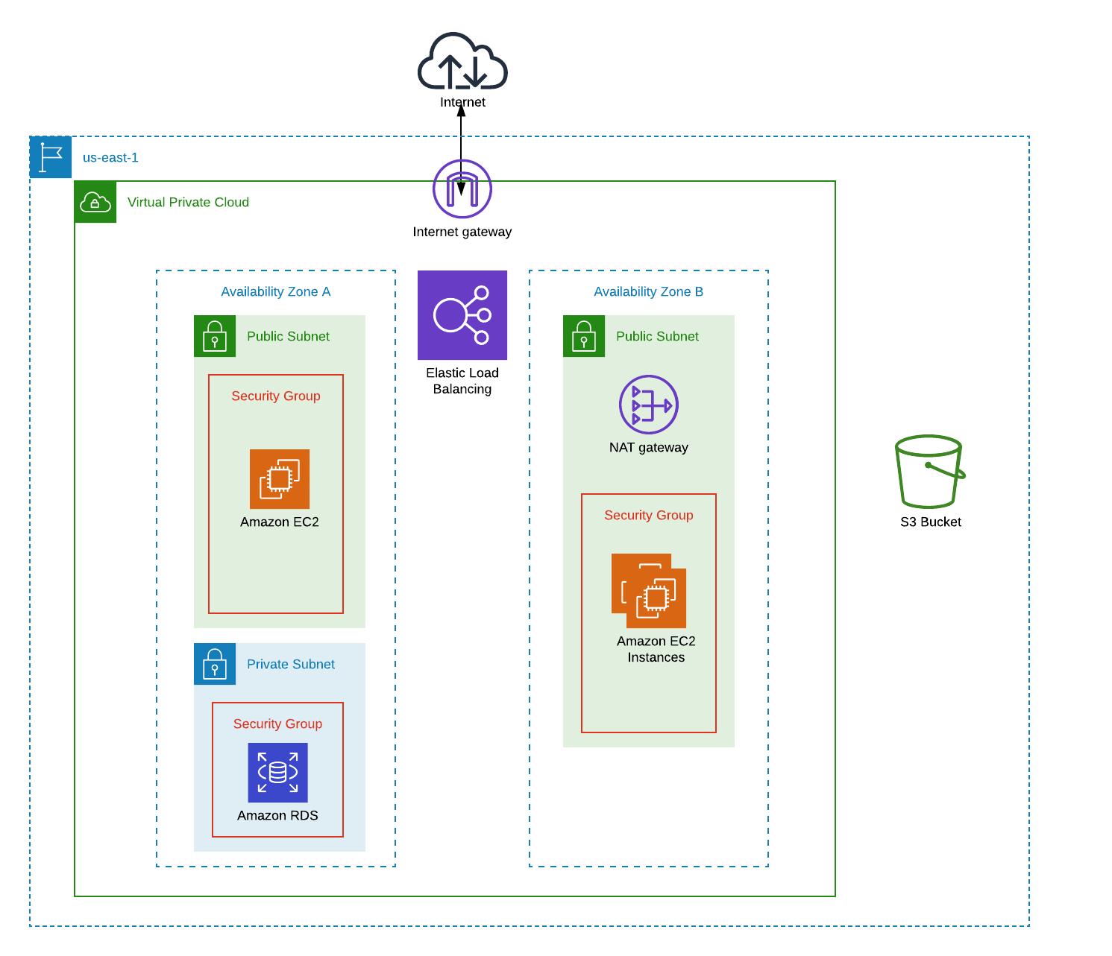
Understanding AWS diagrams

Slide 6
Improving Security
We've been configuring security groups to allow incoming SSH traffic from the Internet (0.0.0.0/0)
Never ever do this in the real world.
Limit incoming SSH to corporate IP block or (better yet) only allow SSH if it comes through a VPN Gateway.
Even worse: Allowing all protocols/ports from anywhere (this will get you fired!)
In all future work we will limit SSH access to our workstation IP address.
Use "My IP" to assign your current IP as the source in a security group rule.
Or use http://checkip.amazonaws.com to determine your current IP.
Note: You will need to update the security group configuration if you move your workstation to a different network (home -> school -> work).

Slide 7
Homework
Assignment 4: VPC
Watch Lecture 5 videos

Slide 8
Classroom Project
Attendance
Overview:
Create a VPC with multiple public and private subnets.
Launch webservers into the public subnets and load balance using an application ELB.
Setup routing tables properly to route traffic through the Internet Gateway or NAT gateway depending on the subnet.
Optionally create an RDS instance.
Show me your work when completed!

