Slide 1
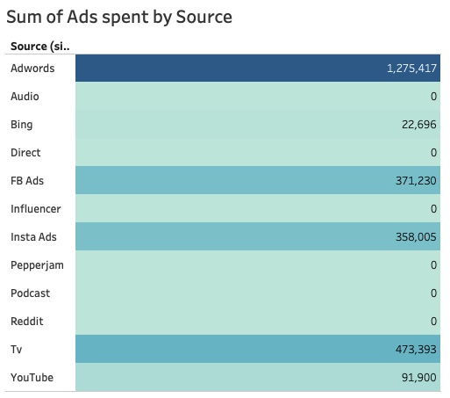
Budget for $13 million Q1= $ 2,592,640

Slide 2
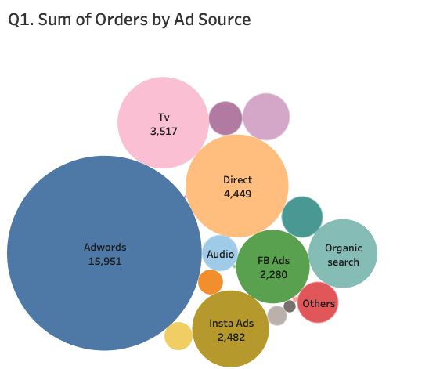
YouTube
929
Total Orders for Q1
34868
Rate of 104,604 orders by Q4
Org – Insta
705
BING

Slide 3
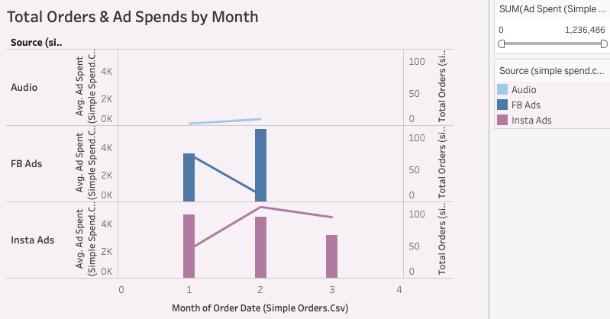

Slide 4
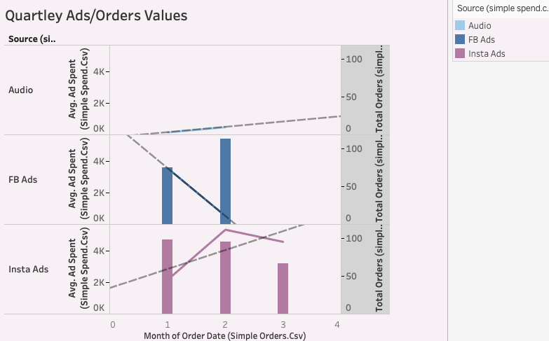
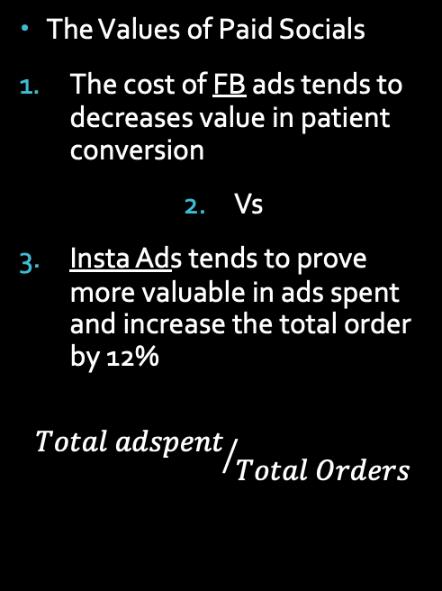
The Values of Paid Socials
The cost of FB ads tends to decreases value in patient conversion
Vs
Insta Ads tends to prove more valuable in ads spent and increase the total order by 12%
$${Total adspent}/{Total Orders}$$

Slide 5
Plan of Action
Start of a Social Media Campaign to build a following
Begin a comprehensive budget starting with Influencers
Influencers can help build a community of followers, which can increase IG search, FB search, lead to a People Hype increase.
Snapchat should be added for its younger platform audience

Slide 6
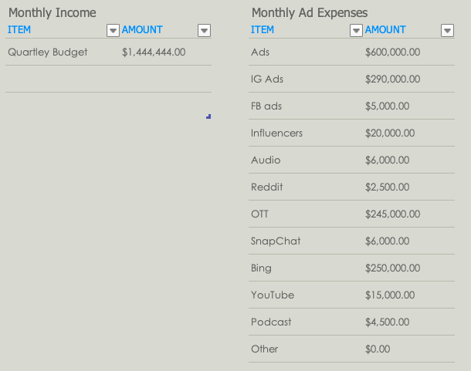
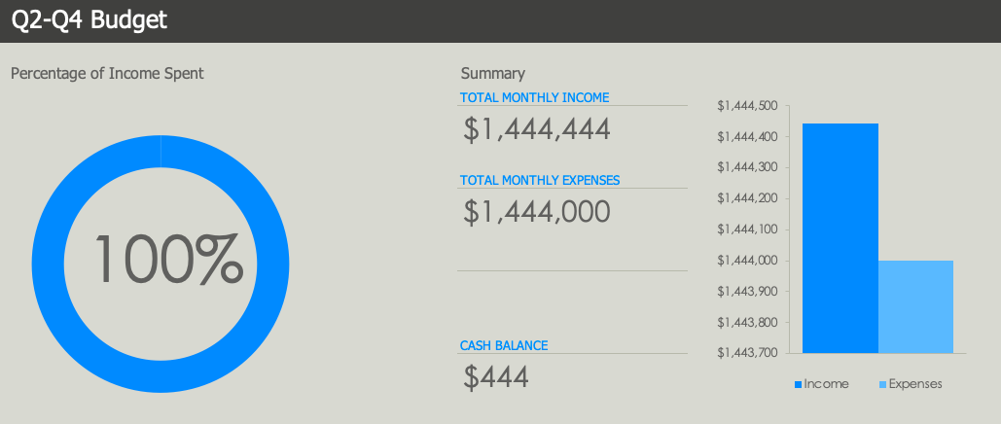
CONCLUSION
START WITH A MORE IMPACTFUL PRACTICAL APPROACH TO PAID SOCIAL
INCREASE BUDGET FOR INFLUENCERS
HELP BUILD SOCIAL COMMUNITY
INFLUENCER CAN :
Cascade orders from IG, FB, and People Hype

