Slide 1


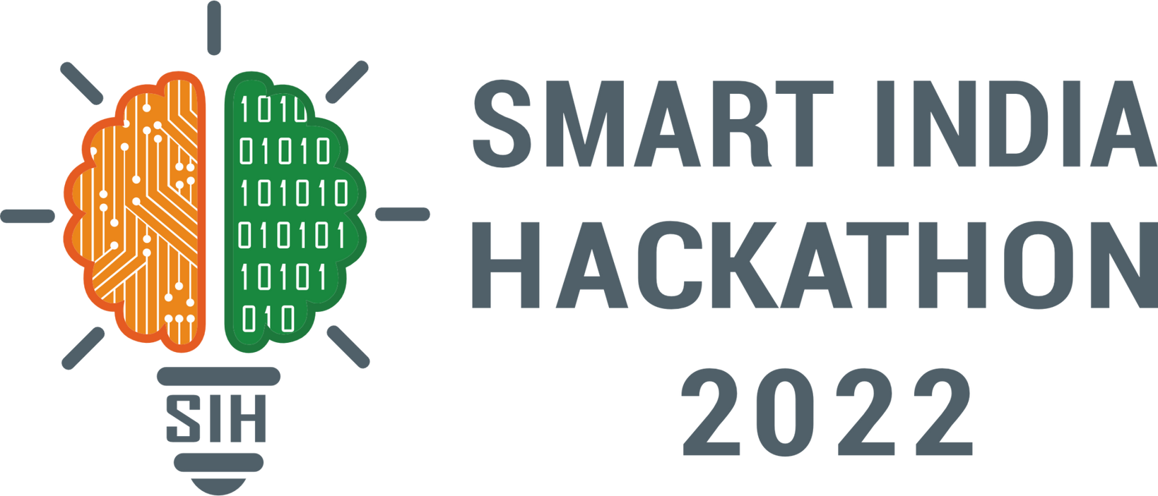
SMART INDIA HACKATHON 2025
TITLE PAGE
    Problem Statement ID – 25041
    Problem Statement Title- AI-Driven Unified Data Platform for Oceanographic, Fisheries, and Molecular Biodiversity Insights
    Theme- Renewable / Sustainable Energy
    PS Category- Software
    Team ID- 84743
    Team Name- SPAARK

Slide 2
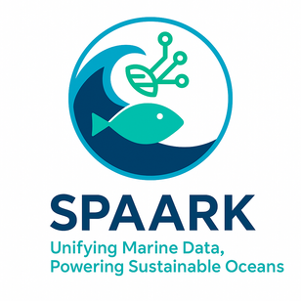

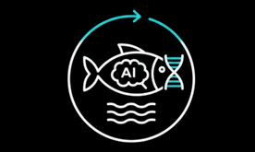

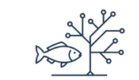


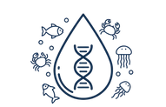



SPAARK – UNIFYING MARINE DATA, POWERING SUSTAINABLE OCEANS
PROPOSED SOLUTION
KEY MARINE DATA DOMAINS
AI-Enabled Marine Data Integration
ECOMORPHOLOGY - Links fish body shape to its ecological role and habitat use.
Cloud-native platform automates ingestion, validation, and management of physical, chemical, biological, and fisheries data from diverse sources.
FISH TAXONOMY - Classifies and organizes fish species using morphological and genetic data.
Scalable System
The system scales using adaptable APIs and multi-store architecture: NoSQL for raw data, Vector DBs for real-time search, and SQL for validated storage.
OTOLITH MORPHOLOGY - Analyzes otolith shapes (tiny ear bones in fish) with AI to identify species and track populations.
ENVIRONMENTAL DNA (E-DNA) - Detects hidden marine species from water samples non-invasively.
Advanced AI Analytics for Sustainability
Uses CNNs for taxonomic classification, otolith morphometrics, and eDNA biodiversity monitoring to enhance renewable energy and ecosystem decisions.
HOW IT ADDRESSES THE PROBLEM ?
    AI-powered platform unifies diverse marine datasets and delivers real-time decision insights.
    Hybrid storage supports scalable, flexible data management and advanced AI analytics for ecosystem health and renewable energy planning.
Standardized & Interoperable Framework
Adopts international metadata standards ensuring data uniformity, reproducibility, and seamless cross-domain collaboration among marine research institutions.
Interactive Decision-Support Dashboards
INNOVATION & UNIQUENESS
Visual dashboards offer real-time analytics, empowering researchers and policymakers with secure, compliant, and cost-efficient marine intelligence.
    Scalable hybrid storage merges NoSQL, SQL, geospatial, and time-series.
    Modular, upgradable APIs enable collaborative, future-ready system growth.
@SIH Idea submission
2

Slide 3
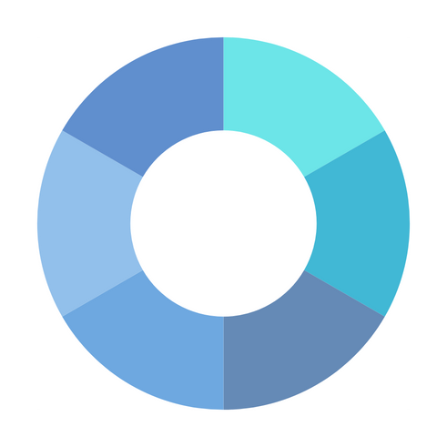
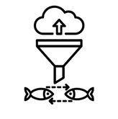
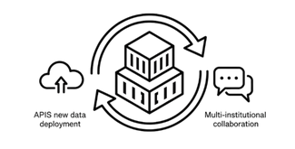
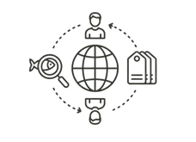
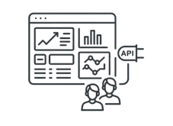

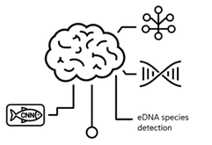
SPAARK – UNIFYING MARINE DATA, POWERING SUSTAINABLE OCEANS
METHODOLOGY
  Data Preparation and Ingestion
  Automated Data Pipelines
  Flexible hybrid storage
6. Focus on Upgradability and Collaboration
  Modular, Containerized architecture
  Upgradable code & APIs
  Integration of new datatypes
  Data Preparation and Ingestion - Use AI clustering techniques to organize unstructured heterogeneous data from multiple sources, ingest via automated data pipelines, and store in flexible hybrid storage. If data is already structured, proceed directly.
  Data Identification and Metadata Tagging - Apply a reference engine leveraging prior research to tag data with standardized metadata formats (e.g., Darwin Core, CF conventions). Define access points for data providers, analysts, and researchers.
  Data Processing and Unification - Clean, standardise, and unify ingested data across disciplines to create a seamless, interoperable dataset for advanced analysis.
  Advanced AI Analytics - Deploy AI models for taxonomic classification, otolith morphology via CNN, and eDNA species detection to extract insights on biodiversity and ecosystem health.
  Visualization and APIs - Provide interactive dashboards and robust APIs enabling multi-institutional access, real-time visualization, and future scalability.
  Focus on Upgradability and Collaboration - Design modular, containerized architecture with upgradable code and APIs to enable seamless integration of new data types and research while supporting multiple centers.
2. Data Identification and Metadata Tagging
  Reference Engine
  Access Points
5. Visualization and APIs
  Interactive dashboards
  Real-time Visualization
APPROACH
3. Data Processing and Unification
  Unification of Ingested Data
  Interoperable dataset
4. Advanced AI Analytics
  Otolith Morphology
  eDNA species detection
TECH STACK
Frontend
Backend
Storage
AI / ML / Bioinformatics
Data Pipelining
React
Tailwind CSS
Mapbox / Kepler.gl
Plotly / D3.js
FastAPI
Springboot
JAVA
Spring AI
PostgreSQL + PostGIS
TimescaleDB
S3 Object Store
PyTorch / TensorFlow
DADA2 / OBITools
BLAST / DIAMOND
Apache Airflow / Prefect
Pandas / Dask / xarray
Biopython
@SIH Idea submission
3

Slide 4
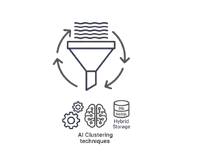







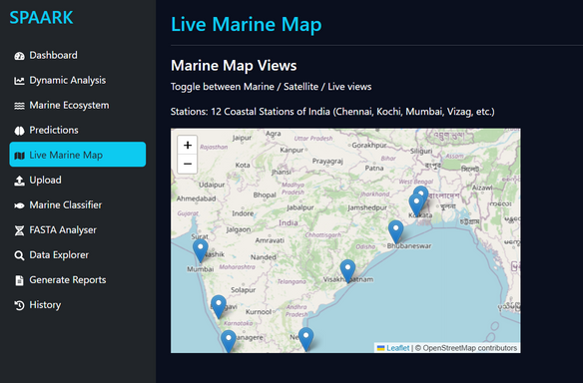
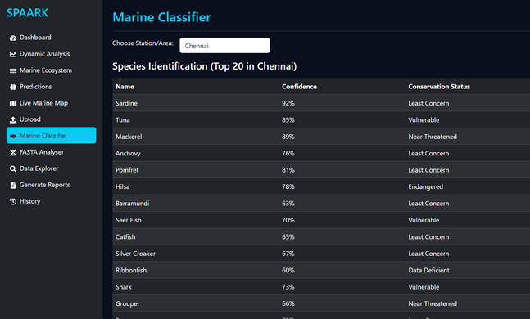
SPAARK – UNIFYING MARINE DATA, POWERING SUSTAINABLE OCEANS
FEASIBILITY AND VIABILITY
API WORKFLOW
  Technically feasible: AI/ML and cloud pipelines can handle diverse marine data.
  High impact: Supports research, fisheries management, and conservation.
  Scalable & sustainable: Modular design allows integration.
Data Ingestion & Clustering
MetaData Tagging API
Data Processing & Unification API
Analysis & Analytics
Visualization & Access
Management API
Supports CSV, Net CDF, FASTA, raw images; validation pipelines
Global standards—Darwin Core, CF conventions,custom tagging scripts
Transform & unify datasets; knowledge-base reference
AI/ML analytics, geo/time-series queries
Dashboards, visualization, role-based access
Scaling, monitoring, cloud cost management
POTENTIAL CHALLENGES
  Data complexity: Integrating diverse oceanographic, morphological, and molecular datasets.
  High volume: Managing and processing large-scale continuous data.
  Cross-domain analysis: Computationally intensive correlations across multiple disciplines.
Python (FastAPI, Flask), Apache Kafka
Python, pyDarwinCore, JSON Schema,
Apache Spark, PostgreSQL, ETL tools
Python (scikit-learn, TensorFlow), PostGIS, REST endpoints
React, D3.js, Plotly, Grafana, REST APIs, OAuth2
AWS/GCP, Prometheus, Grafana
PROTOTYPE SNAPSHOTS
STRATEGIES FOR OVERCOMING CHALLENGES
  Standardize data using global formats.
  Use cloud infrastructure for storage and processing.
  Apply AI/ML for cross-domain analysis.
  Build user-friendly dashboards with role-based access.
@SIH Idea submission
4

Slide 5
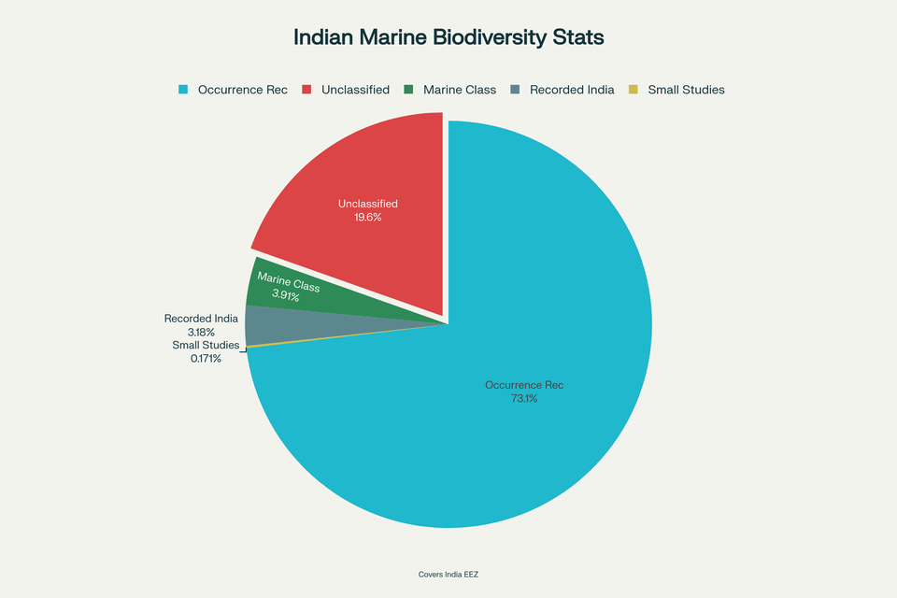
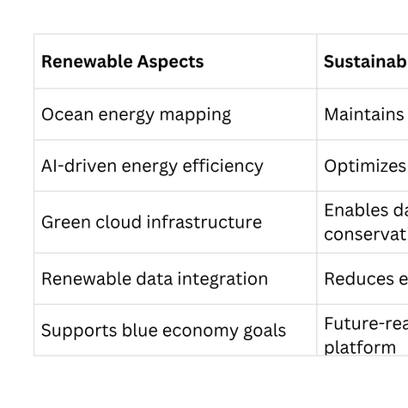
SPAARK – UNIFYING MARINE DATA, POWERING SUSTAINABLE OCEANS
POTENTIAL IMPACT ON TARGET AUDIENCE
ENVIRONMENTAL BENEFITS
ECONOMIC BENEFITS
SOCIAL BENEFITS
  Real-time actionable marine data.
  Better policy and siting decisions.
  Faster, reproducible scientific research.
  Improved cross-institution collaboration.
  Faster offshore renewable deployment.
  Lower research and operational costs.
  Enhanced blue-economy investment appeal.
  Data-driven resource optimisation.
  Sustainable fisheries and food security.
  Increased public awareness and engagement.
  Stronger coastal livelihoods.
  Community-backed conservation actions.
  Reduced the ecological impacts of projects.
  Early detection of biodiversity threats.
  Improved ecosystem resilience.
  Supports climate and conservation goals.
STATISTICS
  India is home to approximately 13,000 recorded marine species.
  The Indian Exclusive Economic Zone (EEZ) covers around 2.02 million square kilometres.
  A rapid survey by CMFRI recorded 468 marine species just off the Kerala coast.
  OBIS (Ocean Biodiversity Information System – India Node) currently holds around:
  298,585 occurrence records
  15,965 marine species
  230 datasets
  Nearly 80% of marine biodiversity in the Indian Ocean remains unclassified or undiscovered.
@SIH Idea submission
5

Slide 6
SPAARK – UNIFYING MARINE DATA, POWERING SUSTAINABLE OCEANS
RESEARCH AND REFERENCES
  Kühn, B., Cayetano, A., Fincham, J. I., Moustahfid, H., Sokolova, M., Trifonova, N., Watson, J. T., Fernandes-Salvador, J. A., & Uusitalo, L. (2024). Machine learning applications for fisheries—At scales from genomics to ecosystems. Reviews in Fisheries Science & Aquaculture. https://doi.org/10.1080/23308249.2024.2423189
  [Anonymous Authors]. (2024). Leveraging deep learning and computer vision technologies to enhance management of coastal fisheries in the Pacific region. Scientific Reports. https://pmc.ncbi.nlm.nih.gov/articles/PMC11381547/
  Mwamburi, L., Obura, D., Hume, B., & Tuda, A. (2023). Integration of environmental DNA metabarcoding technique to reinforce fish biodiversity assessments in seagrass ecosystems: A case study of Gazi Bay seagrass meadows. Environmental DNA, 5(3), 571–585. https://doi.org/10.1002/edn3.483
  Nash, R. D. M., Dickey-Collas, M., & Kell, L. T. (2022). DeepOtolith v1.0: An open-source AI platform for automating fish age reading from otolith or scale images. Fishes, 7(3), 121. https://www.mdpi.com/2410-3888/7/3/121
  Strelkov, A. A., Arkhipkin, A. I., & Balykin, P. A. (2024). Morphological variability of otolith organs in three congeneric Pagellus species. Oceanological and Hydrobiological Studies, 53(1), 88–101. https://doi.org/10.26881/oahs-2024.1.10
  Nasreem, N., Muthukumar, K., & Narayanasamy, R. (2025). Unveiling diversity in inhabited and uninhabited reefs of the Lakshadweep Archipelago, India using eDNA. Frontiers in Marine Science, 12, 1592429. https://www.frontiersin.org/journals/marine-science/articles/10.3389/fmars.2025.1592429/full
@SIH Idea submission
6

