Slide 1
Who is Homo Economicus and does he/she actually exist?

Slide 2
An Example

Slide 3
A Problem
Decision Maker (Doris) lives for two periods
In each period she will receive some income.
In the first period does not know what income in second period will be
In each period will spend money on two goods
Bourbon (b) or Yoga classes (y)
Can borrow and save between periods at interest rate r, but cannot die in debt

Slide 4
A Problem
Our job is to predict how Doris is going to behave
How much bourbon and yoga she will she consume in each period?
How much will she save?
Let’s start with the predictions we would get from the standard economic model

Slide 5
A Solution: Period 2
Decision maker has a utility function
Say they arrive in period 2 with savings s, and receive income
They will choose their consumption to solve
Tells us the Doris will buy as a function of
Also the utility of having in period 2

Slide 6
A Solution: Period 1
Income in period 2 can be with probability p and with probability (1-p)
Decision maker will maximize utility in period one plus the expected utility of period 2, given their savings
Solution tells us what they will consume in period one, and how much they will save

Slide 7
What Assumptions is this Model Making (that you don’t like)?
Period 1
Period 2

Slide 8
The Assumptions

Slide 9
The Assumptions
Doris makes optimal choices – i.e. maximizes her utility
Doris’s tastes do not change between period 1 and 2
Doris forms the correct expectations about income in period 2, and makes choices based on expected utility
The only thing that appears in Doris’s utility function is the amount of bourbon and yoga consumed
No ‘reference points’
Not other people’s consumption

Slide 10
The Assumptions
Doris makes optimal choices – i.e. maximizes her utility
Doris’s tastes do not change between period 1 and 2
Doris forms the correct expectations about income in period 2, and makes choices based on expected utility
The only thing that appears in Doris’s utility function is the amount of bourbon and yoga consumed
No ‘reference points’
Not other people’s consumption

Slide 11

Utility Maximization
Choose the optimal Bourbon

Slide 12

Utility Maximization
Choose the optimal Bourbon

Slide 13
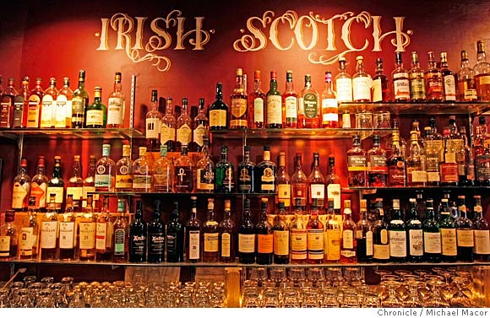
Utility Maximization
Choose the optimal Bourbon

Slide 14
Utility Maximization
Which of the following would you choose?
4
2
3
13
20
11
15
8
8
10

Slide 15
Utility Maximization
Which of the following would you choose?
4+6+10-11-23+9
2+3+6-11-14+9+10
3+9-17-99+102-6+15
6+18-19-55+70
20-27+7-19+2+3-5
11+2-5+7-8-9+10
15-5-5+6+16+17-20-9
8+9+10-11+8+2+6-32
8+8+9-13-9-6+7
10-9+17-23+10+2+15

Slide 16
Caplin, Dean and Martin [2011]
22 Subjects, 657 choices
6 treatments
2 complexity levels: 3 or 7 operations
3 choice set sizes: 10, 20, 40 options

Slide 17
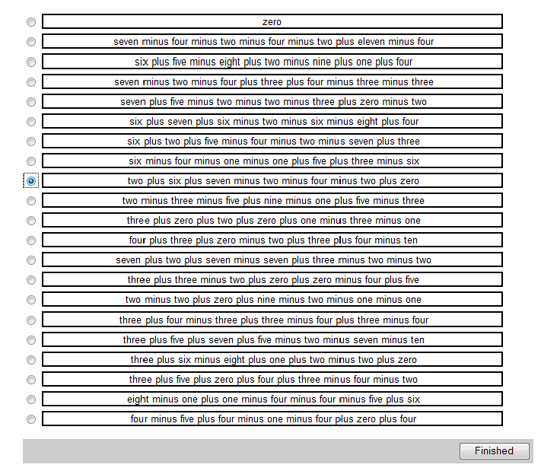
Caplin, Dean and Martin [2011]

Slide 18
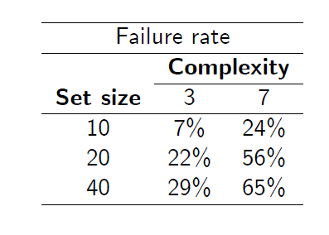
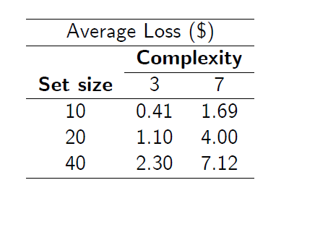
Caplin, Dean and Martin [2011]

Slide 19
The Assumptions
Doris makes optimal choices – i.e. maximizes her utility
Doris’s tastes do not change between period 1 and 2
Doris forms the correct expectations about income in period 2, and makes choices based on expected utility
The only thing that appears in Doris’s utility function is the amount of bourbon and yoga consumed
No ‘reference points’
Not other people’s consumption

Slide 20
Preferences don’t change
We assumed that the utility function that Doris used was the same in the first and second period
Just allowing the utility function to change is not very interesting
For example it could be that Doris likes Bourbon less and Yoga more as she gets older

Slide 21
Read and van Leeuwen [1998]
Choice 1: What would you like to eat in 1 week’s time
Fruit (74%)
Chocolate (26%)
Choice 2: What would like to eat today?
Fruit (30%)
Chocolate (70%)

Slide 22
Temptation and Self Control
These issues are addressed with models of Temptation and Self Control
These have been used to address many issues
Addiction
Low savings rates
Credit card borrowing
Obesity
Procrastination

Slide 23
The Assumptions
Doris makes optimal choices – i.e. maximizes her utility
Doris’s tastes do not change between period 1 and 2
Doris forms the correct expectations about income in period 2, and makes choices based on expected utility
The only thing that appears in Doris’s utility function is the amount of bourbon and yoga consumed
No ‘reference points’
Not other people’s consumption

Slide 24
Expectations
Doris makes decisions about uncertain events in the following way
For each action, figure out the utility that action will give in each state of the world
e.g. for each s figure out and
Correctly figure out the probability of each state of the world (using Bayes’ rule if necessary)
e.g. figures out p
Calculate the expected utility of each action using these probabilities
e.g.
Two possible problems with this

Slide 25
1: People are not Expected Utility Maximizers
A
100% $3000
vs
80% $4000
$0
B

Slide 26
1: People are not Expected Utility Maximizers
C
75 % $0
vs
80% $0
D
25% $3000
20% $4000

Slide 27
1: People are not Expected Utility Maximizers
A
100% $3000
vs
80% $4000
$0
B
C
75 % $0
vs
80% $0
D
25% $3000
20% $4000
Most People Choose A over B and D over C
(As we shall see) this is impossible with expected utility

Slide 28
2: People are utility maximizers, but have wrong expectations
Statistical Errors
e.g. Gambler’s fallacy: Imagine you are at a roulette table and black comes up 10 times in a row, what do you bet on?
Evidence of Gambler’s fallacy in lottery play and horse racing
Over/Underconfidence
93% of US drivers rate themselves as better than average
68% of U. Nebraska professors rated themselves in the top 25%

Slide 29
Choice under Risk and Uncertainty
These issues fall under the study of choice under risk and uncertainty
Try to find a descriptive model of choice that takes into account violations of expected utility.
…and mistaken beliefs
Has important implications for
Finance
Insurance
Entrepreneurship

Slide 30
The Assumptions
Doris makes optimal choices – i.e. maximizes her utility
Doris’s tastes do not change between period 1 and 2
Doris forms the correct expectations about income in period 2, and makes choices based on expected utility
The only thing that appears in Doris’s utility function is the amount of bourbon and yoga consumed
No ‘reference points’
Not other people’s consumption

Slide 31
Utility Depends only on Levels of Goods
In each period, Doris has a utility function that depends only on the level of bourbon and yoga consumed
Evidence suggests that this might not be the case:
We care about consumption relative to some reference point (reference dependent preferences)

Slide 32
Example: The Rare Disease Problem
The US is expecting an outbreak of a rare disease that is expected to kill 600 people.
Two alternative programs are considered
Program A: 200 people will be saved
Program B: 1/3 chance that 600 people will be saved, 2/3 chance that no-one will be saved
Or: Two alternative programs are considered
Program C: 400 people will die
Program D: 1/3 chance that nobody will die, 2/3 chance that 600 people will die

Slide 33
Example: The Rare Disease Problem
The US is expecting an outbreak of a rare disease that is expected to kill 600 people.
Two alternative programs are considered
Program A: 200 people will be saved (72%)
Program B: 1/3 chance that 600 people will be saved, 2/3 chance that no-one will be saved (28%)
Or: Two alternative programs are considered
Program C: 400 people will die (22%)
Program D: 1/3 chance that nobody will die, 2/3 chance that 600 people will die (78%)

Slide 34
Reference Dependent Preferences
People’s choices depend on their reference point
E.g. place higher weight on losses rather that gains
This is the study of reference dependent preferences
Try to find a descriptive model of choice that takes this into account
Has important implications for
Finance
Labor Economics
Public Economics

Slide 35
The Assumptions
Doris makes optimal choices – i.e. maximizes her utility
Doris’s tastes do not change between period 1 and 2
Doris forms the correct expectations about income in period 2, and makes choices based on expected utility
The only thing that appears in Doris’s utility function is the amount of bourbon and yoga consumed
No ‘reference points’
Not other people’s consumption

Slide 36
Self Interest
We assumed that Doris’s utility depended only on her own consumption of bourbon and yoga
It is actually pretty easy to adapt the standard model to allow for altruism
Just add consumption by Doris’s husband as an argument in her utility function
But what about fairness, spite or envy?

Slide 37
The Ultimatum Game
Consider the following experiment
Player 1 proposes a division of $10 between themselves and player 2
Player 2 can either accept the split, or reject, in which case both get nothing
Standard Model
Player 2 accepts all offers
Player 1 offers approx $0
What do you think will happen?
Player 1 offers between 25%-50% of pie
Player 2 usually rejects offers that are ‘too low’ (below 20%)
Cannot be explained by self interest or altruism

Slide 38
Other Regarding Preferences
We want a model that takes into account:
Fairness
Spite
Envy
This is the study of other regarding preferences
Adapt game theoretic models to take these factors into account
Has important implications for
Bargaining
Public Goods
Economic Growth

