Slide 1
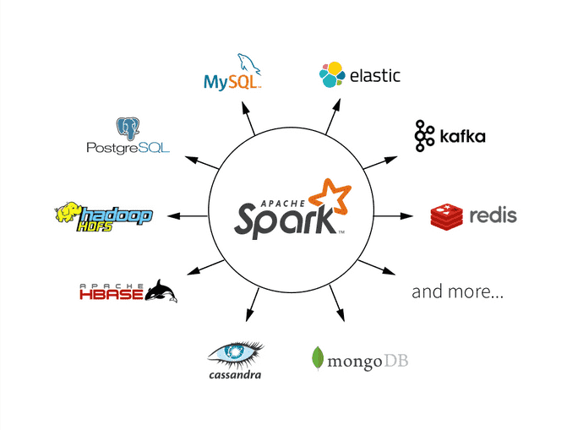
Apache Spark™ is a unified analytics engine for large-scale data processing. Its a lightning-fast engine for big data and machine learning. The largest open source project in data processing. It works seamlessly on almost all open source big data technologies.

Slide 2
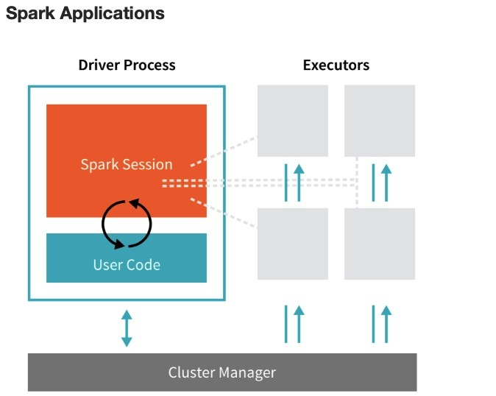

Slide 3
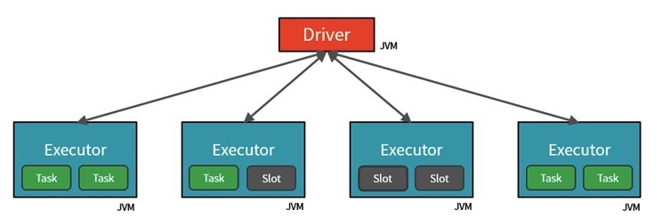

Slide 4
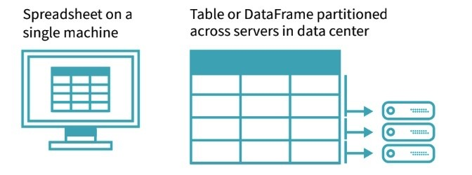
What is a Partition?
In order to allow every executor to perform work in parallel, Spark breaks up the data into chunks, called partitions.

Slide 5
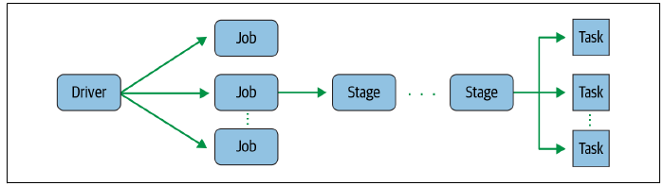
Job, Stage and Task

Slide 6
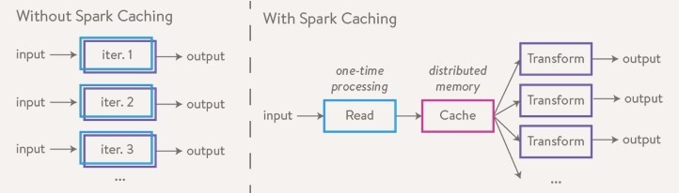
Caching

Slide 7
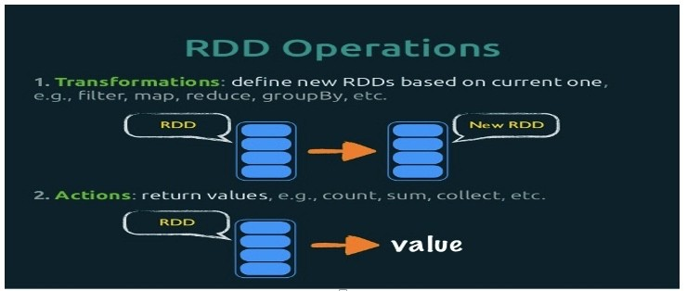
Operations

Slide 8
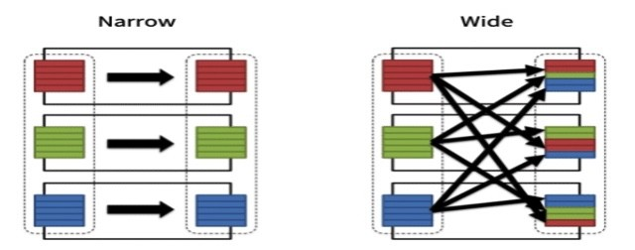
Types of Transformation

Slide 9
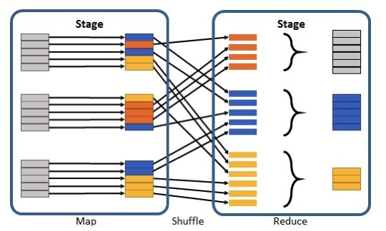
Shuffling

Slide 10
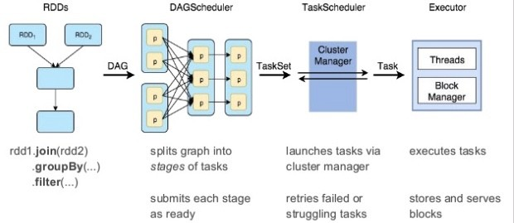
What is a DAG?
Directed Acyclic Graph ( DAG ) in Apache Spark is a set of Vertices and Edges, where vertices represent the RDDs and the edges represent the Operation to be applied on RDDs.
DAG Scheduler is the scheduling layer of Apache Spark that implements stage-oriented scheduling. It transforms a logical execution plan to a physical execution plan (using stages).

Slide 11
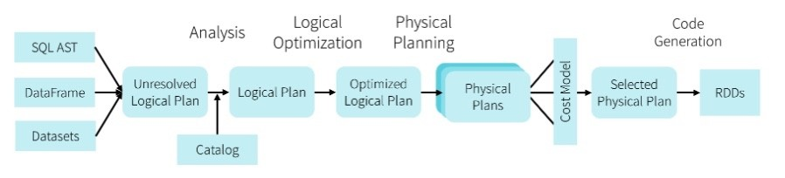
Catalyst and Tungsten

Slide 12
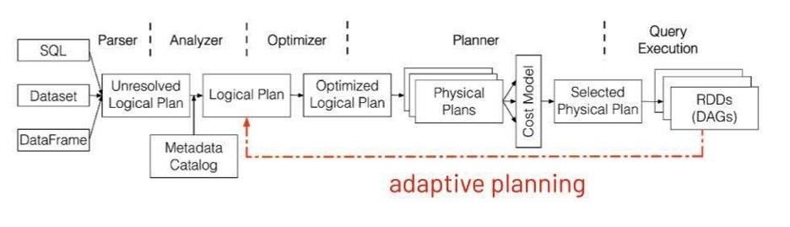
Adaptive Query Execution & Dynamic Partition Pruning

