Slide 1
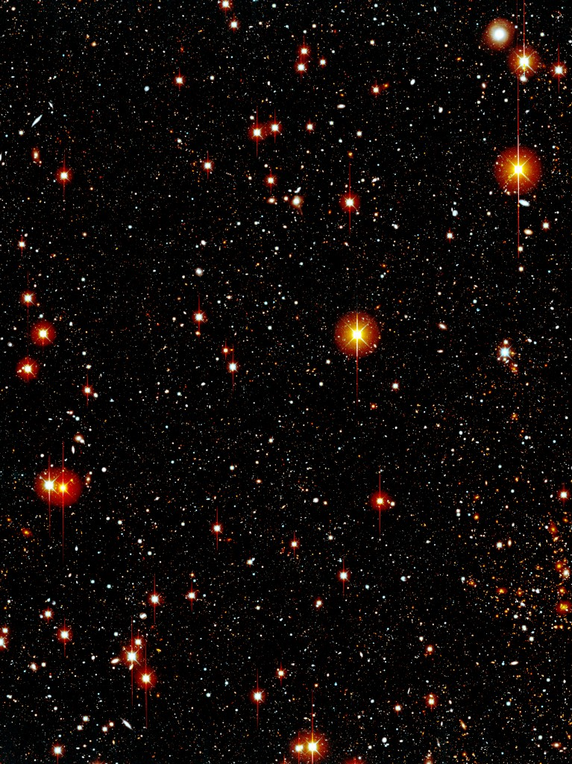
1st and 2nd year grads:
Like looking at the stars?
Don’t like looking for a group?
Come to the:
Cosmology Group Open House
TODAY!!!!
Wednesday, April 23rd
7pm
Faculty Lounge, Rm 723
!!!!! PIZZA !!!!!

