Slide 1
Simulation of Reactive Distillation Column
Name : a.k. gokul Raman
Discipline : chemical engineering
Supervisor : prof. nitin padhiyar

Slide 2
Overview into the slides
Understanding the concept of Reactive Distillation
Associated material and Heat Balance
Work till Mid-semester
Future Prospects

Slide 3
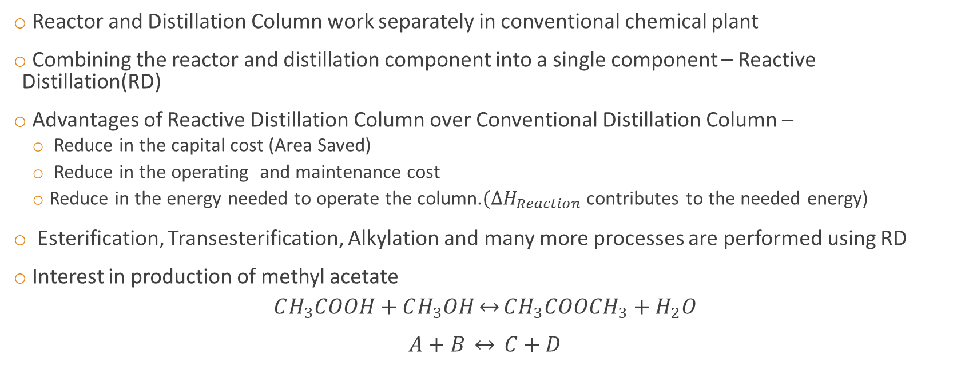
Understanding the concept of Reactive Distillation
Reactor and Distillation Column work separately in conventional chemical plant
Combining the reactor and distillation component into a single component – Reactive Distillation(RD)
Advantages of Reactive Distillation Column over Conventional Distillation Column –
Reduce in the capital cost (Area Saved)
Reduce in the operating and maintenance cost
Reduce in the energy needed to operate the column.$(∆H_{Reaction}$contributes to the needed energy)
Esterification, Transesterification, Alkylation and many more processes are performed using RD
Interest in production of methyl acetate $CH_{3}COOH+CH_{3}OH\underset{↔}{}CH_{3}COOCH_{3}+H_{2}O$
$$A+B \underset{↔}{} C+D$$

Slide 4
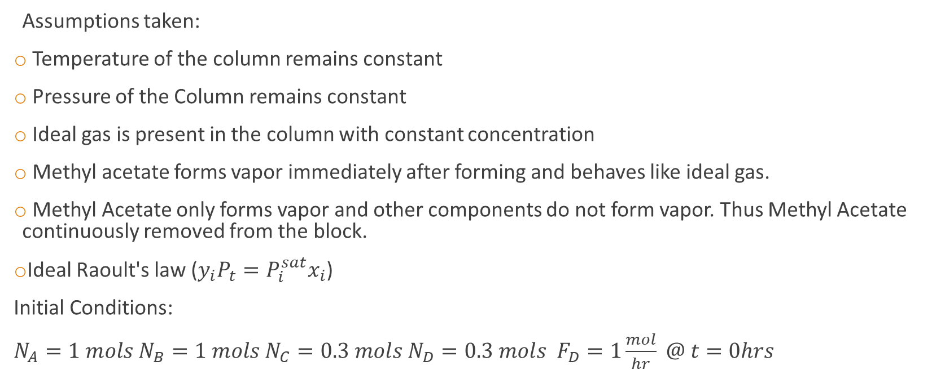
Considering RDC entirely as block
Assumptions taken:
Temperature of the column remains constant
Pressure of the Column remains constant
Ideal gas is present in the column with constant concentration
Methyl acetate forms vapor immediately after forming and behaves like ideal gas.
Methyl Acetate only forms vapor and other components do not form vapor. Thus Methyl Acetate continuously removed from the block.
Ideal Raoult's law ($y_{i}P_{t}=P_{i}^{sat}x_{i}$)
Initial Conditions:
$N_{A}=1 mols N_{B}=1 mols N_{C}=0.3 mols N_{D}=0.3 mols F_{D}=1\frac{mol}{hr} @ t=0hrs$

Slide 5

Associated Mass balance and block diagram
Mass Balance inside the block
$\frac{dN_{A}}{dt}=−\frac{k\left(N_{A}N_{B}−\frac{N_{C}N_{D}}{Keq}\right)}{V}$
$\frac{dN_{B}}{dt}=−\frac{k\left(N_{A}N_{B}−\frac{N_{C}N_{D}}{Keq}\right)}{V}$
$\frac{dN_{D}}{dt}=\frac{k\left(N_{A}N_{B}−\frac{N_{C}N_{D}}{Keq}\right)}{V}$
$\frac{dN_{C}}{dt}=\frac{k\left(N_{A}N_{B}−\frac{N_{C}N_{D}}{Keq}\right)}{V} −\frac{y_{C}}{1−y_{C}}F_{I}$
$∀ y_{C}=\frac{N_{C}}{N_{A}+N_{B}+N_{C}+N_{D}}{ P}_{C}^{sat}/P_{o}$
Acid(A) + Methanol(B) + Water(D) +Acetate
(C)+
Inert(I)
Acetate
(C)+
Inert(I)
RDC
Acid(A) + Methanol(B) + Water(D)

Slide 6
MATLAB Simulation Considering Entire RDC as block

Slide 7
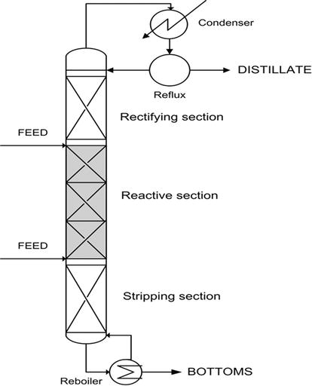
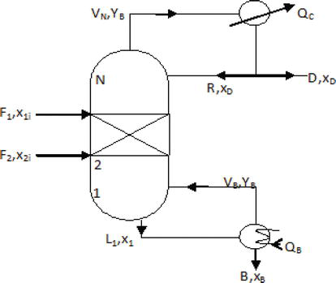
Schematic of Reactive Distillation Column

Slide 8


Nomenclature used in Mass and Energy Balance
$$∆H_{v}−Total Heat of Vaporisation$$
$$D−Distillate Flow Rate$$
$$B −Bottoms Flow Rate$$
$$y_{n,j}−Vapor composition of n^{th}stage$$
$$RR−Reflux Ratio$$
$$F_{n}−Feed flow rate on n^{th}stage$$
$$z_{n,j}−Feed COmposition on n^{th}stage$$
$$NT −Total number of stages$$
$v_{j} −Stoichiometric Coefficient$
$R_{n,j}−Reaction rate on n^{th}stage$
$M_{n}−Liquid Holdup on n^{th}stage$
$k_{Fn}−Forward Reaction rate on n^{th}stage$
$k_{Bn}−Backward Reaction rate on n^{th}stage$
$x_{n,j}−liquid composition on n^{th} stage$
$V_{n}−Flow rate of vapor on n^{th}stage$
$L_{n}−Flow rate of liquid on n^{th}stage$

Slide 9
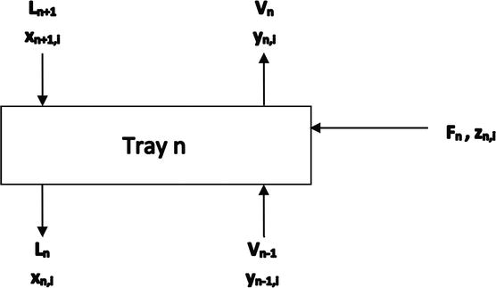
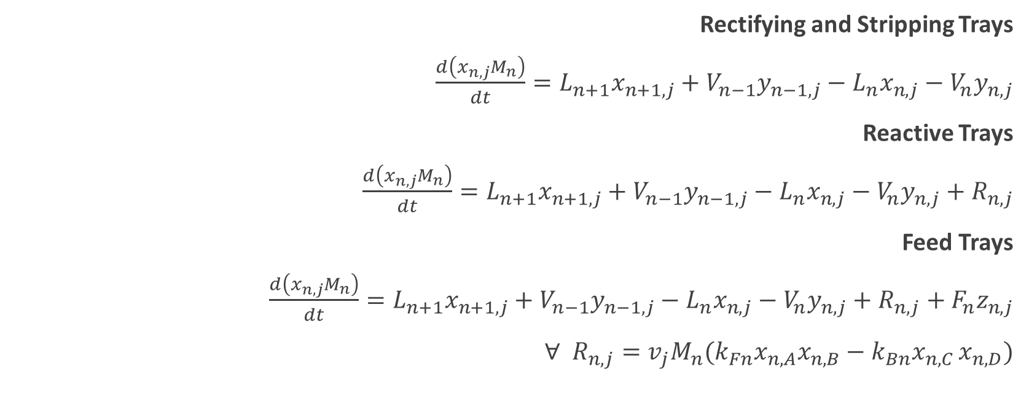
Associated Mass and Energy Balance
Rectifying and Stripping Trays
$\frac{d\left(x_{n,j}M_{n}\right)}{dt}=L_{n+1}x_{n+1,j}+V_{n−1}y_{n−1,j}−L_{n}x_{n,j}−V_{n}y_{n,j}$
Reactive Trays
$\frac{d\left(x_{n,j}M_{n}\right)}{dt}=L_{n+1}x_{n+1,j}+V_{n−1}y_{n−1,j}−L_{n}x_{n,j}−V_{n}y_{n,j}+R_{n,j}$
Feed Trays
$\frac{d\left(x_{n,j}M_{n}\right)}{dt}=L_{n+1}x_{n+1,j}+V_{n−1}y_{n−1,j}−L_{n}x_{n,j}−V_{n}y_{n,j}+R_{n,j}+F_{n}z_{n,j}$
$∀ R_{n,j}=v_{j}M_{n}(k_{Fn}x_{n,A}x_{n,B}−k_{Bn}x_{n,C }x_{n,D})$

Slide 10
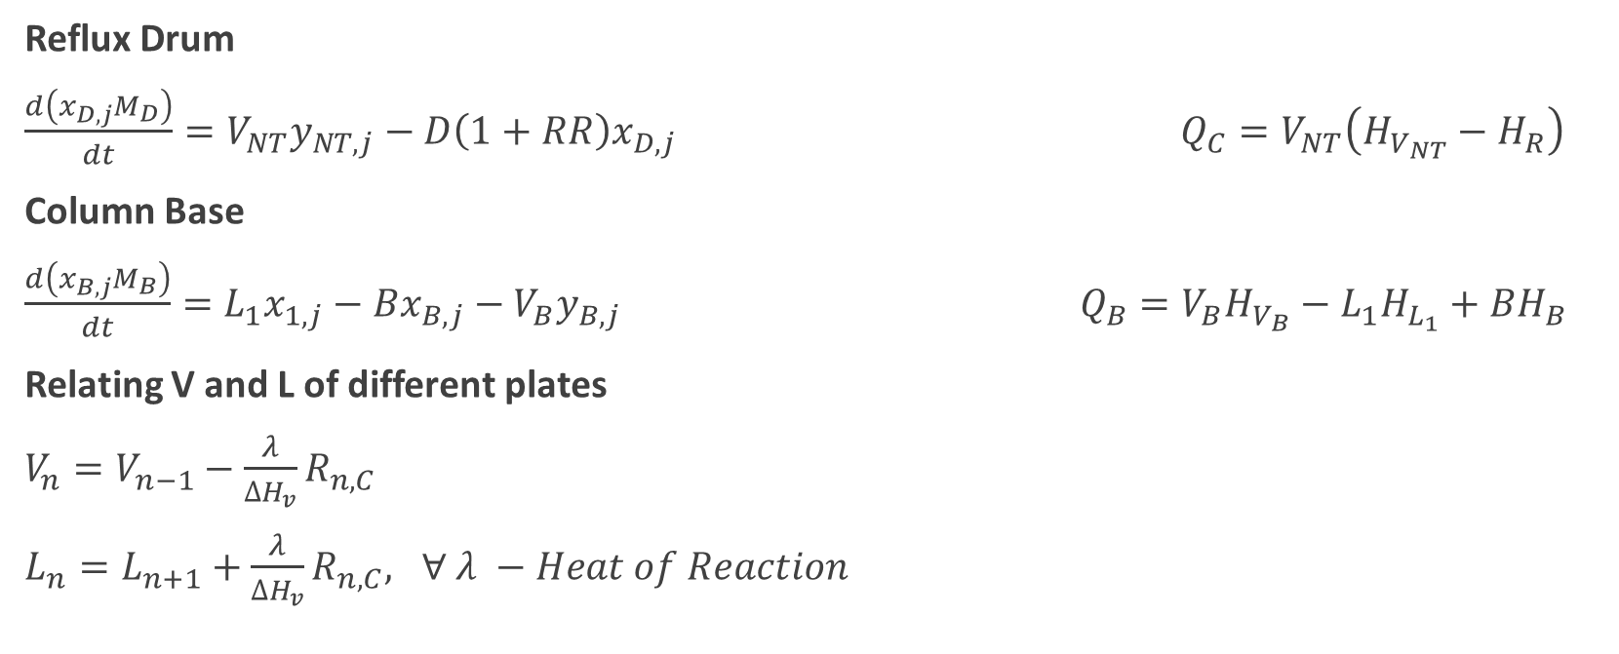
Reflux Drum
$\frac{d\left(x_{D,j}M_{D}\right)}{dt}=V_{NT}y_{NT,j}−D\left(1+RR\right)x_{D,j}$ $Q_{C}=V_{NT}\left(H_{V_{NT}}−H_{R}\right)$
Column Base
$\frac{d\left(x_{B,j}M_{B}\right)}{dt}=L_{1}x_{1,j}−Bx_{B,j}−V_{B}y_{B,j}$ $Q_{B}=V_{B}H_{V_{B}}−L_{1}H_{L_{1}}+BH_{B}$
Relating V and L of different plates
$V_{n}=V_{n−1}−\frac{λ}{∆H_{v}}R_{n,C}$
$L_{n}=L_{n+1}+\frac{λ}{∆H_{v}}R_{n,C}, ∀ λ −Heat of Reaction$

Slide 11

MATLAB Simulation of RDC by considering it as plate wise column
Assumptions taken:
Temperature of the column remains constant
Pressure of the Column remains constant
Ideal Raoult's law ($y_{i}P_{t}=P_{i}^{sat}x_{i}$)
Mass Holdup in every tray is equal

Slide 12
for B = 46 mols/hr.

Slide 13
for B = 30 mols/hr.

Slide 14
Future Prospects
To optimize the results to obtain minimum amount of methyl acetate at the bottom by considering to vary certain parameters like
Bottoms Rate
RR
Distillate
Pressure of the column
To include variation in temperature and pressure in the column

Slide 15
References
Fogler, H. Scott. Elements Of Chemical Reaction Engineering. Upper Saddle River, N.J. :Prentice Hall PTR, 1999.
Kumar, Hemant & Arora, Shivali. (2014). Modeling of Reactive Distillation Column for the production of Ethyl Acetate. International Journal of Current Engineering and Technology. 4. 842-845.
Sakhre, Vandana. (2019). Reactive Distillation: Modeling, Simulation, and Optimization. 10.5772/intechopen.85433.
Huss, Robert & Chen, Fengrong & Doherty, Michael. (2003). Reactive distillation for methyl acetate production. Computers & Chemical Engineering. 27. 1855-1866. 10.1016/S0098-1354(03)00156-X.

Slide 16
Thankyou

