Slide 1
REPORT
IAP Assignment 2
Group 14
Bhusan kulkarni 12CS30016
Gaurav Kumar 12CS10020
Ankit Kumar Gupta 12CS10006

Slide 2
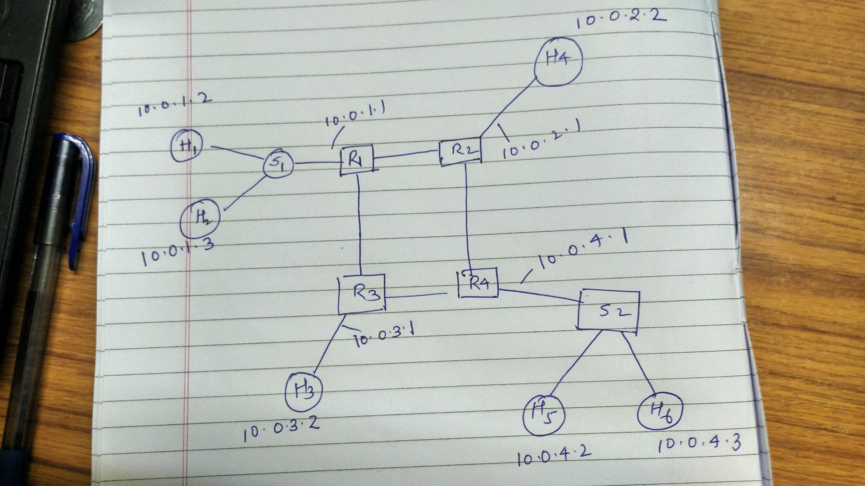
Q1)

Slide 3
Q2)
Routing table for r1
IP Netmask Next Hop Interface
10.0.1.2 255.255.255.255 10.0.1.2 eth2
10.0.1.3 255.255.255.255 10.0.1.3 eth2
10.0.2.0 255.255.255.0 10.0.2.1 eth3
10.0.3.0 255.255.255.0 10.0.3.1 eth1
10.0.4.0 255.255.255.0 10.0.3.1 eth1
Rotuing table for r2
IP Netmask Next Hop Interface
10.0.2.2 255.255.255.255 10.0.2.2 eth2
10.0.1.0 255.255.255.0 10.0.1.1 eth1
10.0.3.0 255.255.255.0 10.0.1.1 eth1
10.0.4.0 255.255.255.0 10.0.4.1 eth3

Slide 4
Q2)
Routing table for r3
IP Netmask Next Hop Interface
10.0.3.2 255.255.255.255 10.0.3.2 eth3
10.0.2.0 255.255.255.0 10.0.1.1 eth1
10.0.1.0 255.255.255.0 10.0.1.1 eth1
10.0.4.0 255.255.255.0 10.0.4.1 eth2
Rotuing table for r4
IP Netmask Next Hop Interface
10.0.4.2 255.255.255.255 10.0.4.2 eth2
10.0.4.3 255.255.255.255 10.0.4.3 eth2
10.0.2.0 255.255.255.0 10.0.2.1 eth3
10.0.3.0 255.255.255.0 10.0.3.1 eth1
10.0.1.0 255.255.255.0 10.0.3.1 eth1

Slide 5
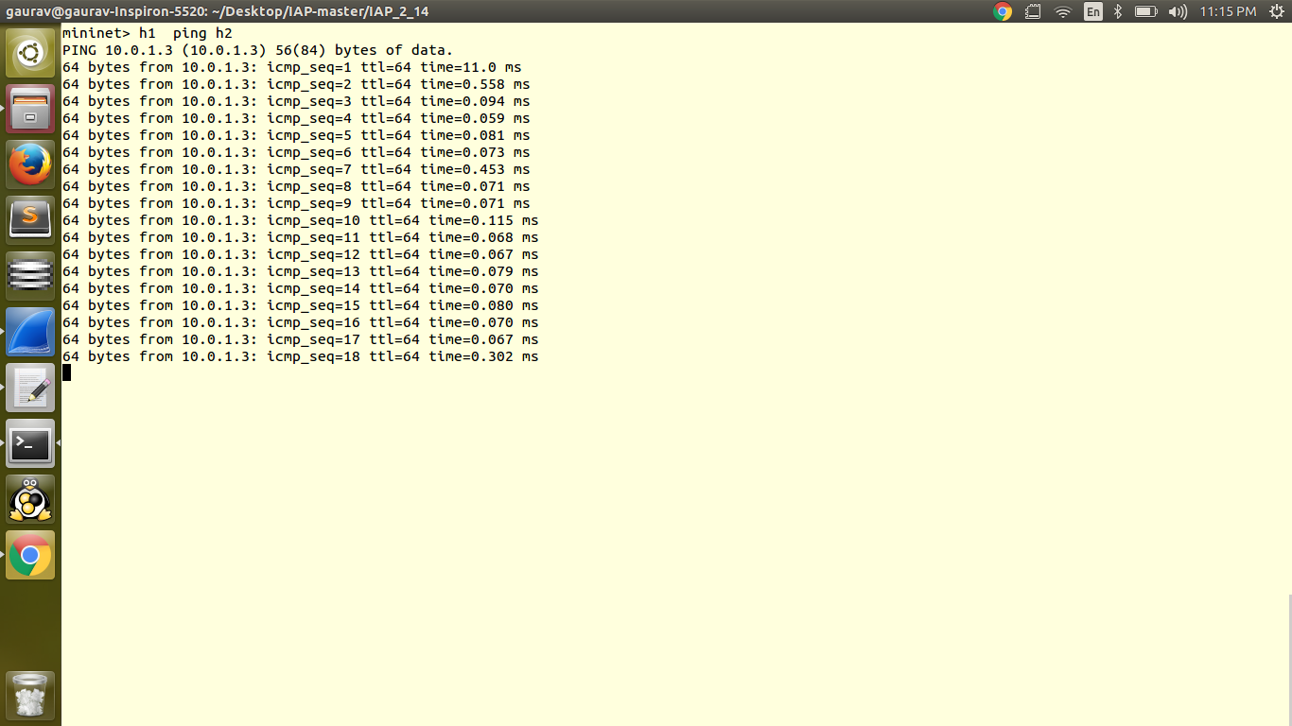
Q3)ping from h1-h2

Slide 6
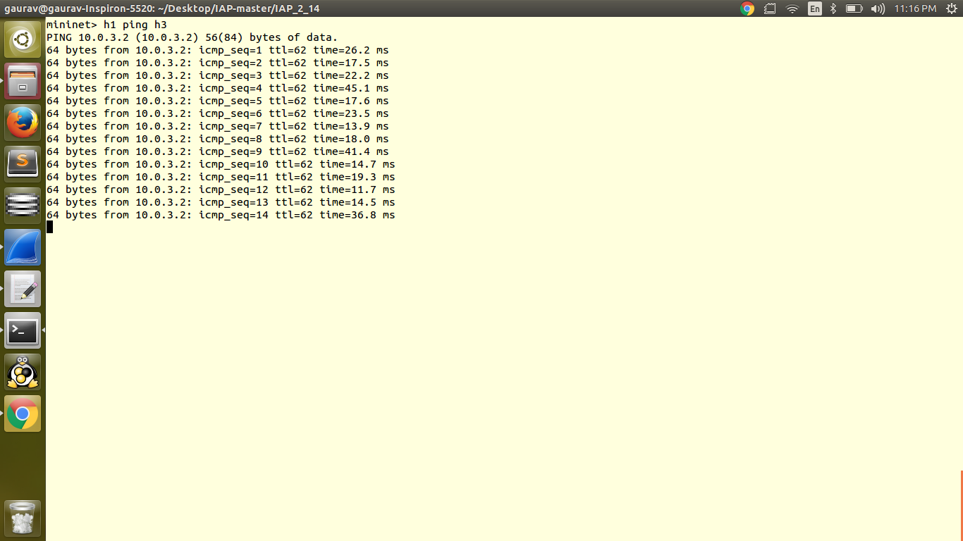
Ping from h1-h3

Slide 7
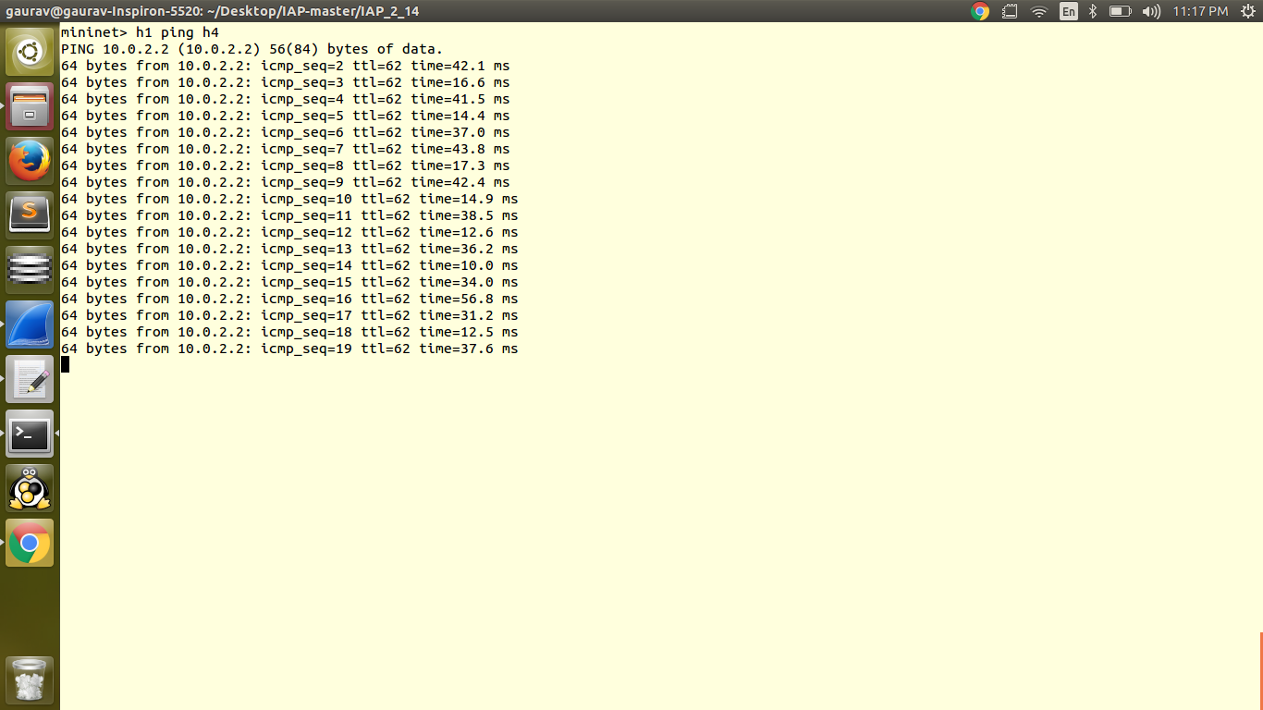
Ping from h1 to h4

Slide 8
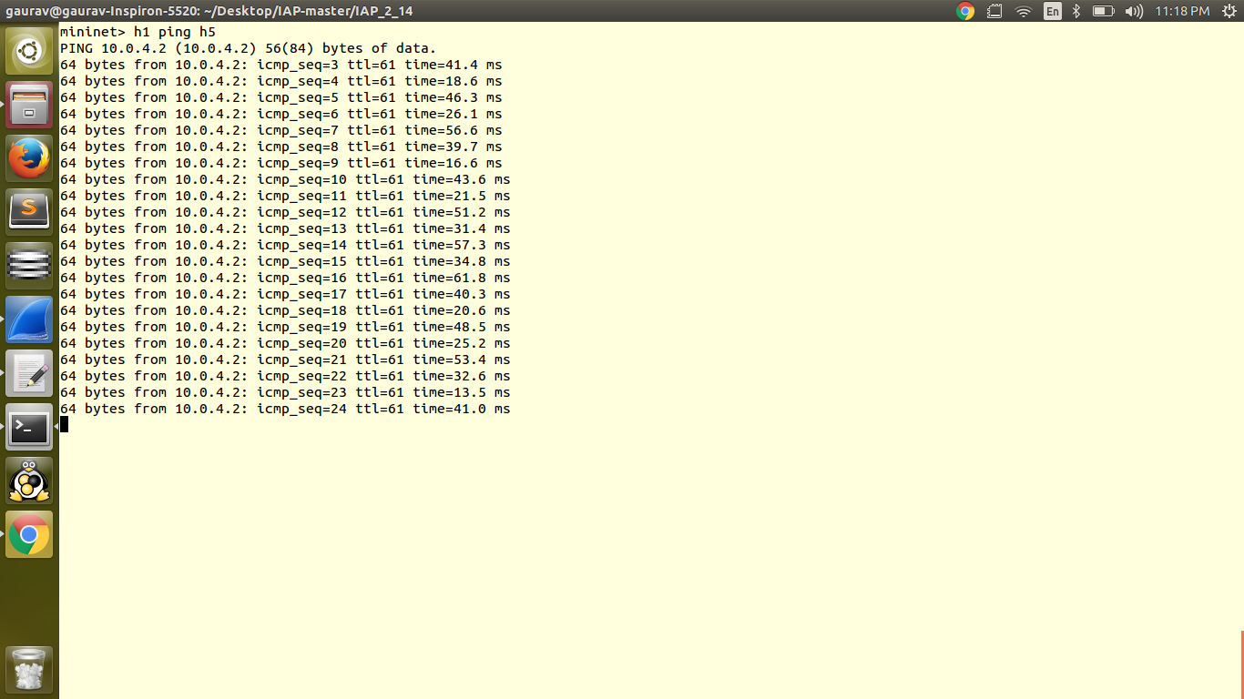
Ping from h1 to h5

Slide 9
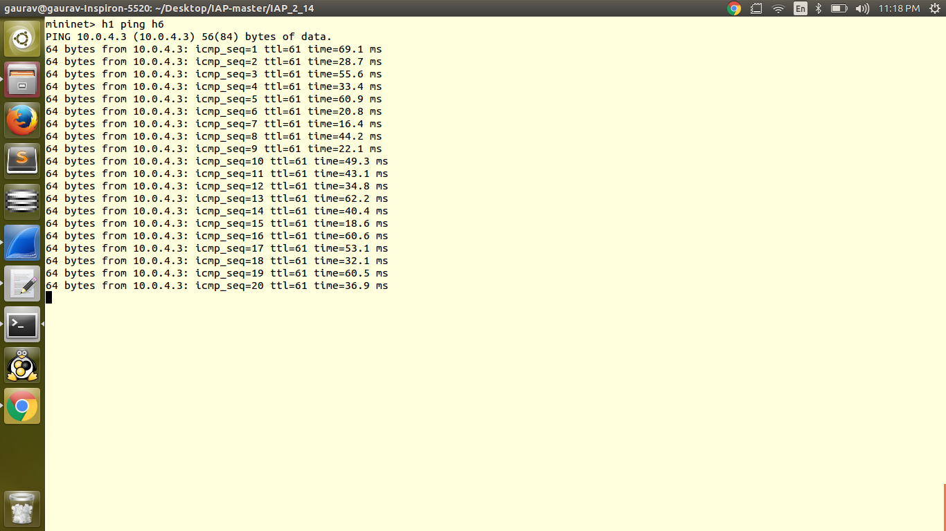
Ping from h1 to h6

Slide 10
Q 5,6,7,8
Refer folder wireshark_screenshot
You can observe network and destination host
unreachable behavior
You can also see trace route behavior in pcap file
Middle host are sending Time to live exceeded message and final destination is sending Echo
Reply message

Slide 11
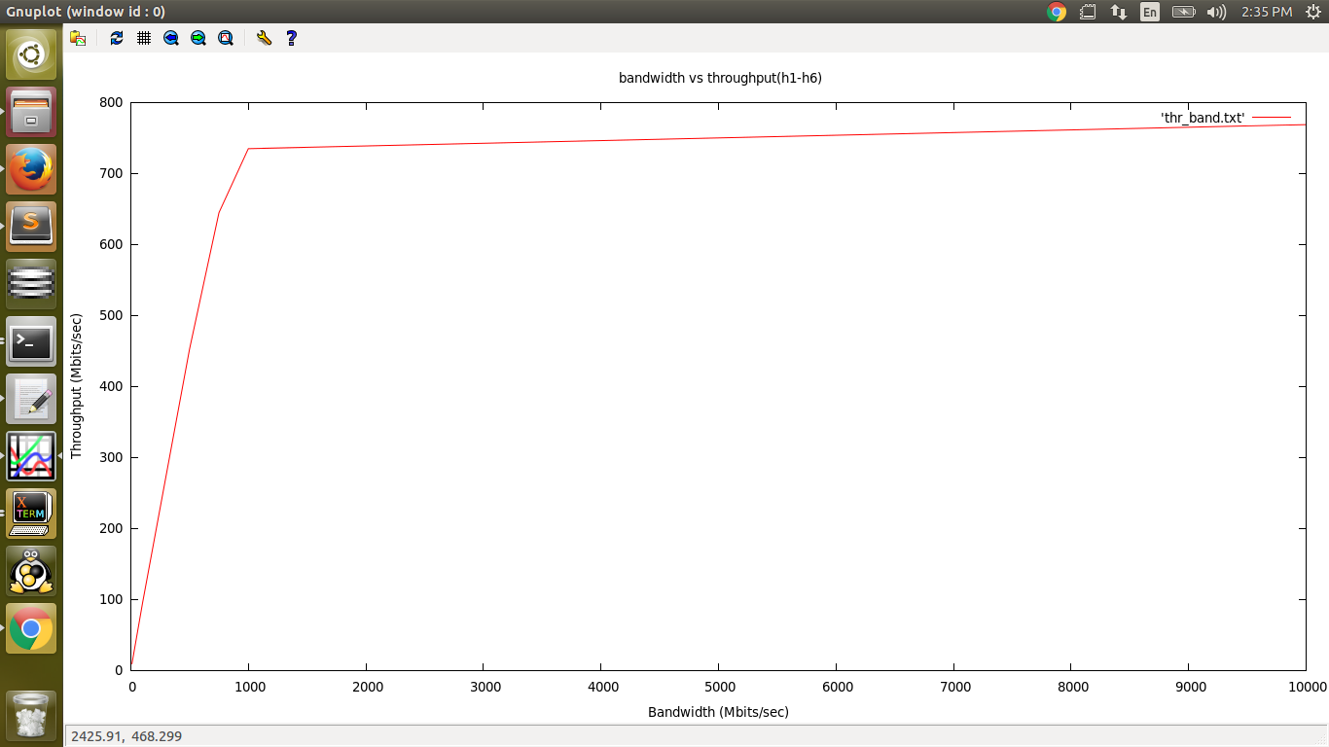
Plot of Bandwidth vs throughput (h1-h6) for UDP

Slide 12
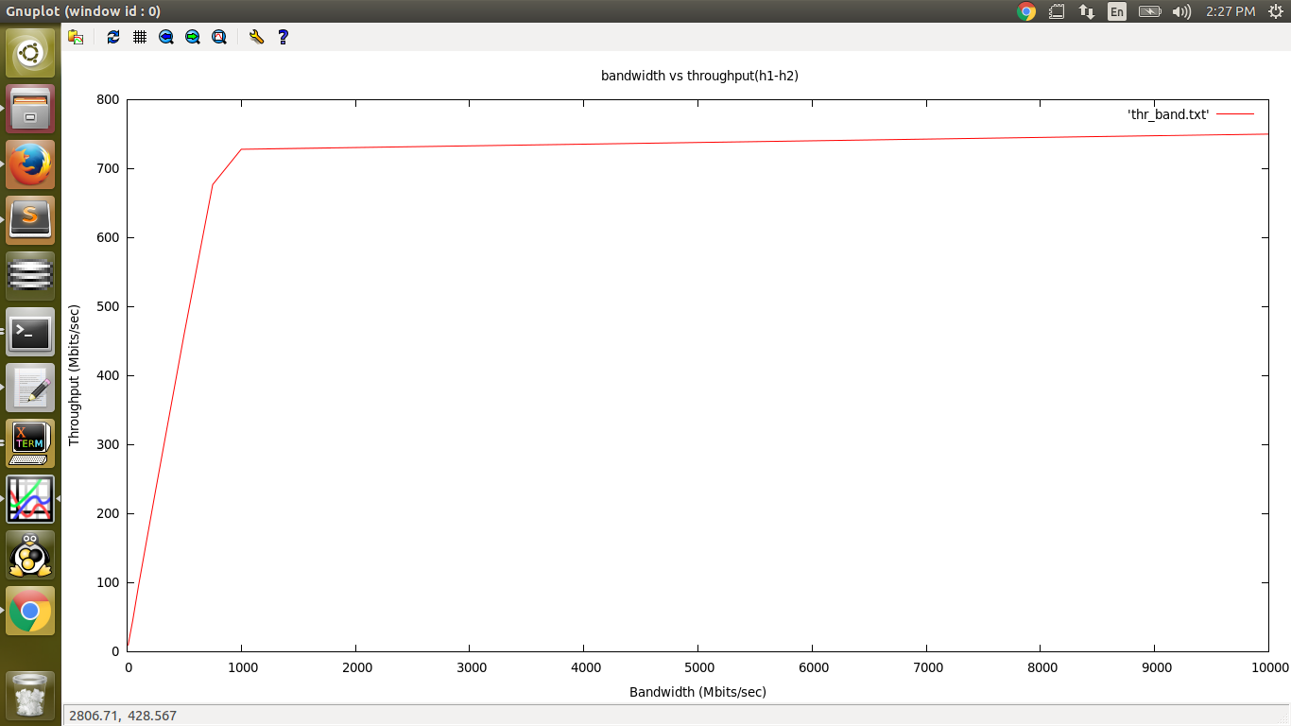
Plot of bandwidth vs throughput (h1-h2) for UDP

Slide 13
Observations from ping h1-H*
As you can see the ping screen shots that time taken for ping form h1-h* increases with number for hops between h1-h*.
so ping time for h1-h6 > h1-h2
For any Ping H1-H* :
First ping taken more time that subsequent pings since in the first ping router do an ARP query to find next hop HW address after than it caches that address.

Slide 14
Observations from ping h2 to unreachable IP
For this case ICMP reply type to TYPE_DEST_UNREACH
And then we set code for unreachable in two ways
  Network unreachable : router first checks whether the destination network exists or not. If it doesn't
  it sets code to CODE_UNREACH_NET
  Host unreachable : it destination network exists it forwards packet
  to the next Hop using routing table. Once the packet reaches to that
  networks gateway router it checks whether host exists or not. If
  destination Host doesn't exist set
  code to CODE_UNREACH_HOST
  You can see this behavior in the wireshark traces of that ping.

Slide 15
Observations from ipef with UDP
Since every channel has a maximum data rate which it can support hence throughput does not always increase with bandwidth. After some bandwidth it becomes constant. Initially it increases linearly with bandwidth.
Max. Throughput for H1-H6 UDP – 768 Mb/sec
Max. Throughput for H1-H2 UDP – 750 Mb/sec

Slide 16
Contribution Table
Every one equally contributed to assignment

