Slide 1
Memory Management

Slide 2
Memory management
We have seen how CPU can be shared by a set of processes
Improve system performance
Process management
Need to keep several process in memory
Share memory
Learn various techniques to manage memory
Hardware dependent

Slide 3
Memory management
What are we going to learn?
Basic Memory Management: logical vs. physical address space, protection, contiguous memory allocation, paging, segmentation, segmentation with paging.
Virtual Memory: background, demand paging, performance, page replacement, page replacement algorithms (FCFS, LRU), allocation of frames, thrashing.

Slide 4

Background
Program must be brought (from disk) into memory
Fetch-decode-execute cycle
Memory unit only sees a stream of addresses + read requests, or address + data and write requests
Sequence of memory addresses generated by running program
CPU

Slide 5

Logical vs. Physical Address Space
Logical address – generated by the CPU; also referred to as virtual address
Physical address – address seen by the memory unit
Logical address space is the set of all logical addresses generated by a program
Physical address space is the set of all physical addresses generated by a program
CPU

Slide 6
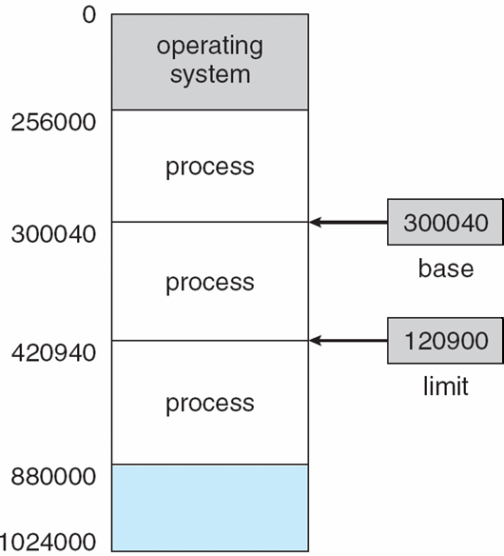
Background
Multiple processes resides in memory
Protection of memory required to ensure correct operation
1. Protect OS
2. Protect user processes

Slide 7
Base and Limit Registers
A pair of base and limit registers define the logical address space

Slide 8
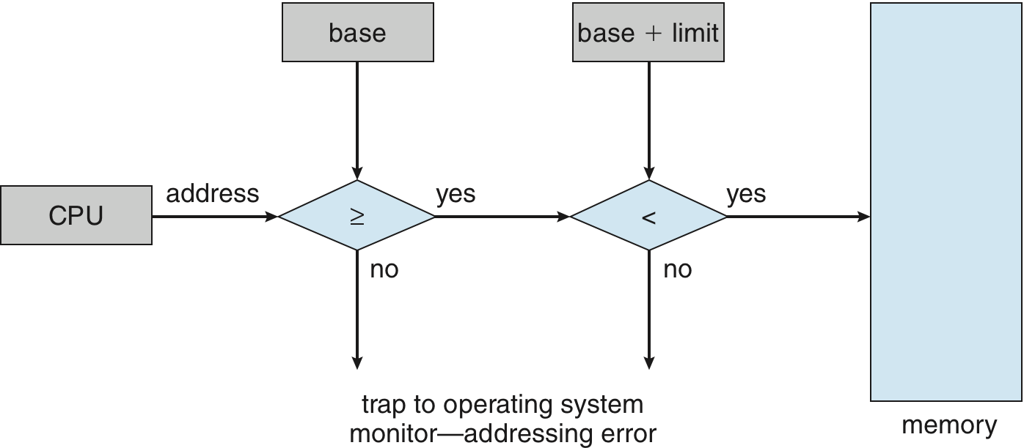
Hardware Address Protection with Base and Limit Registers
OS loads the base & limit reg.
Privileged instruction

Slide 9
Address Binding
Process resides in main memory
Associate each data element with memory address
Further, addresses represented in different ways at different stages of a program’s life
Source code addresses usually symbolic
Compiled code addresses bind to relocatable addresses
i.e. “14 bytes from beginning of this module”
Linker or loader will bind relocatable addresses to absolute addresses
i.e. 74014

Slide 10
Binding of Instructions and Data to Memory
Address binding of instructions and data to memory addresses can happen at three different stages
Compile time: If memory location known a priori, absolute code can be generated; must recompile code if starting location changes
Load time: Must generate relocatable code if memory location is not known at compile time
Execution time: If the process can be moved during its execution from one memory segment to another
Binding delayed until run time
Need hardware support for address maps (e.g., base and limit registers)

Slide 11
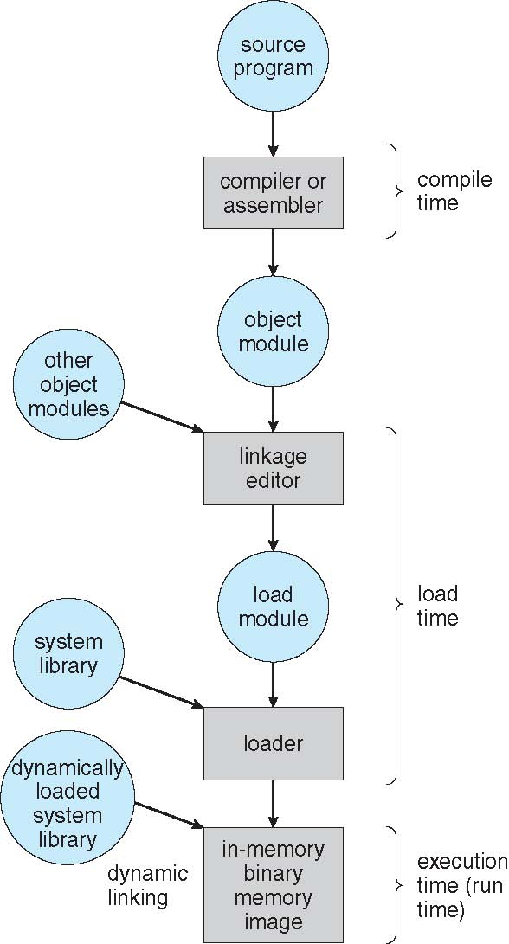
Multistep Processing of a User Program

Slide 12
Logical vs. Physical Address Space
Logical address – generated by the CPU; also referred to as virtual address
Physical address – address seen by the memory unit
Logical and physical addresses are the same in compile-time and load-time address-binding schemes;
logical (virtual) and physical addresses differ in execution-time address-binding scheme
Logical address space is the set of all logical addresses generated by a program
Physical address space is the set of all physical addresses generated by a program
CPU

Slide 13
Memory-Management Unit (MMU)
Hardware device that at run time maps virtual to physical address
Many methods possible
To start, consider simple scheme where the value in the relocation register is added to every address generated by a user process at the time it is sent to memory
relocation register
MS-DOS on Intel 80x86 used 4 relocation registers
The user program deals with logical addresses (0 to max); it never sees the real physical addresses (R to R+max)
Say the logical address 25
Execution-time binding occurs when reference is made to location in memory
Logical address bound to physical addresses

Slide 14
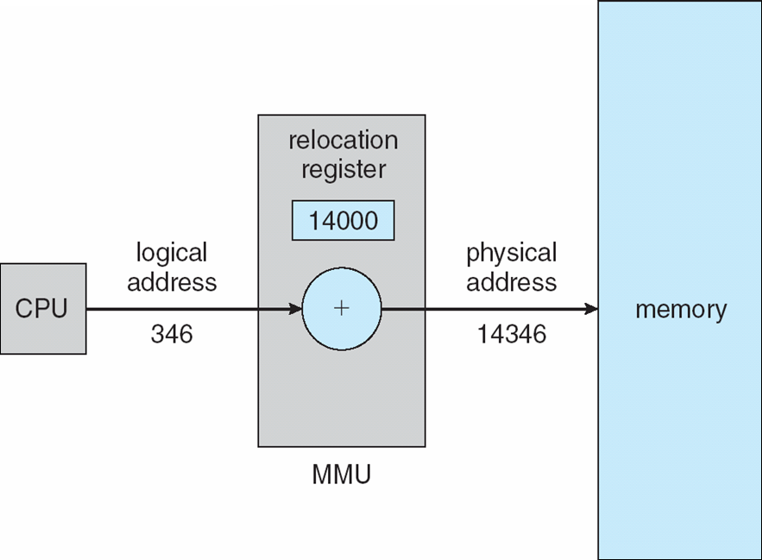
Dynamic relocation using a relocation register
14000
Relocatable code

Slide 15
Contiguous Allocation
Multiple processes resides in memory

Slide 16
Contiguous Allocation
Main memory usually divided into two partitions:
Resident operating system, usually held in low memory
User processes then held in high memory
Each process contained in single contiguous section of memory

Slide 17
Contiguous Allocation (Cont.)
Multiple-partition allocation
Divide memory into several Fixed size partition
Each partition stores one process
Degree of multiprogramming limited by number of partitions
If a partition is free, load process from job queue
MFT (IBM OS/360)

Slide 18
Contiguous Allocation (Cont.)
Multiple-partition allocation
Variable partition scheme
Hole – block of available memory; holes of various size are scattered throughout memory
Keeps a table of free memory
When a process arrives, it is allocated memory from a hole large enough to accommodate it
Process exiting frees its partition, adjacent free partitions combined
Operating system maintains information about: a) allocated partitions b) free partitions (hole)
OS
OS
OS
OS
OS
process 5
process 5
process 5
process 5
process 9
process 9
Hole
process 8
process 10
process 2
process 2
process 2
process 2

Slide 19
Dynamic Storage-Allocation Problem
How to satisfy a request of size n from a list of free holes?
Dynamic storage allocation problem
First-fit: Allocate the first hole that is big enough
Best-fit: Allocate the smallest hole that is big enough; must search entire list, unless ordered by size
Produces the smallest leftover hole
Worst-fit: Allocate the largest hole; must also search entire list
Produces the largest leftover hole

Slide 20
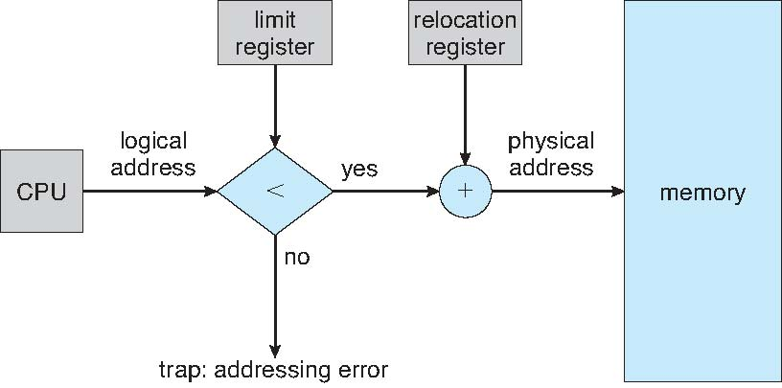
Hardware Support for Relocation and Limit Registers
Relocation registers used to protect user processes from each other, and from changing operating-system code and data
Relocation register contains value of smallest physical address
Limit register contains range of logical addresses – each logical address must be less than the limit register
Context switch
MMU maps logical address dynamically

Slide 21
Fragmentation
Processes loaded and removed from memory
Memory is broken into little pieces
External Fragmentation – total memory space exists to satisfy a request, but it is not contiguous
First fit analysis reveals that given N blocks allocated, 0.5 N blocks lost to fragmentation
1/3 may be unusable -> 50-percent rule

Slide 22
Fragmentation (Cont.)
Reduce external fragmentation by compaction
Shuffle memory contents to place all free memory together in one large block
Compaction is possible only if relocation is dynamic, and is done at execution time
Change relocation reg.
Cost
Internal Fragmentation – allocated memory may be slightly larger than requested memory; this size difference is memory internal to a partition, but not being used

Slide 23
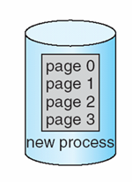
Paging
Physical address space of a process can be noncontiguous;
process is allocated physical memory whenever the latter is available
Divide physical memory into fixed-sized blocks called frames
Size is power of 2, between 512 bytes and 16 Mbytes
Divide logical memory into blocks of same size called pages
To run a program of size N pages, need to find N free frames and load program
Backing store likewise split into pages
Set up a page table to translate logical to physical addresses
System keeps track of all free frames

Slide 24
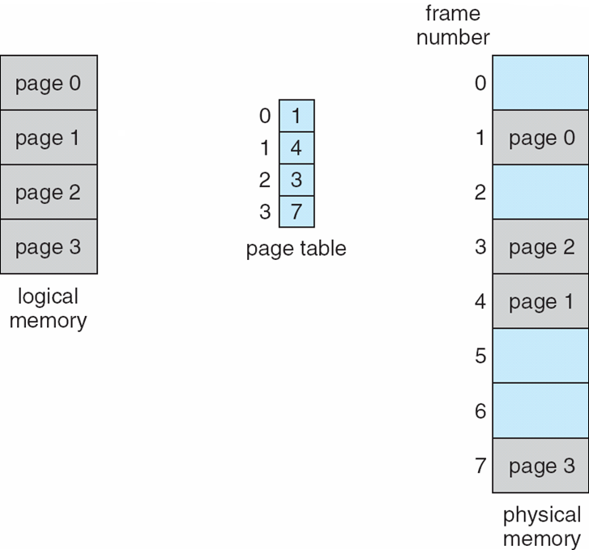
Paging Model of Logical and Physical Memory
page table to translate logical to physical addresses

