Slide 1
CIS 501
Computer Organization and Design
Unit 2: Digital Logic & Hardware Description
Based on slides by Benedict Brown, Amir Roth,
Milo Martin & C.J. Taylor
CIS 501: Comp. Arch. | Dr. Joe Devietti | Hardware Description

Slide 2
This Unit: Digital Logic & Hdw Description
App
App
App
Transistors & fabrication
Digital logic basics
  Focus on useful components
Hardware design methods
  Introduction to Verilog
System software
Mem
CPU
I/O
CIS 501: Comp. Arch. | Dr. Joe Devietti | Hardware Description
Notes:
credential:
bring a computer
die photo
wafer
:
This can be an hidden slide. I just want to use this to do my own planning.
I have rearranged Culler’s lecture slides slightly and add more slides. This covers everything he covers in his first lecture (and more) but may
We will save the fun part, “ Levels of Organization,” at the end (so student can stay awake): I will show the internal stricture of the SS10/20.
Notes to Patterson: You may want to edit the slides in your section or add extra slides to taylor your needs.

Slide 3
Readings
Digital logic
  P&H, Appendix C
Manufacturing
  P&H, Section 1.7
Introduction to Logic Synthesis using Verilog HDL, Reese & Thornton
See webpage for other Verilog HDL resources
CIS 501: Comp. Arch. | Dr. Joe Devietti | Hardware Description

Slide 4
Motivation: Implementing a Datapath
datapath
fetch
Insn
memory
Register
File
Data
Memory
PC
control
Datapath: performs computation (registers, ALUs, etc.)
  ISA specific: can implement every insn (single-cycle: in one pass!)
Control: determines which computation is performed
  Routes data through datapath (which regs, which ALU op)
Fetch: get insn, translate opcode into control
Fetch → Decode → Execute “cycle”
CIS 501: Comp. Arch. | Dr. Joe Devietti | Hardware Description

Slide 5
Two Types of Components
datapath
fetch
Insn
memory
Register
File
Data
Memory
PC
control
Purely combinational: stateless computation
  ALUs, muxes, control
  Arbitrary Boolean functions
Combinational+sequential: storage
  PC, insn/data memories, register file
  Internally contain some combinational components
CIS 501: Comp. Arch. | Dr. Joe Devietti | Hardware Description

Slide 6
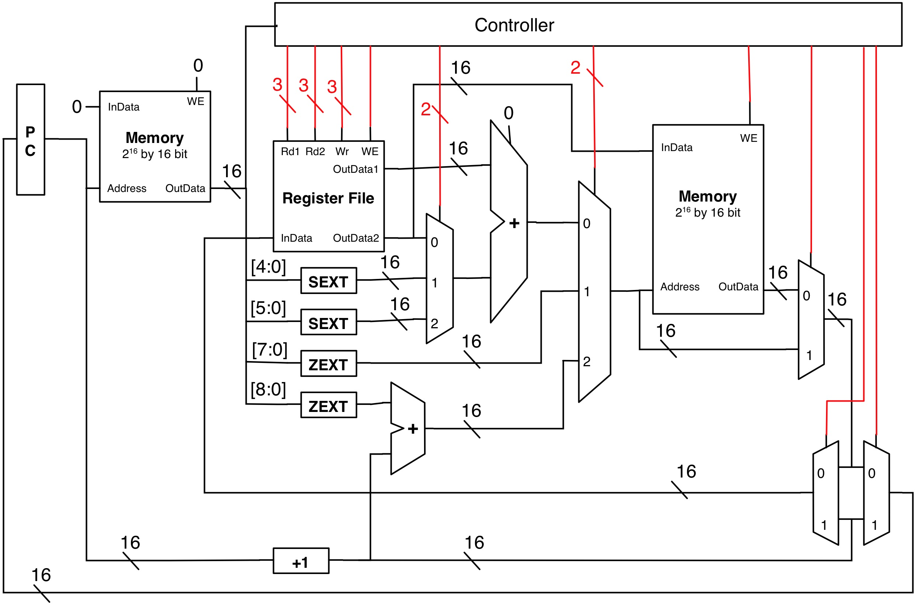
Example LC4 Datapath
CIS 501: Comp. Arch. | Dr. Joe Devietti | Hardware Description

Slide 7
LC4 Datapath
+1
16
insn[2:0]
3
insn[11:9]
insn[8:6]
insn[11:9]
3
insn[11:9]
3
3’b111
PC
Memory
2¹⁶ by
16 bit
3’b111
16
16
16
Reg.
File
we
wsel
r1sel
r2sel
16
Reg.
File
16
r1data
16
ALU
Memory
2¹⁶ by 16 bit
16
addr
we
wdata
r2data
out
in
n/z/p
16
Branch
Logic
3
NZP Reg
we
3
NZP Reg
16
CIS 501: Comp. Arch. | Dr. Joe Devietti | Hardware Description

Slide 8
Transistors & Fabrication
CIS 501: Comp. Arch. | Dr. Joe Devietti | Hardware Description

Slide 9
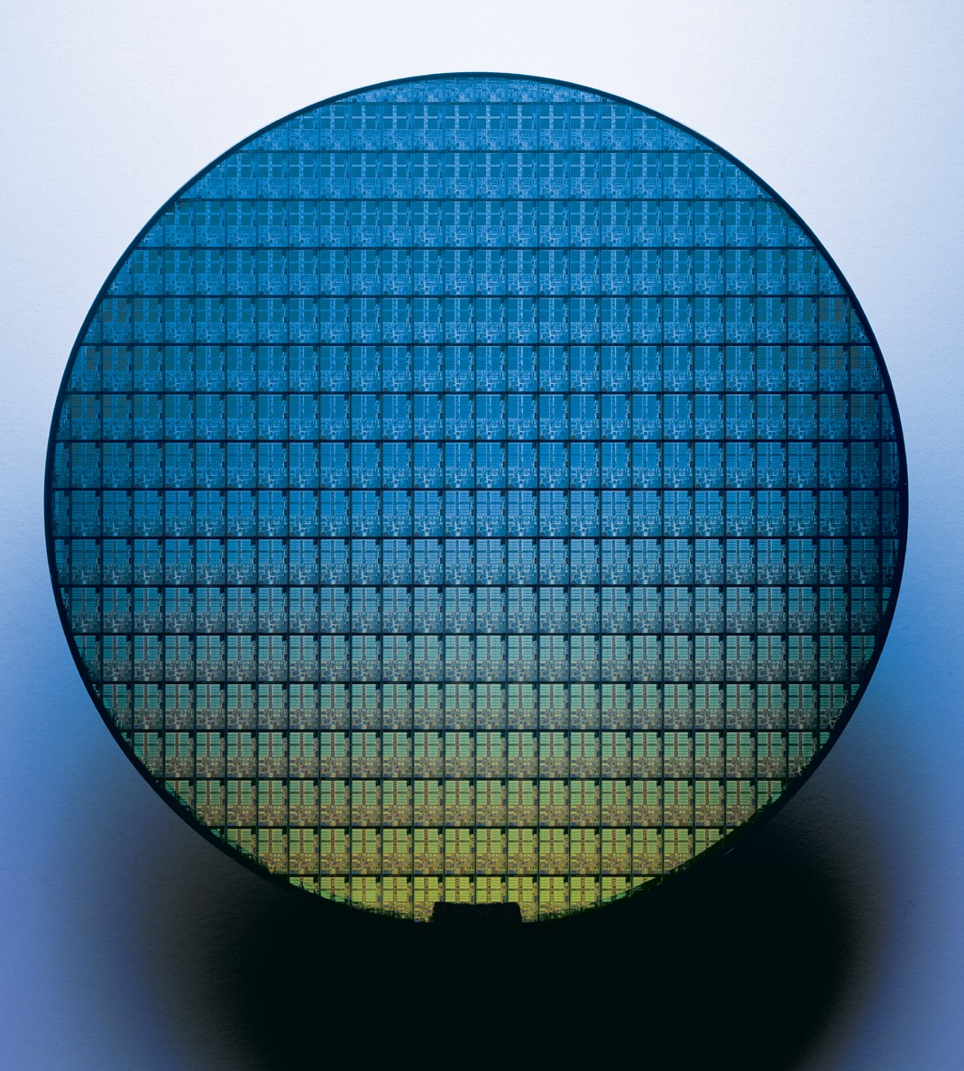
Intel
Pentium M
Wafer
CIS 501: Comp. Arch. | Dr. Joe Devietti | Hardware Description

Slide 10
Semiconductor Technology
gate
gate
insulator
channel
source
drain
source
drain
Substrate
channel
Basic technology element: MOSFET
  Solid-state component acts like electrical switch
  MOS: metal-oxide-semiconductor
    Conductor, insulator, semi-conductor
FET: field-effect transistor
  Channel conducts source→drain only when voltage applied to gate
Channel length: characteristic parameter (short → fast)
  Aka “feature size” or “technology”
  Currently: 0.007 micron (μm), 7 nanometers (nm)
  Continued miniaturization (scaling) known as “Moore’s Law”
    Won’t last forever, physical limits approaching (or are they?)
CIS 501: Comp. Arch. | Dr. Joe Devietti | Hardware Description

Slide 11
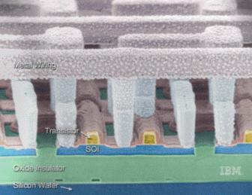
Transistors and Wires
©IBM
From slides © Krste Asanović, MIT
CIS 501: Comp. Arch. | Dr. Joe Devietti | Hardware Description

Slide 12
Complementary MOS (CMOS)
Voltages as values
  Power (V_{DD}) = “1”, Ground = “0”
Two kinds of MOSFETs
  N-transistors
    Conduct when gate voltage is 1
    Good at passing 0s
  P-transistors
    Conduct when gate voltage is 0
    Good at passing 1s
CMOS
  Complementary n-/p- networks form boolean logic (i.e., gates)
  And some non-gate elements too (important example: RAMs)
power (1)
p-transistor
input
output
(“node”)
n-transistor
ground (0)
CIS 501: Comp. Arch. | Dr. Joe Devietti | Hardware Description

Slide 13
Basic CMOS Logic Gate
Inverter: NOT gate
  One p-transistor, one n-transistor
  Basic operation
  Input = 0
    P-transistor closed, n-transistor open
    Power charges output (1)
  Input = 1
    P-transistor open, n-transistor closed
    Output discharges to ground (0)
0
1
1
0
CIS 501: Comp. Arch. | Dr. Joe Devietti | Hardware Description

Slide 14


Another CMOS Gate Example
What is this? Look at truth table
  0, 0 → 1
  0, 1 → 1
  1, 0 → 1
  1, 1 → 0
  Result: NAND (NOT AND)
  NAND is “universal”
  What function is this?
A
B
output
A
B
A
B
output
A
B
CIS 501: Comp. Arch. | Dr. Joe Devietti | Hardware Description
Notes:
NOR – Not Or

Slide 15
Digital Building Blocks: Logic Gates
Logic gates: implement Boolean functions
  Basic gates: NOT, NAND, NOR
    Underlying CMOS transistors are naturally inverting ( = NOT)
  NAND, NOR are “Boolean complete”
NOT (Inverter)
NAND
NOR
A’
A
A
A
(AB)’
(A+B)’
B
B
BUF
AND
OR
A
A
A+B
A
A
AB
B
B
AND3
ANDNOT
XOR
A
A
A
B
AB’
AB’+A’B
(A^B)
B
B
C
CIS 501: Comp. Arch. | Dr. Joe Devietti | Hardware Description

Slide 16
Digital Logic Review
CIS 501: Comp. Arch. | Dr. Joe Devietti | Hardware Description

Slide 17
Boolean Functions and Truth Tables
Any Boolean function can be represented as a truth table
  Truth table: point-wise input → output mapping
  Function is disjunction of all rows in which “Out” is 1
A,B,C → Out
0,0,0 → 0
0,0,1 → 0
0,1,0 → 0
0,1,1 → 0
1,0,0 → 0
1,0,1 → 1
1,1,0 → 1
1,1,1 → 1
  Example above: Out = AB’C + ABC’ + ABC
CIS 501: Comp. Arch. | Dr. Joe Devietti | Hardware Description
Notes:
We will return to this when we talk about CLBs in FPGAs

Slide 18
Truth Tables and PLAs
Implement Boolean function by implementing its truth table
  Takes two levels of logic
    Assumes inputs and inverses of inputs are available (usually are)
  First level: ANDs (product terms)
  Second level: ORs (sums of product terms)
PLA (programmable logic array)
  Flexible circuit for doing this
CIS 501: Comp. Arch. | Dr. Joe Devietti | Hardware Description

Slide 19
PLA Example
PLA with 3 inputs, 2 outputs, and 4 product terms
  Out0 = AB’C + ABC’ + ABC
A
Permanent connections
B
C
Programmable connections (unconnected)
Out0
Out1
CIS 501: Comp. Arch. | Dr. Joe Devietti | Hardware Description
Notes:
One implementation with a programmable interconnect.

Slide 20
Boolean Algebra
Boolean Algebra: rules for rewriting Boolean functions
  Useful for simplifying Boolean functions
    Simplifying = reducing gate count, reducing gate “levels”
  Rules: similar to logic (0/1 = F/T)
    Identity: A1 = A, A+0 = A
    0/1: A0 = 0, A+1 = 1
    Inverses: (A’)’ = A
    Idempotency: AA = A, A+A = A
    Tautology: AA’ = 0, A+A’ = 1
    Commutativity: AB = BA, A+B = B+A
    Associativity: A(BC) = (AB)C, A+(B+C) = (A+B)+C
    Distributivity: A(B+C) = AB+AC, A+(BC) = (A+B)(A+C)
    DeMorgan’s: (AB)’ = A’+B’, (A+B)’ = A’B’
CIS 501: Comp. Arch. | Dr. Joe Devietti | Hardware Description

Slide 21
Logic Minimization
Logic minimization
  Iterative application of rules to reduce function to simplest form
  Design tools do this automatically
Out = AB’C + ABC’ + ABC
Out = A(B’C + BC’ + BC) // distributivity
Out = A(B’C + (BC’ + BC)) // associativity
Out = A(B’C + B(C’+C)) // distributivity (on B)
Out = A(B’C + B1) // tautology
Out = A(B’C + B) // 0/1
Out = A((B’+B)(C+B)) // distributivity (on +B)
Out = A(1(B+C)) // tautology
Out = A(B+C) // 0/1
CIS 501: Comp. Arch. | Dr. Joe Devietti | Hardware Description

Slide 22
Non-Arbitrary Boolean Functions
PLAs implement Boolean functions point-wise
  E.g., represent f(X) = X+5 as [0→5, 1→6, 2→7, 3→8, …]
  Mainly useful for “arbitrary” functions, no compact representation
Many useful Boolean functions are not arbitrary
  Have a compact implementation
  Examples
    Multiplexer
    Adder
CIS 501: Comp. Arch. | Dr. Joe Devietti | Hardware Description

Slide 23
Multiplexer (Mux)
Multiplexer (mux): selects output from N inputs
  Example: 1-bit 4-to-1 mux
  Not shown: N-bit 4-to-1 mux = N 1-bit 4-to-1 muxes + 1 decoder
S (binary)
S (1-hot)
S (binary)
A
A
B
O
B
O
C
D
C
D
CIS 501: Comp. Arch. | Dr. Joe Devietti | Hardware Description

Slide 24
Adder
Adder: adds/subtracts two binary integers in two’s complement format
  Half adder: adds two 1-bit “integers”, no carry-in
  Full adder: adds three 1-bit “integers”, includes carry-in
  Ripple-carry adder: N chained full adders add 2 N-bit integers
  To subtract: negate B input, set bit 0 carry-in to 1
CIS 501: Comp. Arch. | Dr. Joe Devietti | Hardware Description

Slide 25
Full Adder
What is the logic for a full adder?
  Look at truth table
CI A B → C0 S
0 0 0 → 0 0
0 0 1 → 0 1
0 1 0 → 0 1
0 1 1 → 1 0
1 0 0 → 0 1
1 0 1 → 1 0
1 1 0 → 1 0
1 1 1 → 1 1
  S = C’A’B + C’AB’ + CA’B’ + CAB = C ^ A ^ B
  CO = C’AB + CA’B + CAB’ + CAB = CA + CB + AB
CI
S
CI
A
A
S
B
FA
B
CO
CO
CIS 501: Comp. Arch. | Dr. Joe Devietti | Hardware Description

Slide 26
N-bit Adder/Subtracter
0
1
A₀
FA
S₀
B₀
A₁
FA
S₁
A
+/-
S
B₁
B
+/–
…
A_{N-1}
FA
S_{N-1}
B_{N-1}
+/–
More later when we cover arithmetic
CIS 501: Comp. Arch. | Dr. Joe Devietti | Hardware Description

Slide 27
FPGAs
CIS 501: Comp. Arch. | Dr. Joe Devietti | Hardware Description

Slide 28
Alternative to Fabrication: FPGA
We’ll use FPGAs (Field Programmable Gate Array)
  Also called Programmable Logic Devices (PLDs)
An FPGA is a special type of programmable chip
  Conceptually, contains a grid of gates
  The wiring connecting them can be reconfigured electrically
    Using more transistors as switches
  Once configured, the FPGA can emulate any digital logic design
  Tool converts gate-level design to configuration
Uses
  Hardware prototyping (what “we” are doing)
  Low-volume special-purpose hardware
  Network processing. FPGAs in AWS, Azure Clouds
CIS 501: Comp. Arch. | Dr. Joe Devietti | Hardware Description

Slide 29
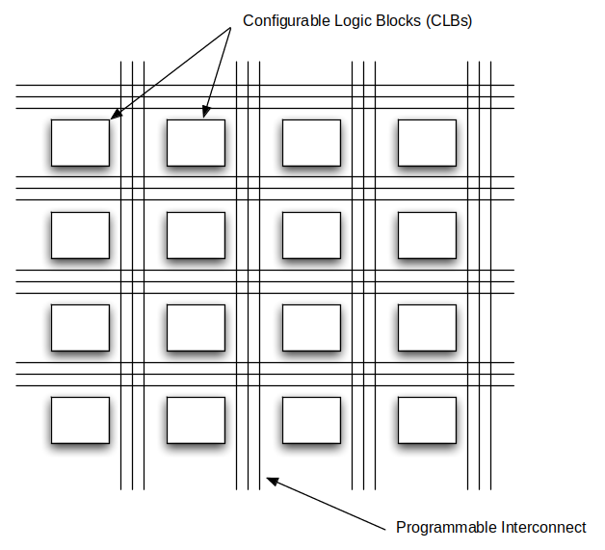
FPGA
A Field Programmable Gate Array contains a collection of configurable logic elements and a programmable interconnect that can be set up to perform the desired logical operations.
CIS 501: Comp. Arch. | Dr. Joe Devietti | Hardware Description

Slide 30
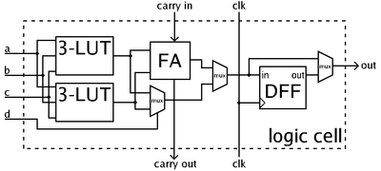
Configurable Logic Blocks
Each of the configurable logic blocks (or logic cells) contains some lookup tables and one or more flip-flops.
By setting the entries in the lookup tables (LUTs) these units can be programmed to implement arbitrary logical functions on their inputs.
http://en.wikipedia.org/wiki/Field-programmable_gate_array
ZedBoard has 85K logic cells
CIS 501: Comp. Arch. | Dr. Joe Devietti | Hardware Description
Notes:
walkthrough LUT-as-gate

Slide 31
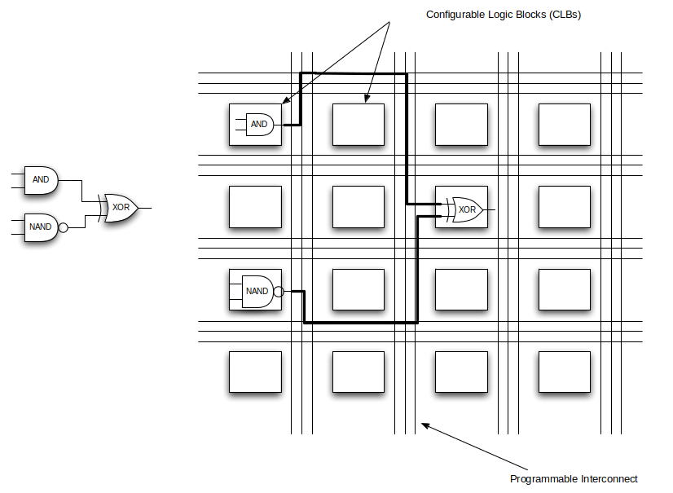
Configuring FPGAs
By configuring the CLBs and the interconnect the FPGA can be ‘programmed’ to implement the desired operation.
CIS 501: Comp. Arch. | Dr. Joe Devietti | Hardware Description

Slide 32
Hardware Design Methods
CIS 501: Comp. Arch. | Dr. Joe Devietti | Hardware Description

Slide 33
Hardware Design Methodologies
Fabricating a chip requires a detailed layout
  All transistors & wires
How does a hardware designer describe such design?
  (Bad) Option #1: draw all the masks “by hand”
    All 1 billion transistors? Umm…
  Option #2: use computer-aided design (CAD) tools to help
    Layout done by engineers with CAD tools or automatically
Design levels – uses abstraction
  Transistor-level design – designer specifies transistors (not layout)
  Gate-level design – designer specifics gates, wires (not transistors)
  Higher-level design – designer uses higher-level building blocks
    Adders, memories, etc.
    Or logic in terms of and/or/not, and tools translates into gates
CIS 501: Comp. Arch. | Dr. Joe Devietti | Hardware Description

Slide 34
Describing Hardware
Two general options
Schematics
  Pictures of gates & wires
Hardware description languages
  Use textual descriptions to specify hardware
Translation process called “synthesis”
  Textual description -> gates -> full layout
    Tries to minimizes the delay and/or number of gates
  Much like process of compilation of software
    Much slower!
CIS 501: Comp. Arch. | Dr. Joe Devietti | Hardware Description

Slide 35
Schematics
S
A
O
B
Draw pictures
  Use a schematic entry program to draw wires, logic blocks, gates
  Support hierarchical design (arbitrary nesting)
  Good match for hardware which is inherently spatial
  Time consuming, “non-scalable” (large designs are unreadable)
  Rarely used in practice (“real-world” designs are too big)
CIS 501: Comp. Arch. | Dr. Joe Devietti | Hardware Description

Slide 36
Hardware Description Languages (HDLs)
Write “code” to describe hardware
  HDL vs. SDL
  Specify wires, gates, modules (also hierarchical)
  Easier to create, edit, modify, scales well
  Misleading “sequential” representation: must still “think” spatially (gets easier with practice)
module mux2to1(S, A, B, Out);
input S, A, B;
output Out;
wire S_, AnS_, BnS;
not (S_, S);
and (AnS_, A, S_);
and (BnS, B, S);
or (Out, AnS_, BnS);
endmodule
S
A
Out
B
CIS 501: Comp. Arch. | Dr. Joe Devietti | Hardware Description

Slide 37
(Hierarchical) HDL Example
Build up more complex modules using simpler modules
  Example: 4-bit wide mux from four 1-bit muxes
S
4
A
4
module mux2to1_4(S, A, B, Out);
input [3:0] A;
input [3:0] B;
input S;
output [3:0] Out;
mux2to1 mux0 (S, A[0], B[0], Out[0]);
mux2to1 mux1 (S, A[1], B[1], Out[1]);
mux2to1 mux2 (S, A[2], B[2], Out[2]);
mux2to1 mux3 (S, A[3], B[3], Out[3]);
endmodule
4
Out
B
CIS 501: Comp. Arch. | Dr. Joe Devietti | Hardware Description
Notes:
Key point – abstraction of designs.

Slide 38
Verilog HDL
Verilog: HDL we will be using
  Syntactically similar to C (by design)
  Ease of syntax hides fact that this isn’t C (or any software lang)
  We will use a few lectures to learn Verilog
module mux2to1_4(S, A, B, Out);
input [3:0] A;
input [3:0] B;
input S;
output [3:0] Out;
mux2to1 mux0 (S, A[0], B[0], Out[0]);
mux2to1 mux1 (S, A[1], B[1], Out[1]);
mux2to1 mux2 (S, A[2], B[2], Out[2]);
mux2to1 mux3 (S, A[3], B[3], Out[3]);
endmodule
These aren’t variables
These aren’t function calls
CIS 501: Comp. Arch. | Dr. Joe Devietti | Hardware Description

Slide 39
HDLs are not “SDLs”
SDL == Software Description Language (e.g., Java, C)
Similar in some (intentional) ways …
  Syntax
    Named entities, constants, scoping, etc.
  Tool chain: synthesis tool analogous to compiler
    Multiple levels of representation
    “Optimization”
    Multiple targets (portability)
  “Software” engineering
    Modular structure and parameterization
    Libraries and code repositories
… but different in many others
  One of the most difficult conceptual leaps of this course
CIS 501: Comp. Arch. | Dr. Joe Devietti | Hardware Description

Slide 40
Hardware is not Software
Just two different beasts (or two parts of the same beast)
  Things that make sense in hardware, don’t in software, vice versa
  One of the main themes of this course
Software is sequential
  Hardware is inherently parallel and “always on”
  Have to work to get hardware to not do things in parallel
Software atoms are purely functional (“digital”)
  Hardware atoms have quantitative (“analog”) properties too
  Including correctness properties!
Software mostly about quality (“functionality”)
  Hardware mostly about quantity: performance, area, power, etc.
One reason that HDLs are not SDLs
CIS 501: Comp. Arch. | Dr. Joe Devietti | Hardware Description
Notes:
Tip write Verilog but think in terms of schematics.

Slide 41
HDL: Behavioral Constructs
HDLs have low-level structural constructs
  Specify hardware structures directly
  Transistors, gates (and, not) and wires, hierarchy via modules
Also have mid-level behavioral constructs
  Specify operations, not hardware to perform them
  Low-to-medium-level: &, ~, +, *
Also higher-level behavioral constructs
  High-level: if-then-else, for loops
  Some of these are synthesizable (some are not)
    Tools try to guess what you want, often highly inefficient
    Higher-level → more difficult to know what it will synthesize to!
HDLs are both high- and low-level languages in one!
  And the boundary is not clear!
CIS 501: Comp. Arch. | Dr. Joe Devietti | Hardware Description

Slide 42
HDL: Simulation
Another use of HDL: simulating & testing a hardware design
  Cheaper & faster turnaround (no need to fabricate)
  More visibility into design (“debugger” interface)
HDLs have features just for simulation
  Higher level data types: integers, FP-numbers, timestamps
  Routines for I/O: error messages, file operations
  Obviously, these cannot be synthesized into circuits
Also another reason for HDL/SDL confusion
  HDLs have “SDL” features for simulation
CIS 501: Comp. Arch. | Dr. Joe Devietti | Hardware Description
Notes:
Verilog actually designed to support simulation more than synthesis – idea was you would come up with a design and then in the same language write code for testing the design hence a lot of constructs for doing looping and input output that are not related to hardware layout cannot be synthesized.

Slide 43
FPGA “Design Flow”
netlist
(wires, gates, FFs)
implementation
(place & route)
HDL source code
bitstream
synthesis
simulation
Hardware compilers are generally much slower than their software counterparts
  solving hard problems: many more choices, optimizing for area, power, picosecond-level timing
CIS 501: Comp. Arch. | Dr. Joe Devietti | Hardware Description

Slide 44
Side note: High-Level Synthesis
Translate “C to gates”
write hardware at a higher level of abstraction than conventional HDLs
  greater programmer productivity
  need to write stylized C that will synthesize well
  tools are still slow
  take ESE 532 to learn (much!) more
CIS 501: Comp. Arch. | Dr. Joe Devietti | Hardware Description

Slide 45
Verilog HDL
CIS 501: Comp. Arch. | Dr. Joe Devietti | Hardware Description

Slide 46
HDL History
1970s:
  First HDLs
Late 1970s: VHDL
  VHDL = VHSIC HDL = Very High Speed Integrated Circuit HDL
  VHDL inspired by programming languages of the day (Ada)
1980s:
  Verilog first introduced
  Verilog inspired by the C programming language
  VHDL standardized
1990s:
  Verilog standardized (Verilog-1995 standard)
2000s:
  Continued evolution (Verilog-2001 standard)
Both VHDL and Verilog are evolving, still in use today
CIS 501: Comp. Arch. | Dr. Joe Devietti | Hardware Description

Slide 47
Modern HDLs
BlueSpec
  MIT startup from 2003
  more functional style, richer types
  inspired by Haskell
Chisel
  from Berkeley in 2012
  embedded DSL in Scala
CIS 501: Comp. Arch. | Dr. Joe Devietti | Hardware Description

Slide 48
Verilog HDL
Verilog is a (surprisingly) big language
  Structural constructs at both gate and transistor level
  Facilities for specifying memories
  Precise timing specification and simulation
  Lots of “behavioral” constructs
  C-style procedural variables, including arrays
  A pre-processor
  VPI: Verilog programming interface
  …
CIS 501: Comp. Arch. | Dr. Joe Devietti | Hardware Description

Slide 49
Our Verilog HDL
We’re going to learn a focused subset of Verilog
  Focus on synthesizable constructs
  Focus on avoiding subtle synthesis errors
  Use as an educational tool
For synthesis
  Structural constructs at gate-level only
  A few behavioral constructs
Some testing and debugging features
Rule 1: if you haven’t seen it in lecture, you can’t use it!
Rule 1a: when in doubt, ask!
CIS 501: Comp. Arch. | Dr. Joe Devietti | Hardware Description

Slide 50
Basic Verilog Syntax
Have already seen basic syntax, looks like C
  C/C++/Java style comments
  Names are case sensitive, and can use _ (underscore)
  Avoid: clock, clk, power, pwr, ground, gnd, vdd, vcc, init, reset, rst
  Some of these are “special” and will silently cause errors
/* this is a module */
module mux2to1(input wire S, input wire A,
input wire B,
output wire Out);
wire S_, AnS_, BnS;
// these are gates
not (S_, S);
and (AnS_, A, S_);
and (BnS, B, S);
or (Out, AnS_, BnS);
endmodule
CIS 501: Comp. Arch. | Dr. Joe Devietti | Hardware Description

Slide 51
(Gate-Level) Structural Verilog
Primitive “data type”: wire
  Have to declare it
Structural
module mux2to1(input wire S, input wire A,
input wire B,
output wire Out);
wire S_, AnS_, BnS;
not (S_, S);
and (AnS_, A, S_);
and (BnS, B, S);
or (Out, AnS_, BnS);
endmodule
S
A
Out
B
CIS 501: Comp. Arch. | Dr. Joe Devietti | Hardware Description

Slide 52
(Gate-Level) Structural Verilog
Primitive “operators”: gates
  Specifically: and, or, xor, nand, nor, xnor, not, buf
  Can be multi-input: e.g., or (C, A, B, D) (C= A+B+D)
  “Operator” buf just repeats input signal (may amplify it)
Structural
module mux2to1(input wire S, input wire A,
input wire B,
output wire Out);
wire S_, AnS_, BnS;
not (S_, S);
and (AnS_, A, S_);
and (BnS, B, S);
or (Out, AnS_, BnS);
endmodule
S
A
Out
B
CIS 501: Comp. Arch. | Dr. Joe Devietti | Hardware Description

Slide 53
(Gate-Level) Behavioral Verilog
Primitive “operators”: boolean operators
  Specifically: &, |, ^, ~
  Can be combined into expressions
  Can be mixed with structural Verilog
“Behavioral” (Synthesizable)
module mux2to1(input wire S, input wire A,
input wire B,
output wire Out);
wire S_, AnS_, BnS;
assign S_ = ~S;
assign AnS_ = A & S_;
assign BnS = B & S;
assign Out = AnS_ | BnS;
endmodule
S
A
Out
B
CIS 501: Comp. Arch. | Dr. Joe Devietti | Hardware Description
Notes:
The difference – Structural specifies what structures you want to create. Behavioral says this is what I want the system to do – I don’t care how you do it.

Slide 54
Wire Assignment
Wire assignment:
  Connect combinational logic block or other wire to wire input
  Order of statements not important, executed totally in parallel
  When right-hand-side changes, it is re-evaluated and re-assigned
  Designated by the keyword assign
“Behavioral” (Synthesizable)
module mux2to1(input wire S, input wire A,
input wire B,
output wire Out);
wire S_, AnS_, BnS;
assign S_ = ~S;
assign AnS_ = A & S_;
assign BnS = B & S;
assign Out = AnS_ | BnS;
endmodule
S
A
Out
B
CIS 501: Comp. Arch. | Dr. Joe Devietti | Hardware Description

Slide 55
Wire Assignment
Assignment can be combined with declaration
wire c = a | b;
“Behavioral” (Synthesizable)
S
module mux2to1(input wire S, input wire A,
input wire B,
output wire Out);
wire S_ = ~S;
wire AnS_ = A & S_;
wire BnS = B & S;
assign Out = AnS_ | BnS;
endmodule
A
Out
B
CIS 501: Comp. Arch. | Dr. Joe Devietti | Hardware Description

Slide 56
(Gate-Level) Behavioral Verilog
Primitive “operators”: boolean operators
  Specifically: &, |, ^, ~
  Can be combined into expressions
  Can be mixed with structural Verilog
“Behavioral” (Synthesizable)
S
module mux2to1(input wire S,
input wire A,
input wire B,
output wire Out);
assign Out = (~S & A) | (S & B);
endmodule
A
Out
B
CIS 501: Comp. Arch. | Dr. Joe Devietti | Hardware Description

Slide 57
Best Way to do a Mux
Verilog supports ?: conditional assignment operator
  Much more useful (and common) in Verilog than in C/Java
“Behavioral” (Synthesizable)
S
module mux2to1(input wire S,
input wire A,
input wire B,
output wire Out);
assign Out = S ? B : A;
endmodule
A
Out
B
CIS 501: Comp. Arch. | Dr. Joe Devietti | Hardware Description

Slide 58
Wires Are Not C-like Variables!
Order of assignment doesn’t matter
  This works fine
module mux2to1(input wire S,
input wire A,
input wire B,
output wire Out);
assign Out = AnS_ | BnS;
assign BnS = B & S;
assign AnS_ = A & S_;
assign S_ = ~S;
endmodule
Can’t “reuse” a wire
assign temp = a & b;
assign temp = a | b;
  Actually, you can; but doesn’t do what you think it does
CIS 501: Comp. Arch. | Dr. Joe Devietti | Hardware Description
Notes:
What does reusing a wire do? Puts two signals onto the same wire! Helpfully referred to as a “net with multiple drivers”

Slide 59
Wire Vectors
Wire vectors: also called “arrays” or “buses”
wire [7:0] w1; // 8 bits, w1[7] is most significant bit
wire [0:7] w2; // 8 bits, w2[0] is most significant bit
Example:
module mux2to1(input wire S,
input wire [7:0] A,
input wire [7:0] B,
output wire [7:0] Out);
assign Out = S ? B : A;
endmodule
Operations
  Bit select: vec[3]
  Range select: vec[3:2]
  Concatenate: assign vec = {w, x, y, z};
Unlike C, array range is part of type, not variable!
CIS 501: Comp. Arch. | Dr. Joe Devietti | Hardware Description

Slide 60
Wire and Wire Vector Constants
wire [3:0] w = 4’b0101;
  The “4” is the number of bits﻿
  The “b” means “binary” - “h” for hex, “o” for octal, “d” for decimal
  The “0101” are the digits (in binary in this case)
wire [3:0] w = 4’d5; // same thing, effectively
  Here is a single wire constant
wire w = 1’b0;
  A useful example of wire-vector constants:
module mux4to1(input [1:0] Sel, input A, input B, input C, input D, output Out);
assign Out = (Sel == 2’d0) ? A :
(Sel == 2’d1) ? B :
(Sel == 2’d2) ? C : D;
endmodule
CIS 501: Comp. Arch. | Dr. Joe Devietti | Hardware Description

Slide 61




Repeated Signals
Concatenation
wire vec[2:0] = {x, y, z};
Can also repeat a signal n times
wire vec[15:0] = {16{x}}; // 16 copies of x
{{a,b},{c,d}} = {a, b, c, d}
Example uses (what does this do?):
wire [7:0] out;
wire [3:0] A;
assign out = {{4{1’d0}}, A[3:0]};
What about this?
assign out = {{4{A[3]}}, A[3:0]};
8’b0000A3A2A1A0
8’bA3A3A3A3A3A2A1A0
CIS 501: Comp. Arch. | Dr. Joe Devietti | Hardware Description
Notes:
Zero extend & Sign extend

Slide 62


Gate-Level Vector Operators
Verilog also supports behavioral vector operators
Logical bitwise and reduction: ~,&,|,^
wire [7:0] vec1, vec2;
wire [7:0] vec3 = vec1 & vec2; // bitwise AND
wire w1 = |vec1; // OR reduction
Integer arithmetic comparison: +,–,*,/,%,==,!=,<,>
wire [7:0] vec4 = vec1 + vec2; // vec1 + vec2
  Important: all arithmetic is unsigned by default
  Good: in signed/unsigned integers: +, –, * produces same output
    Just a matter of interpretation
  Bad: in signed/unsigned integers: / % is not the same
CIS 501: Comp. Arch. | Dr. Joe Devietti | Hardware Description

Slide 63
Signed types
All wires are unsigned by default
Verilog supports signed types as well
  changes the semantics of comparison operators < > <= >=
  permits use of >>> arithmetic shift operator
  useful for implementing CMP,SRA insns
Vivado lets you intermix signed and unsigned types
  use signed sparingly to avoid confusion
wire signed [3:0] s; // signed wire
assign s = …;
wire out = (s > 1) ? 1’b0 : 1’b1 ;
wire [3:0] sra = s >>> amt[1:0];
// $signed() operator on an unsigned wire
wire [3:0] u;
wire out2 = ($signed(u) > 2) ? 1’b0 : 1’b1;
CIS 501: Comp. Arch. | Dr. Joe Devietti | Hardware Description
Notes:
no simulation/synth error for mixed-sign comparison

Slide 64
Why Use a High-Level Operator?
Abstraction
  Why write assembly, when you can write C? (yay?)
Take advantage of built-in high level implementation
  Zedboard FPGAs have integer adders/multipliers on them
  Xilinx will use these rather than synthesizing a multiplier from gates
    Much faster and more efficient
  How hard is it for Xilinx to figure out you were doing a multiply?
    If you use “*”: easy
    If you “roll your own” using gates: nearly impossible
Why not use high-level operators?
  Less certain what they will synthesize to
  Or even if it will synthesize at all
CIS 501: Comp. Arch. | Dr. Joe Devietti | Hardware Description

Slide 65
Hierarchical Design using Modules
Old-style interface specification
module mux2to1(Sel, A, B, Out);
input Sel, A, B;
output Out;
  Can also have inout: bidirectional wire (we will not use this)
Recommended Alternative: Verilog 2001 interfaces
module mux2to1(input wire Sel, A, B, output Out);
A and B share same type as Sel. Convenient, but dangerous!
Declarations
  Internal wires, i.e., “locals”
  Wires also called “nets” or “signals”
wire S_, AnS_, BnS;
Implementation: primitive and module instantiations
and (AnS_, A, S_);
CIS 501: Comp. Arch. | Dr. Joe Devietti | Hardware Description

Slide 66
Verilog Module Example
module mux2to1(input wire Sel,
input wire A,
input wire B,
output wire Out);
wire S_, AnS_, BnS;
not (S_, Sel);
and (AnS_, A, S_);
and (BnS, B, Sel);
or (Out, AnS_, BnS);
endmodule
S
A
O
B
Instantiation: mux2to1 mux0 (cond, in1, in2, out);
  Non-primitive module instances must be named (helps debugging)
Operators and expressions can be used with modules
  ﻿mux2to1 mux0 (cond1 & cond2, in1, in2, out);
CIS 501: Comp. Arch. | Dr. Joe Devietti | Hardware Description

Slide 67
Hierarchical Verilog Example
Build up more complex modules using simpler modules
Example: 4-bit wide mux from four 1-bit muxes
  Again, just “drawing” boxes and wires
module mux2to1_4(input wire Sel,
input wire [3:0] A,
input wire [3:0] B,
output wire [3:0] Out);
mux2to1 mux0 (Sel, A[0], B[0], Out[0]);
mux2to1 mux1 (Sel, A[1], B[1], Out[1]);
mux2to1 mux2 (Sel, A[2], B[2], Out[2]);
mux2to1 mux3 (Sel, A[3], B[3], Out[3]);
endmodule
CIS 501: Comp. Arch. | Dr. Joe Devietti | Hardware Description
Notes:
Note that mux0 – mux3 are named

Slide 68
Connections via Named Association
ALWAYS specify module connections by name
  Like named parameters/keyword arguments in SDLs
  Helps keep the bugs away
  Bad example
mux2to1 mux0 (res, s, a, b);
  Good example
mux2to1 mux0 (.Sel(s), .A(a), .B(b), .Out(res));
  Also, order becomes irrelevant
mux2to1 mux1 (.A(a), .B(b), .Out(res), .Sel(s));
CIS 501: Comp. Arch. | Dr. Joe Devietti | Hardware Description

Slide 69
Generate construct
basic metaprogramming to reduce repetition
for loop must have a fixed bound
module mux2to1_4(input wire Sel,
input wire [3:0] A,
input wire [3:0] B,
output wire [3:0] Out);
genvar i;
for (i = 0; i < 4; i = i+1) begin
mux2to1 m(.Sel(Sel),.A(A[i]),.B(B[i]),
.Out(Out[i]));
end
endmodule
CIS 501: Comp. Arch. | Dr. Joe Devietti | Hardware Description

Slide 70
Per-Instance Module Parameters
Module parameters: useful for defining varying bus widths
module Nbit_mux2to1 (input wire Sel,
input wire [N-1:0] A,
input wire [N-1:0] B,
output wire [N-1:0] Out);
parameter N = 1;
assign Out = Sel ? B : A;
endmodule
  Two ways to instantiate: implicit
Nbit_mux2to1 #(4) mux1 (.Sel(S),.A(in1),.B(in2),.Out(out));
  And explicit
Nbit_mux2to1 mux1 (.Sel(S),.A(in1),.B(in2),.Out(out));
defparam mux1.N = 4;
  Multiple parameters per module allowed
CIS 501: Comp. Arch. | Dr. Joe Devietti | Hardware Description

Slide 71
Per-Instance Module Parameters
localparam: a parameter that is only visible within a module
  a constant, scoped to that module
CIS 501: Comp. Arch. | Dr. Joe Devietti | Hardware Description

Slide 72
Getting Fancy: Generate and Parameters
module rca
#(parameter N = 4)
(input wire [N-1:0] a,
input wire [N-1:0] b,
output wire [N-1:0] s);
wire [N:0] carry;
assign carry[0] = 1'b0;
genvar i; // skip optional “generate” keyword
for (i=0; i<N; i = i+1) begin
fulladder f(.cin(carry[i]),.a(a[i]),.b(b[i]),
.s(s[i]),.cout(carry[i+1]));
end
endmodule
CIS 501: Comp. Arch. | Dr. Joe Devietti | Hardware Description

Slide 73
Verilog Pre-Processor
Like the C pre-processor
  But uses ` (back-tick) instead of #
  Constants: `define
    No parameterized macros
    Use ` before expanding constant macro
`define letter_A 8’h41
wire w[7:0] = `letter_A;
  Conditional compilation: `ifdef, `endif
  File inclusion: `include
Parameter vs `define
  A parameter is scoped to a module instance
  A `define is scoped to a file (potentially across modules)
  Can use parameters as constants
CIS 501: Comp. Arch. | Dr. Joe Devietti | Hardware Description

Slide 74
Verilog Errata
Wires have binary values: 0 or 1
  except when they don’t: x and z are undefined values
No particular naming convention for modules and their files
  Unlike, say, Java public classes
No “imports” or “libraries”
  There are ways to do this, to integrate 3rd-party Intellectual Property (IP) into your design. We won’t explore this.
CIS 501: Comp. Arch. | Dr. Joe Devietti | Hardware Description

Slide 75
Verilog testing constructs
integer, reg types
  correspond to storage (unlike wire which is stateless)
  DO NOT use these outside of testing!
    we’ll see this later: reg will synthesize into a latch/FF
delay statement
  #10; means “wait 10 cycles”
for/while loops
  allow iterating over test inputs
$display()
  printf-like output
  $display(“wire was %b", a);
$finish
  ends the simulation
CIS 501: Comp. Arch. | Dr. Joe Devietti | Hardware Description
Notes:
big source of bugs is latches/FFs showing up where they shouldn’t

Slide 76
Sequential Logic
CIS 501: Comp. Arch. | Dr. Joe Devietti | Hardware Description

Slide 77
Two Types of Digital Circuits
Combinational Logic
  Logic without state variables
  Examples: adders, multiplexers, decoders, encoders
  No clock involved
Sequential Logic
  Logic with state variables
  State variables: latches, flip-flops, registers, memories
  Clocked
  State machines, multi-cycle arithmetic, processors
Sequential Logic in Verilog
  Special idioms using behavioral constructs that synthesize into latches, memories
CIS 501: Comp. Arch. | Dr. Joe Devietti | Hardware Description

Slide 78
Sequential Logic & Synchronous Systems
Combinational
Logic
Storage
Element
Clock
Processors are complex fine state machines (FSMs)
  Combinational (compute) blocks separated by storage elements
    State storage: memories, registers, etc.
Synchronous systems
  Clock: global signal acts as write enable for all storage elements
    Typically marked as triangle
  All state elements write together, values move forward in lock-step
  Simplifies design: design combinational blocks independently
Aside: asynchronous systems
  Same thing, but … no clock
  Values move forward using explicit handshaking
  May have some advantages, but difficult to design
CIS 501: Comp. Arch. | Dr. Joe Devietti | Hardware Description

Slide 79
Datapath Storage Elements
datapath
fetch
Insn
memory
Register
File
Data
Memory
PC
control
Three main types of storage elements
  Singleton registers: PC
  Register files: ISA registers
  Memories: insn/data memory
CIS 501: Comp. Arch. | Dr. Joe Devietti | Hardware Description

Slide 80
S-R Latch
S-R (set-reset) latch
  Cross-coupled NOR gates
  Distinct inputs/outputs
S,R → Q
0,0 → oldQ
0,1 → 0
1,0 → 1
1,1 → 0
  S=0, R=0? circuit degenerates to cross-coupled INVs
  S=1, R=1? not very useful
  Not really used … except as component in something else
R
Q
Q’
S
R
Q
SR
S
CIS 501: Comp. Arch. | Dr. Joe Devietti | Hardware Description

Slide 81
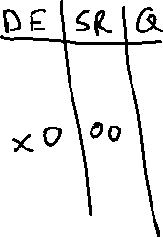

D Latch
D latch: S-R latch + …
  add Enable signal that makes S=R=1 impossible
E,D → Q
0,0 → oldQ
0,1 → oldQ
1,0 → 0
1,1 → 1
  In other words
0,D → oldQ
1,D → D
  In words
    When E is 1, Q gets D
    When E is 0, Q retains old value
D
Q
E
D
Q
DL
E
CIS 501: Comp. Arch. | Dr. Joe Devietti | Hardware Description

Slide 82
Timing Diagrams
Voltage {0,1} diagrams for different nodes in system
  “Digitally stylized”: changes are vertical lines (instantaneous?)
  Reality is analog, changes are continuous and smooth
Timing diagram for a D latch
E
D
Q
CIS 501: Comp. Arch. | Dr. Joe Devietti | Hardware Description

Slide 83
Triggering: Level vs. Edge
E
D
Q
The D-latch is level-triggered
  The latch is open for writing as long as E is 1
  If D changes continuously, so does Q
  Usually not the functionality we want
Often easier to reason about an edge-triggered latch
  The latch is open for writing only on E transition (0 → 1 or 1 → 0)
  Don’t need to worry about fluctuations in value of D
CIS 501: Comp. Arch. | Dr. Joe Devietti | Hardware Description

Slide 84
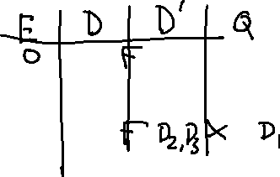

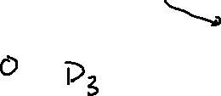



D Flip-Flop
D Flip-Flop:
  Sequential D-latches
  Enabled by inverse signals
  First latch open when E = 0
  Second latch open when E = 1
  Overall effect?
    D flipflop latches D on 0→1 transition
  E is the “clock” signal input
D
Q
DL
DL
E
D
Q
FF
E
E
D
Q
CIS 501: Comp. Arch. | Dr. Joe Devietti | Hardware Description
Notes:
Old value of D is Q, Q stops following D’ then D’ starts following D.
Q starts following D’ gets D1, the last value before edge; current changes in D (D2) ignored
Q stops following D’ ; D1 stays in Q; D’ then starts following D3 no change on downward edge
Q starts following D’; D3 goes to Q; then D’ stops following D; D4 ignored

Slide 85
FF_{WE}: FF with Separate Write Enable
FF_{WE}: FF with separate write enable
  FF D(ata) input is MUX of D and Q, WE selects
  Bad idea: why not just AND the CLK and WE?
    Fewer gates
    Creates timing problems
      Do not try to do logic on CLK in Verilog
      No, really. Never do this.
D
Q
Q
FF
D
FF_{WE}
WE
WE
CIS 501: Comp. Arch. | Dr. Joe Devietti | Hardware Description

Slide 86
N-bit Register
D₀
Q₀
FF_{WE}
D₁
Q₁
n
n
FF_{WE}
D
Q
D_{N-1}
Q_{N-1}
FF_{WE}
WE
Register: one n-bit storage word
  Non-multiplexed input/output: data buses write/read same word
Implementation: FF_{WE} array with shared write-enable (WE)
  FFs written on CLK edge if WE is 1 (or if there is no WE)
WE
CIS 501: Comp. Arch. | Dr. Joe Devietti | Hardware Description

Slide 87
Sequential Logic in Verilog
CIS 501: Comp. Arch. | Dr. Joe Devietti | Hardware Description

Slide 88
Designing Sequential Logic
key design rule: separate combinational logic from sequential state elements
  Not enforced by Verilog, but a very good idea
  Possible exceptions: counters, shift registers
We’ll give you a flip-flop module (see next slide)
  Edge-triggered, not a transparent latch
  Parameterized to create an n-bit register
Example use: state machine
Clock
State
Register
Combinational
Logic
Output
Current
State
Next State
CIS 501: Comp. Arch. | Dr. Joe Devietti | Hardware Description

Slide 89
Sequential Logic In Verilog
How are state-holding variables specified in Verilog?
  First instinct: structurally
  After all, real latches and flip-flops are made from gates…
module latch(out, in, we);
output out; input in, we;
wire not_out = ~(out | (we & ~in));
assign out = ~(not_out | (we & in));
endmodule
This should work, right? RIGHT?
  Logically, yes… in practice, no
    Storage elements are highly analog
    FPGAs have dedicated storage
in
out
we
CIS 501: Comp. Arch. | Dr. Joe Devietti | Hardware Description

Slide 90
Verilog Flipflop (Behavioral Magic)
How do we specify state-holding constructs in Verilog?
module dff (output wire out,
input wire in, input wire writeEnable,
input wire reset, input wire clock);
reg out;
always @(posedge clock)
begin
if (reset)
out = 0;
else if (writeEnable)
out = in;
end
endmodule
reg: storage bit
always @ (): synthesizable behavioral sequential Verilog
  Tricky: hard to know exactly what it will synthesize to
  We will give this to you,
  don’t write your own
  “Creativity is a poor substitute for knowing what you’re doing”
CIS 501: Comp. Arch. | Dr. Joe Devietti | Hardware Description

Slide 91
Verilog Register (Behavioral Magic)
How do we specify state-holding constructs in Verilog?
module register (output wire [n-1:0] out,
input wire [n-1:0] in, input wire writeEnable,
input wire reset, input wire clock);
parameter n = 1;
reg [n-1:0] out;
always @(posedge clock)
begin
if (reset)
out = 0;
else if (writeEnable)
out = in;
end
endmodule
reg: interface-less storage bit
always @ (): synthesizable behavioral sequential Verilog
  Tricky: hard to know exactly what it will synthesize to
  We will give this to you,
  don’t write your own
  “Creativity is a poor substitute for knowing what you’re doing”
CIS 501: Comp. Arch. | Dr. Joe Devietti | Hardware Description

Slide 92
Clock Signals
Clocks & reset signals are not normal signals
Travel on dedicated “clock” wires
  Reach all parts of the chip
  Special “low-skew” routing
Ramifications:
  Never do logic operations on the clocks
  If you want to add a “write enable” to a flip-flop:
    Use a mux to route the old value back into it
    (or use the flip-flop with write enable we give you!)
    Do not just “and” the write-enable signal with the clock!
Messing with the clock can cause a errors
  Often can only be found using detail low-level simulation
CIS 501: Comp. Arch. | Dr. Joe Devietti | Hardware Description

Slide 93
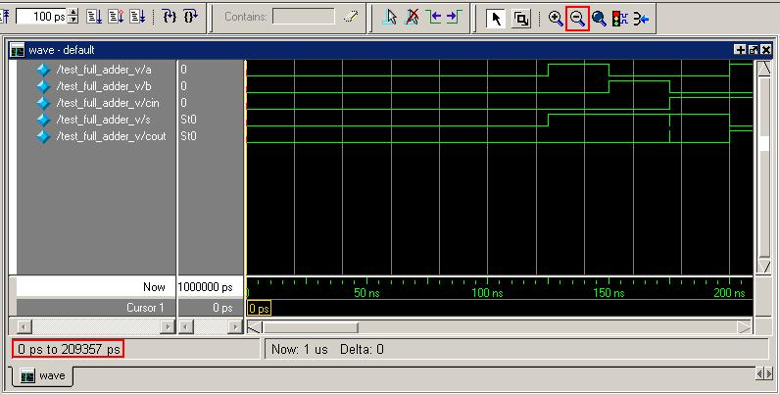
Simulation
One way to test and debug designs
Graphical output via waveforms
CIS 501: Comp. Arch. | Dr. Joe Devietti | Hardware Description

Slide 94
Testbenches
A more effective way to test & debug designs
In C/Java?
  Write test code in C/Java to test C/Java
  “Test harness”, “unit testing”
For Verilog/VHDL?
  Write test code in Verilog to test Verilog
  Verilog has advanced “behavioral” commands to facilitate this:
    Delay for n units of time
    Full high-level constructs: if, while, sequential assignment, ints
    Input/output: file I/O, output to display, etc.
CIS 501: Comp. Arch. | Dr. Joe Devietti | Hardware Description

Slide 95
Common Errors
Tools are from a less civilized time
  More like C, less like Java
  Assume that you mean what you say
Common errors:
  Not assigning a wire a value
  Assigning a wire a value more than once
  Implicit wire declarations (default to type “wire” 1-bit wide)
  Mis-matched wire assignment widths
﻿Avoid names such as:
  clock, clk, power, pwr, ground, gnd, vdd, vcc, init, reset, rst
  Some of these are “special” and will silently cause errors
CIS 501: Comp. Arch. | Dr. Joe Devietti | Hardware Description

Slide 96
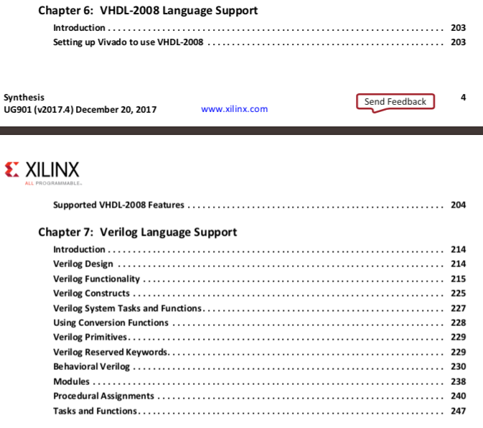
Official Vivado Verilog Reference
from Vivado Design Suite User Guide: Synthesis UG901 (v2017.4)
CIS 501: Comp. Arch. | Dr. Joe Devietti | Hardware Description

Slide 97
List of Verilog keywords
_{always} _{and} _{assign} _{automatic} _{begin} _{buf} _{bufif0} _{bufif1} _{case} _{casex} _{casez} _{cell*} _{cmos} _{config*} _{deassign} _{default} _{defparam} _{design*} _{disable} _{edge} _{else} _{end} _{endcase} _{endconfig*} _{endfunction} _{endgenerate} _{endmodule} _{endprimitive} | _{endspecify} _{endtable} _{endtask} _{event} _{for} _{force} _{forever} _{fork} _{function} _{generate} _{genvar} _{highz0} _{highz1} _{if} _{ifnone} _{incdir*} _{include*} _{initial} _{inout} _{input} _{instance*} _{integer} _{join} _{larger} _{liblist*} _{library*} _{localparam} _{macromodule} | _{medium} _{module} _{nand} _{negedge} _{nmos} _{nor} _{noshow-cancelled*} _{not} _{notif0} _{notif1} _{or} _{output} _{parameter} _{pmos} _{posedge} _{primitive} _{pull0} _{pull1} _{pullup*} _{pulldown*} _{pulsestyle_ondetect*} _{pulsestyle_onevent*} _{rcmos} _{real} _{realtime} _{reg} _{release} _{repeat} | _{rnmos} _{rpmos} _{rtran} _{rtranif0} _{rtranif1} _{scalared} _{show-cancelled*} _{signed} _{small} _{specify} _{specpa} _{strong0} _{strong1} _{supply0} _{supply1} _{table} _{task} _{time} _{tran} _{tranif0} _{tranif1} _{tri} _{tri0} _{tri1} _{triand} _{trior} _{trireg} _{use*} | _{vectored} _{wait} _{wand} _{weak0} _{weak1} _{while} _{wire} _{wor} _{xnor} _{xor}
from Chapter 7 of Vivado Design Suite User Guide: Synthesis UG901 (v2017.4)
CIS 501: Comp. Arch. | Dr. Joe Devietti | Hardware Description

Slide 98
Additional Verilog Resources
Elements of Logic Design Style by Shing Kong, 2001
  Do’s, do-not’s, other tips
  http://www.cis.upenn.edu/~milom/elements-of-logic-design-style/
Verilog HDL Synthesis: A Practical Primer
  By J. Bhasker, 1998
  To the point (<200 pages)
Advanced Digital Design with the Verilog HDL
  By Michael D. Ciletti, 2003
  Verilog plus lots of digital logic design (~1000 pages)
CIS 501: Comp. Arch. | Dr. Joe Devietti | Hardware Description

Slide 99
Summary
App
App
App
Transistors & fabrication
Digital logic basics
  Focus on useful components
Hardware design methods
  Introduction to Verilog
Next unit: fast arithmetic
System software
Mem
CPU
I/O
CIS 501: Comp. Arch. | Dr. Joe Devietti | Hardware Description

