Slide 1
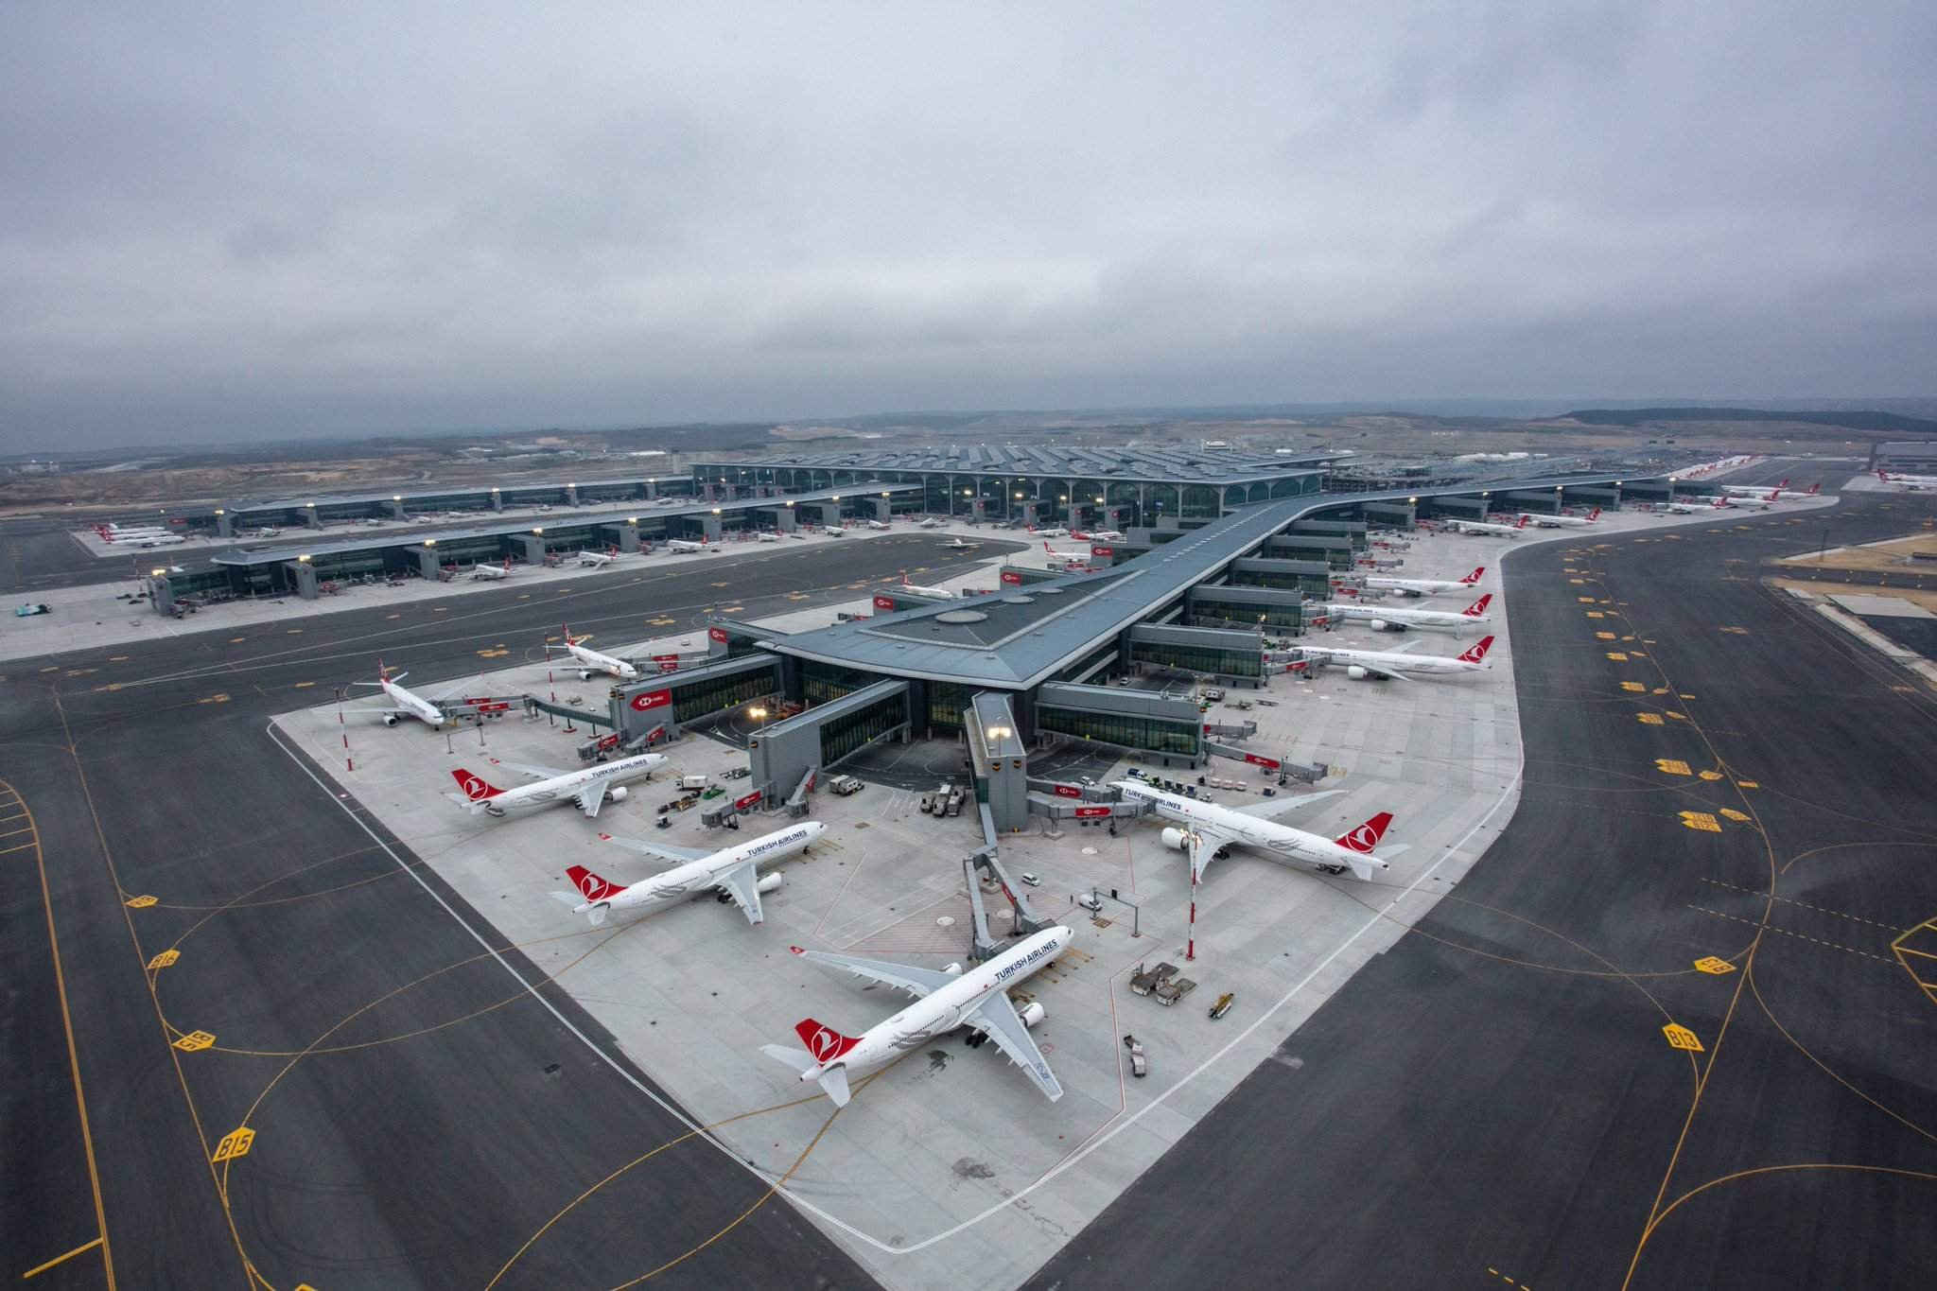
ONLINE AIRLINES DATABASE MANAGEMENT SYSTEM
Presented by :
Deepali ghumare
and
Abhishek sahani

Slide 2
General Description :-
Database management system helps making data more efficient and effective. This system stores, organises and manages a large amount of information within a single software application.
Our Project on airline database system holds flight details, Airport details , Airline details, user information's , passenger information's reservation records , payment records, fare and classes details etc.
We have used SQL as a language for applying queries. (Queries for insertion, deletion, updating, etc.)

Slide 3
Entity Sets & Attributes
Airlines( Airline_ID, Airline Name, AirportCode )
Classes ( Class_ID, ClassType, Class_description )
Flights( FlightNumber, Flight Name,DepartureDate, DepartureTime, ArrivalDate, ArrivalTime, Price, SeatCapacity, AirlineId, DepartureAirportCode, ArrivalAirportCode)
Fares ( Fare_ID, ClassId, Amount )
Passengers ( Passenger_ID, PassengerName, Email , Age, Gender, Phone number)
User( User_ID, FirstName, LastName, Email_ID, Phone number)
PaymentInformation( Payment_ID, CardNumber, ExpiryDate, CVV, BillingAddress,)
Reservations( Reservation_ID, ResrvationDate, Route, Amount)
Airport( Air_Code, Air_Name, City, State )

Slide 4
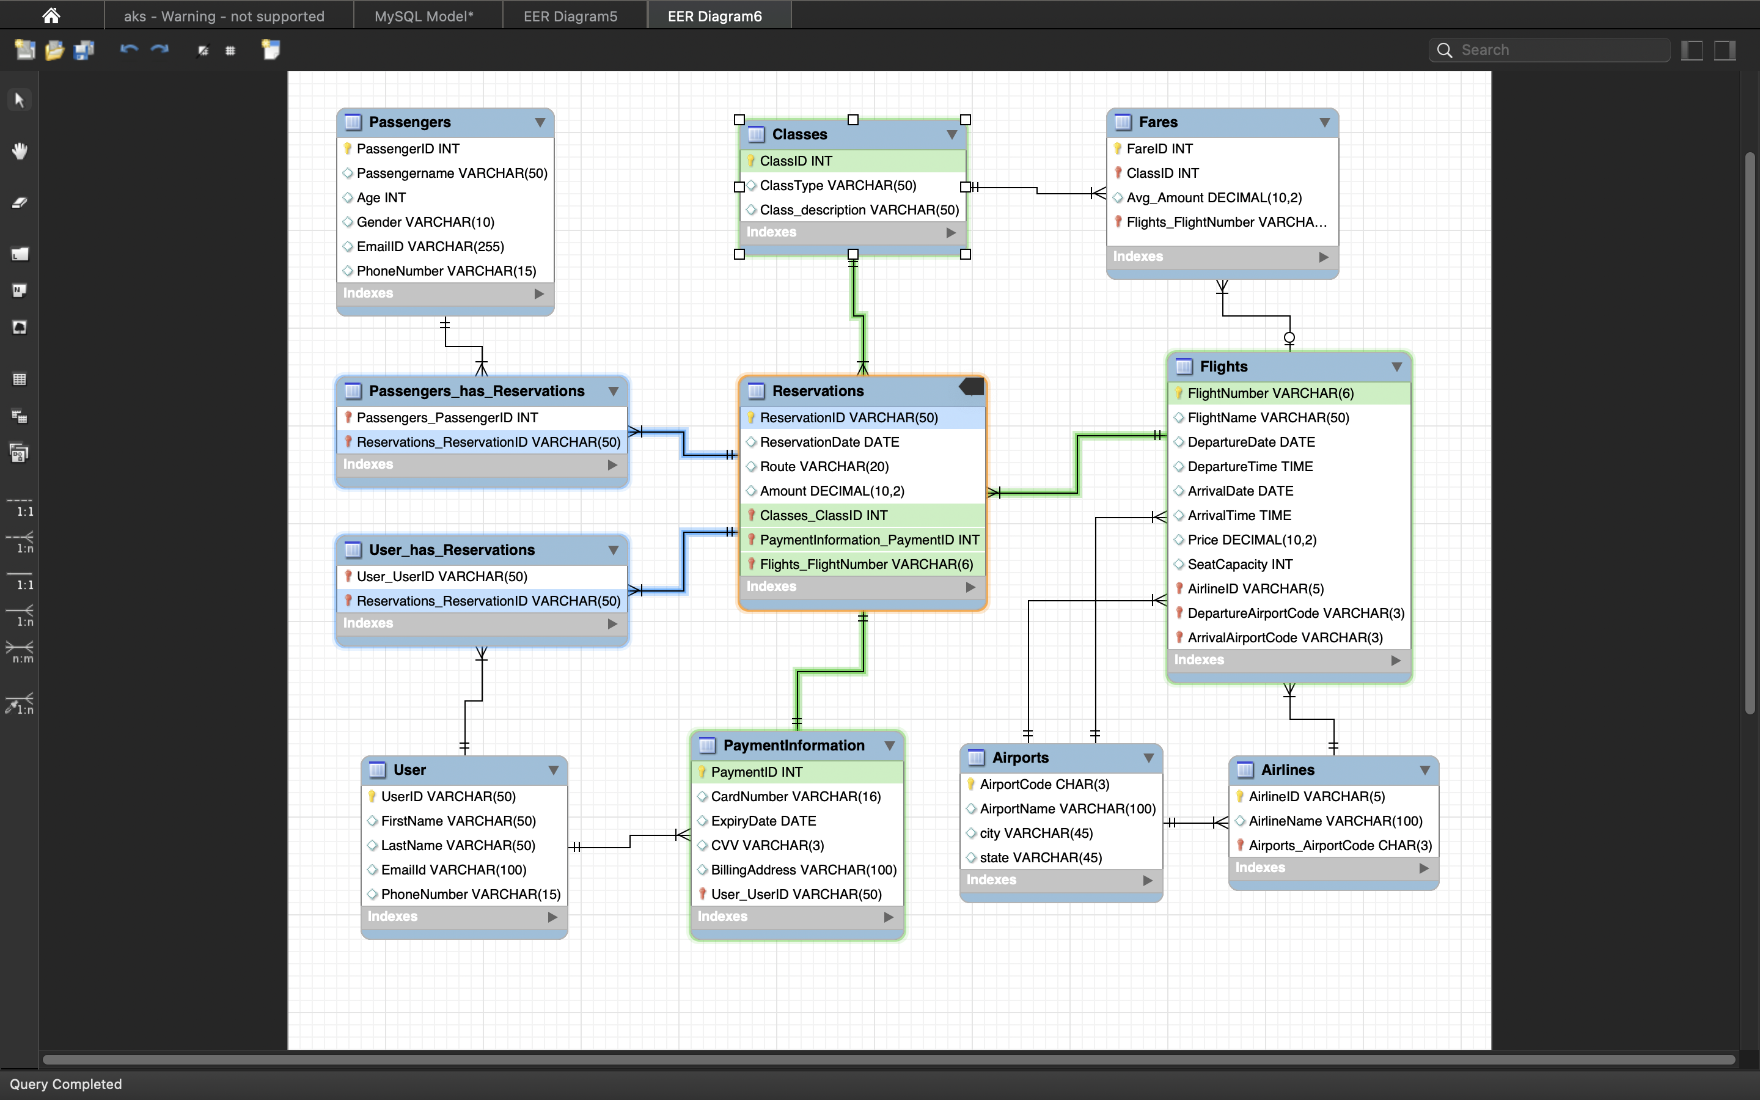
ER Diagram

Slide 5
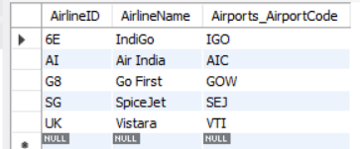
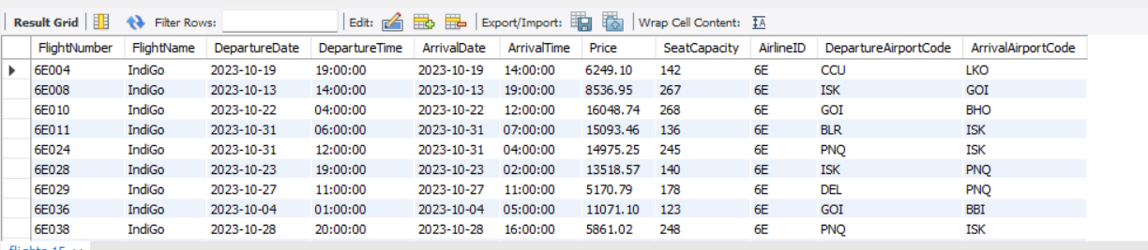
Insert Data
INSERT INTO Airline VALUES (’6E’,’Indigo’, IGO );
INSERT INTO Airline VALUES (AI, Air India,’AIC');
INSERT INTO Airline VALUES (G8,’Go Fast’,GOW);
INSERT INTO Airline VALUES (SG,'SpiceJet’,SEJ);
INSERT INTO Airline VALUES (UK,’Vistara’,VTI);
SELECT * FROM Airline;
Similarly
select * from flights;

Slide 6
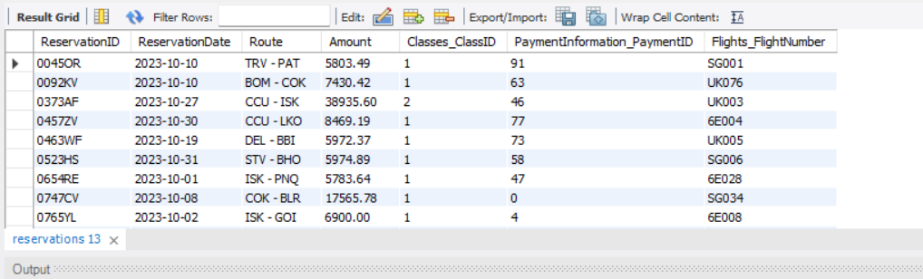
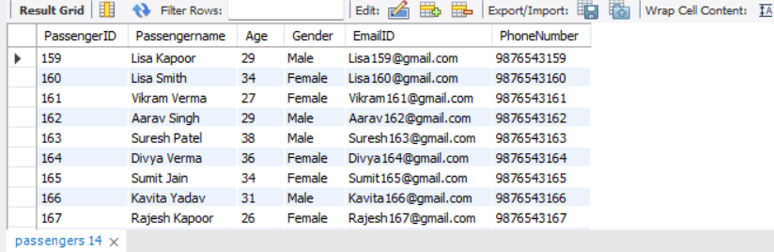
Select * from reservations;
select * from passengers;

Slide 7
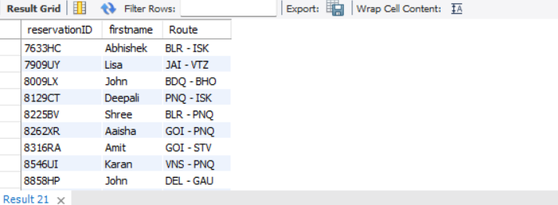
SQL QUERIES
Query 1: Display the reservationId , user’s first name and their route information for all flights.
SELECT r.reservationID, u.firstname, r.Route
FROM user u
JOIN user_has_reservations ur ON u.userID = ur.user_userID
JOIN reservations r ON ur.reservations_reservationID = r.reservationID
LIMIT 0, 10;

Slide 8
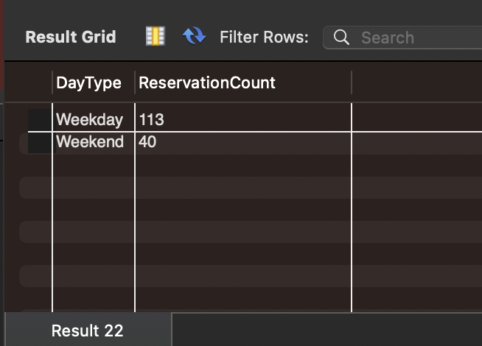
Query 2: find the count of bookings for each day of the week
SELECT
CASE WHEN DAYOFWEEK(ReservationDate) IN (1, 7) THEN 'Weekend' ELSE 'Weekday' END AS DayType,
COUNT(*) AS ReservationCount
FROM
Reservations
WHERE
MONTH(ReservationDate) = 10
GROUP BY
DayType;

Slide 9
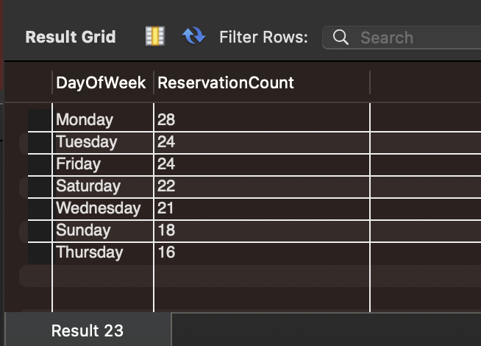
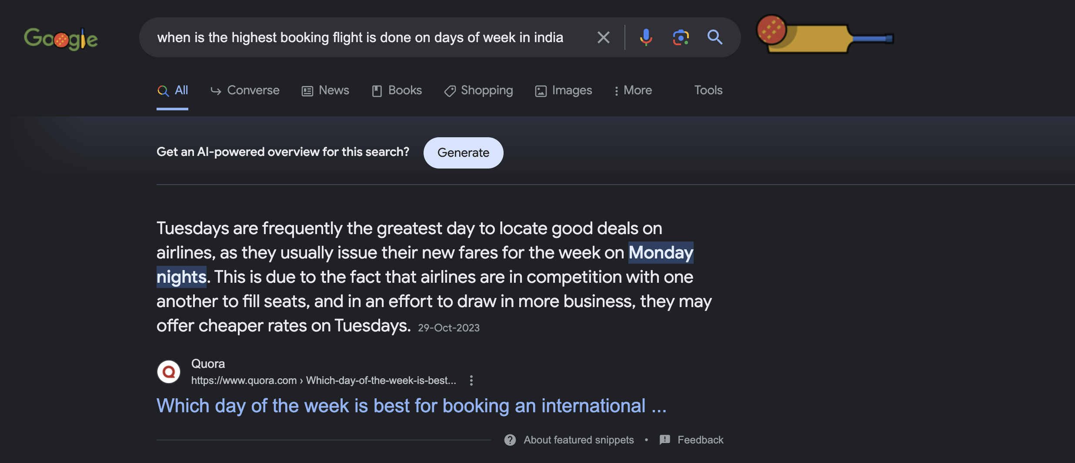
Also count reservations and the days of week
SELECT
DAYNAME(ReservationDate) AS DayOfWeek,
COUNT(*) AS ReservationCount
FROM
Reservations
WHERE
MONTH(ReservationDate) = 10
GROUP BY
DayOfWeek
ORDER BY
ReservationCount DESC;

Slide 10
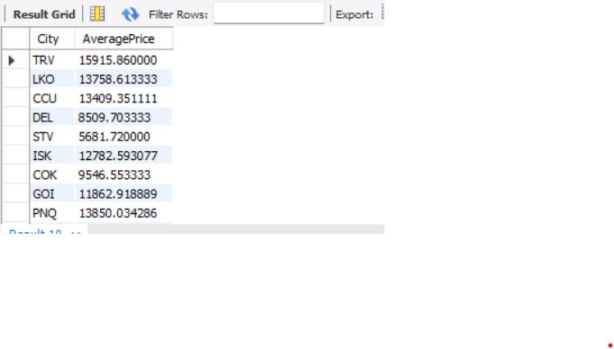
Query 3: Display The average amount of price for each city
SELECT
F.DepartureAirportCode AS City,
AVG(F.Price) AS AveragePrice
FROM
Flights F
JOIN
Reservations R ON F.FlightNumber = R.Flights_FlightNumber
GROUP BY
F.DepartureAirportCode;

Slide 11
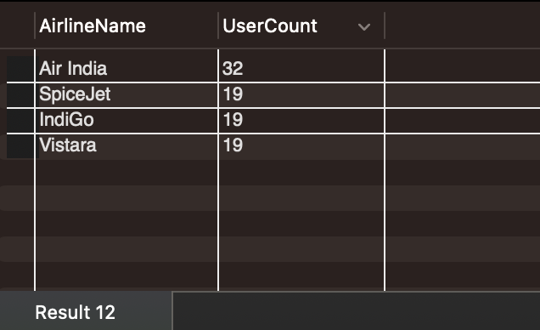
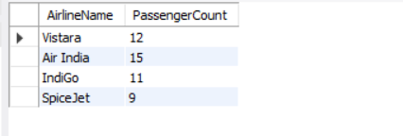
Query 4: Display the total number of users and passengers for each Airlines
SELECT A.AirlineName,
COUNT(U.userID) AS UserCount
FROM
user_has_Reservations PR
JOIN
Reservations R ON PR.Reservations_ReservationID = R.ReservationID
JOIN
Flights F ON R.Flights_FlightNumber = F.FlightNumber
JOIN
Airlines A ON F.AirlineID = A.AirlineID
JOIN
user U ON PR.user_userid = U.userID
GROUP BY
A.AirlineName;
Similarly for passengers count

Slide 12
Conclusion:
Choosing online airline booking over offline options offers:
Convenience: Book flights anytime, anywhere.
Cost Savings: Access exclusive online discounts.
Time Efficiency: Swift, real-time bookings.
Options: Compare flights and amenities easily.
User Reviews: Make informed decisions based on feedback.

Slide 13


Project in charge :
Abhishek sahani and Deepali Ghumare
Guided by : Pournima mam

