Slide 1
M&I Invited Speaker Diversity
Dr. Ada Hagan
Dr. Josie Libertucci
Notes:
1
Introduction by Josie – main points, suggestions, outcomes from retreat
Context – why does speaker diversity matter?
Student demographics
Question – what are the demos of invited speakers? AKA what role models are we providing for our trainees?
Methods/Dataset - A
Breakdown by gender/ethnicity - A
Breakdown Lectureship - A
Conclusions - A&J
Resources - Josie

Slide 2
Why Representation Matters in STEM
Women and people of colour are underrepresented in academic science and medicine (Coe et al 2019. The Lancet)
Growing body of evidence suggests:
Exposure to female/POC scientists increases retention in STEM majors
Strengthens attitudes of self-identification, which promotes motivation to pursue career in STEM (Carter et al., 2018. PLOSOne)
Notes:
1
Social role theory explains how gendered expectations of certain roles are formed based on who is seen occupying those roles
access to successful ingroup role models (e.g., women in senior levels of the academy) can be a key factor in determining what course of study or occupation a person will pursue [6,9], and, when people do not have first-hand experience in a particular domain, ingroup role models can signal whether a person would also be likely to achieve success in that domain [7,8].

Slide 3
Question: What are the demographics of the invited speakers in the Dept. of M&I and do they match our trainee demographics?
Data & Methods:
M&I Trainees (including masters, Ph.D., and Postdocs) on the current department listservs
M&I Invited Faculty Speakers from Fall 2014 to Spring 2019 – 5 academic years.
Each speaker was only counted once, and anyone listed as a “host” could not be an “invited speaker”
Lectureships – special circumstances around the invitation, e.g. Heritage, Brockman
Demographics hand-coded using google/personal knowledge:
Presenting gender (man/woman)
Presenting race (Caucasian: y,n)
Caucasian – U.S. Census definition includes Middle Eastern, European, Russian
Person of Color – includes Hispanic, Indigenous, Asian
Notes:
<number>

Slide 4
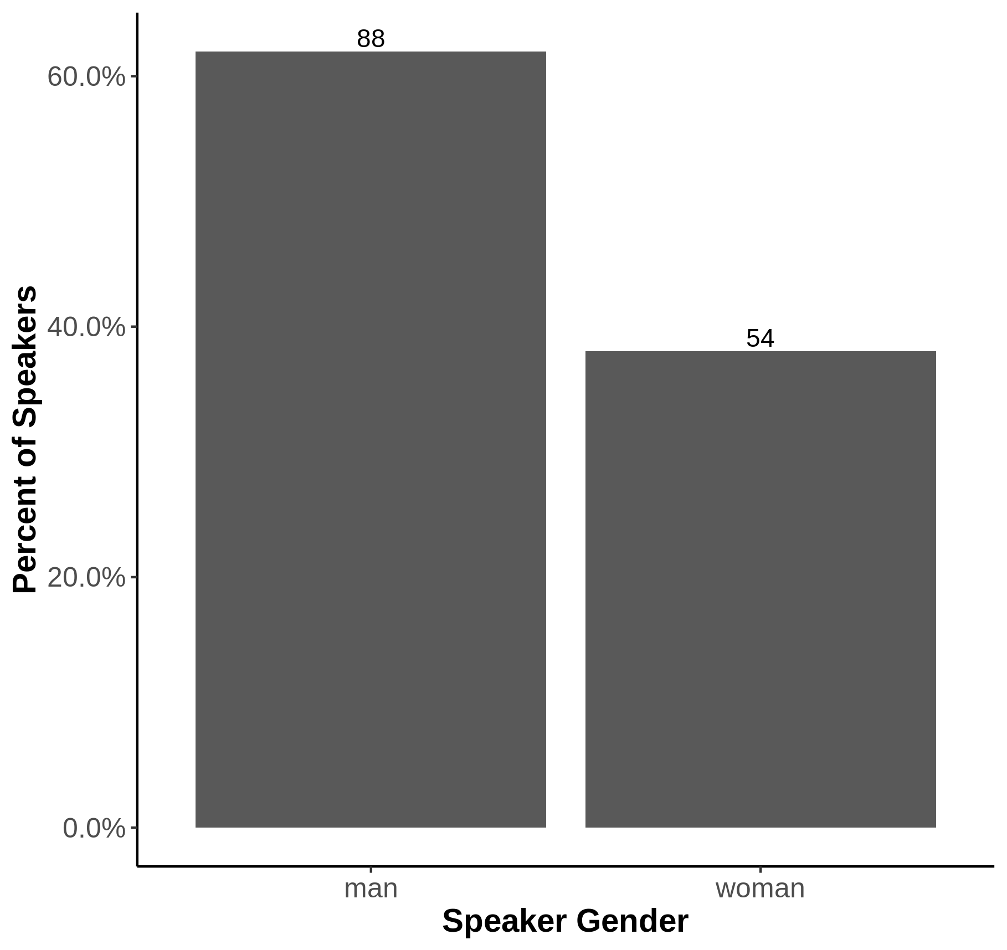
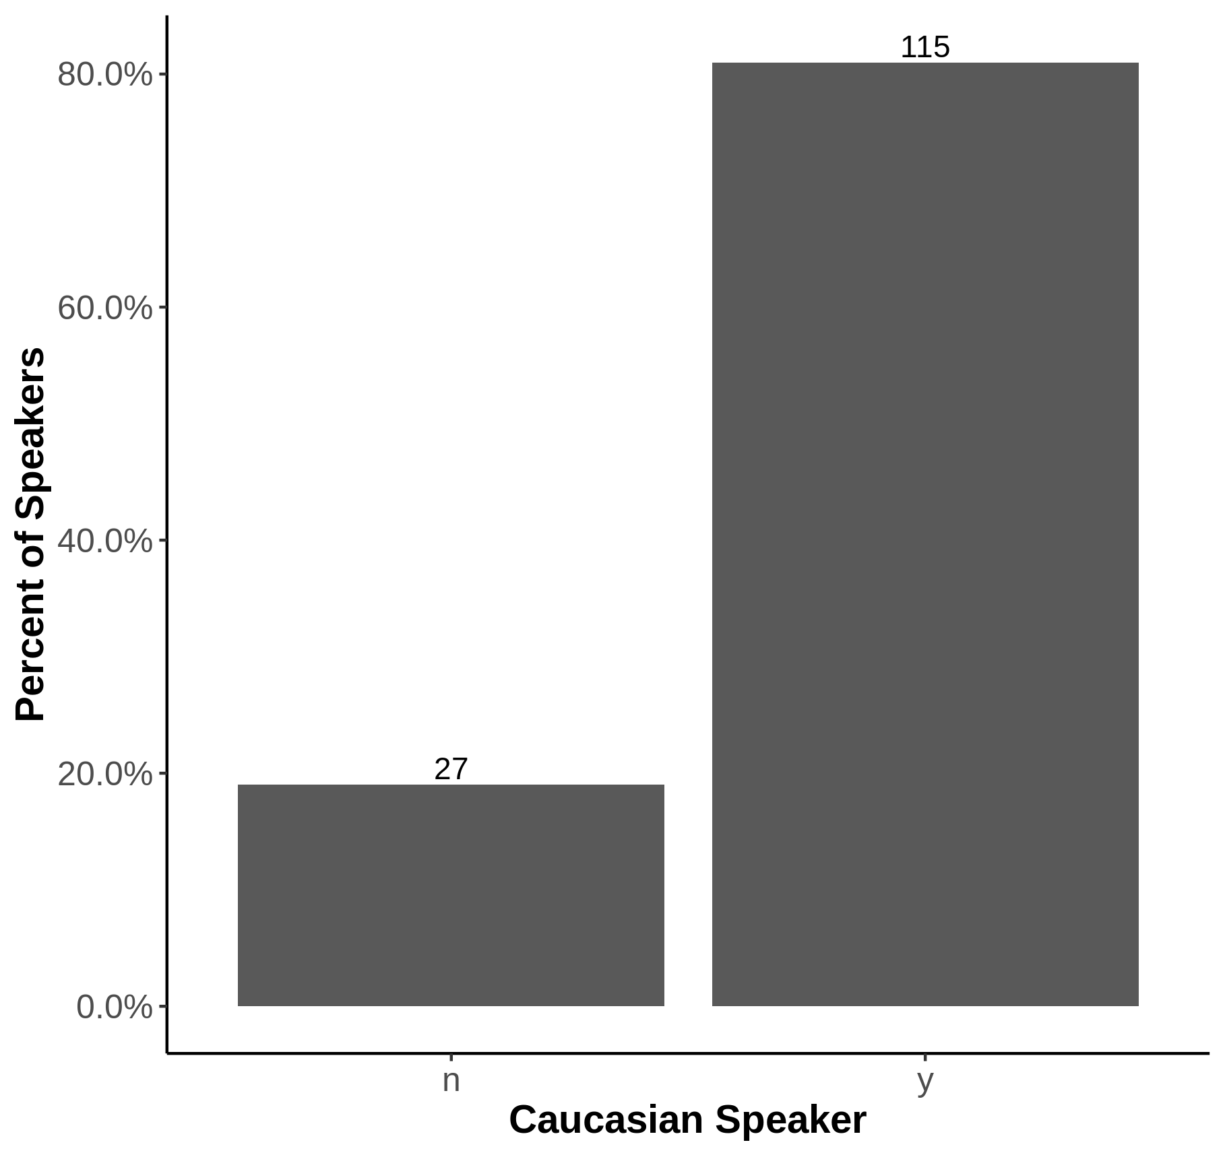
Demographics of Invited Speakers
Notes:
<number>

Slide 5
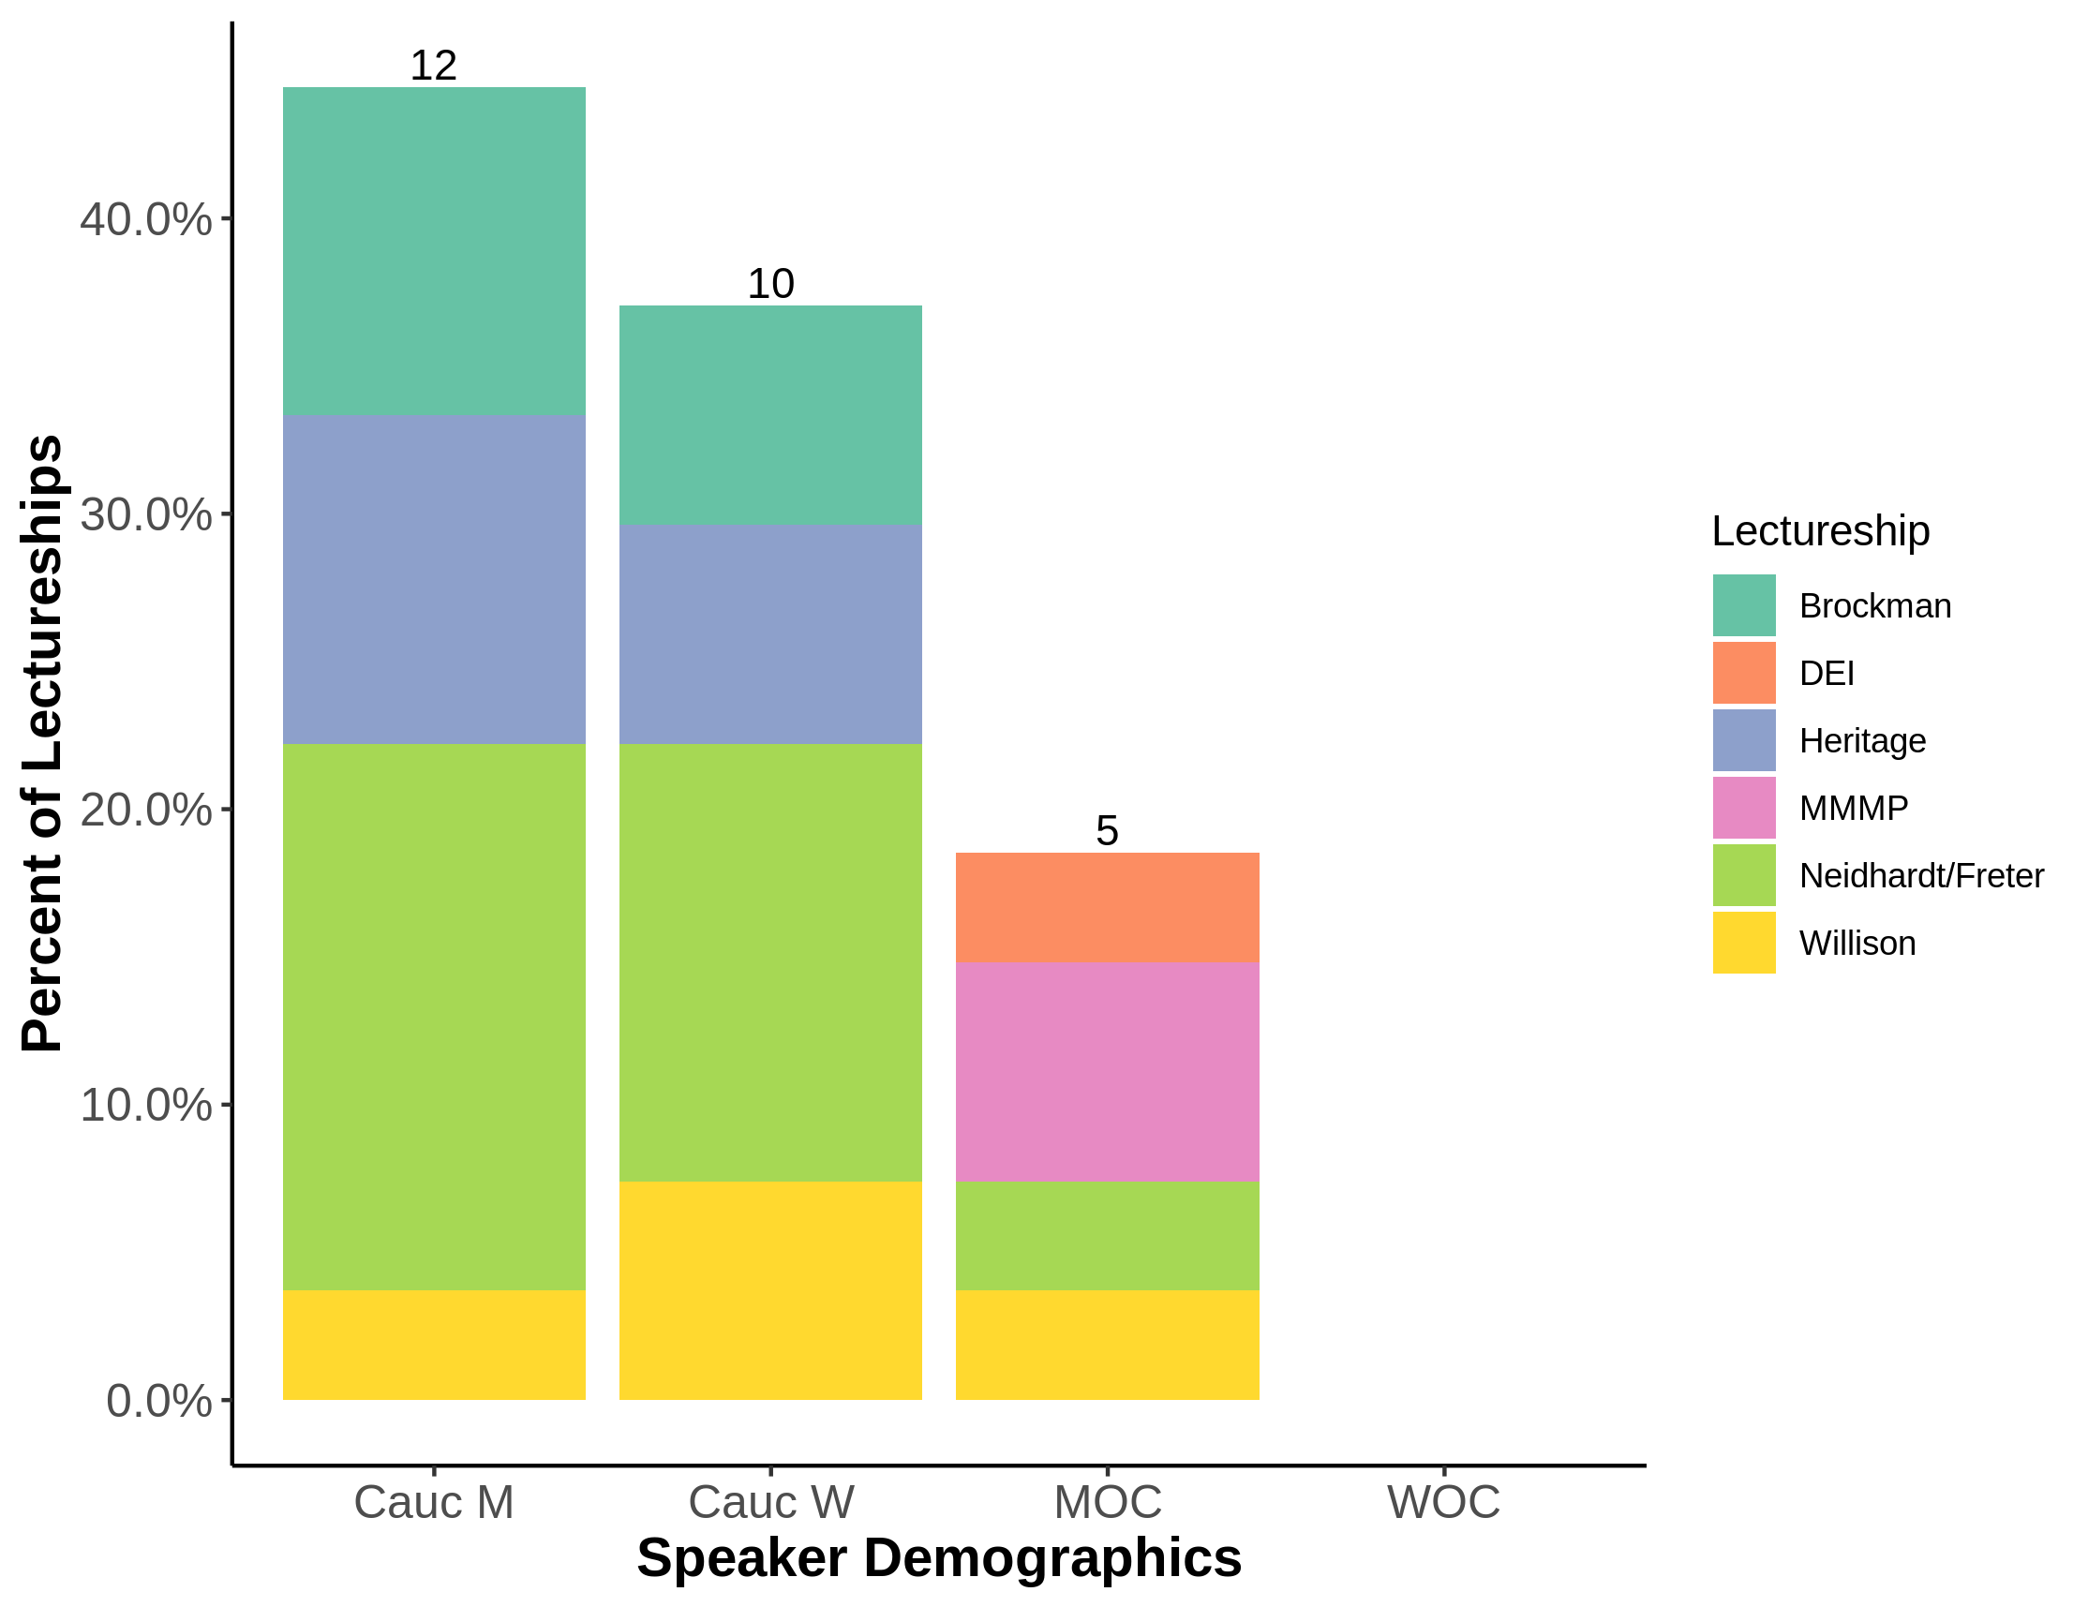
Demographics of Special Lectureships
Notes:
<number>

Slide 6
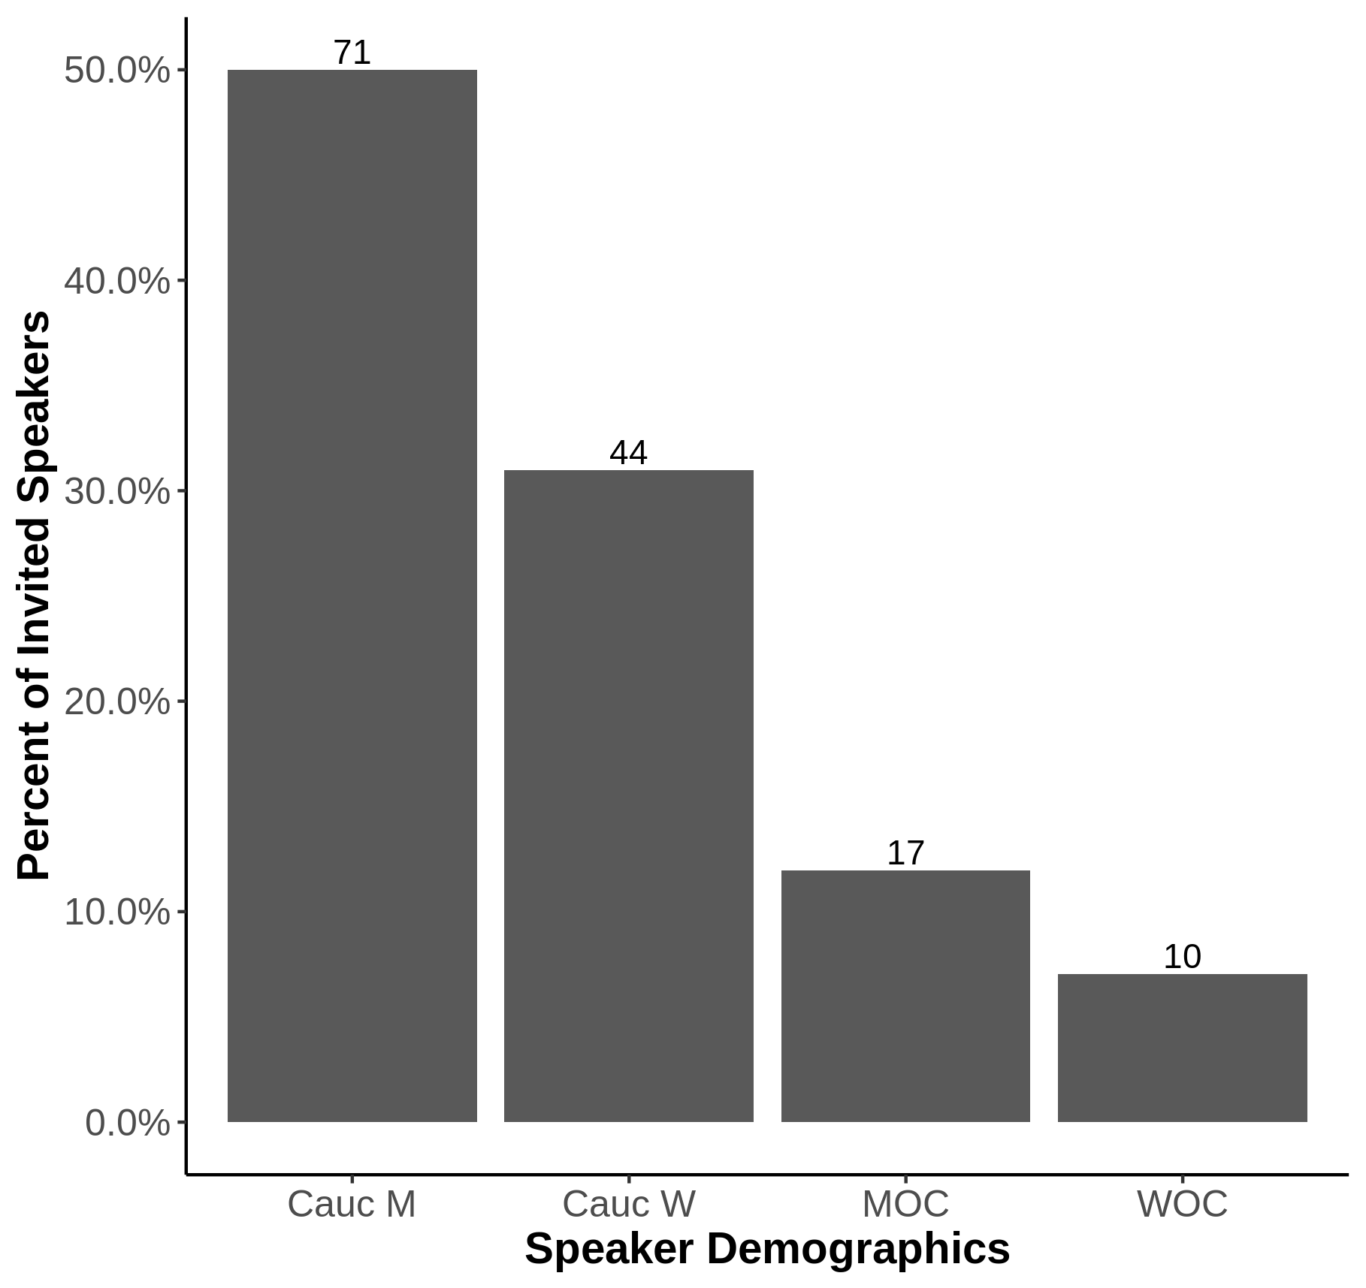
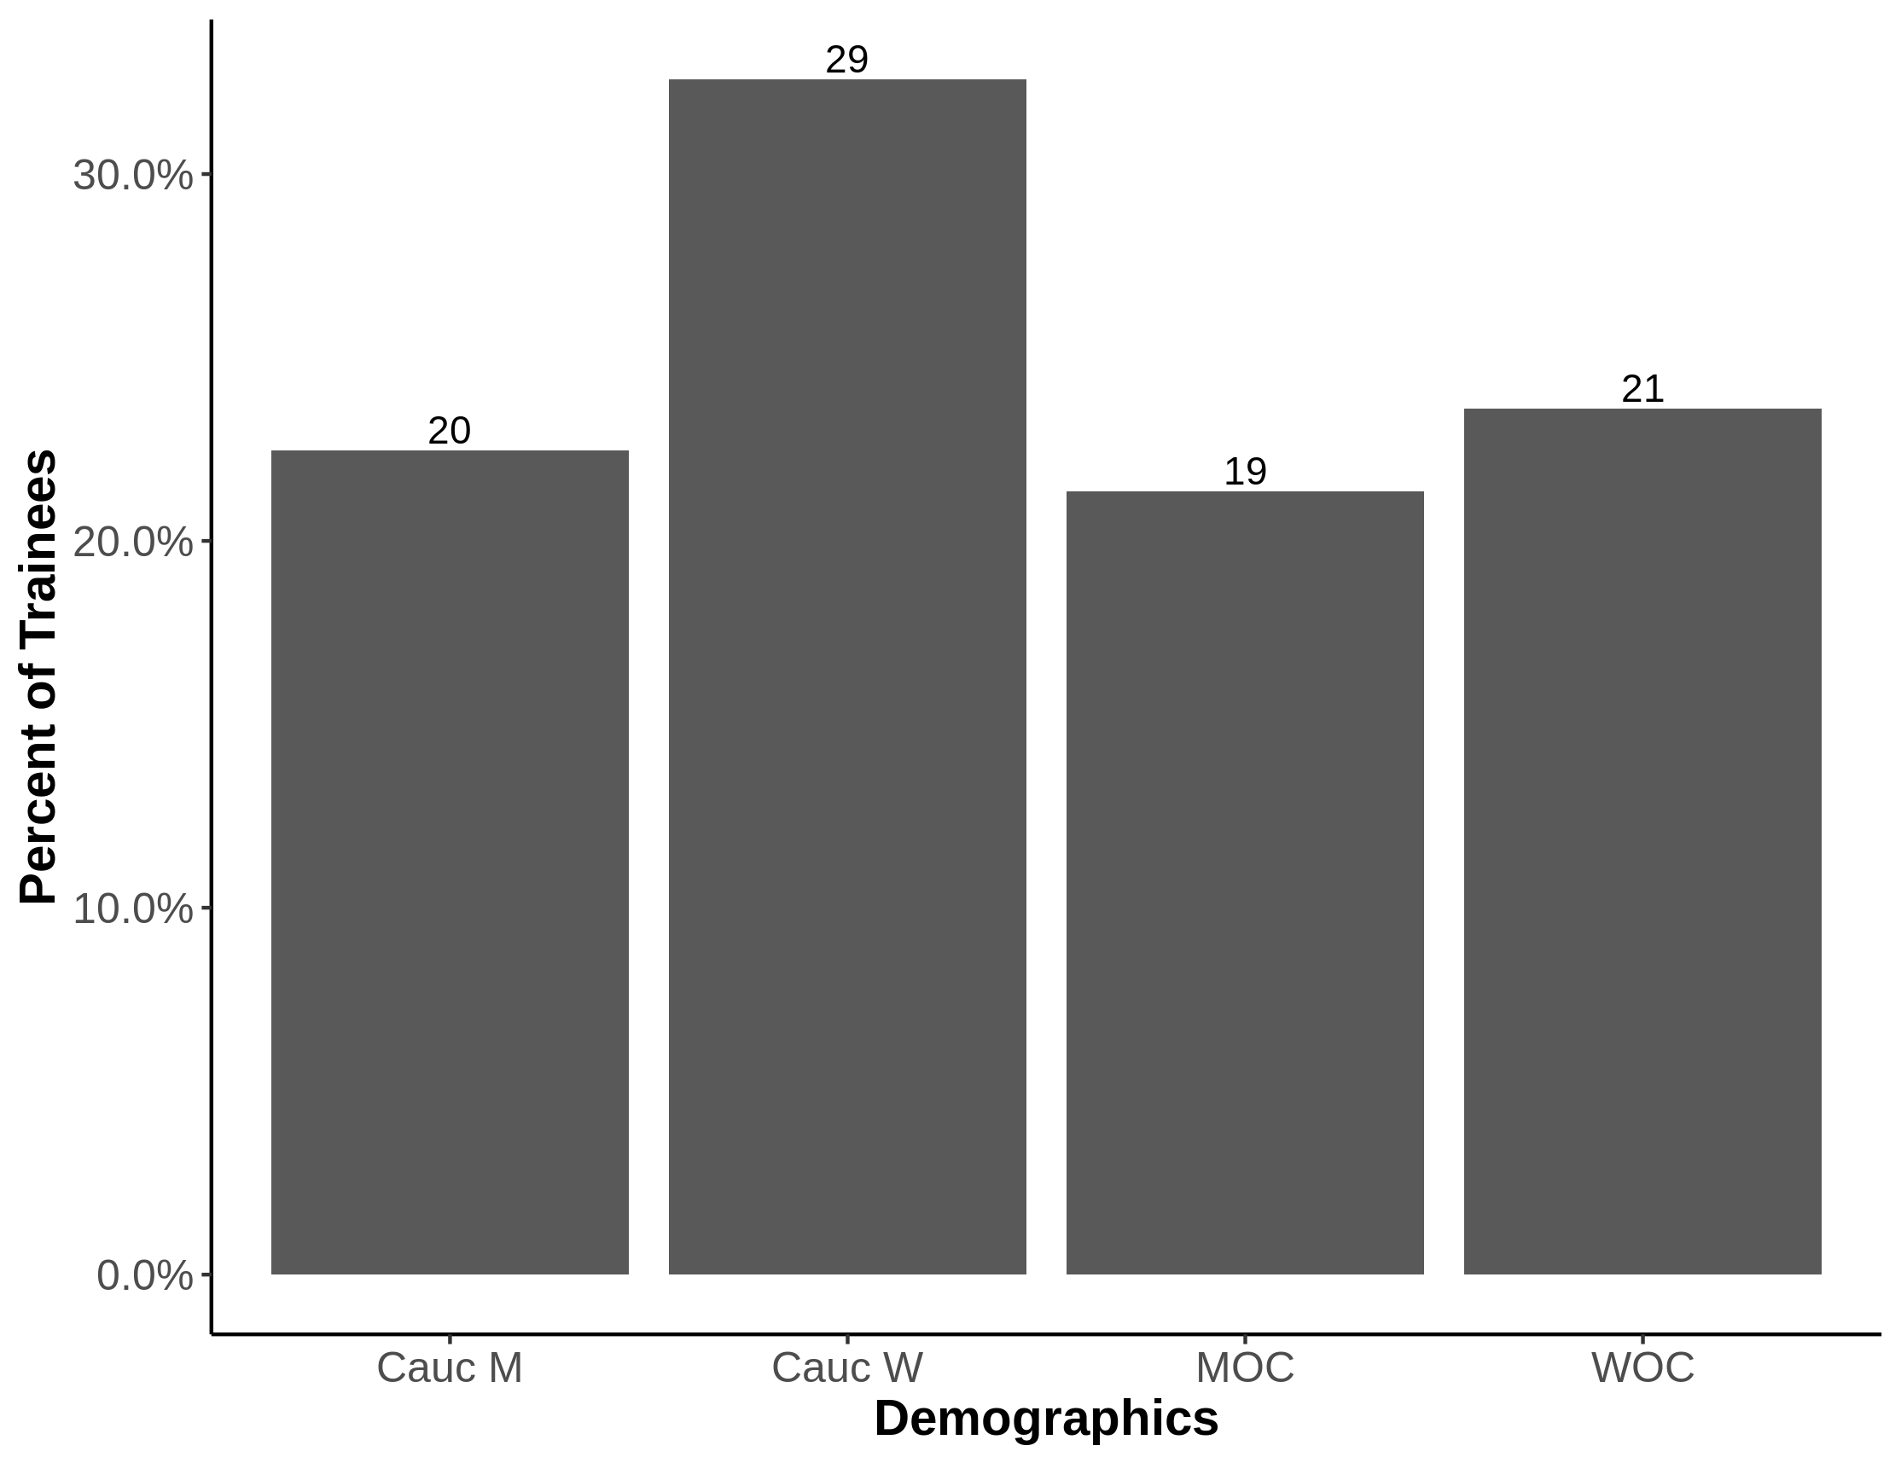
Demographics of invited speakers do not match those of trainees
Demographics of M&I Trainees
Demographics of M&I Invited Speakers

Slide 7
A proposal: Best-practices for selecting invited speakers
Aim: To represent all groups equally (CM/CW/MOC/WOC)
Some options:
Switch from “PI invited” to “Lab invited” and encourage your trainees to choose a speaker from an under-represented group
Use diversity resources:
500queerscientists.com
500womenscientists.org/request-a-speaker
diversifyeeb.com
diversifychemistry.com
List of women virologists
ASM list of minority microbiologists

Slide 8
Thank you & Questions

