Slide 1
M&I
Invited Speaker
Diversity
Dr. Ada Hagan,
Dr. Josie Libertucci

Slide 2
Representation Matters
Social role theory
Exposure to successful female scientists:
  strengthens female students’ self-identification with the field
  enhances positive attitudes, feelings of self-efficacy, and motivation to pursue careers in the field
Notes:
Social role theory explains how gendered expectations of certain roles are formed based on who is seen occupying those roles
access to successful ingroup role models (e.g., women in senior levels of the academy) can be a key factor in determining what course of study or occupation a person will pursue [6,9], and, when people do not have first-hand experience in a particular domain, ingroup role models can signal whether a person would also be likely to achieve success in that domain [7,8].

Slide 3
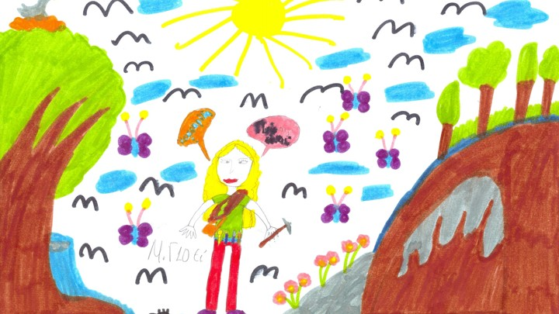
Notes:
Classic experiment asks children to draw images of scientists: ~30% draw women, indicating a skew in either the stereotypes of who is a scientist or a skew in how children perceive who can be a scientist.

Slide 4
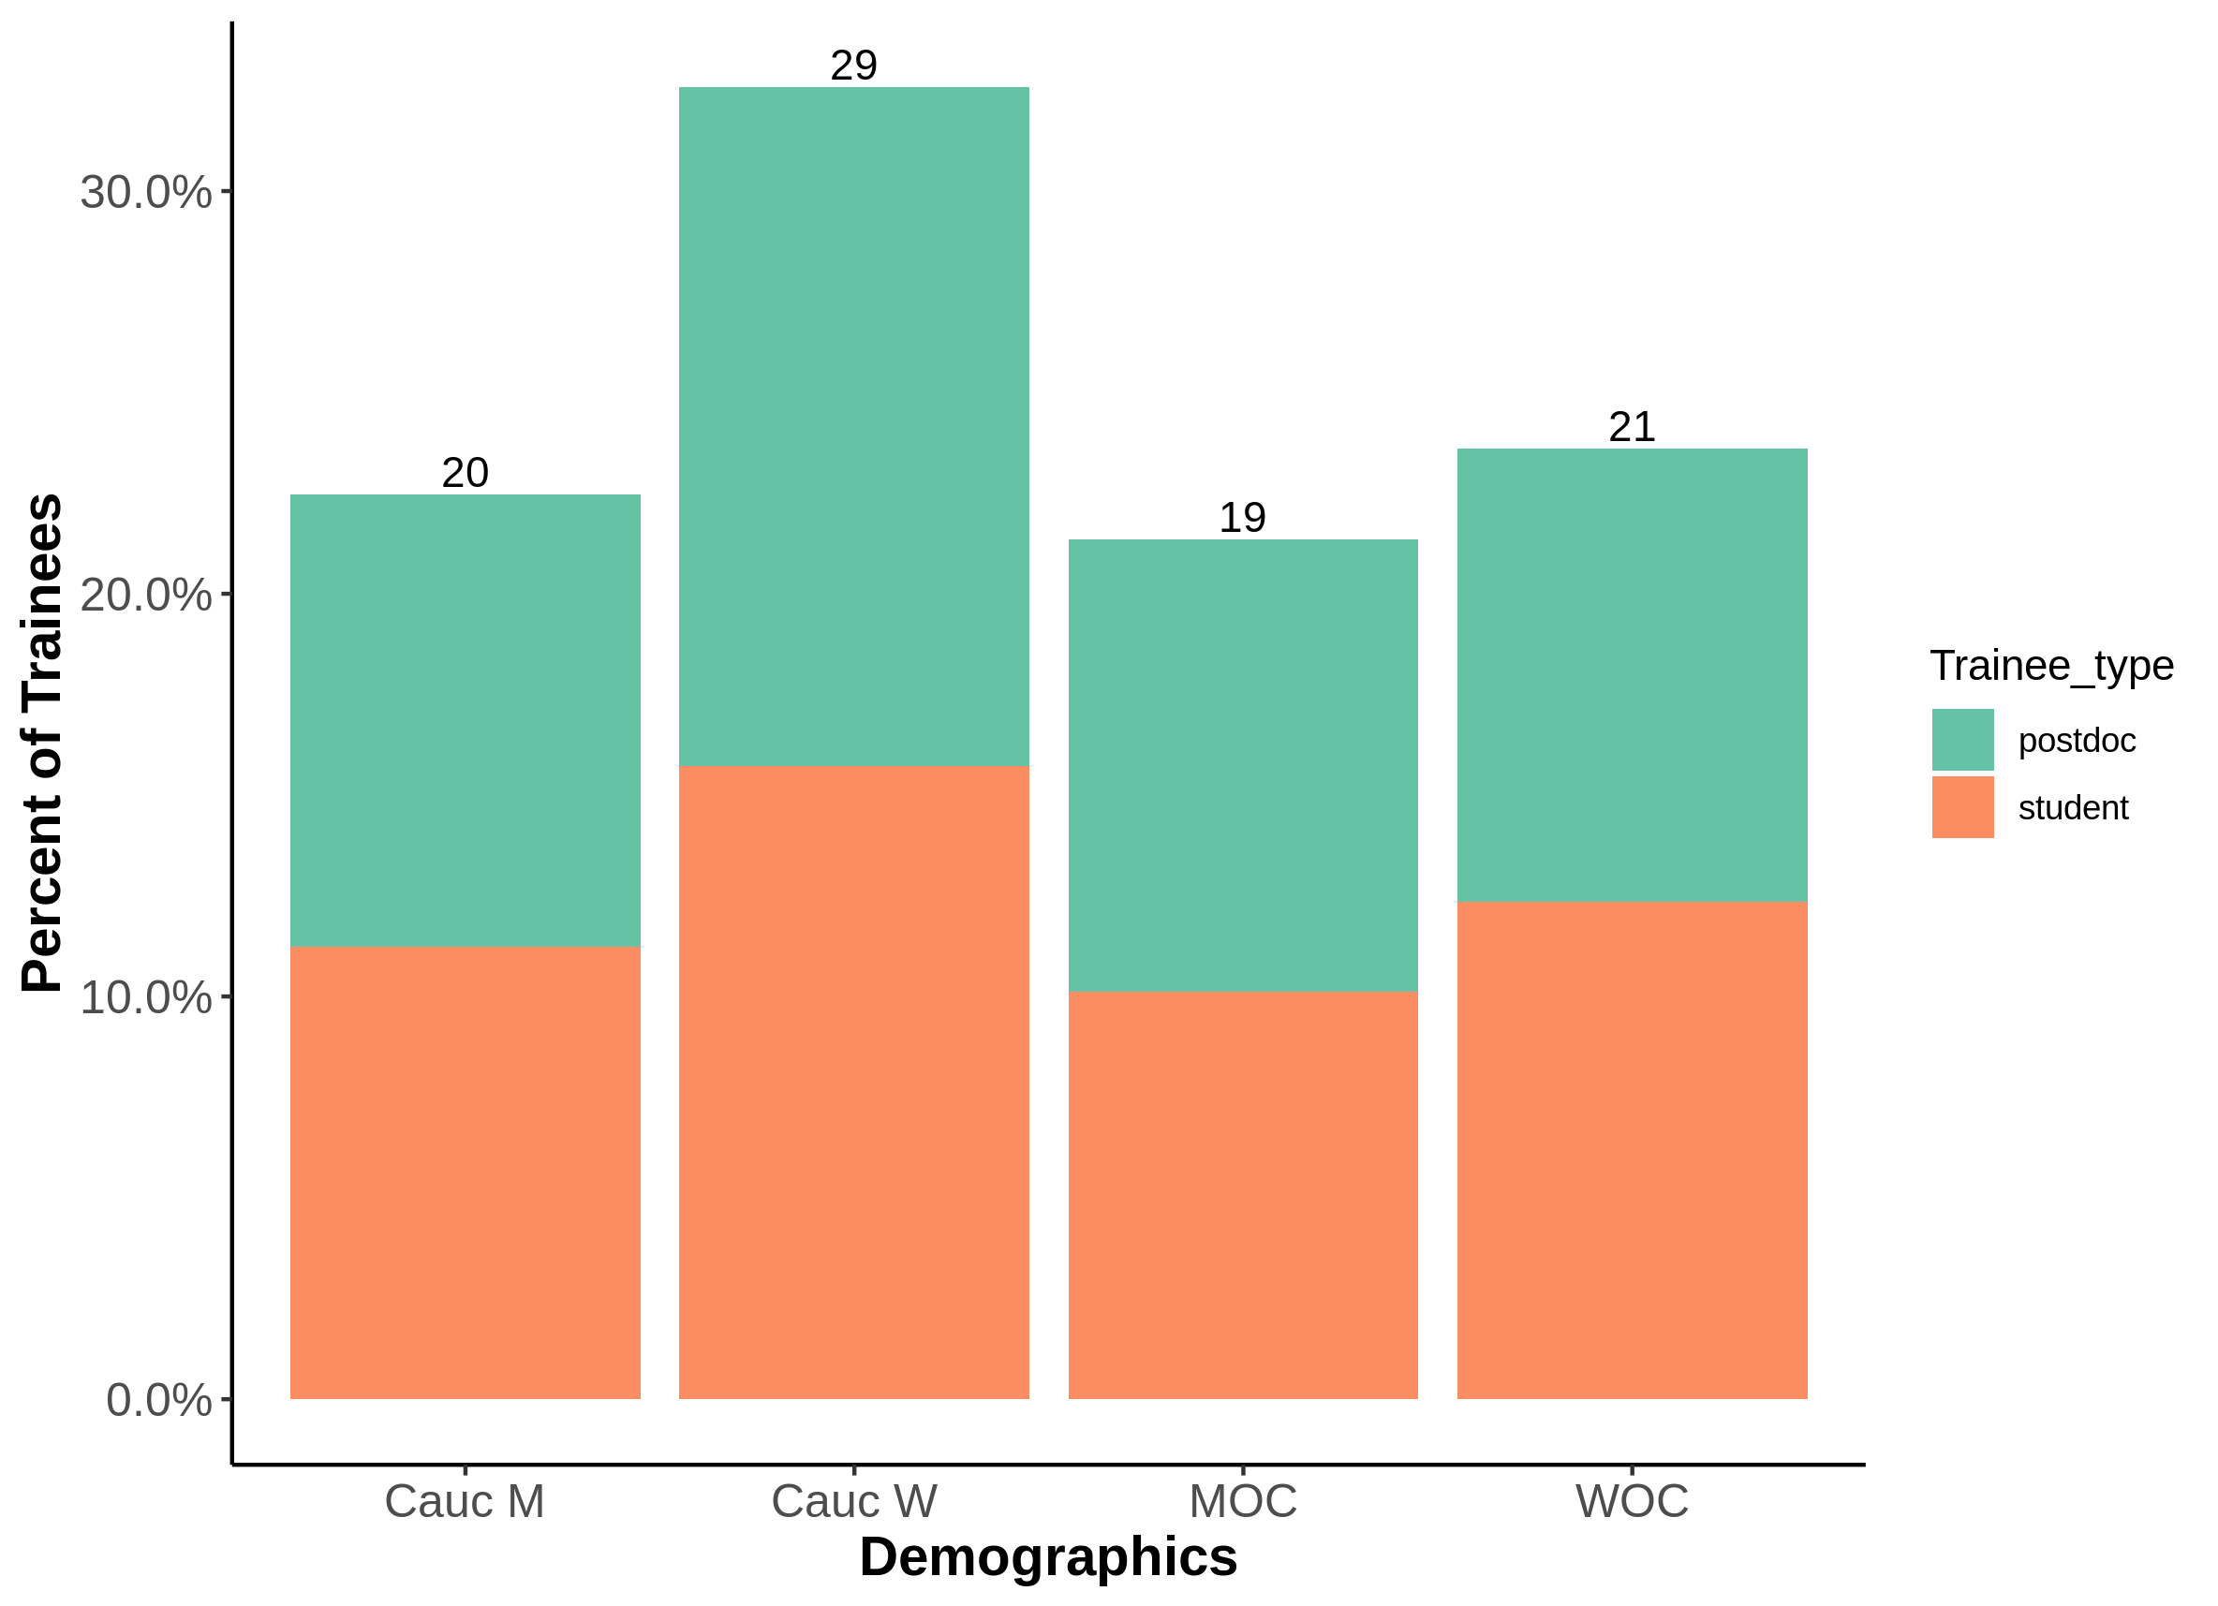
Trainee Demographics?

Slide 5
Dataset & Methods
Demographics of available M&I invited faculty speakers from Fall 2014 to Spring 2019 – 5 academic years.
Each speaker was only counted once, and anyone listed as a “host” could not be an “invited speaker”
Demographics collected:
  Presenting gender (man/woman)
  Presenting race (Caucasian: y,n)
Lectureships – special circumstances around the invitation, e.g. Heritage, Brockman

Slide 6
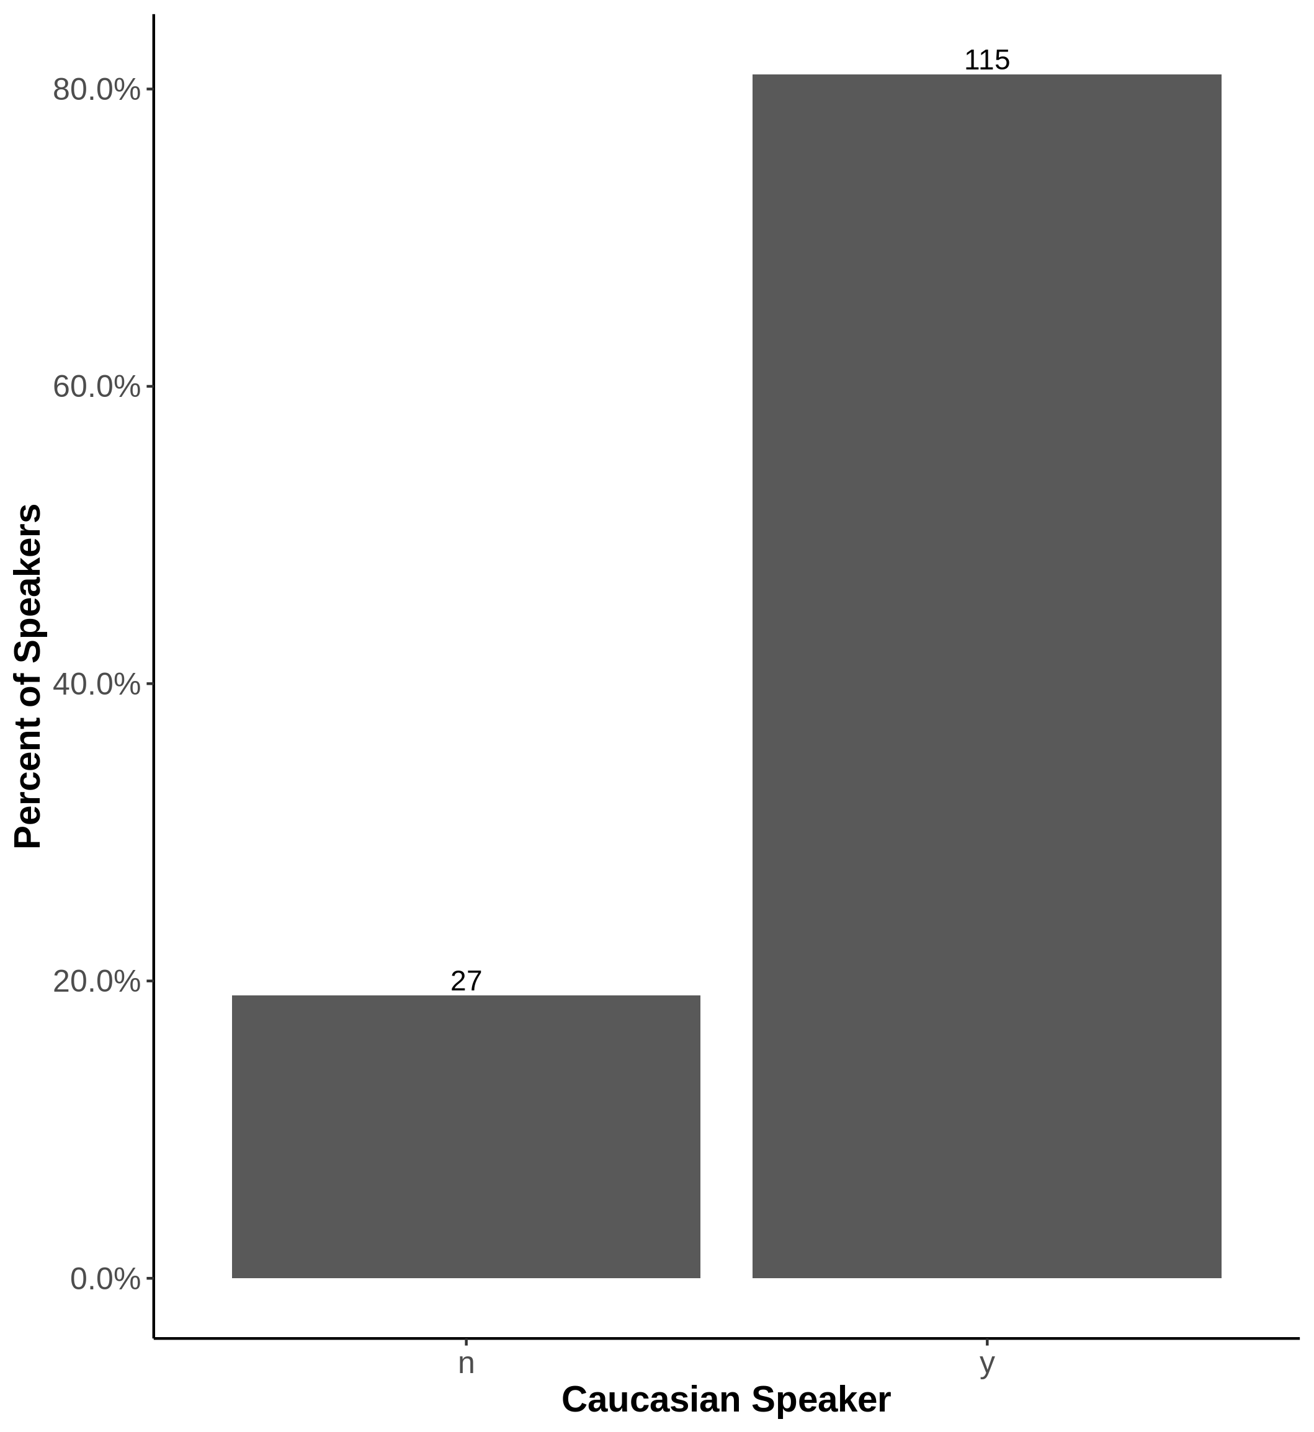
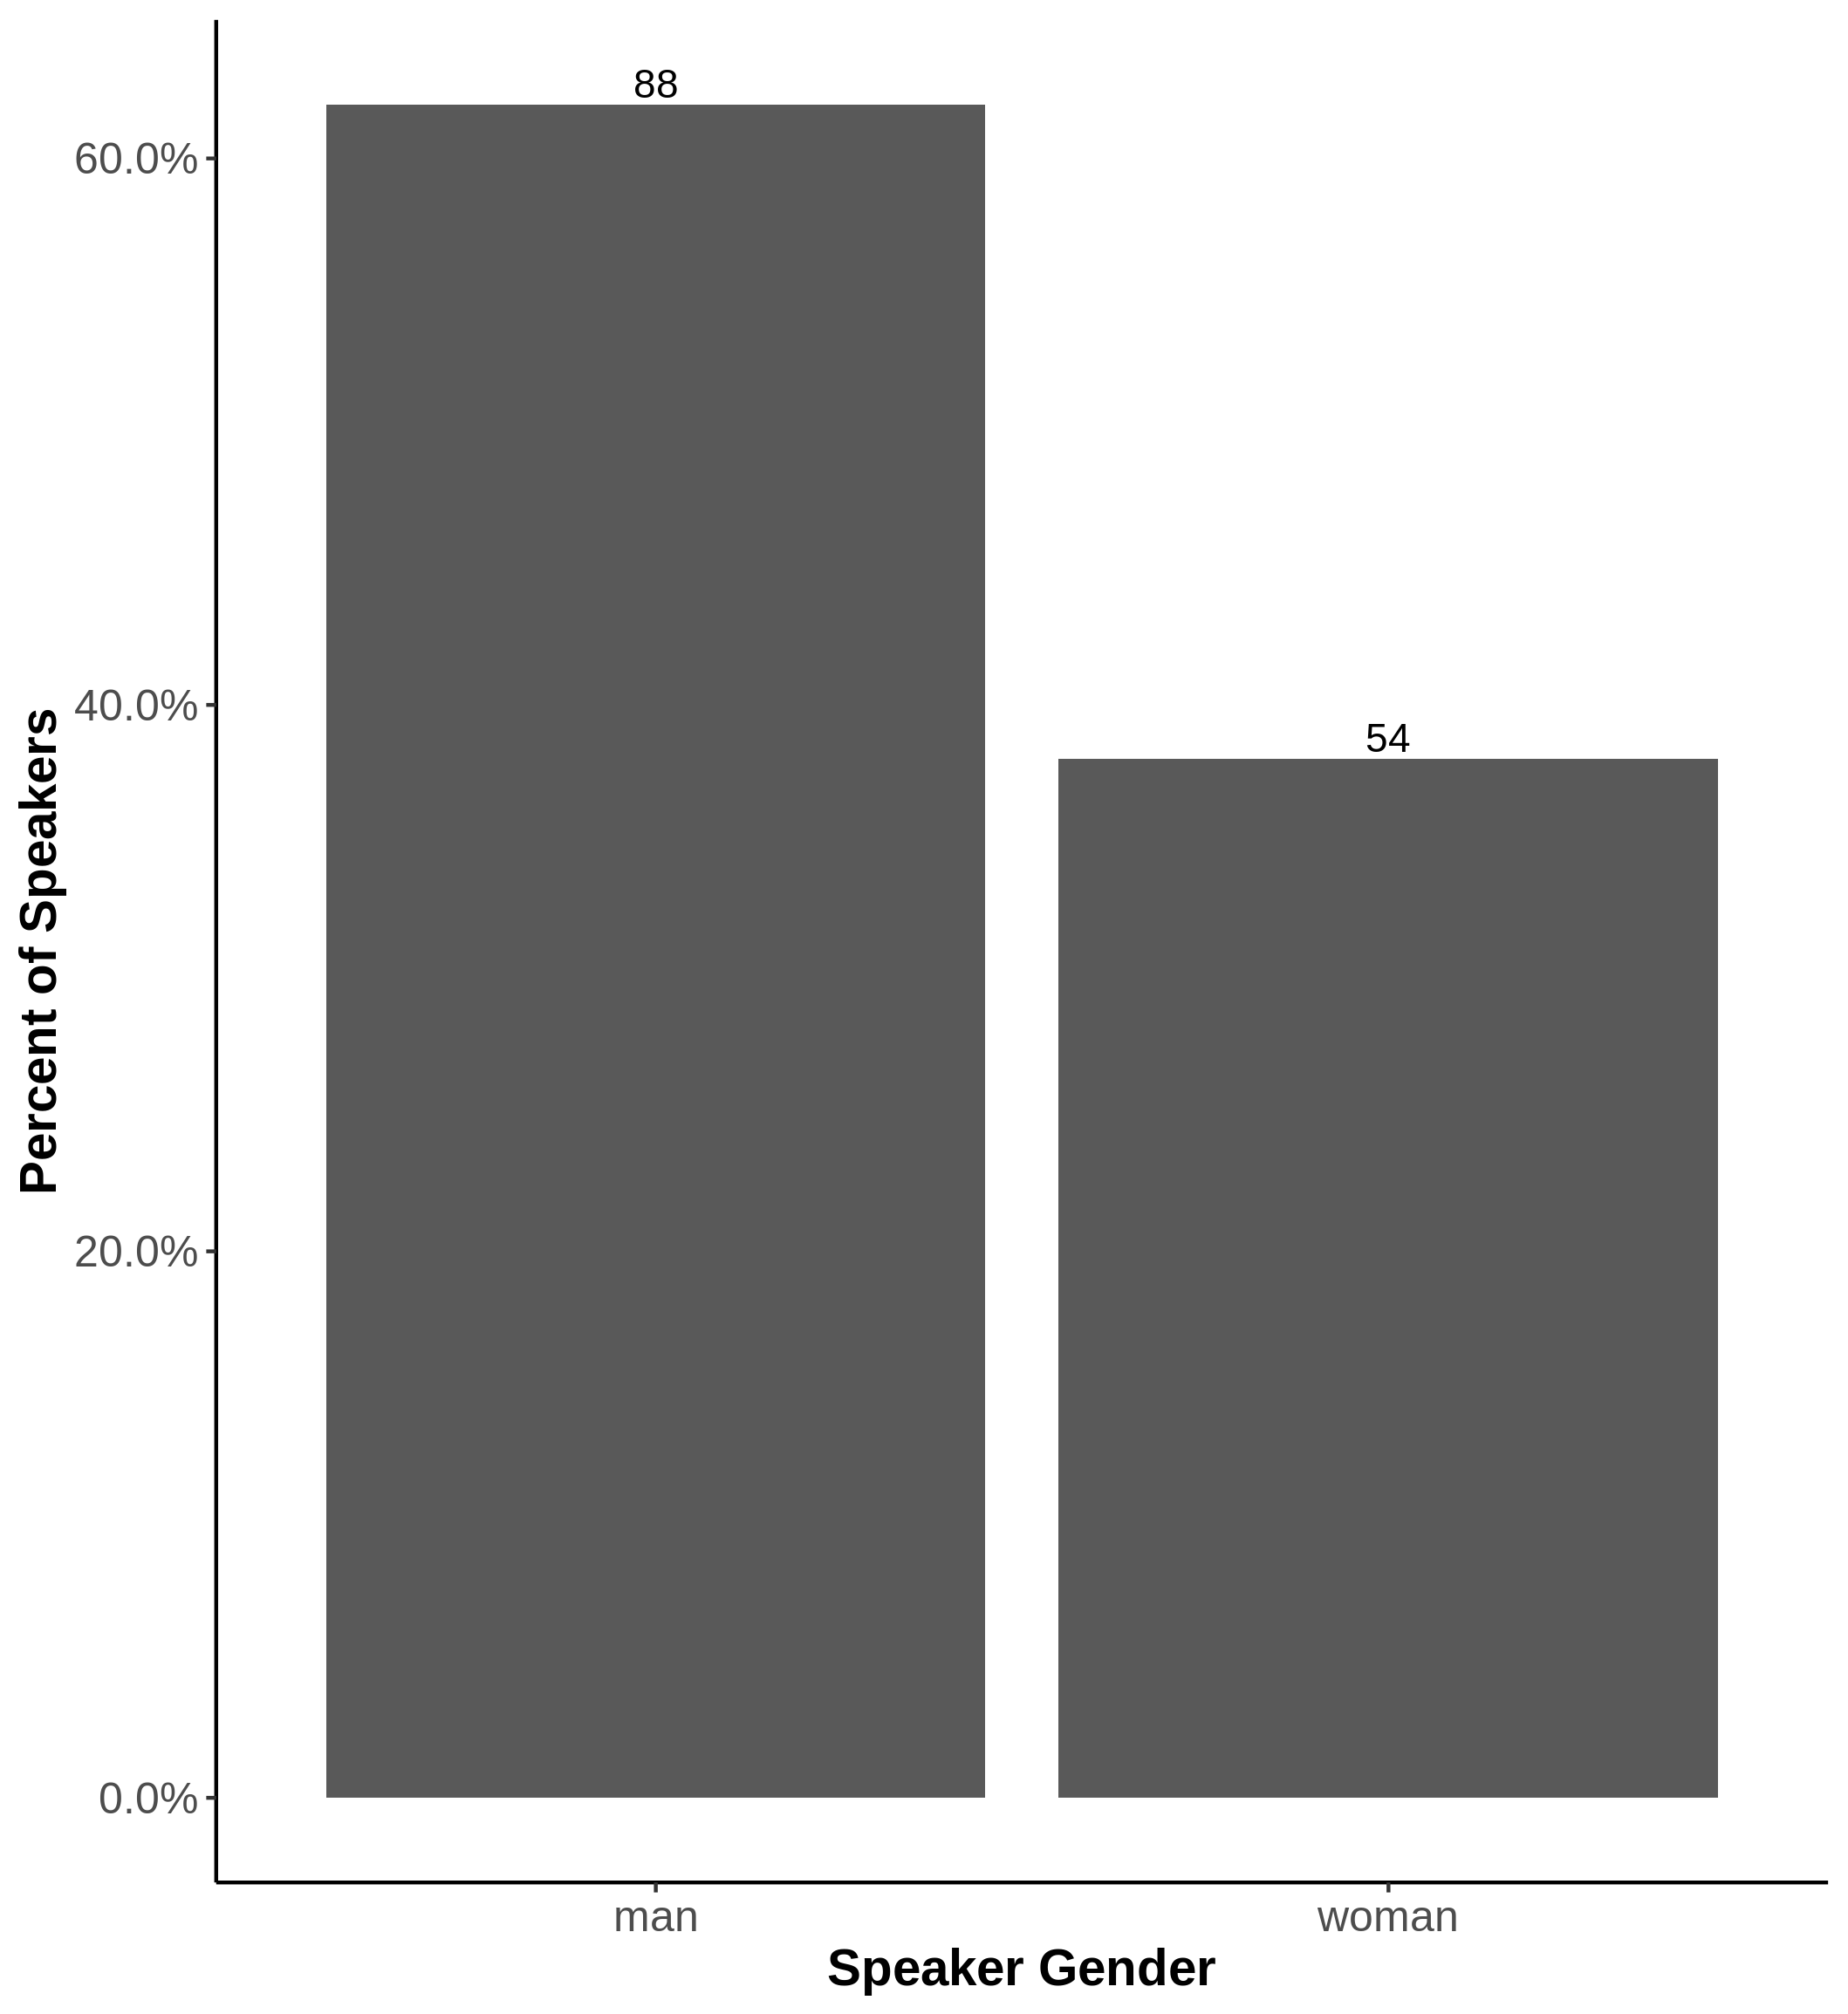

Slide 7
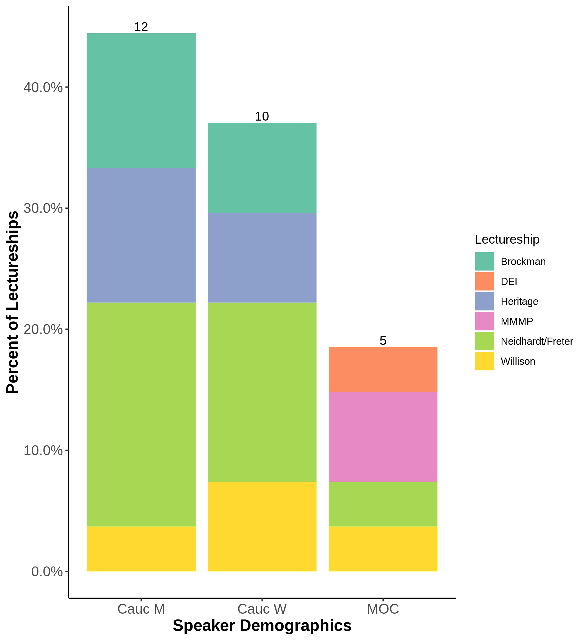

Slide 8
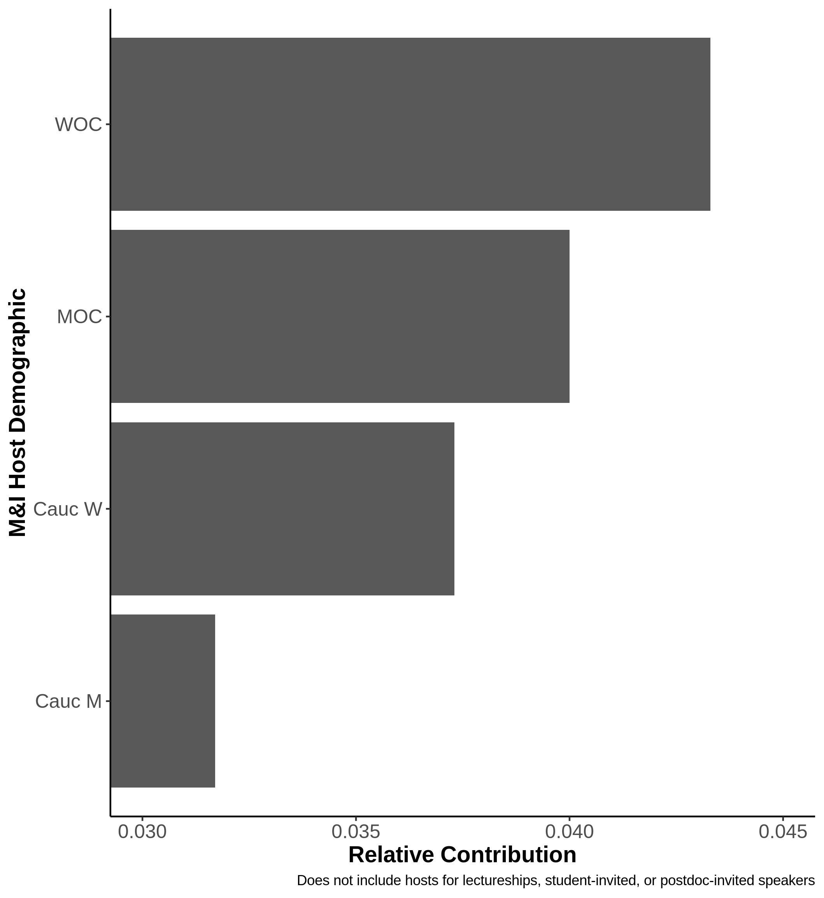
Who’s doing the work

Slide 9
Representational or Aspirational?

Slide 10
Resources

