Slide 1

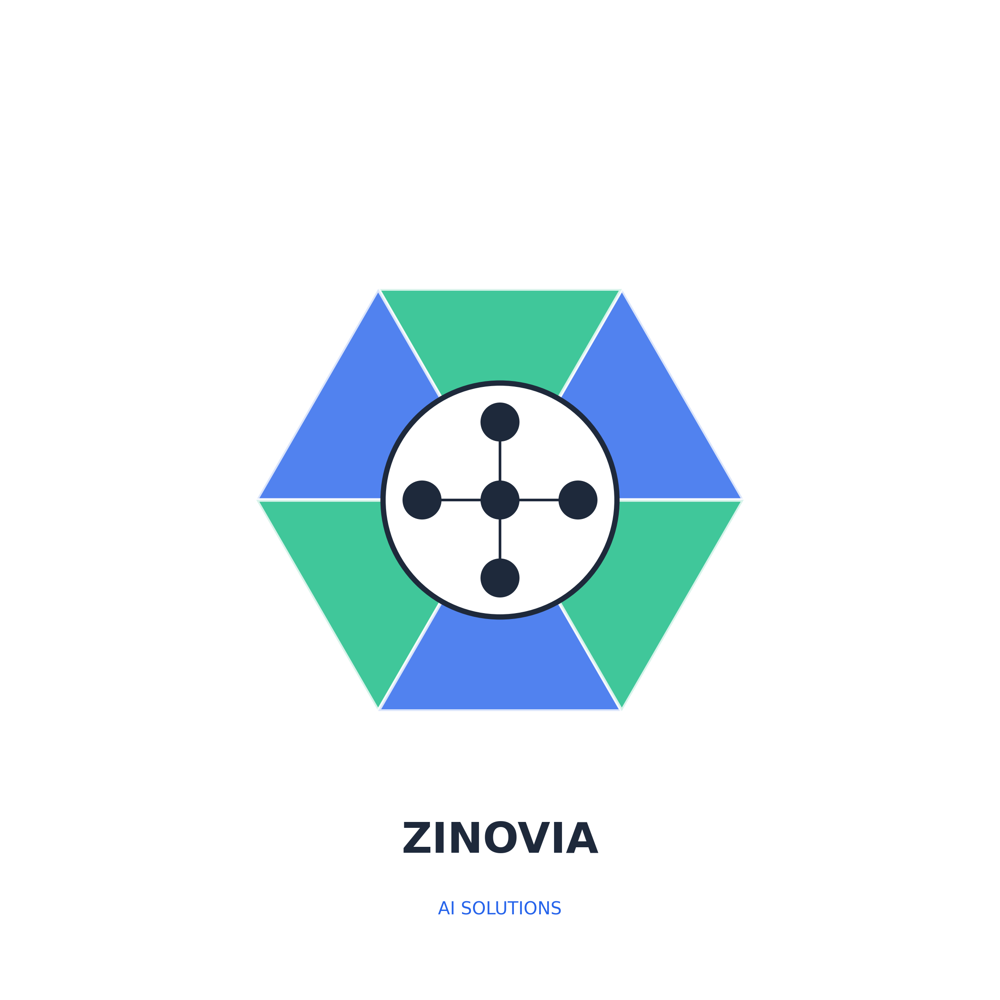
ZINOVIA.AI
Enterprise AI Solutions Platform
Transform Your Business with Intelligent Automation

Slide 2
Who We Are
Zinovia.ai is a leading AI enablement company specializing in enterprise-grade automation solutions that deliver measurable ROI within weeks, not months.
500+
98%
24hrs
Projects Delivered
Client Satisfaction
Deployment Time

Slide 3



Core AI Solutions
🤖
📄
⚡
AI Chatbots
Document Intelligence
AI Agents
50+ language support
Omnichannel integration
Sentiment analysis
24/7 availability
Workflow automation
Multi-agent orchestration
500+ API integrations
Predictive analytics
OCR & data extraction
Smart categorization
Compliance verification
Batch processing

Slide 4
Industry-Specific Solutions
🏦
🏥
🛒
Financial Services
Healthcare
E-Commerce
Fraud detection, KYC/AML, Risk assessment
HIPAA compliance, Patient data, Clinical support
Product recommendations, Dynamic pricing
🏭
⚖️
🎓
Manufacturing
Legal Services
Education
Predictive maintenance, Quality control
Contract analysis, Legal research
Personalized learning, Assessment automation

Slide 5

Our Proven Process
4
1
2
3
Launch & Scale
Discovery
Strategy
Development
Understand your needs & challenges
Custom AI blueprint & roadmap
Build & integrate solutions
Deploy & continuous optimization
24 hours
48 hours
1-2 weeks
Ongoing
Fastest in Industry: From Strategy to Production in Under 24 Hours

Slide 6
Measurable Impact & ROI
2.5x
Client ROI Timeline
Average ROI in Year 1
73%
Cost Reduction
85%
Process Efficiency Gain

Slide 7

Technology & Security
Powered by Latest AI Models
Enterprise Security
SOC 2 Type II Certified
HIPAA Compliant
GDPR & CCPA Ready
End-to-End Encryption
99.9% Uptime SLA
24/7 Security Monitoring
Cloud & Deployment

Slide 8
Flexible Pricing Plans
Professional
Enterprise
Starter
For growing businesses
Custom solutions at scale
Perfect for small teams
$7,999/month
Custom
$2,499/month
3 AI Solutions
Unlimited interactions
Priority support
Custom integrations
Unlimited Solutions
White-label options
Dedicated team
24/7 support
1 AI Solution
10K interactions/mo
Basic analytics

Slide 9

Client Success Stories
Zinovia's AI chatbot reduced our customer support costs by 68% while improving satisfaction scores to 4.8/5.
Document processing that took days now happens in minutes. ROI achieved in just 3 months!
Sarah Chen
Michael Torres
CTO, TechRetail Inc.
VP Operations, FinanceFirst
By the Numbers
500+
15M+
$450M+
Happy Clients
AI Interactions
Client Savings

Slide 10



Ready to Transform?
Join 500+ companies already leveraging AI
Start Free Trial
Schedule Demo

