Slide 1
AGILITY REFINER
The project is based on Shuttle Run (used in Badminton).
It can help a player to improve his or her agility while playing badminton,the player comes to know about time taken by him or her in ten consecutive rounds in random direction(left or right).It can further be used by any sports person.

Slide 2
COMPONENTS USED:
Arduino UNO
Lcd Display
Laser
Ldr
Push buttons
Leds
Jumper wires
Resistors
Perf board

Slide 3
HOW IT WORKS?
The process begins by generating random numbers between 0 and 3 .
If 1 comes, the player has to run towards left and press pushbutton there to switch off the glowing led and come back in the initial position and vice versa ,if 2 comes.The time for whole process is calculated and displayed for particular round.Finally the average time of ten rounds is shown.The visitor can check their agility by playing the game.

Slide 4
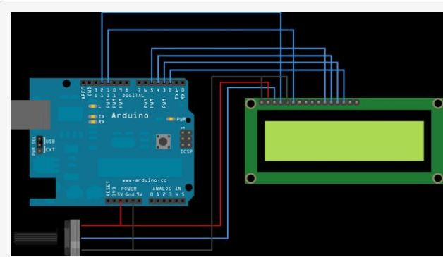
CONNECTIONS:
LCD display
http://www.instructables.com/id/Connecting-an-LCD-to-the-Arduino/

Slide 5
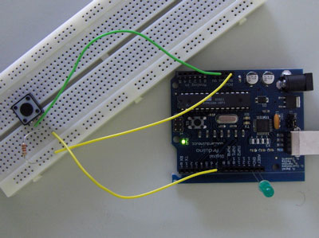
Pushbutton
https://www.arduino.cc/en/tutorial/pushbutton

Slide 6
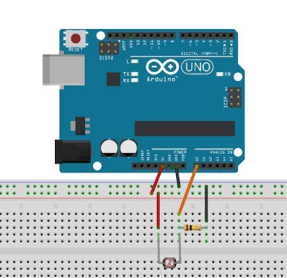
LDR
https://diyhacking.com/arduino-ldr-sensor/

Slide 7
BY
ARSHIYA KHAN AND KHYATI KIYAWAT
ECE 1ST YEAR

