Slide 1
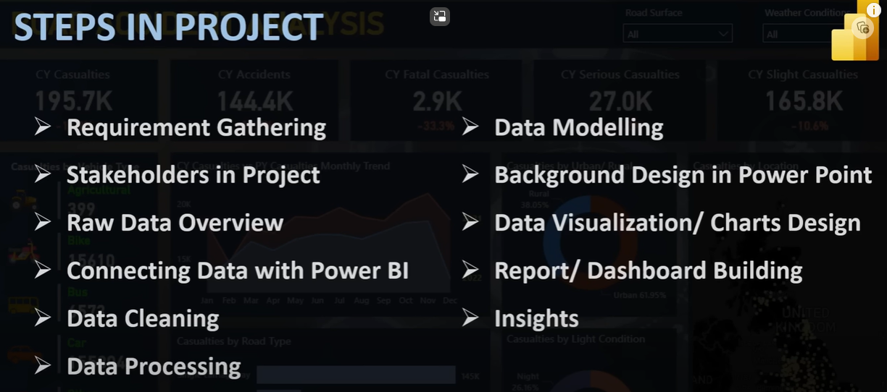
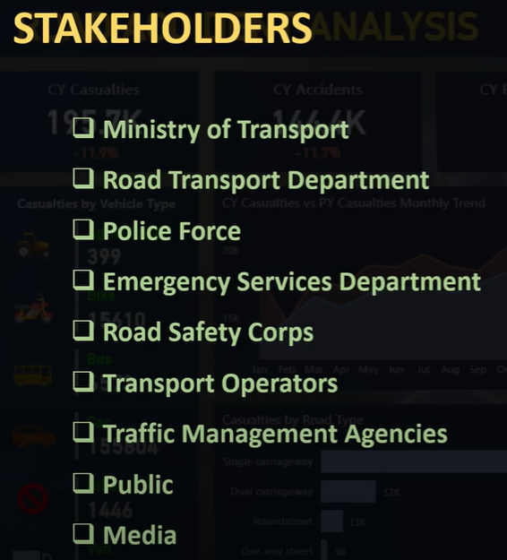
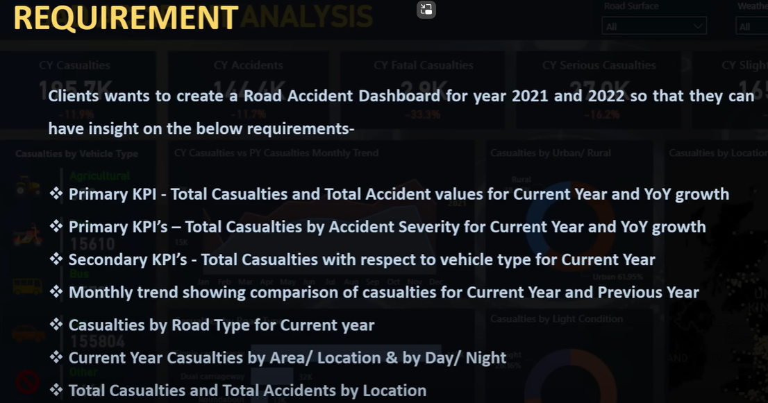
Portfolio Project – Power BI

Slide 2
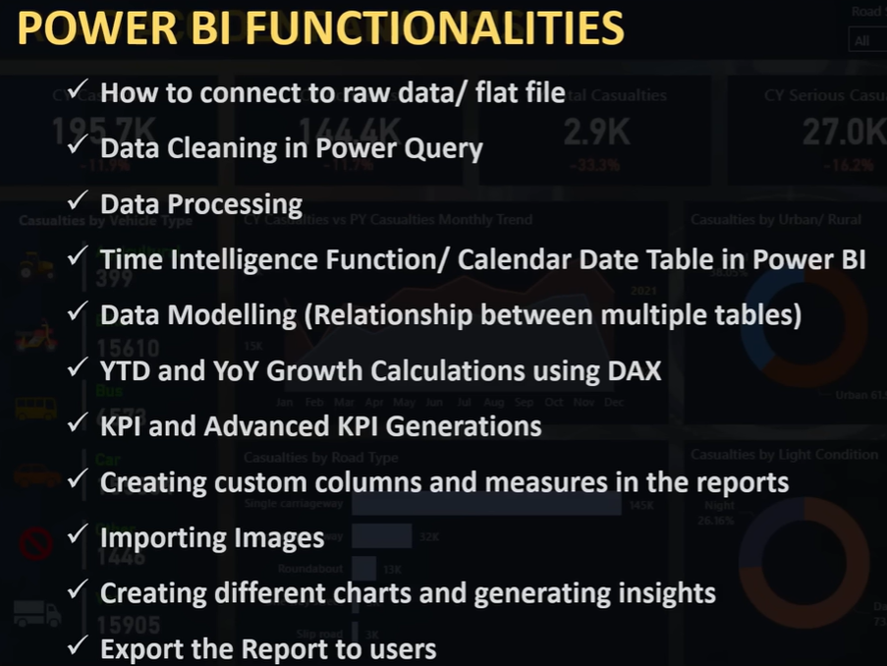

What is Data
What is meta data
Power BI can analyze data from various sources, including databases (SQL Server, Oracle), Excel spreadsheets, cloud services (Azure, AWS), web sources, and more.
File: Road Accident Data.xlsx
Columns: 21
Rows: 307974

Slide 3

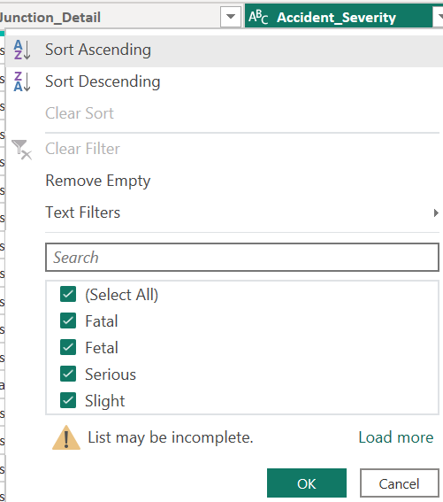
When studying data for analysis, consider factors such as data quality, completeness, relevance, structure, and potential biases to ensure meaningful and accurate insights.
Data granularity refers to the level of detail or specificity present in a set of data. It involves determining the extent to which data is broken down into smaller, more specific pieces. For example, in a sales dataset, the granularity could be at the daily, monthly, or yearly level, depending on how detailed the information is for each time period. Choosing the right granularity is crucial for accurate analysis and reporting.
Data Modeling

Slide 4
Use your Requirement and create KIPs

Slide 5
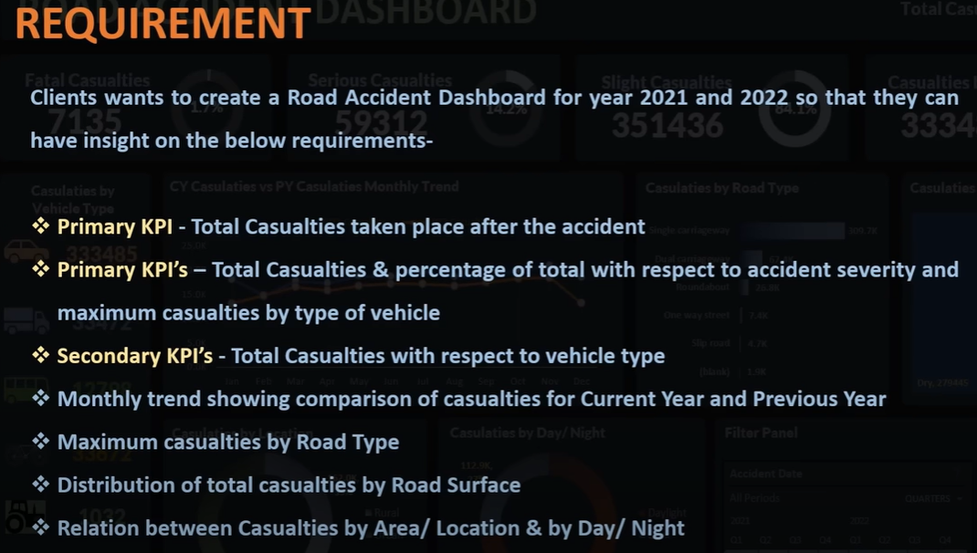
EXCEL Project
Following point to consider while doing Excel Project:
Data Gathering
Data Cleaning
Data Processing: Apply some formulas, build customize columns for data used for visualization.
Data Analysis: We use aggregation data, build different Pivot table, build some charts out of that.
Data Visualization: Custom Charts, formatting, try to place them in dashboard.
Report/ Dashboard: Dynamic one so they can see that in different granularity level.

Slide 6
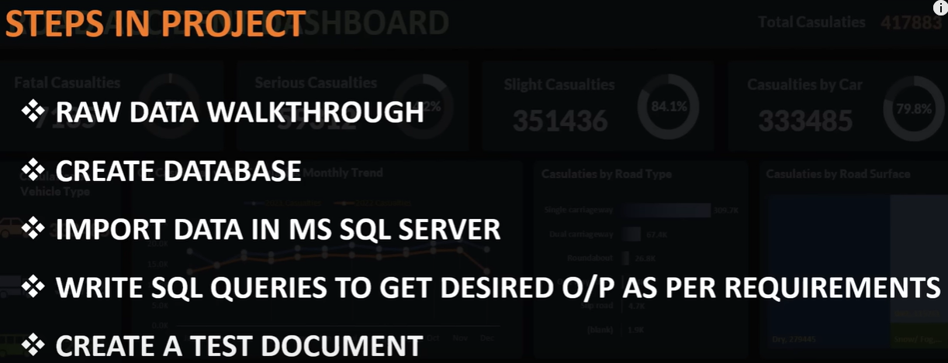
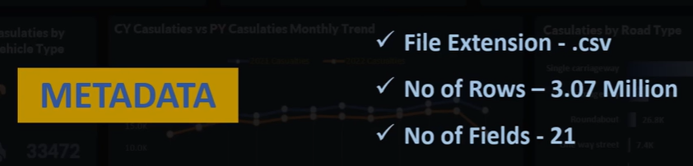
SQL Server
Use .csv file
Not million

