Slide 2
Ansible – Contents
About
Why ???
Architecture
Prerequisite
Release Structure
Execution Steps
Demo
Q & A
Notes:
TITLE PAGE
– Headline 36pt Arial in WHITE
– Sub-head 18pt Arial Reg in GREY
– Do not include client logos on title page
– TEXT ONLY
***It’s not recommended to use any sort of graphic animation. Although in some cases it may be appropriate to apply “Appear” effect to slide sections to show sections one-by-one on the slide***

Slide 3
Ansible – About
Notes:
TITLE PAGE
– Headline 36pt Arial in WHITE
– Sub-head 18pt Arial Reg in GREY
– Do not include client logos on title page
– TEXT ONLY
***It’s not recommended to use any sort of graphic animation. Although in some cases it may be appropriate to apply “Appear” effect to slide sections to show sections one-by-one on the slide***

Slide 4
Ansible is a radically simple IT automation platform that makes your applications and systems easier to deploy.
It support configuration management with examples as below.
Configuration of servers
Application deployment
Orchestration
Automation of tasks

Slide 5
Ansible - Why???
Notes:
TITLE PAGE
– Headline 36pt Arial in WHITE
– Sub-head 18pt Arial Reg in GREY
– Do not include client logos on title page
– TEXT ONLY
***It’s not recommended to use any sort of graphic animation. Although in some cases it may be appropriate to apply “Appear” effect to slide sections to show sections one-by-one on the slide***

Slide 6
Handcrafted Servers are
hard to maintain
very time/cost intensive
setup is not easily reproducible
many times very buggy

Slide 7
Reasons for Ansible
It is a free open source application
Uses SSH ( with one python requirement )
Agentless! – No need for agent installation and management
Everything is a YAML File.
Structure is flexible (ad-hoc, playbooks, roles, orchestration)
Large number of ready to use modules for system management
Easily extensible via modules.
Configuration roll-back in case of error
Simple and human readable
Self documenting
Even more features available in enterprise ( Ansible Tower )

Slide 8
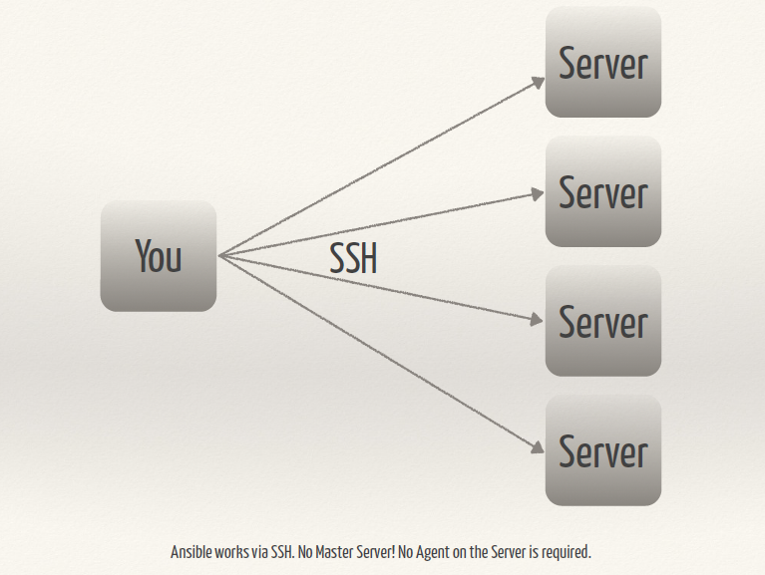

Slide 9

Installation
Rhel/Fedora ( EPEL repo must be configured )
sudo pip install ansible
sudo yum install ansible
Ubuntu
sudo apt-get install software-properties-common
sudo apt-add-repository ppa:ansible/ansible
sudo apt-get update
sudo apt-get install ansible
Mac/OSX
brew update
brew install ansible

Slide 10
Ansible - Architecture
Notes:
TITLE PAGE
– Headline 36pt Arial in WHITE
– Sub-head 18pt Arial Reg in GREY
– Do not include client logos on title page
– TEXT ONLY
***It’s not recommended to use any sort of graphic animation. Although in some cases it may be appropriate to apply “Appear” effect to slide sections to show sections one-by-one on the slide***

Slide 11
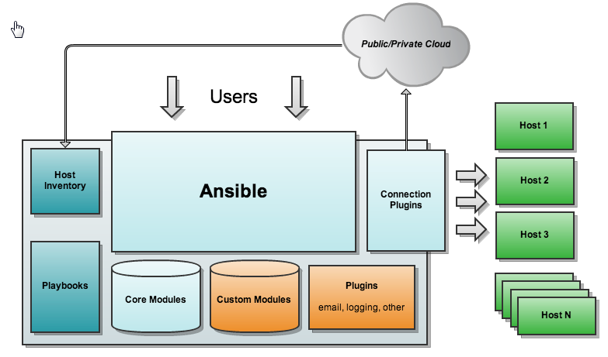

Slide 12
Ansible – Prerequisite
Notes:
TITLE PAGE
– Headline 36pt Arial in WHITE
– Sub-head 18pt Arial Reg in GREY
– Do not include client logos on title page
– TEXT ONLY
***It’s not recommended to use any sort of graphic animation. Although in some cases it may be appropriate to apply “Appear” effect to slide sections to show sections one-by-one on the slide***

Slide 13
RSA public key sharing among nodes for password-less authentication via SSH
SeLinux should be permissive or Disabled
You should have some Linux expertise ( basic command line, user and file management )
YAML Basics
Proper Release structure for deployment and roll-back activity

Slide 14
Ansible – Release Structure
Notes:
TITLE PAGE
– Headline 36pt Arial in WHITE
– Sub-head 18pt Arial Reg in GREY
– Do not include client logos on title page
– TEXT ONLY
***It’s not recommended to use any sort of graphic animation. Although in some cases it may be appropriate to apply “Appear” effect to slide sections to show sections one-by-one on the slide***

Slide 15
/share/release/XX.YY.ZZZ
| -- common (libs)
| -- redis_common_config (Common Redis configuration)
| -- redis_metadata (Common Metadata configuration)
| -- APPLICATION-1
| -- config
| -- libs
| -- vsb-<APPLICATION-1>.jar
| -- APPLICATION-2
| -- config
| -- libs
| -- vsb-<APPLICATION-2>.jar
| -- vsb-facade
| -- application.properties
| -- vsb-facade-0.2-SNAPSHOT.jar

Slide 16
/share/release/XX.YY.ZZZ
| -- common (libs)
| -- redis_common_config (Common Redis configuration)
| -- redis_metadata (Common Metadata configuration)
| -- c2
| -- config
| -- c2-app-config.properties
| -- c2-queue-names.properties
| -- libs
| -- vsb-c2.jar
| -- em
| -- config
| -- em-app-config.properties
| -- em-queue-names.properties
| -- libs
| -- vsb-em.jar
| -- smh
| -- config
| -- application.properties
| -- app-prop-files-list.properties
| -- sm-queue-names.properties
| -- libs
| -- vsb-smh.jar
| -- sml
| -- config
| -- sm-app-config.properties
| -- sm-queue-names.properties
| -- libs

Slide 17
Ansible – Execution Steps
Notes:
TITLE PAGE
– Headline 36pt Arial in WHITE
– Sub-head 18pt Arial Reg in GREY
– Do not include client logos on title page
– TEXT ONLY
***It’s not recommended to use any sort of graphic animation. Although in some cases it may be appropriate to apply “Appear” effect to slide sections to show sections one-by-one on the slide***

Slide 18
Take Backup of running applications (only)
Stop running applications
Change configuration by populating updated config files provided with release into redis (if any) after comparing md5sum
Create softlink of libs (common and application) to respective location
Copy new deployable to respective location
Start the application
Application Status Check
Email Notification

Slide 19
Demo
Contact
​Swapnil Bendekar| Consultant Engineering P +91.710.466.9600 x 630 M +91.808.707.0331
www.globallogic.com

Slide 20
Questions?
Contact
​Swapnil Bendekar| Consultant Engineering P +91.710.466.9600 x 630 M +91.808.707.0331
www.globallogic.com

Slide 21
Thank you !
Contact
​Swapnil Bendekar| Consultant Engineering P +91.710.466.9600 x 630 M +91.808.707.0331
www.globallogic.com

