Slide 1
Docker Fundamentals
Adnan Khan

Slide 2
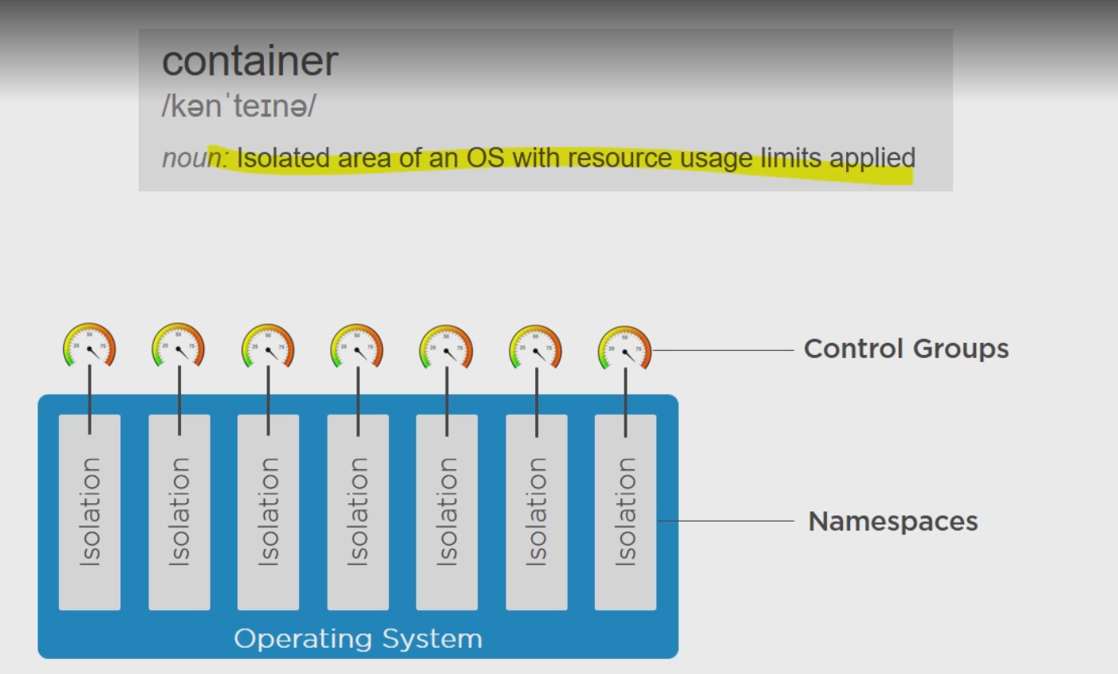
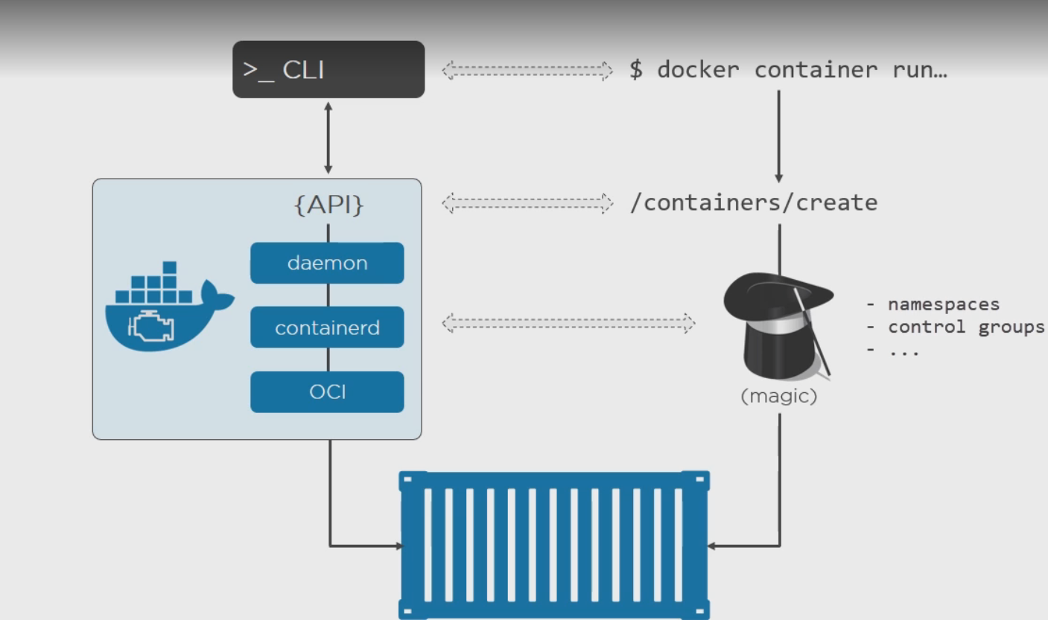
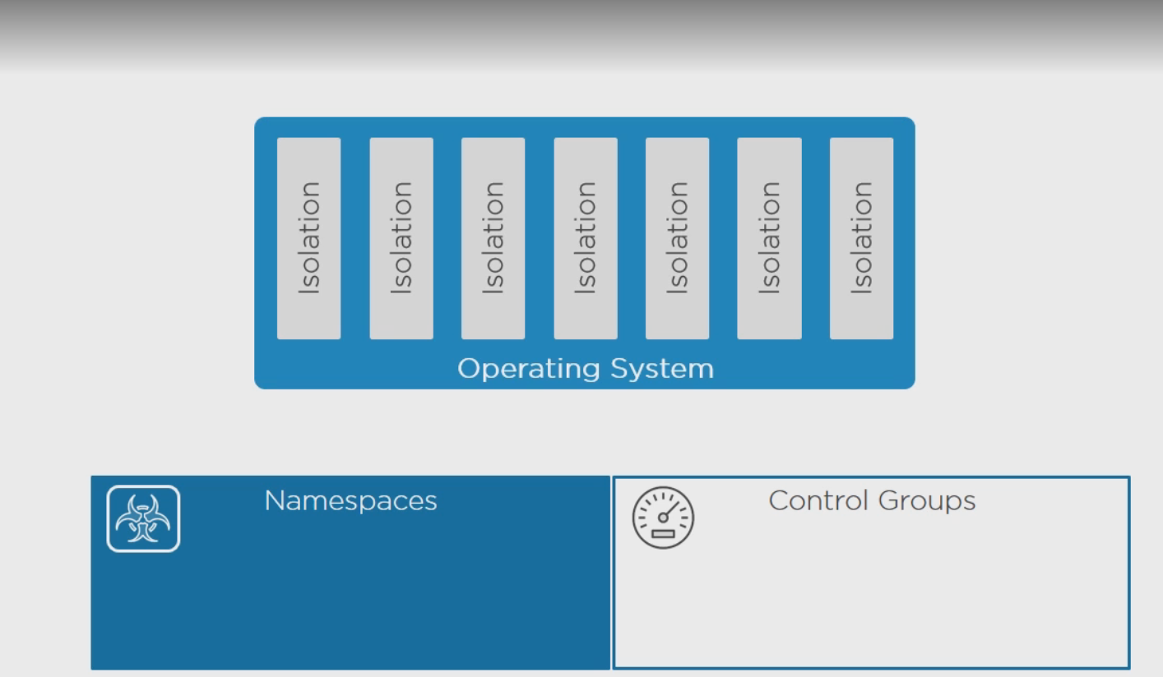
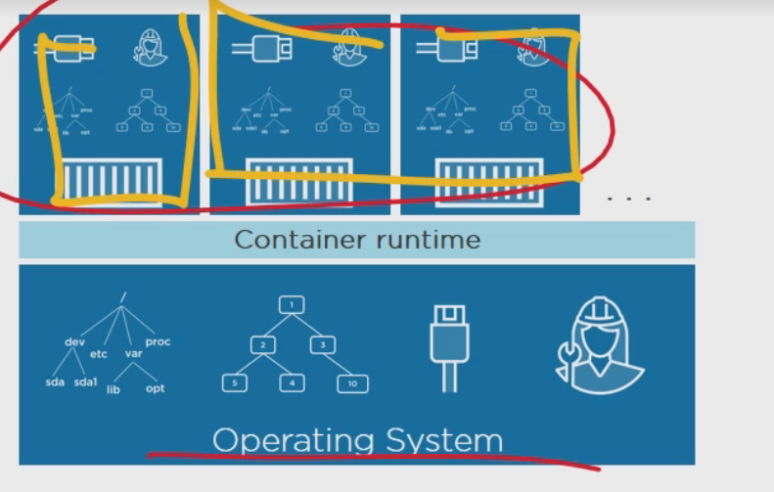
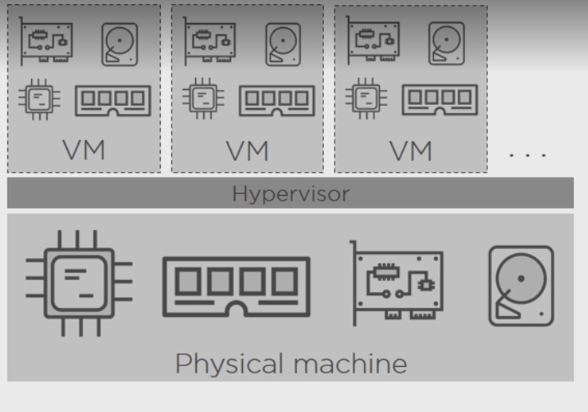
Docker Architecture

Slide 3
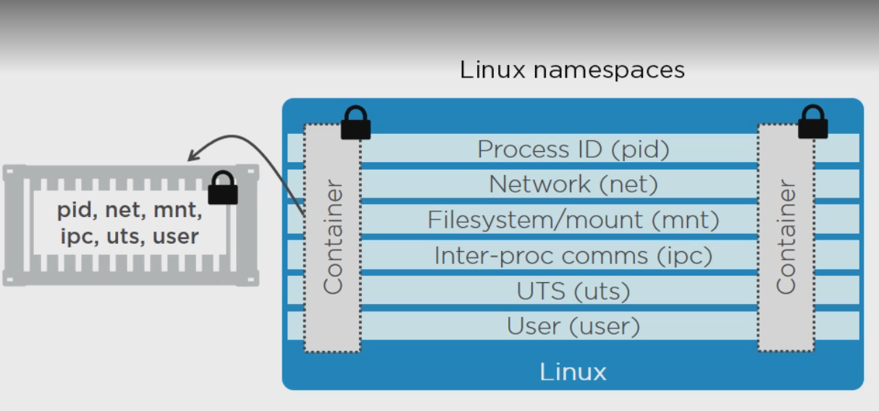
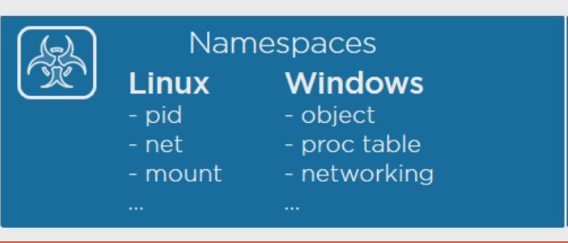
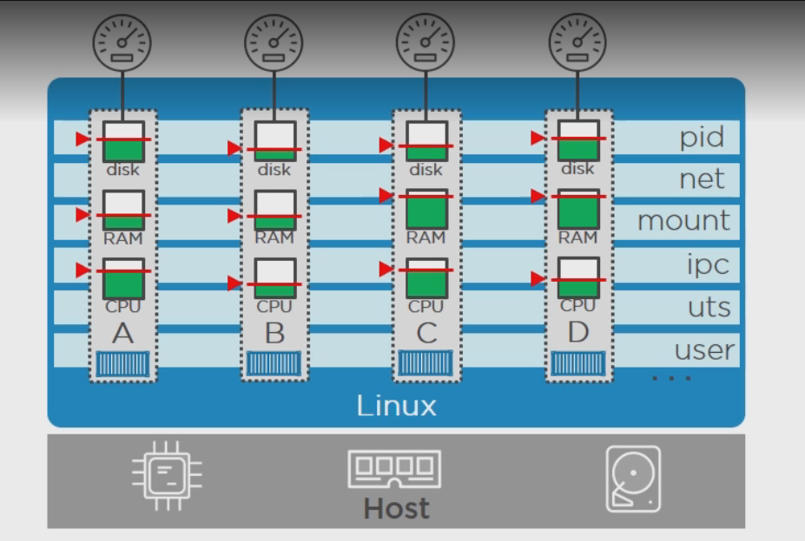
Docker Architecture Contd

Slide 4
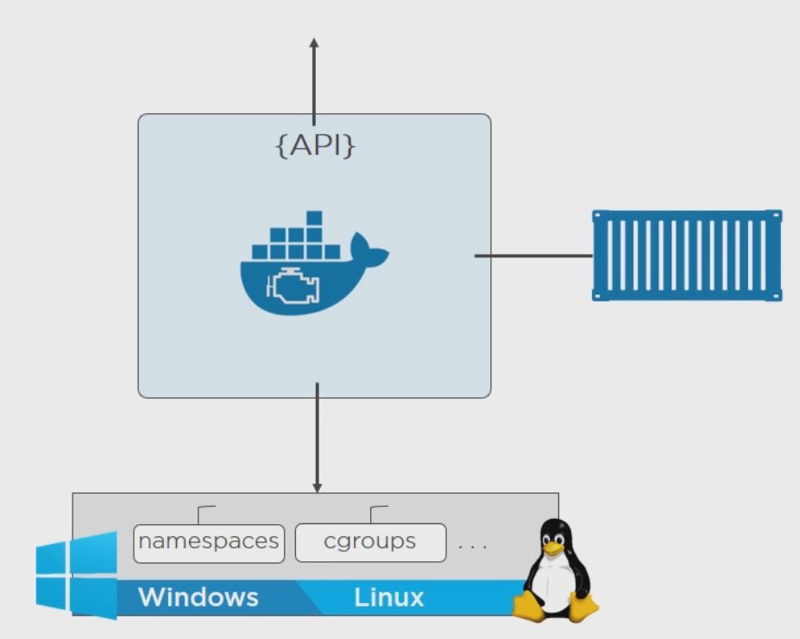
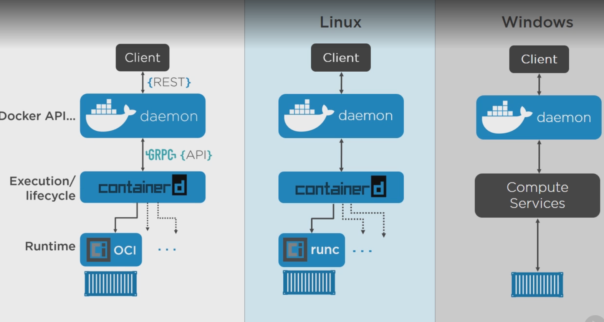
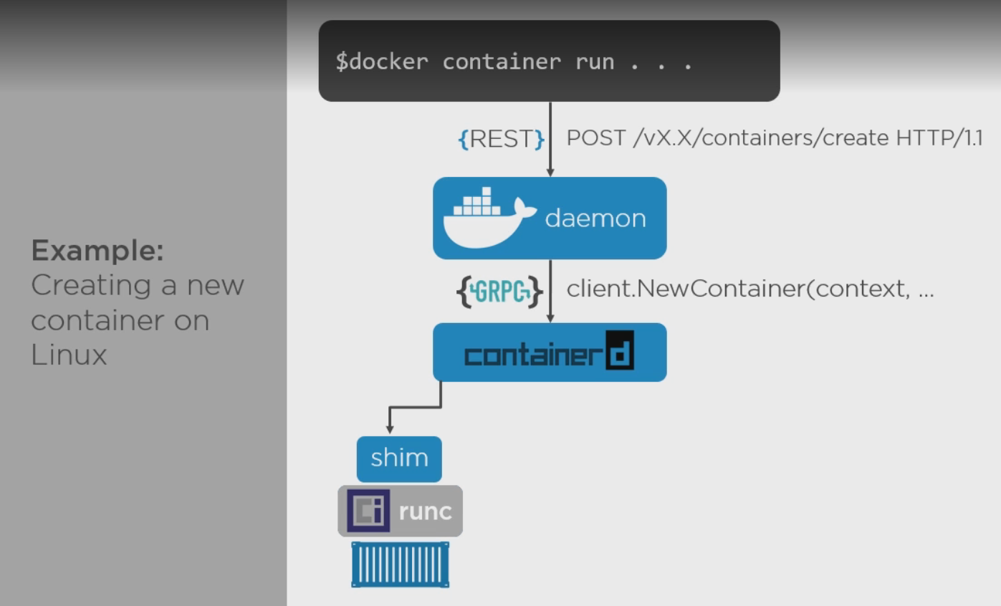

Slide 5
Docker Architecture Contd
Two Main Building Blocks are used when creating Containers:
NameSpaces: These are about Isolation.
These take up an operating system and help them split into multiple operating systems.
Control Groups:
Limit the resources to be used by Processes .
Help in achieving realistic containers on a machine.

Slide 6
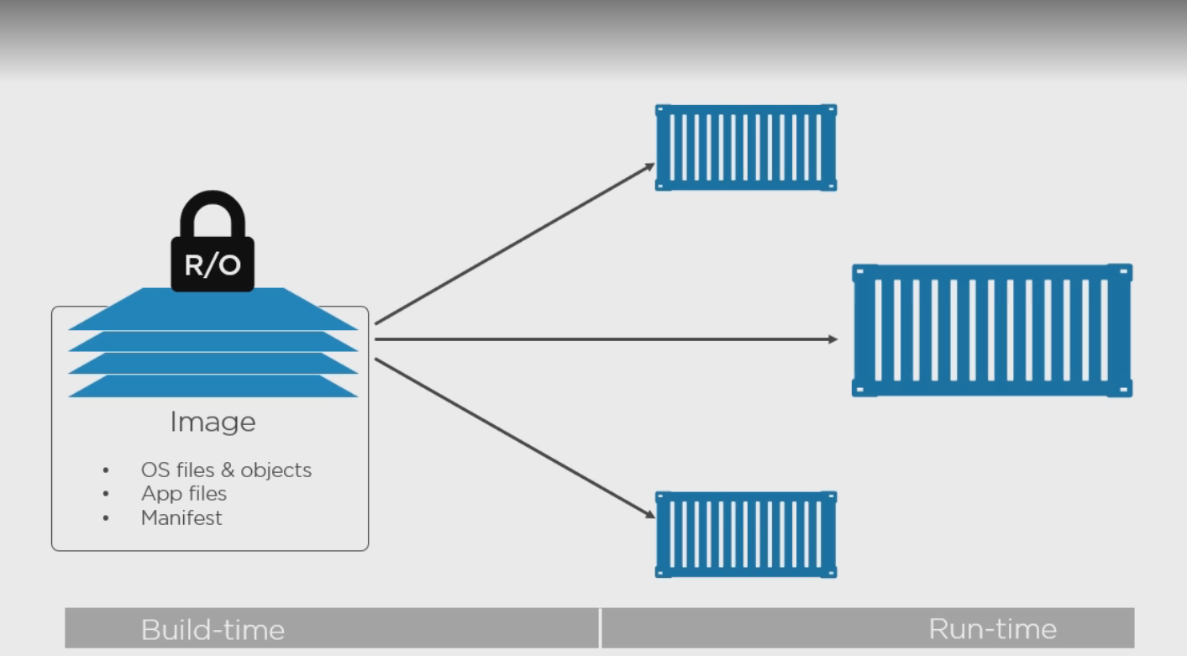
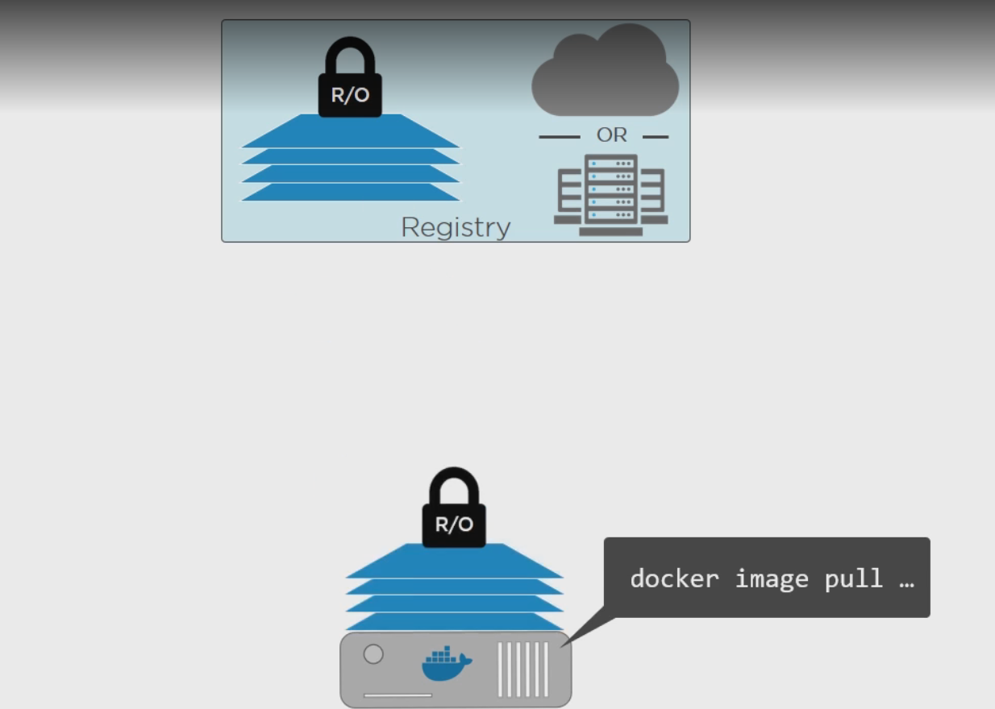
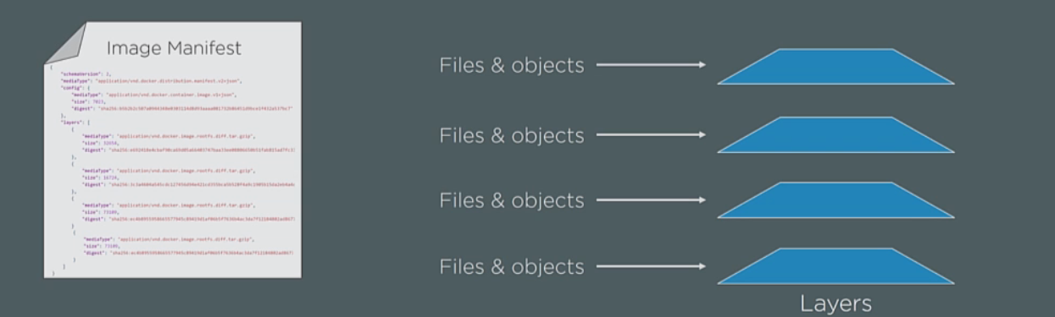
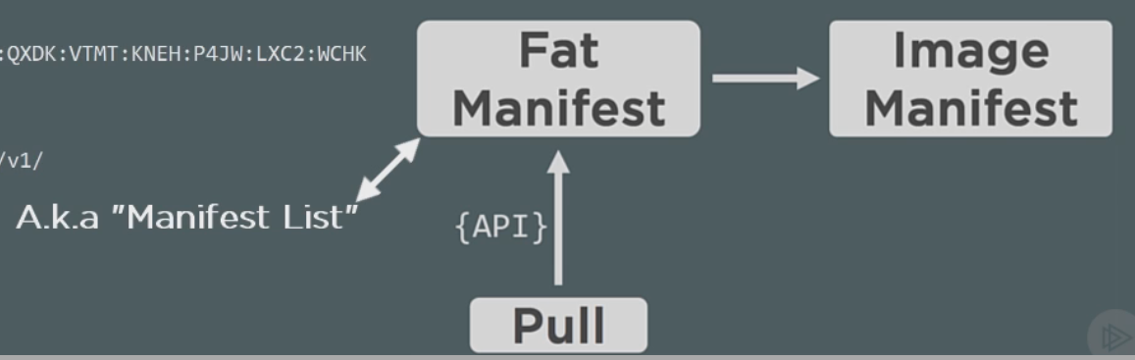
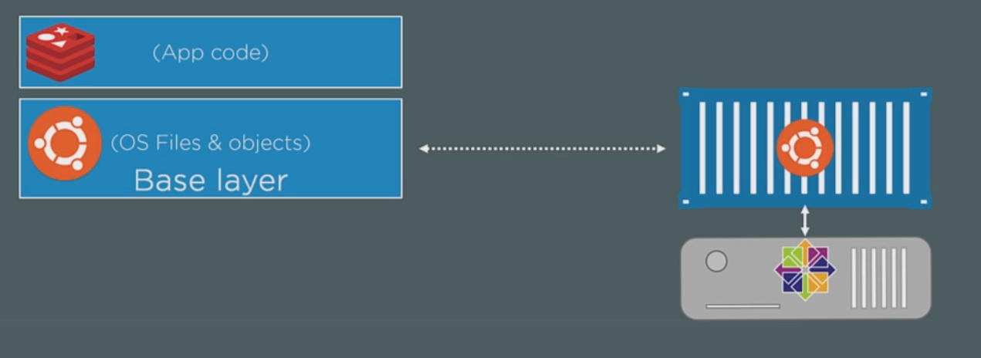
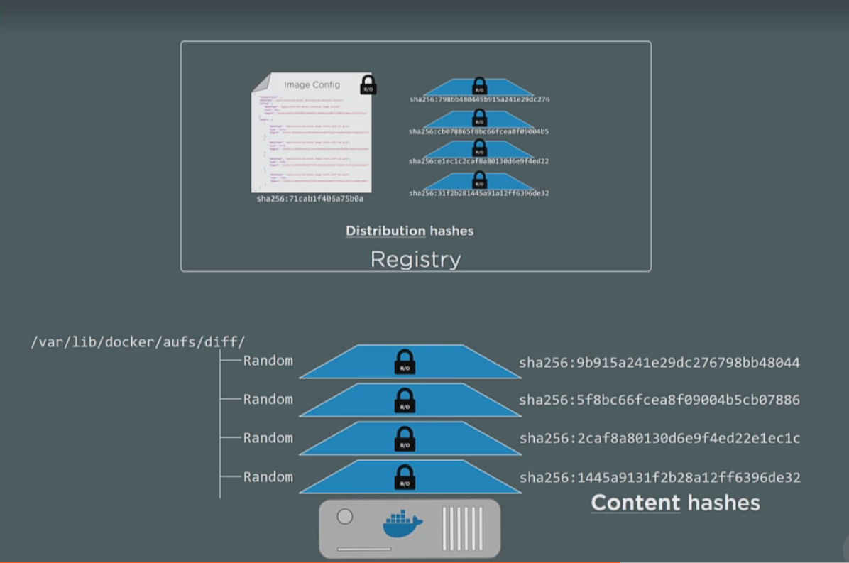
Images

Slide 7
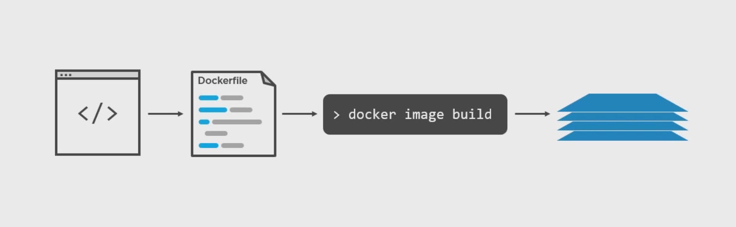
Building Images

Slide 8
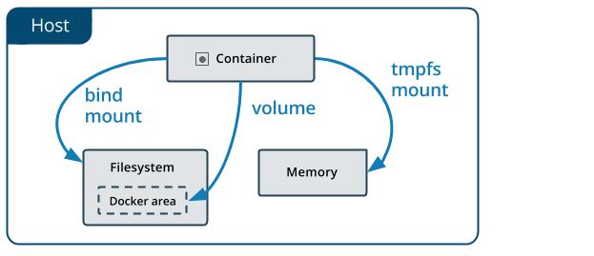
Data Storage in Docker
The data doesn’t persist when that container no longer exists, and it can be difficult to get the data out of the container if another process needs it.
A container’s writable layer is tightly coupled to the host machine where the container is running. You can’t easily move the data somewhere else.
Writing into a container’s writable layer requires a storage driver to manage the filesystem. The storage driver provides a union filesystem, using the Linux kernel. This extra abstraction reduces performance as compared to using data volumes, which write directly to the host filesystem.
Docker has two options for containers to store files in the host machine, so that the files are persisted even after the container stops: volumes, and bind mounts.
Volumes are stored in a part of the host filesystem which is managed by Docker (/var/lib/docker/volumes/ on Linux). Non-Docker processes should not modify this part of the filesystem. Volumes are the best way to persist data in Docker.
Bind mounts may be stored anywhere on the host system. They may even be important system files or directories. Non-Docker processes on the Docker host or a Docker container can modify them at any time.
tmpfs mounts are stored in the host system’s memory only, and are never written to the host system’s filesystem.
More information on storage is available at https://docs.docker.com/storage/ .

