Slide 1
Amazon Web Services
Adnan Khan

Slide 2
Cloud Computing
Cloud computing is a model for enabling ubiquitous, convenient, on-demand network access to a shared pool of configurable computing resources (e.g., networks, servers, storage, applications, and services) that can be rapidly provisioned and released with minimal management effort or service provider interaction.
In layman terms , it is the automation of highly virtualized environments.
5 essential characteristics
On demand .
Broad network access.
Resource Pooling.
Rapid Elasticity
Measured Services.
3 service models
IaaS (Infrastructure as Service)
PaaS (Platform as Service)
SaaS (Software as Service)
5 deployment models
Private Cloud ( On Premises) ,
Private cloud in Public Cloud).
Hybrid ( some on premises and some on Public Cloud)
Community (Vertical/institution Cloud).
Public Cloud.

Slide 3
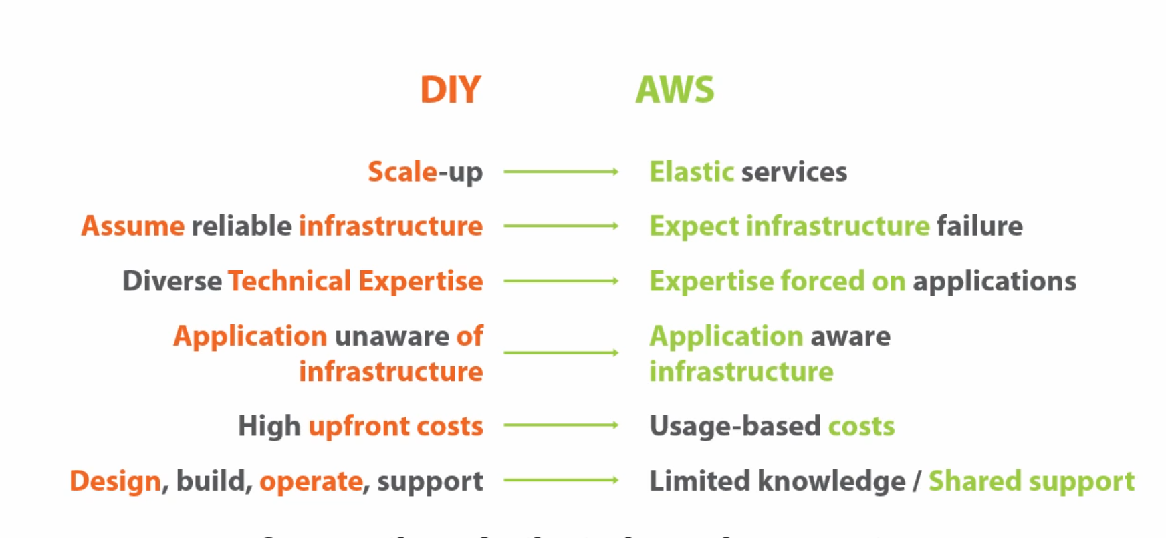
Do it Your Self vs Cloud

Slide 4
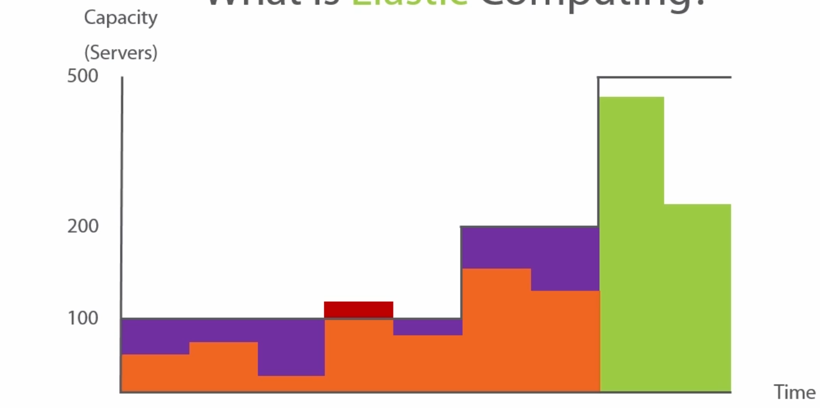
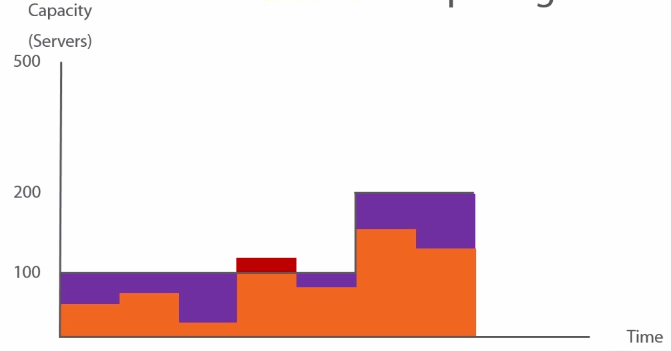
Elastic Computing

Slide 5
Regions and Availability Zones
Region: is a Geographical Area described by the cloud Provider.
Availability Zone: Data Centre(s) .in a Region
Not all the amazon services are available in all the regions.
Edge locations: Areas on which amazon services are available but servers cannot be placed on these locations.

Slide 6
AWS Storage
Ephemeral Storage:
Temporary storage. It is temperory block level storage which is hosted on the same server hosting the EC2 instance.
Data is lost when the instance is stopped or teminated.
S3 : Simple Storage Service
It was the fisrt AWS service introduced in 2006.
It is acceessible over the internet. via http/https.
Can used to store files/backups.
Unlimited bucket size, however single object/file is limited to 5TB.
Not a file system.
Priced on storage used and file transfered out of S3.
Two type of storage , 1) Standard storage 2) Reduced redundancy storage.
Granular selection for storage type.
Bucket name needs to be unique with in the region in which the bucket is being created.
3 uses a flat file sytem.

Slide 7
AWS Storage
Elastic Block Storage(EBS).
Not a service like S3 i.e. not accessible via internet.
is a support system for compute instance.
Doesnot needs to be attached to an instance.
can be transfered between availability zones.
supports incremental snapshots.
Uses S3 for storing snapshot storage.
Provisioned IOPS.
Can be used by a single instance at a given time.

Slide 8
AWS Storage
Elastic File Storage (EFS):
it shrinks and grows as the files are added or removed.
Provides traditional storage paradigm.
Useful for SaaS applications.
Can be mounted on multiple EC2 instances.
Supports NFS 4.
Stores data across multipls availabilty zones in a region.
Supports encryption at two forms, in transit(when mounting the file system) and at rest.
For EFS to be used with an instance the NFS needs to be installed.
EFS can only be mounted on a single VPC at a time.
can also be mounted on on-premises data centres.

Slide 9
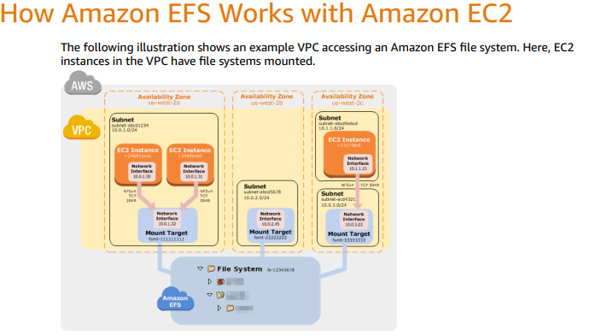
AWS Storage

Slide 10
AWS Storage
Cheap storage.
Used for infrequently used data, ideal for backup.
very slow retrieval times.
High Durability.
Cost for restoring.

