Slide 1
Amazon Web Services
Adnan Khan

Slide 2
Cloud Computing
Cloud computing is a model for enabling ubiquitous, convenient, on-demand network access to a shared pool of configurable computing resources (e.g., networks, servers, storage, applications, and services) that can be rapidly provisioned and released with minimal management effort or service provider interaction.
In layman terms , it is the automation of highly virtualized environments.
5 essential characteristics
On demand .
Broad network access.
Resource Pooling.
Rapid Elasticity
Measured Services.
3 service models
IaaS (Infrastructure as Service)
PaaS (Platform as Service)
SaaS (Software as Service)
5 deployment models
Private Cloud ( On Premises) ,
Private cloud in Public Cloud).
Hybrid ( some on premises and some on Public Cloud)
Community (Vertical/institution Cloud).
Public Cloud.

Slide 3
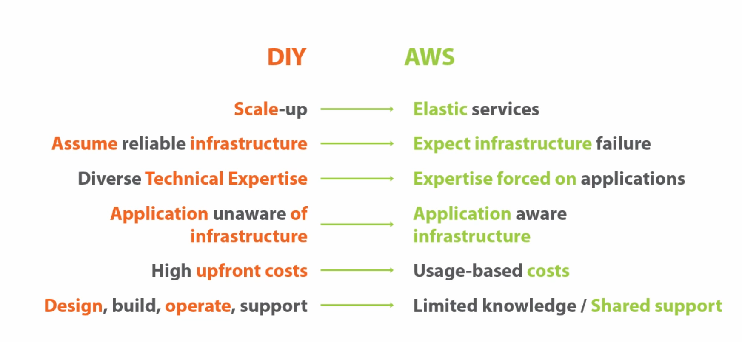
Do it Your Self vs Cloud

Slide 4
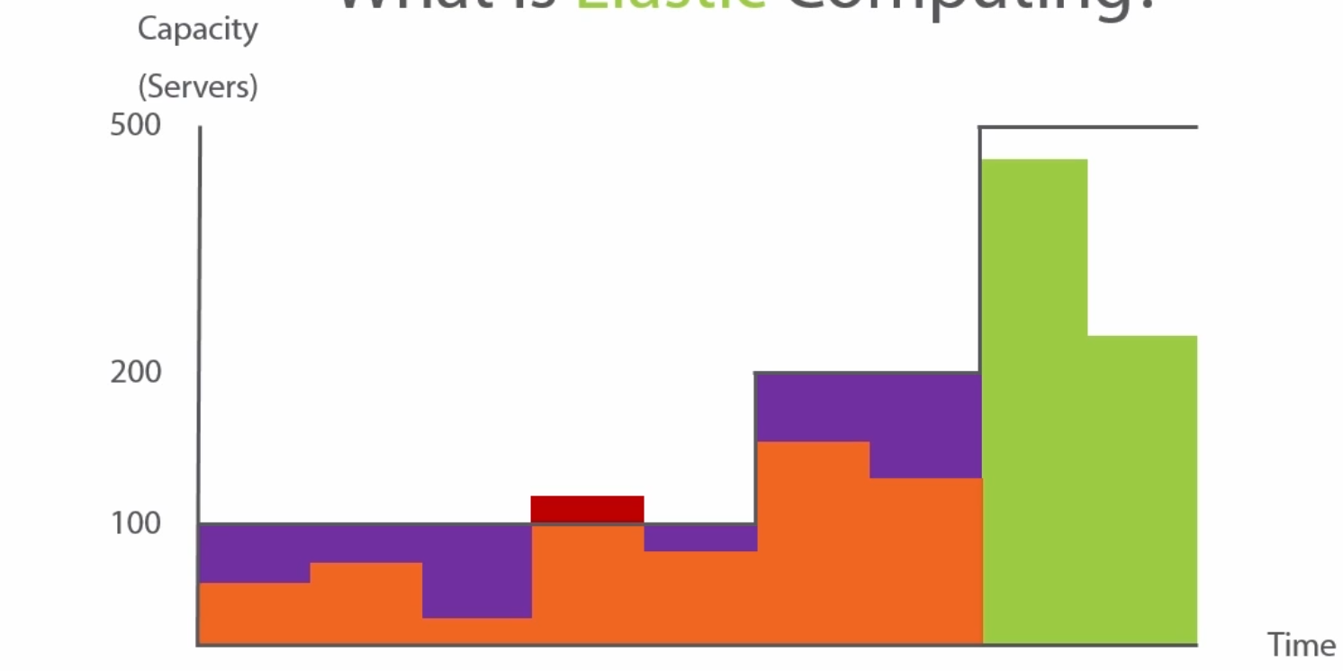
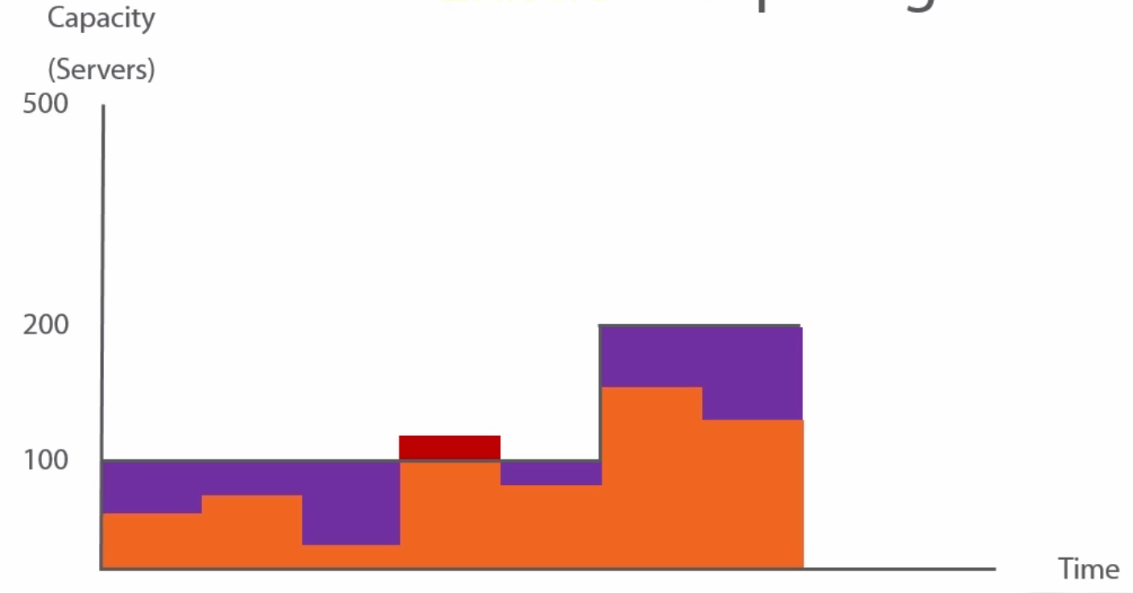
Elastic Computing

Slide 5
Regions and Availability Zones
Region: is a Geographical Area described by the cloud Provider.
Availability Zone: Data Centre(s) .in a Region
Not all the amazon services are available in all the regions.
Edge locations: Areas on which amazon services are available but servers cannot be placed on these locations.

Slide 6
IAM(Identity and Access Management)
Complete AWS security resides here.
Users
Groups
Roles
IAM is at center of IAS, i.e. every service uses IAM for access.
IAM has a global view. i.e. it operates across all regions.
Comes with pre-defined policies.
1 IAM user per person.
1 IAM role per application.
Not all the amazon services are available in all the regions.
Edge locations: Areas on which amazon services are available but servers cannot be placed on these locations.

Slide 7
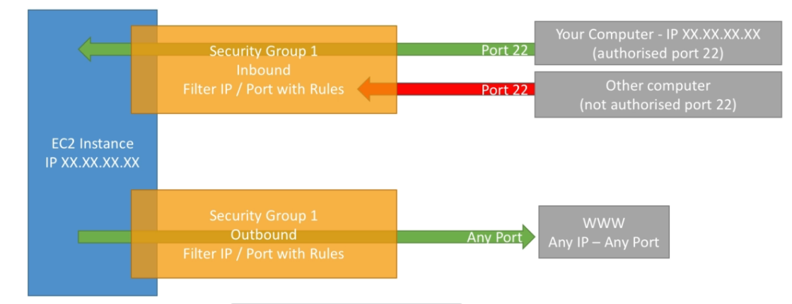
Security Groups
Fundamental for network security on AWS.
Control how traffic is allowed in and out of EC2.
Can be attached to multiple instances, and an instance can have multiple security groups.
Security Groups are limited to VPC and regions.
By default all inbound is blocked.

Slide 8
Demo
EC2 instance creation,connecting to Instance.
Security Groups.

