Slide 1
JENKINS
Continuous Integration
Adnan Khan

Slide 2
CONTINUOUS INTEGRATION
CI - Defined “Continuous Integration is a software development practice where members of a team integrate their work frequently, usually each person integrates at least daily - leading to multiple integrations per day. Each integration is verified by an automated build (including test) to detect integration errors as quickly as possible”

Slide 3
WHAT REALLY HAPPENS IN CI?
At a regular frequency (ideally at every commit), the system is:
Integrated: All changes up until that point are combined into the project
Built: The code is compiled into an executable or package
Tested: Automated test suites are run
Packaged: Versioned and stored so it can be distributed as is, if desired
Deployed: Loaded onto a system where the developers can interact with it

Slide 4
IMPROVING YOUR PRODUCTIVITY
Continuous integration can help you go faster
  Detect build breaks sooner
  Report failing tests more clearly
  Make progress more visible

Slide 5
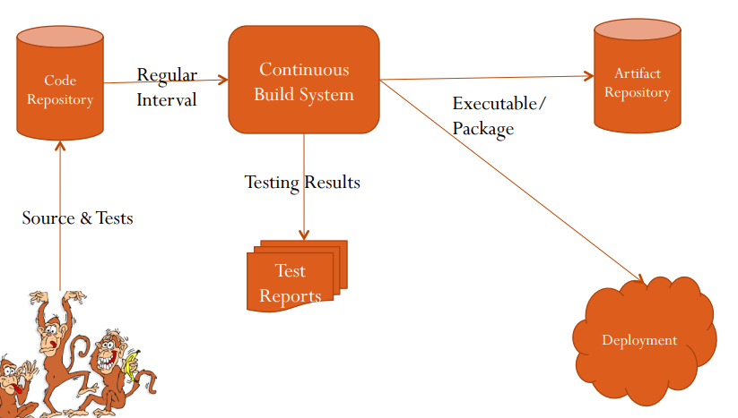
CI WORKFLOW

Slide 6

JENKINS FOR CONTINUOUS INTEGRATION
Jenkins – open source continuous integration server
Jenkins (http://jenkins-ci.org/) is
  Easy to install
  Easy to use
  Multi-technology
  Multi-platform
  Widely used
  Extensible
  Free

Slide 7
HISTORY OF JENKINS
2005 - Hudson was first release by Kohsuke Kawaguchi of Sun Microsystems
2010 – Oracle bought Sun Microsystems
  Due to a naming dispute, Hudson was renamed to Jenkins
  Oracle continued development of Hudson (as a branch of the original)

Slide 8
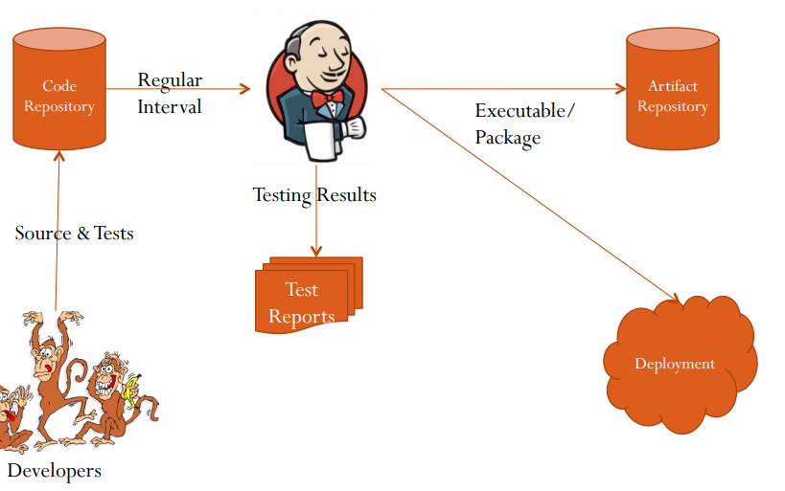
WHERE DOES JENKINS FITS?

Slide 9
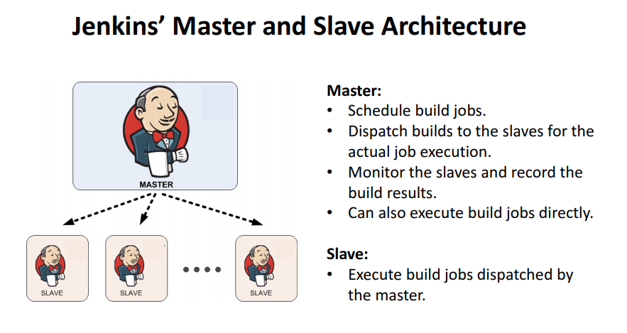
MASTER-SLAVE ARCHITECTURE

Slide 10
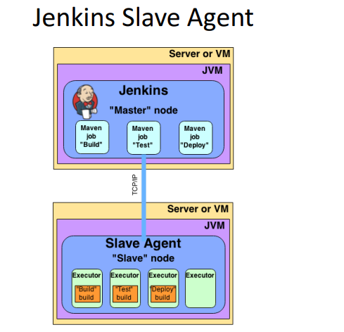
MASTER SLAVE ARCHITECTURE

Slide 11
JENKINS FOR A DEVELOPER
Easy to install
  Download one file – jenkins.war
  Run one command – java –jar jenkins.war
Easy to use
  Create a new job – checkout and build a small project
  Checkin a change – watch it build
  Create a test – watch it build and run
  Fix a test – checkin and watch it pass
Multi-technology
  Build C, Java, C#, Python, Perl, SQL, etc.
  Test with Junit, Nunit, MSTest, etc.

Slide 12
JENKINS INSTALLATION
Prerequisite:
  Gcloud Account
  Linux Machine /VM (CentOS)
Installation Begins:

Slide 13
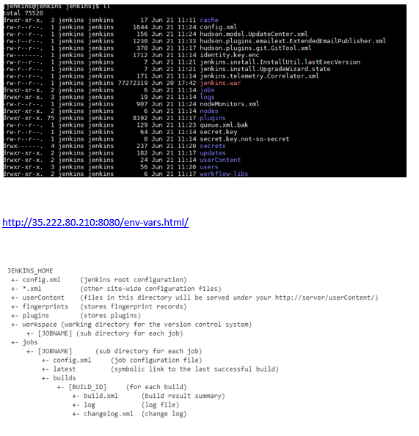
JENKINS HOME

Slide 14
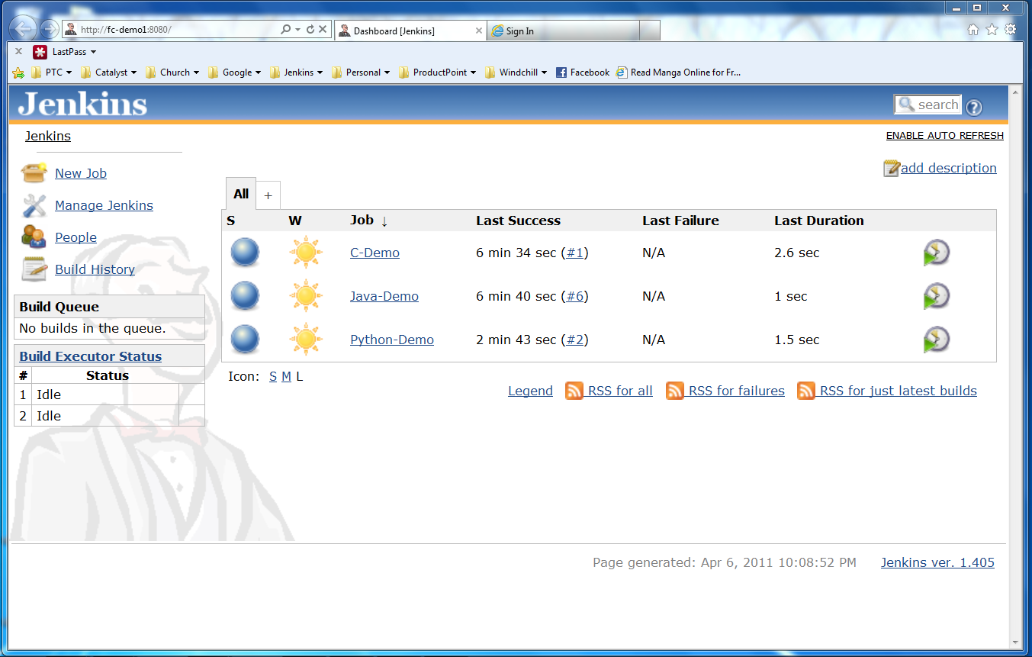
JENKINS USER INTERFACE
Actions
Nodes
Jobs

Slide 15
Create a new job from a Subversion repository
Build that code, see build results
Run its tests, see test results
Make a change and watch it run through the system
Languages
  Java
  C
  Python

Slide 16
MORE POWER – JENKINS PLUGINS
Jenkins has over a variety of plugins
  Software configuration management
  Builders
  Test Frameworks
  Virtual Machine Controllers
  Notifiers
  Static Analyzers

Slide 17
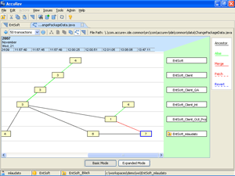

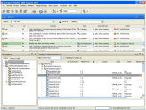



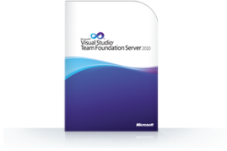
JENKINS PLUGINS - SCM
Version Control Systems
  Accurev
  Bazaar
  BitKeeper
  ClearCase
  Darcs
  Dimensions
  Git
  Harvest
  MKS Integrity
  PVCS
  StarTeam
  Subversion
  Team Foundation Server
  Visual SourceSafe

Slide 18
JENKINS PLUGINS – BUILD & TEST
Build Tools
  Ant
  Maven
  MSBuild
  Cmake
  Gradle
  Grails
  Scons
  Groovy
Test Frameworks
  Junit
  Nunit
  MSTest
  Selenium
  Fitnesse

Slide 19
JENKINS PLUGINS – ANALYZERS
Static Analysis
  Checkstyle
  CodeScanner
  DRY
  Crap4j
  Findbugs
  PMD
  Fortify
  Sonar
  FXCop
Code Coverage
  Emma
  Cobertura
  Clover
  GCC/GCOV

Slide 20
JENKINS PLUGINS – OTHER TOOLS
Authorization
  Active Directory
  LDAP
Cloud Machines
  Amazon EC2
  Gcloud
  OpenStack
Notification
  Slack
  Email
  Chatwork

Slide 21
JENKINS FOR TEAMS
Multi-configuration jobs
Multi-stage jobs
Jenkins can help your development be
  Faster
  Safer
  Easier
  Smarter

Slide 22

DEMO FOR CLASSIC JENKINS

Slide 23
WHAT IS NEXT?
Advanced Jenkins
  Jenkins 2 with pipeline jobs
  Intergration with other Tools (sonar , nexus, Ansible,etc)
  Dockerized Containers.
  Deployment to Servers , Container

