Slide 1
Kubernetes
Adnan Khan

Slide 2
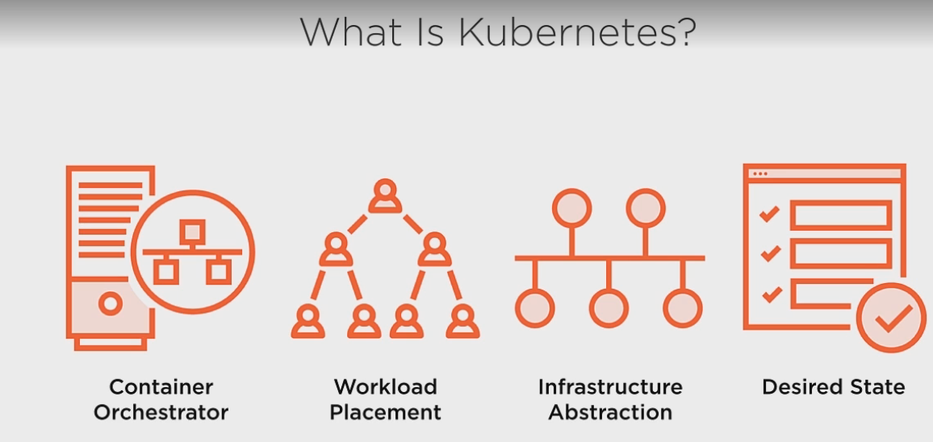
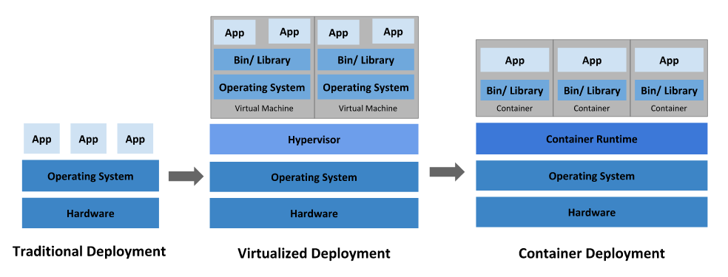
What is KuberNetes

Slide 3
Kubernetes is the container orchestration tool.
Kubernetes is a portable, extensible, open-source platform for managing containerized workloads and services, that facilitates both declarative configuration and automation.
Allows to start ,stop , configure container based applications based on the requirements.
Key Components :
Workload placement, i.e. how will I deploy my container based applications.
Provides Infrastructure Abstraction, being an admin I don’t have to care about the infrastructure details.
Desired State ,we can define the desired state of our application in the configuration and it is job of kubernetes to make sure that the application is in the desired state.
Benefits of Using Kubernetes :
Fast Deployment.
Ability to absorb changes quickly.
Ability to recover quickly.
Hides Complexity of the cluster.

Slide 4
Kubernetes Components
Kubernets components are divided into two parts:
Master Components
Node Components
Master components :
Provide control plane for the cluster and make decisions about the cluster.
Master components detect and respond to the changes in cluster.
Master components can be set up on individual machines in the cluster (this will serve the purpose of high availability)
Check out the link (https://kubernetes.io/docs/setup/production-environment/tools/kubeadm/high-availability/)
Kubernetes API Server:
API server is the restful API server deployed over https/http.
All configuration changes pass through the API server.
Sole way for the admins to interact with the cluster.
Sole way the kubernetes interacts with the cluster.
Consists of API objects, such as nodes , pods , etc.
API objects allow us to configure the state of the system.
State of the system can be defined in two ways:
Declaratively: We can describe how the deployed system will look like and what will be the desired state.
Imperatively: we can perform operation via command line one by one and define the configuration.

Slide 5
Kubernetes Components Contd
ETCD:
It’s the keystore server used by kubernetes.
ETCD stored all the data corresponding to the cluster.
Detailed information at (https://etcd.io/docs/v3.3.12/learning/client-architecture/)
Kube-Scheduler:
It is the component on the master that watches newly generated pods which have no nodes assigned and assigns a node to them.
It allocates the nodes based on the resource requirements.
Responsible for enforcing any restraints for the pods.(e.g. if the pods are to be run on the same node(also called pod affinity)).
Kube-Control-Manager:
It is the component on the master that runs the controllers.
Node Controller: Responsible for noticing the state of node and respond to the change in state of the node.
Replication Controller: Maintains the correct number of pods for every replication object in the system.
End Points controller: Populates the end point objects(Services,Pods)
Service account and Token Controller: Creates default accounts and API access tokens for new namespaces.

Slide 6
Kubernetes Components Contd
Node components :
Run on every Node
Responsible for running ,maintaining and providing runtime environment for pods.
Kubelet:
It is an agent that runs on every nodes.
Ensures that containers are running in a pod.
Kubelet takes a set of PodSpecs and ensures that container are healthy and in desired state as per the specifications.
Monitors the API server for changes.
Reports node and pod state to the API server.
Executes the liveness prob on pod and nodes.
Kube-proxy:
It’s a software proxy that runs on every node.
Provides kubernetes service abstraction by maintaining network rules on the host and enables port forwarding.
Has the responsibility for the networking components on the nodes, which is done behind the scenes with the networking proxy stored in IP tables.
Responsible for routing traffic to pods.
Implements load balancing.
Container Runtime :
Runs on every Node.

Slide 7
Kubernetes API Objects:
Pods:
Single/or a collection of container deployed as a single unit.
These are the container based applications.
When we define pods we also describe the resources that are required for the deployment.
Pods are ephemeral , i.e. no pod is ever re-deployed.
If it is a multi-container pod and one of the container dies , whole pod goes down and a new deployment is made based on the configuration.
Provides a liveness probe , kubernetes the state of the pod and health of the application if its up and running.
Controllers:
Entities which keep our system in the desired state.
Apart from the ones mentioned previously there are many other controllers in kubernetes.
Services:
Provide a persistent access point to the applications we deployed in the pod.
As the underlying applications constantly keep on changing, the services provide a consistent end points for the communication.
Is a network abstraction for the applications that pods are hosting.
Kubernetes allocation a DNS/IP to collection of application service provided by pods.
Services provide scaling and load balancing of the pods.
Storage:
Kubernetes storage objects, which can be used as a persistent storage for our application.
As the underlying applications constantly keep on changing, the services provide a consistent end points for the communication.

Slide 8
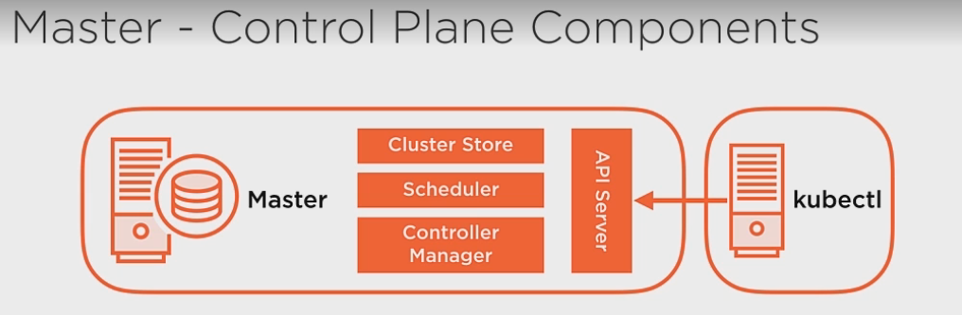
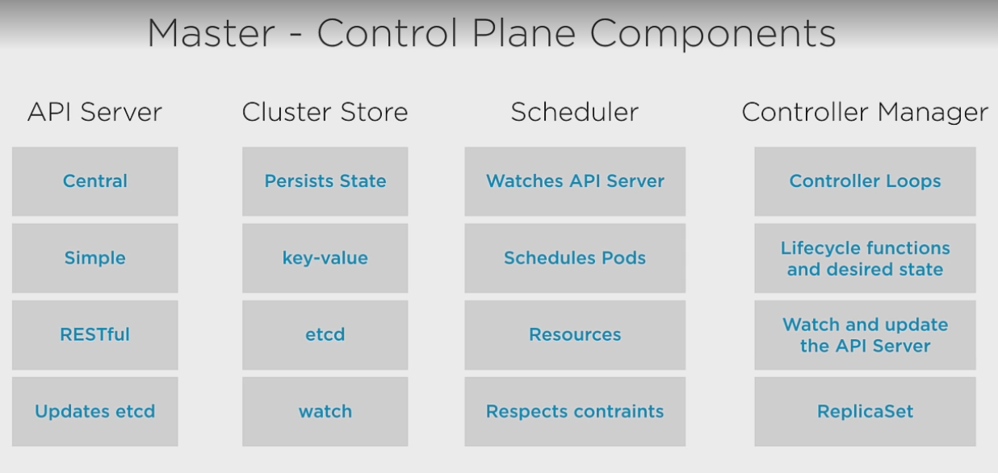
Kubernetes Architecture:

Slide 9
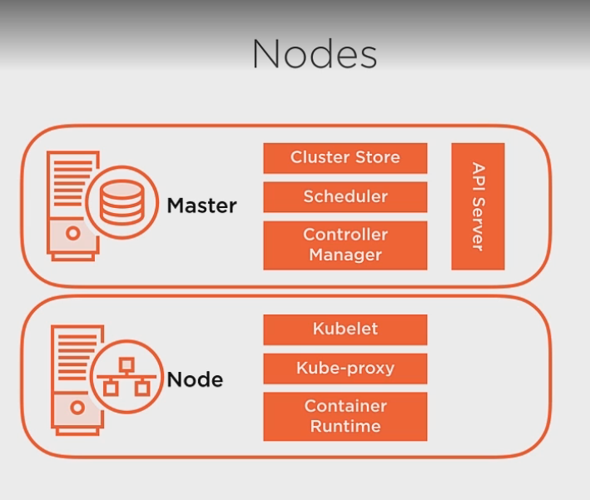
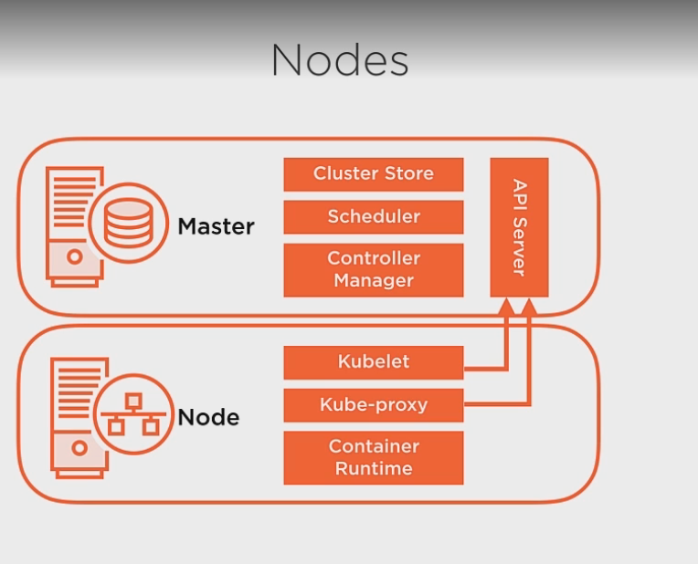
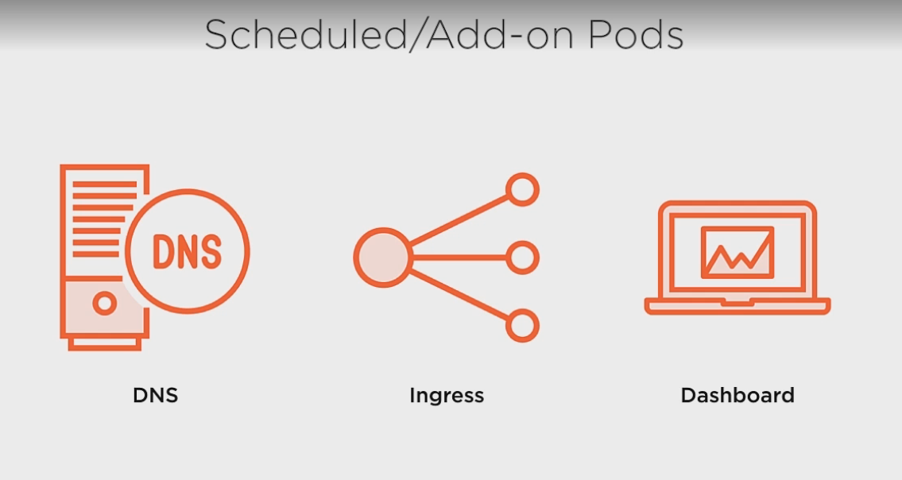
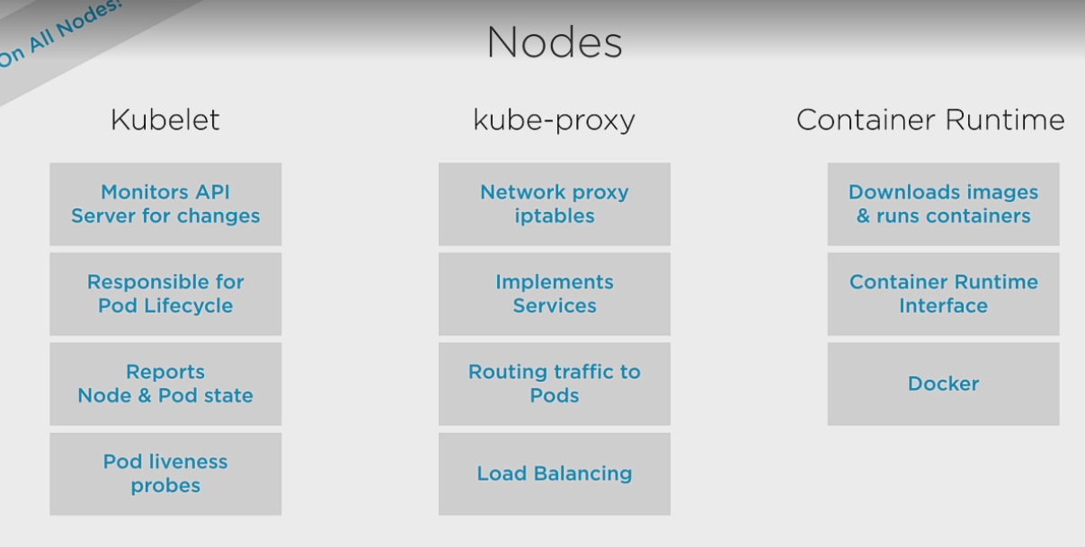

Slide 10
Node Operations
API
Server
KubeCTL Places request for 3 replicaSet
Cluster Store
Master
Controller Manager
Node
Kubelet
Scheduler
Pod
Kube-proxy
Container Runtime
Node
Kubelet
Pod
Node
Kubelet
Pod
Kube-proxy
Kube-proxy
Container Runtime
Pod
Container Runtime

Slide 11
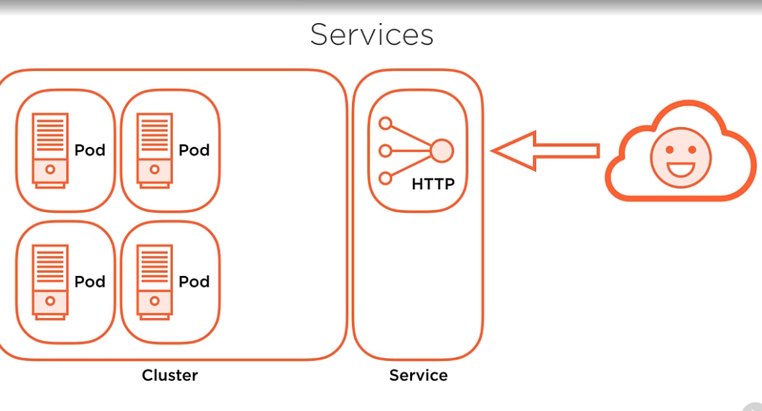
Service Operations

Slide 12
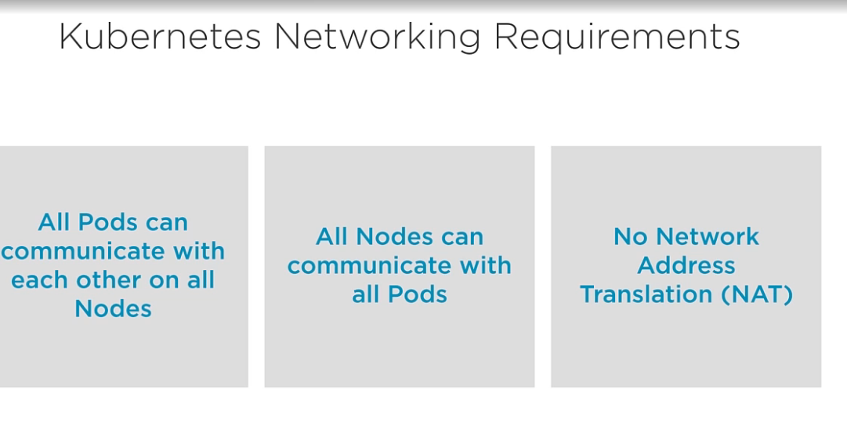
Kubernetes networking fundamentals.
Ed
Saas
Asaa

Slide 13
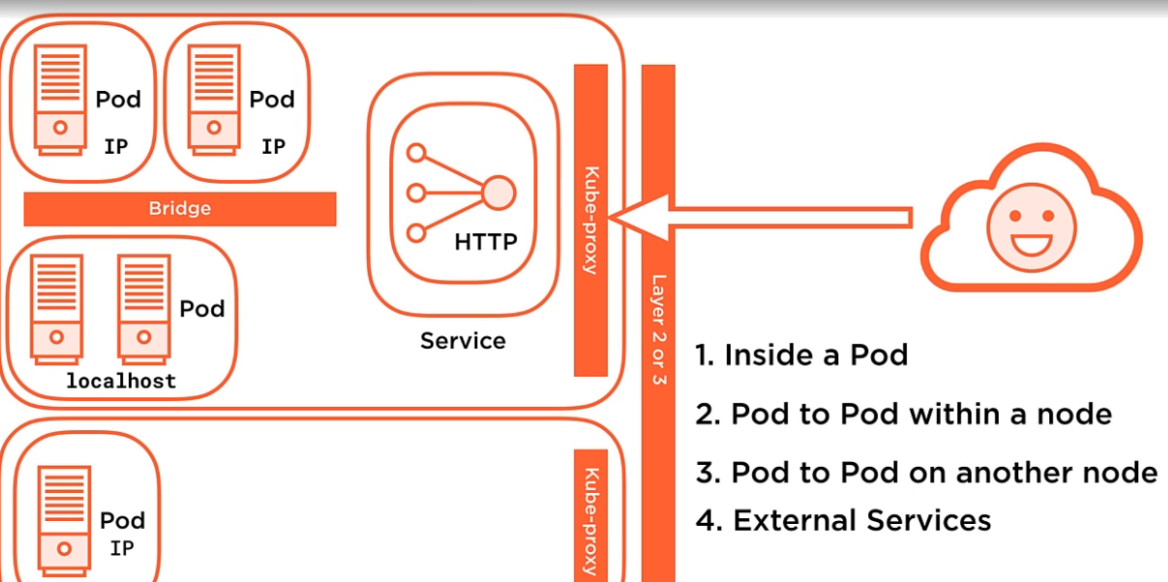
Pod Communication

Slide 14
Kubernetes Installation(kube-adm).
Follow the attached document to install kubernetes on Centos using kubeadm.
Upon Kubeinit , the kubenertes goes through below phases.
Pre-flight checkes:
Ensures that we have right privileges for running kubernetes.
Pulls down the container images.
Verifies that enough resources are available and a compatible container runtime is available.
Creates CA certificates:
Kube adm uses certificates for authentication and encryption.
Certificate is used to secure cluster communication.
Generated certificates are used by the API server to encrypt the http stream by API server for communication.
Certificates are also used for authentication of users and kubelets.
Certificates are stored in /etc/kubernetes/pki
Generates Kube Config Files:
Kubeconfig defines on how to connect to the cluster, contains information on the certificates, cluster location information.
Creates a collection of config files located in /etc/kubernetes
Admin.conf (kubernetes admin account information)
Kubelet.conf , helps kubelet locate the api server and what client certificate to use.
Controller-manager.conf
Scheduler.conf
Kubeconfig files are used for authenticating various components with the API server.

Slide 15
Kubernetes Installation Contd.
Generates Static Pod Manifests:
Manifests are generated for the control plane and stored on the device location.
Located /etc/kubernetes/manifests
Default pod manifests are: etcd.yaml kube-apiserver.yaml kube-controller-manager.yaml kube-scheduler.yaml
Kubelets monitors the directory and starts the pods described in the manifests
Starts up the Control Plane:
Kubeconfig files are used for authenticating various components with the API server.
Taints the Master:
Only system Pods are started up on master node.
Generates Boot Strap Token the Master:
Starts the Add-on Pods:
.DNS and Kube-Proxy

Slide 16
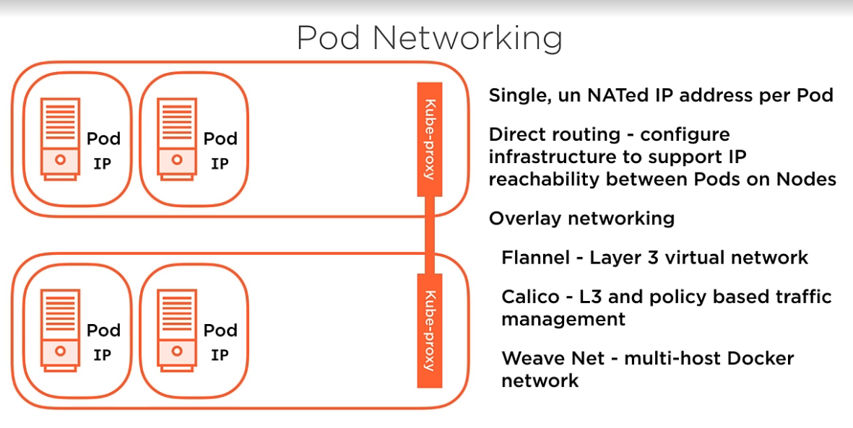
Pod Networking

Slide 17
Kubernetes Network Model
Every Pod gets a Unique IP address.
This created a model in which every pod can be treated as VM on its own.
Kubernetes imposes below fundamentals on networking.
Pods on a node can communicate with all the pods on the node without NAT(without assigning any public address for communication).
Agents on node (kubelet,system daemon) can communicate with all pods on a node.
Pods in the host network of a node can communicate with all pods on all nodes with out NAT.
Ip addresses are allocated on POD basis i.e. not on container basis , due to this containers in a pod share network namespaces and can communicate with each other using localhost and ports.
Pods can request ports on nodes for port forwarding (called host ports)
Network Policy.
It is the specimen on how the pods are allowed to communicate with each other and other network end points.
Network policy is implemented by networking plugin used for kubernetes.
Non-Isolated Pods: By default the pods are non-isolate i.e. they accept traffic from every one.
Isolated Pods: Once a network policy is implemented on a pod, the become isolated.

Slide 18
KubeConfig Files
It is a file which is used to configure access to clusters and is a generic way of referring configuration files, it is not necessary they be named as kubeconfig.
By default Kubectl looks for a file name “config” under $home/.kube.
Other can files can be specified by environment variable “KUBECONFIG” or --kubeconfig flag.
context element is used in kubeconfig to group access parameters under a single name. Each context has 3 parameters namespace, user and cluster.
KUBECONFIG variables holds are list of multiple kubeconfig files to be used in creating a single merged kubeconfig, it is not required to be present for operations to take place, in case of its absence file under $HOME/.kube is considered.
Merging of the files:
If –kubeconfig flag is set , use this config file , no need to merge. In absence consider environment variable.
Upon merging, empty file names are ignored.
Errors are generated for files that cannot be deserialized.
First file to have a key value wins, next file having same key value is ignored.
Initialization for cluster:
Read kubeconfig flag -> ENV -> $HOME/.kube
Determine the context (if empty context , it will proceed)
Determine cluster and User (-- user, --cluster , context) (If user and cluster empty proceed)
Determine actual cluster info (--server, --certificate-authority, --insecure-skip-tls-verify, info from merged kubeconfig), if no server location fail
Build User info for cluster(--client-certificate, --client-key, --username, --password, --token) ( only one method of Auth can be used, multiple fails), use info from kube files , if user empy prompt for information.

Slide 19
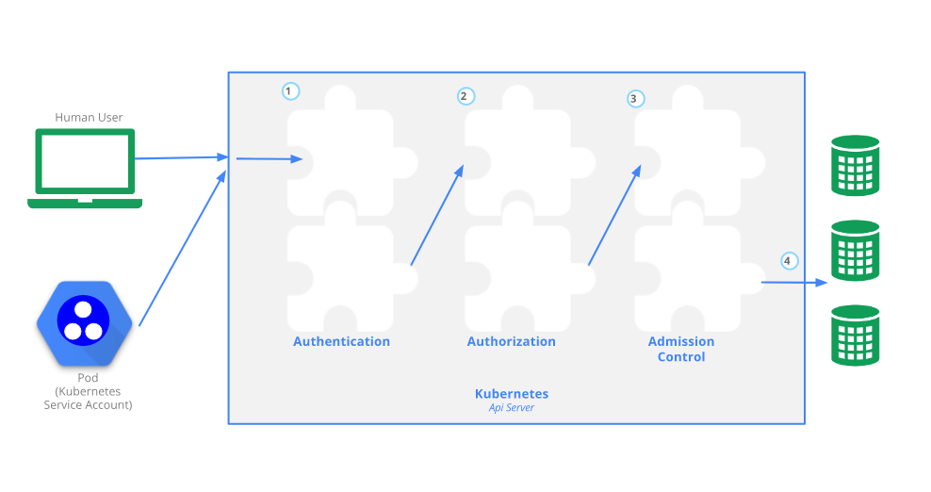
Access Control in Kubernetes
Users access the API using Kubectl,client libraries, api calls.
Both human users and service accounts can be authenticated and upon making requests they go through below process.

Slide 20
Access Control in kubernetes
Good to know TLS configuration in kubernetes(https://kubernetes.io/docs/reference/command-line-tools-reference/kubelet-tls-bootstrapping/)
Typically API server run on 6443. API server represents a self signed certificate, so on user machine $HOME/.kube needs to have root ca certificate for API server.
Once request is made this ca certificate is used to establish TLS. After TLS is established the authentication process starts.
Cluster admin configures API server to use one or more Authentication modules(https://kubernetes.io/docs/reference/access-authn-authz/authentication/)
Users in kubernetes: kubernetes clusters have two types of users service accounts and normal users.
Normal users: these users are managed by and independent outside service like an admin distributing private keys, a user store like Keystone or Google Accounts, even a file with a list of usernames and passwords.
Kubernetes does not have objects for outside users and they cannot be added using API calls.
Service Accounts: these are managed by kubernetes API and belong to specific namespaces and are created automatically by API server or through API calls.
Service accounts are tied to secrets which are mounted on PODS and establish communication to API server.
API requests are either tied to a service account or a user else they are treated as anonymous requests.
Kubernetes uses client certificates, bearer tokens, an authenticating proxy, or HTTP basic auth to authenticate API requests through authentication plugins.
Upon http requests, the plugins associate , USERNAME,UID,GROUPS,EXTRA INFORMATION ,all these values hold importance for authorization.
Multiple authentication can be enabled at a time, however it is recommended to use at leat two modes one for user authentication and other for service account authentication.

Slide 21
Access Control in kubernetes
Once the request has been authenticated , it will need to be Authorized.
Request access header contains username, action, object on which action is to be performed. Request is authorized if the users has permission to perform the action on the object defined in the authorization policy.
Kubernetes supports multiple authorization modules, such as ABAC mode, RBAC Mode, and Webhook mode.
cluster admin, configure the authorization modules at cluster setup that should be used in the API server.
If more than one authorization modules are configured, Kubernetes checks each module, and if any module authorizes the request, then the request can proceed. If all of the modules deny the request, then the request is denied .
More on authorization at https://kubernetes.io/docs/reference/access-authn-authz/authorization/#checking-api-access
Four types of Authorization Modes:
Node Authorization :https://kubernetes.io/docs/reference/access-authn-authz/node/
RBAC Authorization: https://kubernetes.io/docs/reference/access-authn-authz/rbac/
ABAC Authorization: https://kubernetes.io/docs/reference/access-authn-authz/abac/
WebHook Authorization: https://kubernetes.io/docs/reference/access-authn-authz/webhook/
After Authorization the request proceeds Admission Controller.
Admission controllers intercepts the request made to API server and can modify and reject the requests.
Admission controllers only act on the creation and modification requests and not on read requests.
Multiple Admission can be configured by cluster admin, if any of the controller rejects the request ,the request is rejected immediately, unlike in case for authentication and authorization.
Most of the advance features in kubernetes require admission controller to be enabled.
More on admission controller at (https://kubernetes.io/docs/reference/access-authn-authz/admission-controllers/)

