Slide 1
Forecasting Drought Severity in Kerr County, TX
A machine-learning pipeline using weather & vegetation data
REEU 2026 — Team 1 | Progress update | baseline model

Slide 2
Objective
• Goal: forecast the U.S. Drought Monitor (USDM) severity class for Kerr County 4 weeks ahead.
• 6 classes: no_drought, D0 (abnormally dry) ... D4 (exceptional drought).
• Inputs: past weather + vegetation greenness. Why it matters: an early signal supports water-use and agricultural planning.
• Scope of this update: a complete, working end-to-end pipeline and a first baseline model on 2000–2024 data.

Slide 3
Data sources
Kerr County, TX • weekly • 2000–2024
• USDM drought labels (drought.gov) — the weekly truth we predict.
• NOAA daily weather — precipitation and temperature (95 stations).
• MODIS NDVI — satellite vegetation greenness (16-day).
• Texas Mesonet soil moisture — available 2019+, planned as a future feature.

Slide 4
The work behind the results
Most of the effort is data engineering — getting trustworthy, aligned data
• Consolidated ~177,000 daily records from 95 NOAA stations across 4 files; removed duplicate overlap years.
• Found & fixed a data-integrity bug: 2005–2009 temperature/precip were in metric units (tenths °C / mm), producing impossible values (e.g. 380°F). Re-pulled in standard units.
• Built the labels: collapsed USDM cumulative drought %-area into a single weekly class; fixed a parsing pitfall where "None" was read as missing data.
• Unified three different time cadences (weekly / daily / 16-day) onto one weekly grid via resampling and interpolation.
• Framed as forecasting: 4 weeks of weather → drought class 4 weeks later, with a chronological train/test split to prevent the model from peeking at the future.

Slide 5
Modeling approach
• Features: weekly precipitation, max/min temperature, NDVI — over a 4-week window (16 inputs).
• Model: feed-forward neural network (multi-layer perceptron) with a 6-way softmax output.
• Trained on 2000–2017, validated 2017–2021, tested 2021–2024 (strictly chronological — no look-ahead).
• Evaluated with accuracy, macro-F1 (treats rare classes fairly), and a confusion matrix.

Slide 6
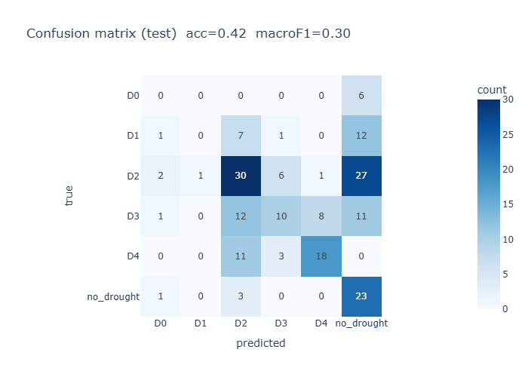
Results — baseline model
Test accuracy 42% • macro-F1 0.30 (held-out 2021–2024)

Slide 7
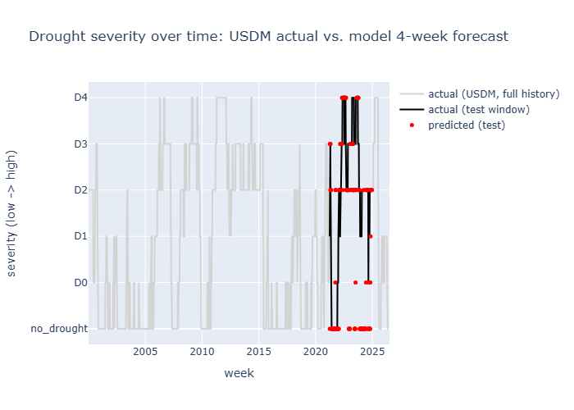
Results — forecast vs. reality over time
Gray: 24-year drought history • Black: actual (test) • Red: model forecast

Slide 8
What the results tell us
• The model reliably distinguishes severe drought (D4) and no-drought conditions.
• It struggles with the rarest mild categories (D0/D1) — a class-imbalance issue, not a pipeline flaw.
• This is an early baseline: its value is proving the full data-to-forecast pipeline works end-to-end.
• Accuracy is expected to rise substantially with the improvements below.

Slide 9
Status: what is built and tested
• Working & tested end-to-end:
– Label preparation, NOAA consolidation + unit fix
– Data pipeline: resample → merge → window → split → scale
– Model training + evaluation + visualizations
• In progress / next:
– Configurable training driver for systematic experiments
– Soil-moisture features; hyperparameter tuning

Slide 10
Next steps
• Address class imbalance (class weights / resampling) so mild-drought classes are learned.
• Add Texas Mesonet soil-moisture features for recent years.
• Hyperparameter tuning and architecture exploration (incl. sequence models / LSTM).
• Try ordinal-aware modeling that respects drought-severity ordering.
• Extend beyond a single county once the approach is validated.

