Slide 1
Diffeomorphic registration implementations
Three different methods:
DARTEL
ANTS SyN
Greedy
How they differ in:
Faster approximations to the LDDMM transformation model
Image cost functions
Practical issues

Slide 2
Fast approximations to LDDMM
As we have seen, LDDMM needs to optimize the entire time-dependent velocity flow at each gradient descent step
This requires a large amount of memory and time
Most registration methods take some shortcuts to make the computations more tractable
Eulerian vs Lagrangian view

Slide 3
DARTEL
Implemented in SPM
Slides taken from: https://www.fil.ion.ucl.ac.uk/~john/misc/dartel.ppt
Papers:
DARTEL: Ashburner. A fast diffeomorphic image registration algorithm. NeuroImage, 2007
Shoot: Ashburner, Friston. Diffeomorphic registration using geodesic shooting and Gauss–Newton optimization. NeuroImage 2011.

Slide 4
Principles
Deformations parameterized by a single flow field, which is considered to be constant in time.
Diffeomorphic
Anatomical
Registration
Through
Exponentiated
Lie Algebra

Slide 5
DARTEL
Parameterising the deformation
φ⁽⁰⁾(x) = x
φ⁽¹⁾(x) = ∫ u(φ^{(t)}(x))dt
u is a flow field to be estimated
1
t=0

Slide 6
Euler integration
The differential equation is
dφ(x)/dt = u(φ^{(t)}(x))
By Euler integration
φ^{(t+h)} = φ^{(t)} + hu(φ^{(t)})
Equivalent to
φ^{(t+h)} = (x + hu) o φ^{(t)}

Slide 7
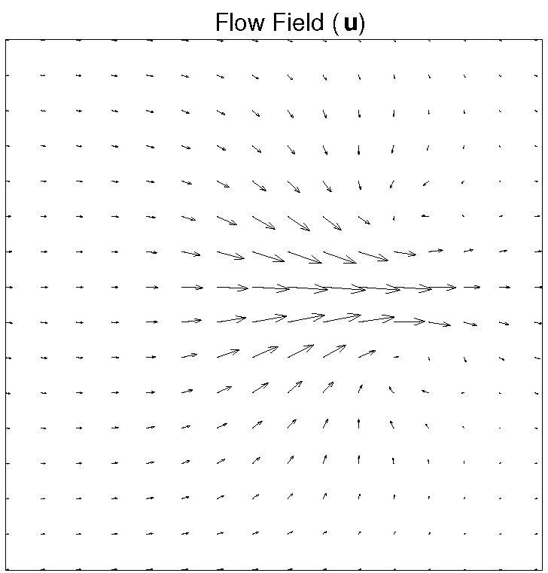
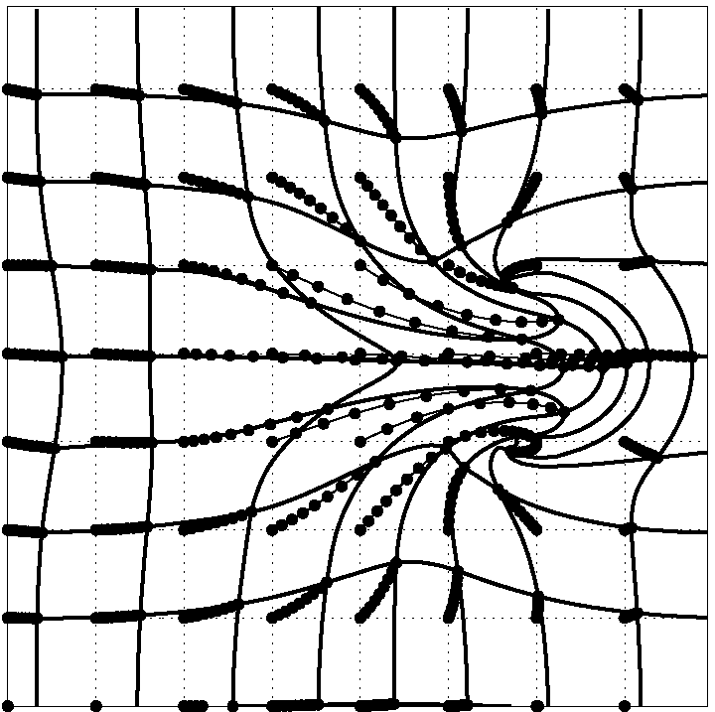
Flow Field

Slide 8
For (e.g) 8 time steps
Simple integration
φ^{(1/8)} = x + u/8
φ^{(2/8)} = φ^{(1/8)} o φ^{(1/8)}
φ^{(3/8)} = φ^{(1/8)} o φ^{(2/8)}
φ^{(4/8)} = φ^{(1/8)} o φ^{(3/8)}
φ^{(5/8)} = φ^{(1/8)} o φ^{(4/8)}
φ^{(6/8)} = φ^{(1/8)} o φ^{(5/8)}
φ^{(7/8)} = φ^{(1/8)} o φ^{(6/8)}
φ^{(8/8)} = φ^{(1/8)} o φ^{(7/8)}
7 compositions
Scaling and squaring
φ^{(1/8)} = x + u/8
φ^{(2/8)} = φ^{(1/8)} o φ^{(1/8)}
φ^{(4/8)} = φ^{(2/8)} o φ^{(2/8)}
φ^{(8/8)} = φ^{(4/8)} o φ^{(4/8)}
3 compositions
Similar procedure used for the inverse.
Starts with
φ^{(-1/8)} = x - u/8

Slide 9
Scaling and squaring example

Slide 10
Geodesic shooting
An alternative approach to time-varying (LDDMM) flows
Relies on the conservation of momentum property
Given the initial conditions, can determine the entire flow

Slide 11
ANTS Symmetric Normalization (SyN)
Advanced Normalization Tools
http://stnava.github.io/ANTs/
Papers:
Avants et al. Symmetric diffeomorphic image registration with cross-correlation: evaluating automated labeling of elderly and neurodegenerative brain. Medical Image Analysis, 2008
Avants et al. Lagrangian frame diffeomorphic image registration: Morphometric comparison of human and chimpanzee cortex. Medical Image Analysis, 2006

Slide 12
ANTS Symmetric Normalization (SyN)
Lagrangian optimization instead of Eulerian
Optimizes the Phi mappings (Lagrangian), instead of the velocity field
Allowing for larger steps to be taken
Still computes the velocities (Eulerian), but by pushing the image forward
Involves inverting the mapping (ie computing Phi inverse) in order to push forward

Slide 13
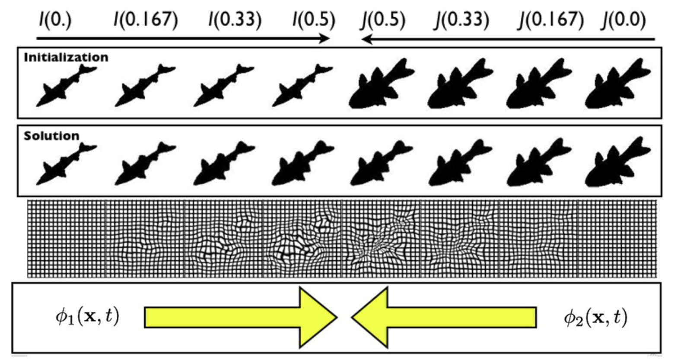
ANTS Symmetric Normalization (SyN)

Slide 14
“Greedy” approach
Algorithm described in Christensen et al (1996); also implemented by Beg
Modern implementation by Yushkevich
https://sites.google.com/view/greedyreg
Eulerian optimization, as in LDDMM
But, instead of optimizing the entire time-dependent flow each step, it uses a “greedy” approach
Solve timesteps in sequence, one at a time, using the transformation and velocity from the previous step
No geodesic or symmetric properties
Gains in speed
Not ideal for computational anatomy (i.e. using metrics on the velocity fields/warps), but still very good for simply aligning anatomy

Slide 15
Image cost functions
DARTEL
Multinomial image cost based on tissue probabilities
ANTS, Greedy
Variety of costs available
Sum of squared differences
Cross-correlation
Mutual information

Slide 16
Summary
DARTEL
Pros:
Probabilistic cost function
Geodesic shooting template generation
Cons:
Stationary velocity field transformation could be limiting
Must use GM+WM probabilities for cost function
Outputs not interoperable (e.g. SPM-specific formats, MATLAB requirement)
ANTS
Pros:
High flexibility (many different transformation models + cost functions implemented)
Interoperable outputs
Many wrappers are available (R, python, etc)
Cons:
API can be intimidating, many different ways of running it
Computationally-intensive
Greedy
Pros:
Fast & easy to use – makes hyper-parameter selection more tractable
Good amount of flexibility (most of the useful cost functions from ANTS)
Robust and fast linear registration too
Interoperable outputs
Cons:
Not suitable if you are doing computational anatomy (ie statistics on velocity/momentum/warp fields
Newer, not recognized by the community yet

Slide 17
Some practical considerations
FSL, SPM, and ITK all have different conventions on how spaces and warps are defined
The ITK conventions are widely adopted as the standard
ANTS and greedy support this
Tools exist to convert between conventions (e.g. FSL <-> ITK)
Transforming images should be done with concatenated transforms to avoid interpolation error
Either by supplying all the warps/matrices at once when warping the image, or generating a concatenated warp file
Transforming images (pull) vs surfaces (push) requires different (inverted) transforms

Slide 18
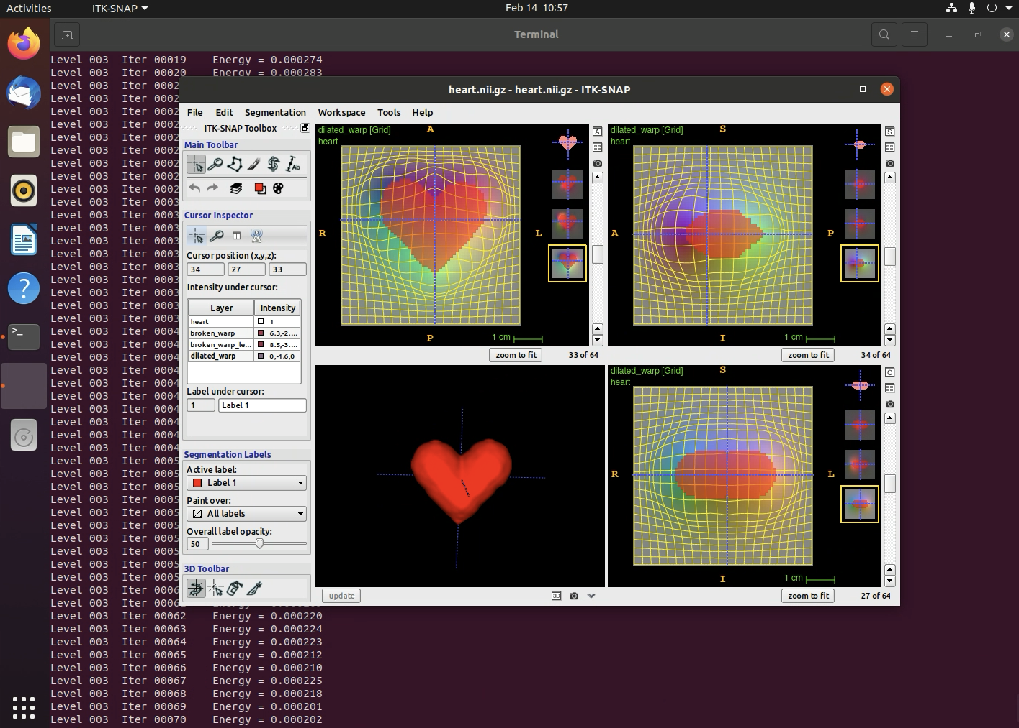
Demo
http://github.com/akhanf/methods-lunch-spatial-normalization

