Slide 1
US Survivor TV Show
Tidy Tuesday R 2021-06-01

Slide 2
Introduction
The data this week comes from the survivorR R package by way of Daniel Oehm.
596 episodes. 40 seasons. 1 package!
survivoR is a collection of data sets detailing events across all 40 seasons of the US Survivor, including castaway information, vote history, immunity and reward challenge winners and jury votes.

Slide 3
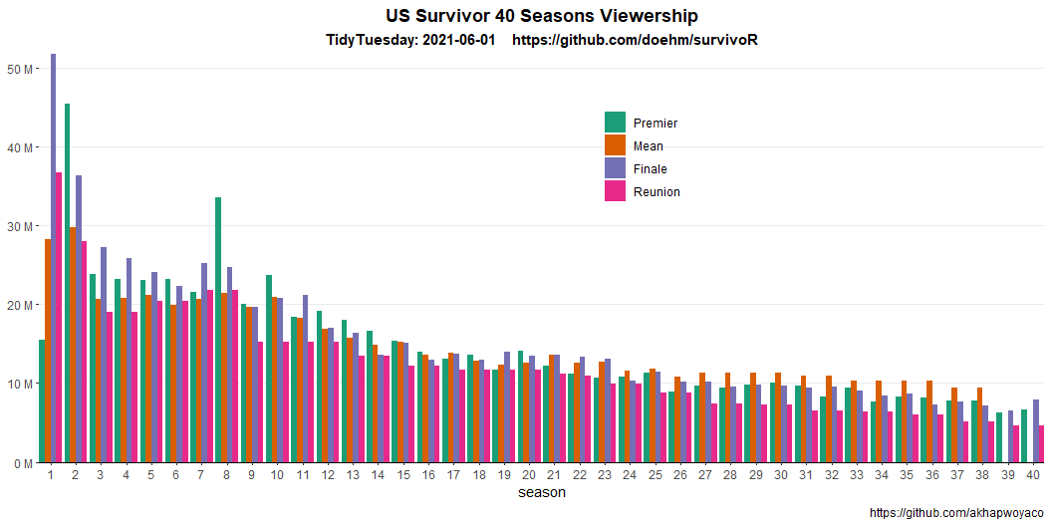
Data
EDA
Viewership
US Survivor 40 Seasons Viewership

Slide 4
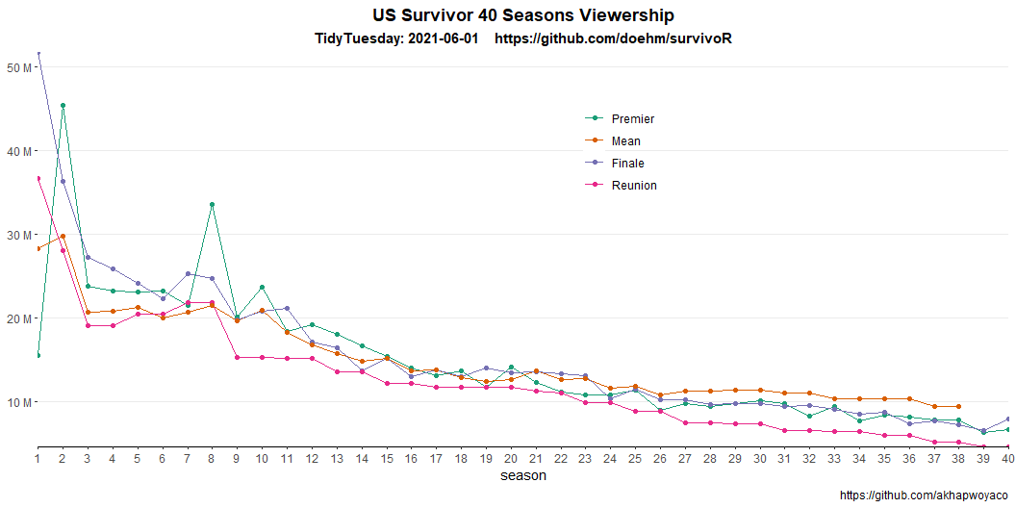

Slide 5
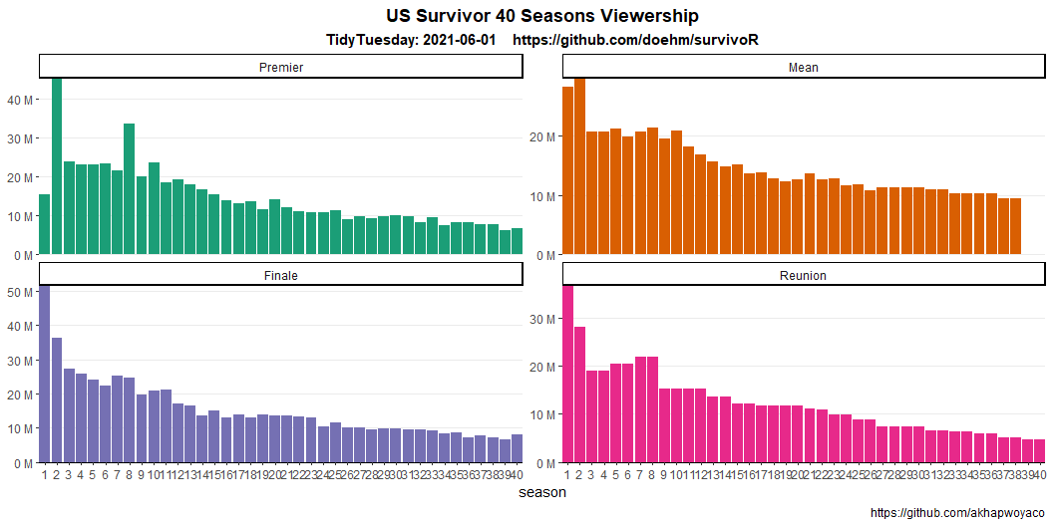

Slide 6
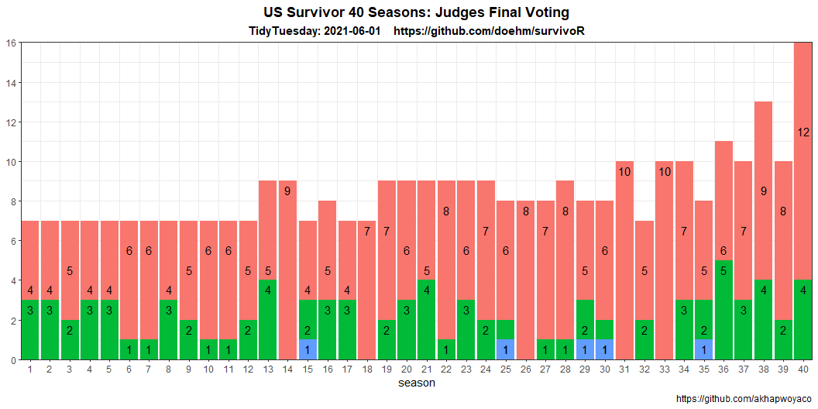
JUDGE VOTES

Slide 7
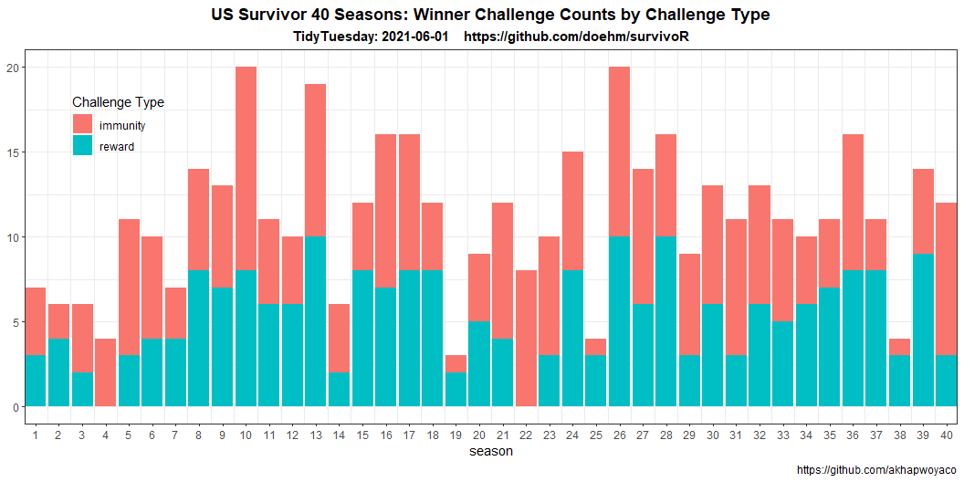
WINNER CHALLENGES

