Slide 1



crud
Students CRUD Operations

Slide 2
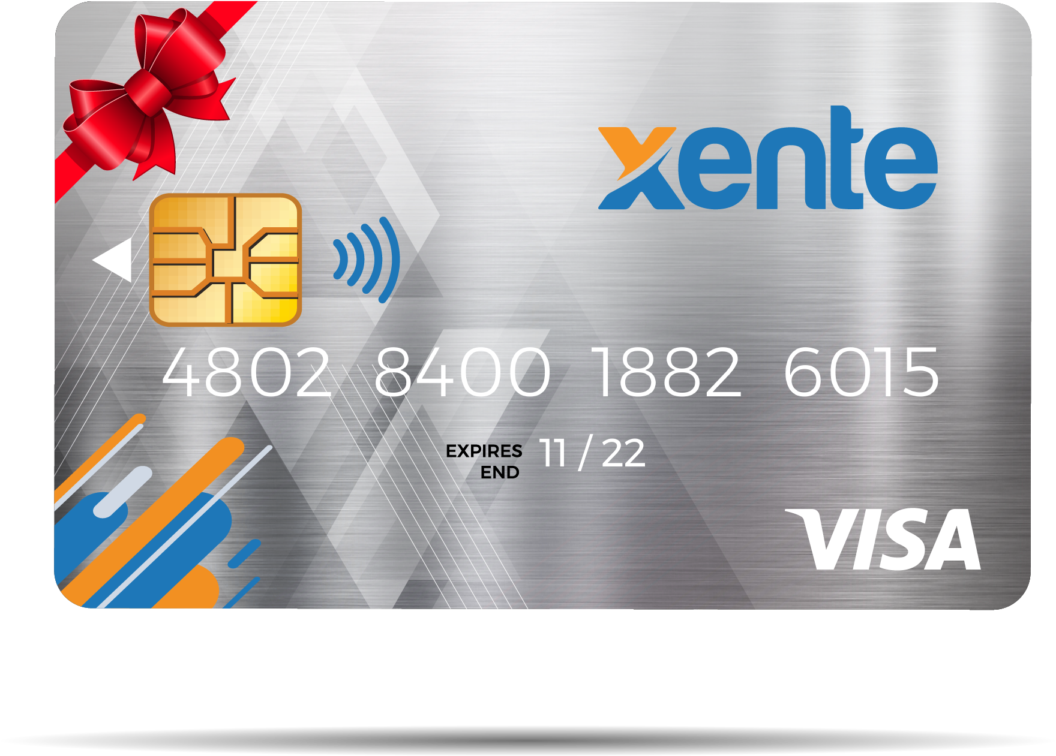





Tech & TOOL stack

Slide 3
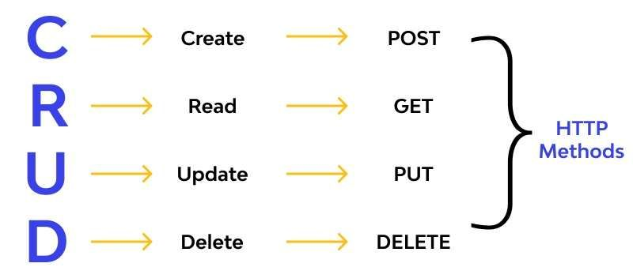
What is CRUD ?

Slide 4
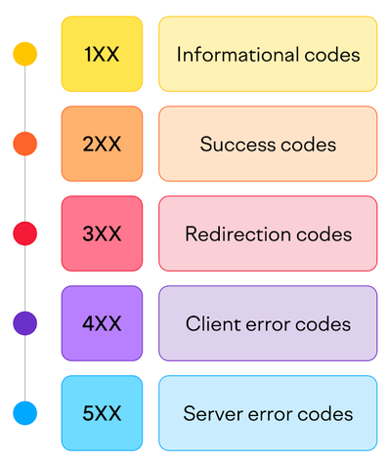
Status codes

Slide 5

REST APIS

Slide 6
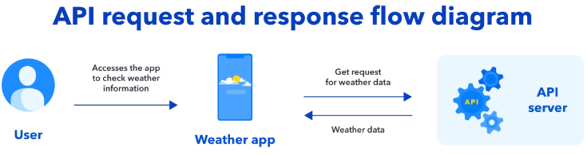
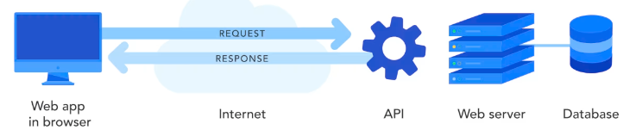
REST APIS

Slide 7
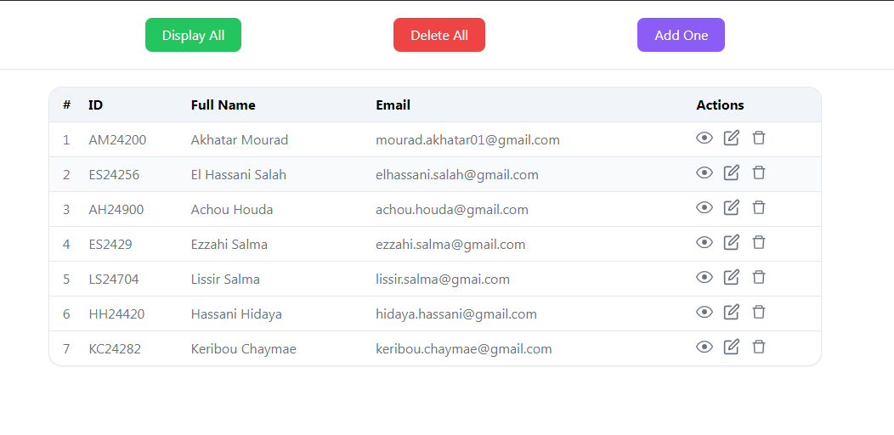


TECHNICAL architecture
2
1
6
5
Processing
4
3
User
User
Interface
Database

Slide 8
THANK YOU

