Slide 1
Commercial service
KPIs Dashboard

Slide 2
Problem statement
MOURAD — Sales Manager:
I hope you are doing well. We need to improve our internet sales reports and transition from static reports to dynamic visual dashboards to enhance our data analysis capabilities.
Specifically, we aim to focus on key metrics such as sales volume by product, client segmentation, and trends over time. This will help us better understand our market performance and adapt our strategies accordingly.
Given that each salesperson manages a different set of products and customers, incorporating features that allow for detailed filtering and segmentation would greatly enhance the usability of the reports.
Additionally, we benchmark our performance against our budget goals, and I've included these figures in a comprehensive spreadsheet. This will enable us to track progress and identify areas needing improvement.
Our current budget is for 2021, and we typically analyze data looking two years back to identify patterns and forecast future performance.
Please let me know if you need further information or additional adjustments.

Slide 3
Business request & demand
Business Request vs. Business Demand
Business Request: Specific Task
A Business Request is a specific action or task someone asks for to solve a problem.
Example in Context: The Sales Manager asks for a Power BI dashboard to see internet sales. This is a direct, specific need: "I need a dashboard to track sales.“
Business Demand: Bigger Goal
A Business Demand is a broader, overall need that drives many requests. It’s about the bigger goal the business wants to achieve.
Example in Context: The demand is to improve sales reporting and forecasting to make better decisions. This demand pushes the request for dashboards and better tools.

Slide 4
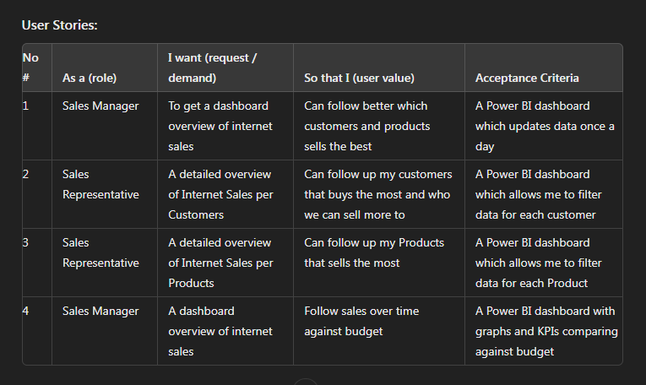
Business request & demand
The table represents a Business Demand Overview along with specific User Stories detailing the needs and expectations of different roles within the sales team. The primary goal is to improve the visibility and usability of sales data through visual dashboards, leveraging tools like Power BI and CRM systems.

Slide 5
Business request & demand
The table outlines User Stories for creating dashboards that improve internet sales reporting. Here's a breakdown of each column and row:
Columns:
No #: The sequence number of each user story.
As a (role): Describes who is making the request (e.g., Sales Manager, Sales Representative).
I want (request/demand): Specifies what the user needs or wants, such as a dashboard overview.
So that I (user value): Explains the benefit or reason behind the request, showing what the user will achieve (e.g., better follow-up on sales).
Acceptance Criteria: Outlines the conditions that must be met for the request to be considered complete and successful (e.g., a Power BI dashboard with specific features).

Slide 6






Tech & TOOL stack

Slide 7






Functional architecture
1
2
3
7
6
5
User
Transaction
Data
API
Endpoints
Transact.
Processing
4
8
9
User
Feedback
Data
Storage

Slide 8








TECHNICAL architecture
2
1
3
7
6
5
User
API
Endpoints
Processing &
Prediction
4
8
9
User
Interface
Database

