Slide 1


Slide 2
What is CLIAR and its key objectives?
Is a quick and accessible tool that quantitatively assesses the strengths and weaknesses of a country’s institutional dimensions against a set of comparator countries based on publicly available data.
Generates systematic evidence to map out a country’s institutional profile.
Is not intended as an exhaustive and comprehensive analysis of the specific institutional constraints of each country.
Objectives:
Identify entry-points and priorities for institutional reforms and distill key messages for policy dialogue
Make Bank institutional diagnostic work and policy dialogue at country level more structured and integrated with WB mandate

Slide 3
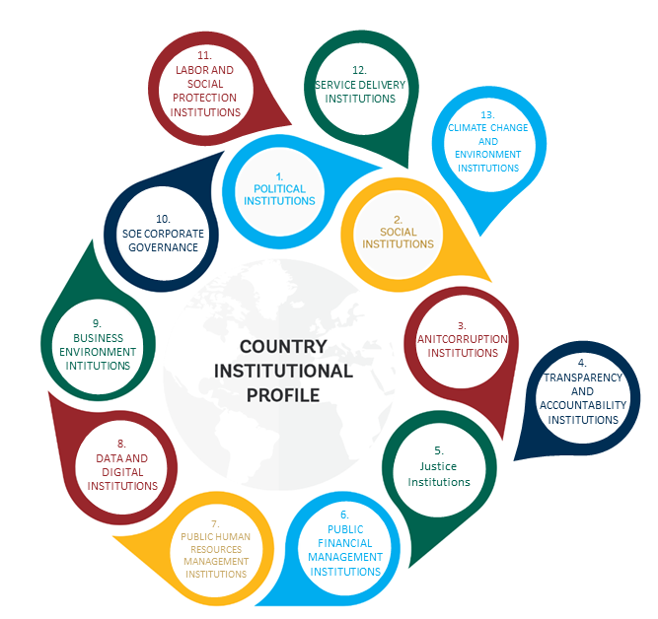
CLIAR Institutional Benchmarking
Mapping the quality of institutional capital using publicly available indicators Benchmarking institutions across up to 13 families (or clusters) ~140 / 300 indicators spanning the period between 1990 and 2022.
Selection criteria: coverage, content and quality
Selection process: quantitative & qualitative review

Slide 4
Selection of institutional clusters
Focus on formal institutions and almost always public institutions (with a few exceptions).
The proposed definition for public institutions is: “Governments and public organizations that structure public affairs, deliver services, and implement regulations, as well as the rules that govern these organizations.”
Focus on institutions, rather than policies and outcomes
While it is difficult to separate the policy from its implementation given the data available, the aim is to focus on how the implementation happens rather than on the policy itself.

Slide 5
Selection of indicators: Two-way review processes
Qualitative Review
Quantitative Review
Ensuring that the indicators selected are publicly available, conceptually relevant to each institutional family and of high quality (e.g., reputable and unbiased institution, data collection and methodology)
Data Expert Group, with World Bank experts from each area
Based on an assessment of indicator coverage for both country and year, with a particular focus on coverage for the last 5 years. In particular, for the quantitative review we provide the following criteria for inclusion:
Continuity: indicator updated in the past five years.
Country Coverage: cover 100 countries (w/exceptions)
Year Coverage: We include only variables that have at least 2 years of data (coverage must be of at least 10 countries)
Exceptions:
An exception to the rule is if the indicator covers at least 50 countries in the past 5 years, with presence in every region
Additional exceptions are allowed and considered on a case-by-case basis.

Slide 6


Caveats
Despite its advantages, the benchmarking analysis presents important limitations, related to both data quality and methodological shortcomings.
Data coverage.
Form vs. function.
Processes vs. outcomes.
Formal vs. informal institutions.
It is not intended as an exhaustive and comprehensive analysis of the specific institutional constraints of each country
The tool should therefore be used only as an initial effort to bring well-structured evidence into the discussion of institutional challenges

Slide 7
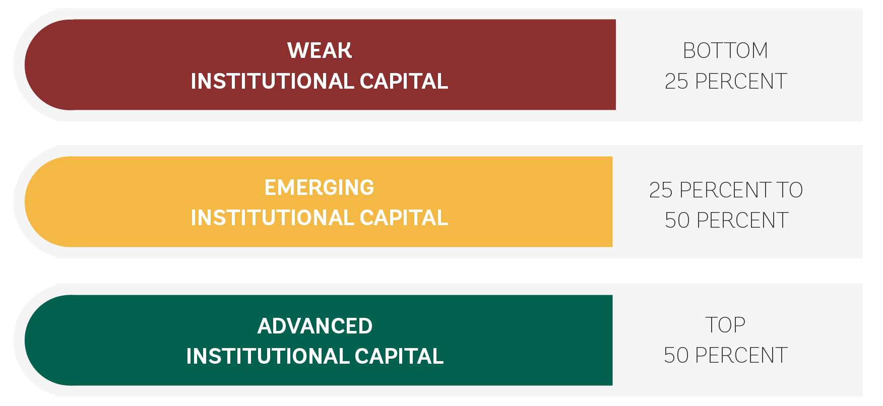
Benchmarking Methodology
Indicators are standardized using the “closeness to frontier” (CTF) transformation. The CTF score captures the gap between a country’s performance and the world’s best performer.
Percentile (distribution) analysis is then used to capture the country’s performance relative to a set of comparators countries (selected by the team)
The Methodology:
“Closeness to Frontier” & Percentile analysis
Two types of analysis: Static (core, snapshot 5-year avg.) & Dynamic (trends)

Slide 8
Institutional Families: Overview

Slide 9
Institutional Families: Dynamic Benchmarking

