Slide 1

{DATE REPORT IS PRODUCED}

Slide 2
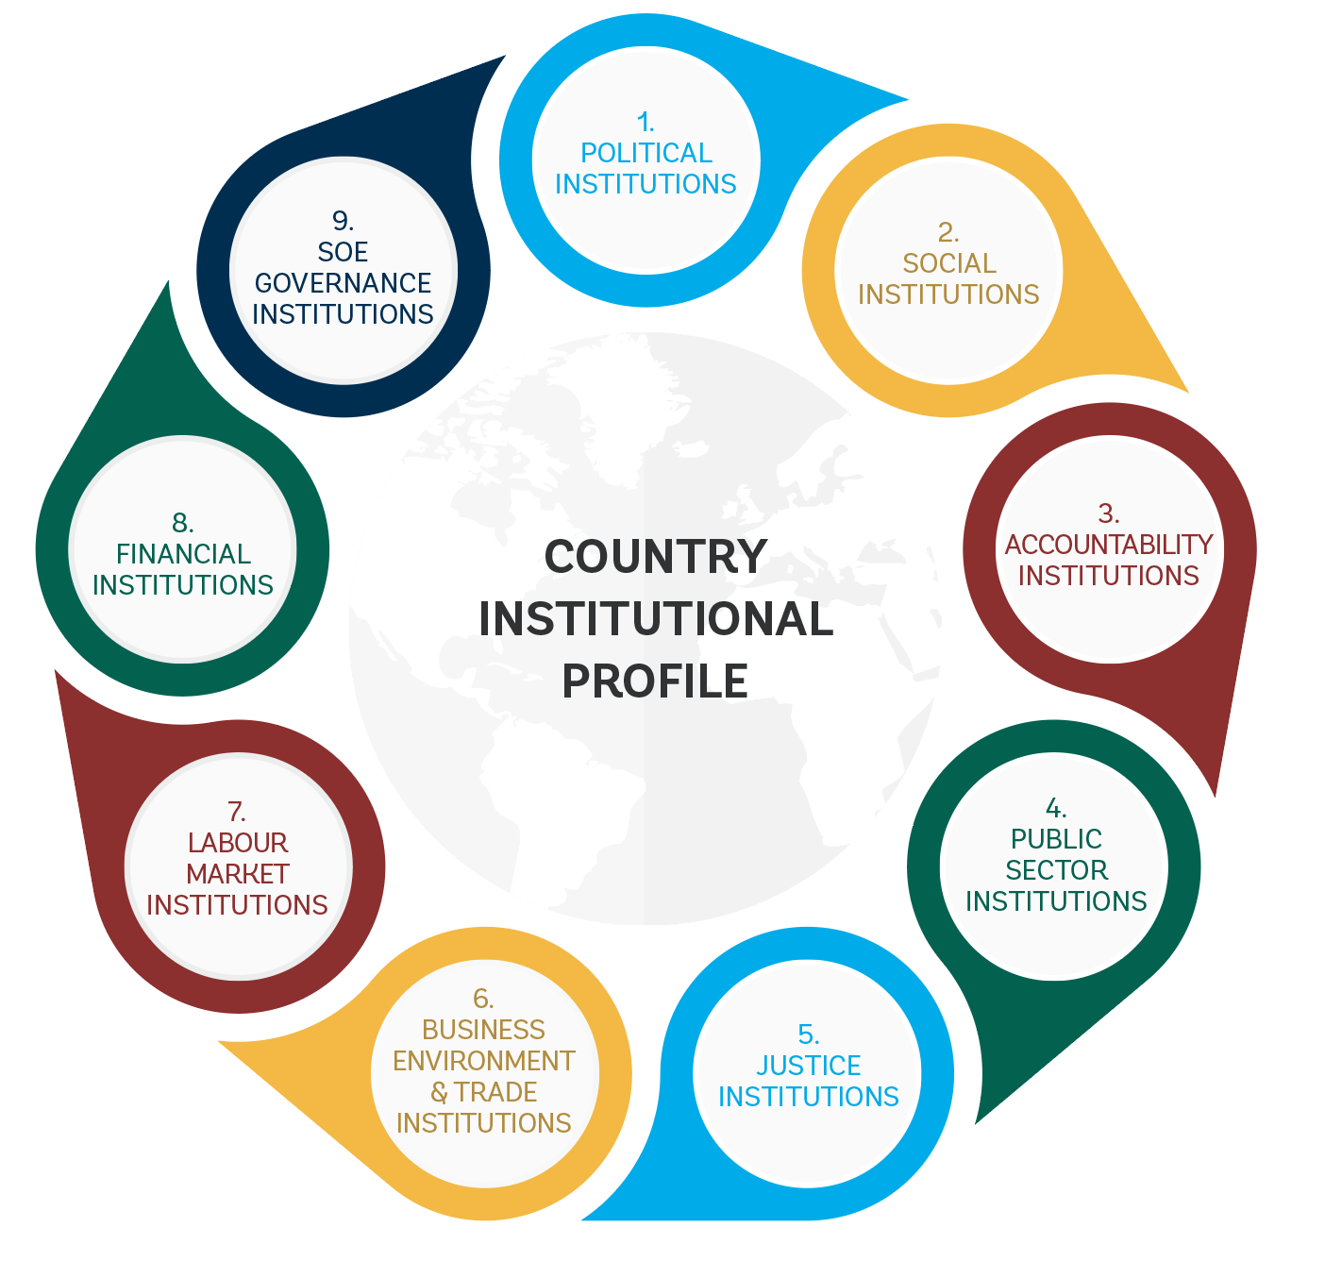
Institutional Benchmarking
Mapping empirically the quality of institutional capital Benchmarking institutions across 9 families

Slide 3
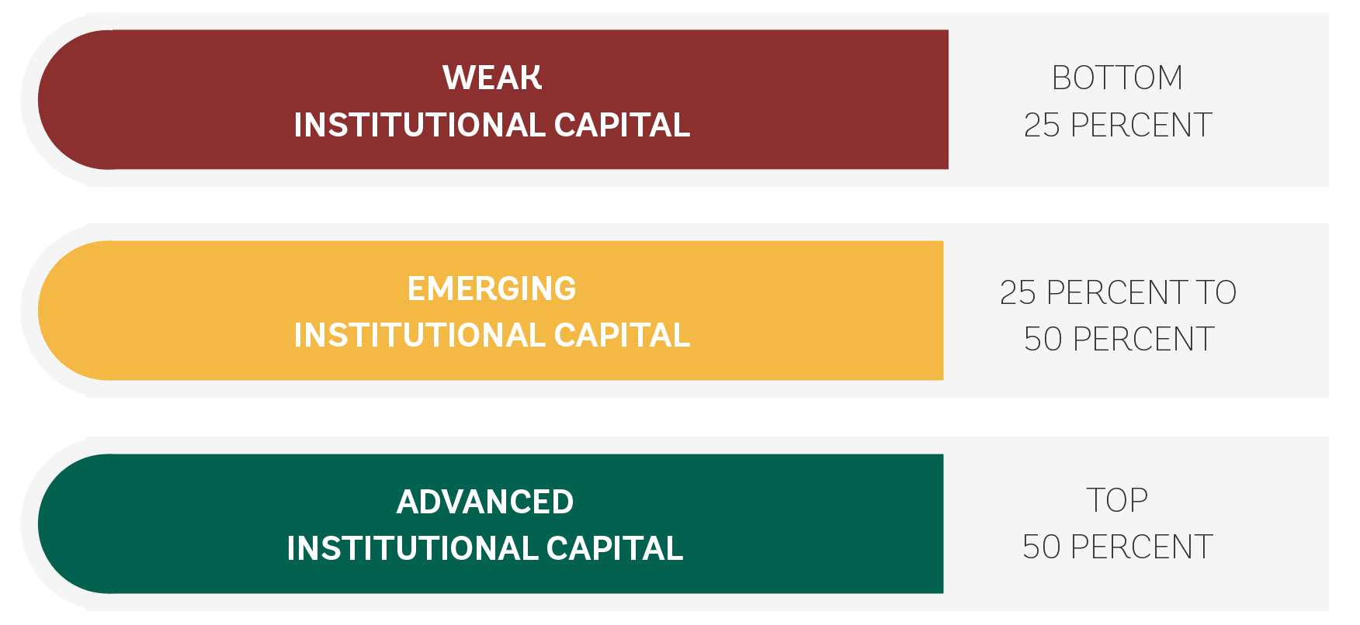
Institutional Benchmarking
Indicators are standardized using the “closeness to frontier” (CTF) transformation. The CTF score captures the gap between a country’s performance and the world’s best performer.
Percentile (distribution) analysis is then used to capture the country’s performance relative to the set of comparators.
The Methodology:
“Closeness to Frontier” & Percentile analysis

Slide 4
Institutional Families: Overview

