Slide 1
CORNERWORK / FOUNDING GYM PROGRAM
Your coach,
between classes.
A member speaks up. A coach responds.
The next class starts with context.
PRODUCT VISION + LOCAL DEMO
CORNERWORK / FOUNDING GYM CONVERSATION
01
Notes:
Open with: This is a local prototype of a class-to-class coaching loop. All athletes are fictional. Messages stay on this computer. We want to learn whether this fits how your coaches work.

Slide 2
CORNERWORK / THE PROBLEM
Members can drift before anyone notices.
A question goes unanswered.
A member feels stuck.
The next coach never hears about it.
Our hypothesis: better follow-up makes coaching feel more continuous.
CORNERWORK / FOUNDING GYM CONVERSATION
02
Notes:
Contextualizes the original problem slide without repeating unverified industry percentages. This is the problem hypothesis to discuss, not a measured Cornerwork retention result. Ask for a recent example from the gym.

Slide 3
CORNERWORK / WHAT KEEPS THEM ENGAGED
Help members feel known.
Continuity
Someone remembers what I am working on.
Progress
I know what to focus on next.
Accountability
My coach checks back with me.
CORNERWORK / FOUNDING GYM CONVERSATION
03
Notes:
Preserves the original human-coaching rationale. Community, progress and accountability are value hypotheses here; we are not claiming a proven retention effect or repeating unsourced survey/injury statistics.

Slide 4
CORNERWORK / THE GAP
Keep the coaching going after class.
Collect the question.
Make time for a human response.
Bring the context into the next class.
Designed to work alongside the gym’s booking system.
Start in combat sports; test the same loop in other coached activities.
CORNERWORK / FOUNDING GYM CONVERSATION
04
Notes:
Replaces the original assertion that gym software only handles billing. Gymdesk already supports notes, tasks and skills; PushPress offers Member Intel. The proposed differentiation is the complete feedback-to-human-response-to-next-class loop, which needs validation. Sources: https://docs.gymdesk.com/en/help/docs/member-profile ; https://docs.gymdesk.com/en/help/docs/skills ; https://www.pushpress.com/features/member-intel

Slide 5
CORNERWORK / THE LOOP
One conversation carries into the next class.
01
Attend class
A short follow-up after training.
02
Ask the coach
Text or a voice note about what happened.
03
Get a response
The coach checks the queue and replies.
04
Return with context
Recent feedback informs the next class.
CORNERWORK / FOUNDING GYM CONVERSATION
05
Notes:
Explain the intended flow before opening the app. The attendance connection, actual messages and audio are not live. The inbox, stored responses and class brief are working local features. Anonymous dashboard omitted by request.

Slide 6
CORNERWORK / 01 / AFTER CLASS
The class ends. The conversation continues.
INTENDED MEMBER EXPERIENCE
In today’s demo
“How did training go?
Anything you want your
coach to help with?”
A simulated post-class
message, triggered in
Demo tools.
Live attendance sync
is the next test.
Target: verified attendance + class end + opt-in. Timing is a pilot choice.
CORNERWORK / FOUNDING GYM CONVERSATION
06
Notes:
Show Demo tools, After class, Run due jobs. Current scheduler uses stored bookings or attendance and an explicit job clock; it is not attendance-only. Target integration must verify attendance and class end, suppress no-shows/cancellations and deduplicate. The quoted nudge is illustrative, not a claim about exact current message wording. Confirm Gymdesk Check-In payload and class-end lookup before promising automation.

Slide 7
CORNERWORK / 02 / THE MEMBER
A small question, while it is still fresh.
ILLUSTRATIVE MEMBER MESSAGE
“My jab felt sharper, but I keep
getting countered as I step out.
What should I focus on next class?”
Text or voice is the target experience.
Today, a typed transcript demonstrates the voice-note path.
CORNERWORK / FOUNDING GYM CONVERSATION
07
Notes:
In Demo tools select Maya Chen, choose Voice note — typed transcript simulation, and enter: My jab felt sharper, but I keep getting countered as I step out. What should I focus on next class? Send into demo. A supplied transcript stands in for audio; there is no microphone or transcription service. This example is fictional and not a customer quote.

Slide 8
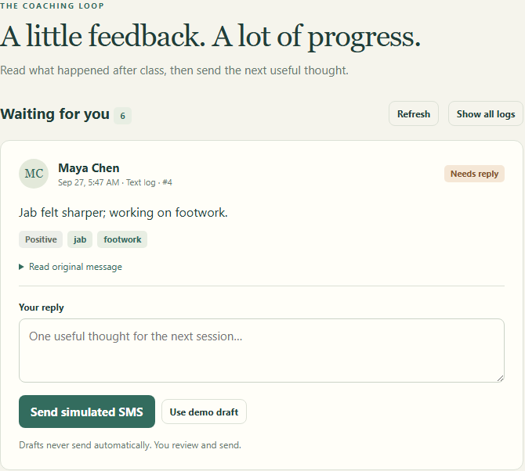
CORNERWORK / 03 / THE COACH
A queue the coach can act on.
Read the original.
Review the context.
Send one useful reply.
The coach stays responsible
for the advice.
CORNERWORK / FOUNDING GYM CONVERSATION
08
Notes:
Open Coach inbox. Find the newly submitted log, expand the original, write a short reply and send. Show its simulated conversation in Demo tools. Rules-based summaries are aids only; the human coach decides what to send. Screenshot is from the local app with fictional seed data.

Slide 9
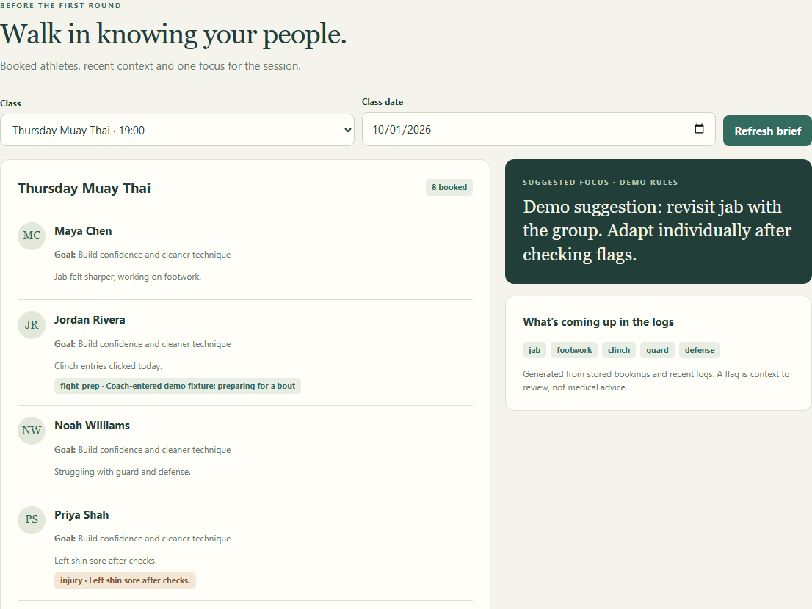
CORNERWORK / 04 / BEFORE THE NEXT CLASS
Walk in knowing what needs attention.
Who is coming?
What have they
been working on?
What should the
coach follow up on?
CORNERWORK / FOUNDING GYM CONVERSATION
09
Notes:
Open Before class. Select the class the same athlete is booked into and refresh. Show their recent context, relevant flags and common themes. A new log does not enroll a member. The current brief uses recent logs from the last seven days and stored bookings, not live provider data. Shared clock and attendance connection are not implemented. Screenshot is actual local app, fictional athletes.

Slide 10
CORNERWORK / TECH DETAILS
Two connections. One coaching product.
FEASIBLE, WITH ONGOING INTEGRATION WORK
Build a separate connection for each platform. Both feed the same
member, class and attendance records into Cornerwork.
Gymdesk: start by testing its Zapier connection.
Mindbody: use its APIs and event updates, with approved access.
The hard part is reliable syncing: no-shows, duplicate updates,
permissions and platform changes. Neither is live in this demo.
CORNERWORK / FOUNDING GYM CONVERSATION
10
Notes:
Feasibility assessment, not an implementation estimate. Proposed scope: read members, class rosters and verified attendance into a common internal model; retain conversations and coaching history in Cornerwork. Do not require payment, booking or membership write-back for the initial coaching loop. Gymdesk documents Zapier Check-In triggers and member/booking/attendance searches; verify class linkage, end time, filters, delivery timing and production-scale access with a cooperating gym. A public direct Gymdesk API is not assumed. Mindbody documents APIs and roster webhooks; live developer approval and business activation are required. Production work includes stable provider IDs per gym, deduplication, missed-event reconciliation, cancellations/no-shows, time zones, credential changes, access separation and monitoring. Validate API/Zapier costs and terms before committing to pricing or a launch date. Difficulty: a narrow proof of concept is manageable; dependable multi-gym operation is a substantial integration and maintenance effort. No live integration is implemented in the current demo. Sources verified 2026-09-28: https://docs.gymdesk.com/en/help/docs/zapier and https://developers.mindbodyonline.com/WebhooksDocumentation

Slide 11
CORNERWORK / INTEGRATION TEST
Start with one gym. Prove the full loop.
GYMDESK FIRST
MINDBODY PATH
Check-In trigger via Zapier
Roster events + signed-in status
Confirm member, class and end time.
Then test one opted-in adult account.
Confirm access and event behavior.
Reuse the same coaching workflow.
Pass condition: one attended class → one delivered ping → reply → next-class context.
CORNERWORK / FOUNDING GYM CONVERSATION
11
Notes:
Official sources accessed 2026-09-28: https://docs.gymdesk.com/en/help/docs/zapier (Check-In trigger, Get Bookings/Get Attendance); https://developers.mindbodyonline.com/WebhooksDocumentation (class roster events and SignedIn status). These are candidate integration paths, not connected integrations. Verify permission, identifiers, class-end data, retries, cancellations and timezone behavior using a partner gym and test adults before any live member rollout. Mindbody sandbox API availability does not prove live webhook access.

Slide 12
CORNERWORK / PROTOTYPE → PILOT
What you are seeing today.
WORKING LOCALLY
NEXT TO VERIFY LIVE
Member message → coach queue
Coach response → conversation
Recent logs → class brief
Attendance and message delivery
Real voice-note capture
Staff access and reliable scheduling
Voice, summaries and delivery are simulated in this demo.
CORNERWORK / FOUNDING GYM CONVERSATION
12
Notes:
This slide is the clear scope boundary. Working locally: message intake, stored logs, coach queue and reply, computed class brief, explicit scheduled-job runner. Simulations: voice transcript, summaries and outbound messages. Before a live pilot: real attendance-only logic, SMS delivery and consent handling, actual audio intake/transcription, authentication and permission isolation, production scheduling and operational support. No retention lift or time-savings claims have been measured.

Slide 13
CORNERWORK / THE MODEL
A gym subscription. Optional member add-on.
$50–100
Optional $10
per gym / month
member add-on / month
Proposed platform pricing
to test with pilot gyms.
The gym chooses whether
to charge members separately.
5–10 members cover the platform fee before coach labor and other costs.
CORNERWORK / FOUNDING GYM CONVERSATION
13
Notes:
Replaces the original $25 member / $10 coach / $5 platform split. $50–100 per gym per month and optional $10 member pricing are hypotheses from the current discussion, not a finalized offer. Scope and usage limits must reflect messaging, transcription, support and integration costs.

Slide 14
CORNERWORK / THE COACH’S WORK
Make the work clear before adding the tool.
One owner for the queue
Decide who responds and who covers an absent coach.
A realistic response rhythm
Agree when replies happen and how that work is paid.
Measure coach minutes and useful follow-ups during the pilot.
CORNERWORK / FOUNDING GYM CONVERSATION
14
Notes:
Preserves the original coach-adoption section without promising one hour per week, $150 pay or a 48-hour SLA. Time, compensation and response cadence require agreement with each pilot gym. Measure rather than assume.

Slide 15
CORNERWORK / TRUST / PILOT REQUIREMENTS
Members choose. Coaches stay accountable.
Opt in, and leave easily.
Begin with consenting adults and reliable opt-out handling.
Human review of advice.
Read the original message; raise concerns without diagnosing.
Before going live: staff permissions, privacy rules and data controls.
CORNERWORK / FOUNDING GYM CONVERSATION
15
Notes:
Updates the original trust section as pilot requirements, not completed production safeguards. Local consent commands exist, but no real authentication or permission isolation exists. Before live use establish access controls, opt-out handling, data retention and export/deletion policies. Injury information must not be treated as an automated diagnosis. Anonymous/owner dashboard remains out of current scope.

Slide 16
CORNERWORK / WHO’S BUILDING IT
A fighter who writes software.
Muay Thai competitor · 9–1–1
Around ten years in Muay Thai, BJJ and wrestling.
Senior software engineer working with AI and data systems.
Built from training experience. Refined with working coaches.
CORNERWORK / FOUNDING GYM CONVERSATION
16
Notes:
Founder background carried from the user-supplied original pitch deck, not independently verified. Removed the broken founder-photo placeholder rather than inventing a portrait. Original background: nationally ranked Muay Thai fighter, 9-1-1; about ten years of Muay Thai, BJJ and wrestling; senior software engineer in AI and data systems.

Slide 17
CORNERWORK / FOUNDING GYM PILOT
Start small. Measure whether it helps.
START WITH
LOOK FOR
One responsible coach
A small adult member group
One verified booking connection
Members sharing useful feedback
Coaches following up
Willingness to keep paying
Agree the offer and service cadence together before a live pilot.
CORNERWORK / FOUNDING GYM CONVERSATION
17
Notes:
Retains the original founding-gym invitation, reframed as a proposed pilot. No three-month waiver, lifetime rate or live-within-a-week promise is approved. Agree duration, price, scope, delivery and staff responsibility before starting. Small pilots measure usage and feasibility, not causal retention lift.

Slide 18
CORNERWORK / THE CONVERSATION
Would your coaches use this next week?
01
How do questions get handled after class today?
02
Which coach would own the queue?
03
What would make a short pilot worth paying for?
CORNERWORK / FOUNDING GYM CONVERSATION
18
Notes:
Ask for a concrete example before pitching price: Tell me about the last member question that got lost after class. Who would own this queue? Would the next coach actually read the brief? Ask permission for a follow-up observation or a tightly scoped pilot; do not promise a start date or free period. If pricing comes up, $50–100 per gym per month is a hypothesis to test, not an approved offer. Optional $10 member resale needs its own demand and coach-labor test. Do not claim ten members means economic break-even.

