Slide 1
CORNERWORK / DEMO
Your coach,
between classes.
A member speaks up. A coach responds.
The next class starts with context.
LOCAL PROTOTYPE · FICTIONAL ATHLETES
A CLASS-TO-CLASS COACHING DEMO
01
Notes:
Open with: This is a local prototype of a class-to-class coaching loop. All athletes are fictional. Messages stay on this computer. We want to learn whether this fits how your coaches work.

Slide 2
CORNERWORK / THE LOOP
One conversation carries into the next class.
01
Attend class
A short follow-up after training.
02
Ask the coach
Text or a voice note about what happened.
03
Get a response
The coach checks the queue and replies.
04
Return with context
Recent feedback informs the next class.
A CLASS-TO-CLASS COACHING DEMO
02
Notes:
Explain the intended flow before opening the app. The attendance connection, actual messages and audio are not live. The inbox, stored responses and class brief are working local features. Anonymous dashboard omitted by request.

Slide 3
CORNERWORK / 01 / AFTER CLASS
The class ends. The conversation continues.
INTENDED MEMBER EXPERIENCE
In today’s demo
“How did training go?
Anything you want your
coach to help with?”
A simulated post-class
message, triggered in
Demo tools.
Live attendance sync
is the next test.
Target: verified attendance + class end + opt-in. Timing is a pilot choice.
A CLASS-TO-CLASS COACHING DEMO
03
Notes:
Show Demo tools, After class, Run due jobs. Current scheduler uses stored bookings or attendance and an explicit job clock; it is not attendance-only. Target integration must verify attendance and class end, suppress no-shows/cancellations and deduplicate. The quoted nudge is illustrative, not a claim about exact current message wording. Confirm Gymdesk Check-In payload and class-end lookup before promising automation.

Slide 4
CORNERWORK / 02 / THE MEMBER
A small question, while it is still fresh.
ILLUSTRATIVE MEMBER MESSAGE
“My jab felt sharper, but I keep
getting countered as I step out.
What should I focus on next class?”
Text or voice is the target experience.
Today, a typed transcript demonstrates the voice-note path.
A CLASS-TO-CLASS COACHING DEMO
04
Notes:
In Demo tools select Maya Chen, choose Voice note — typed transcript simulation, and enter: My jab felt sharper, but I keep getting countered as I step out. What should I focus on next class? Send into demo. A supplied transcript stands in for audio; there is no microphone or transcription service. This example is fictional and not a customer quote.

Slide 5
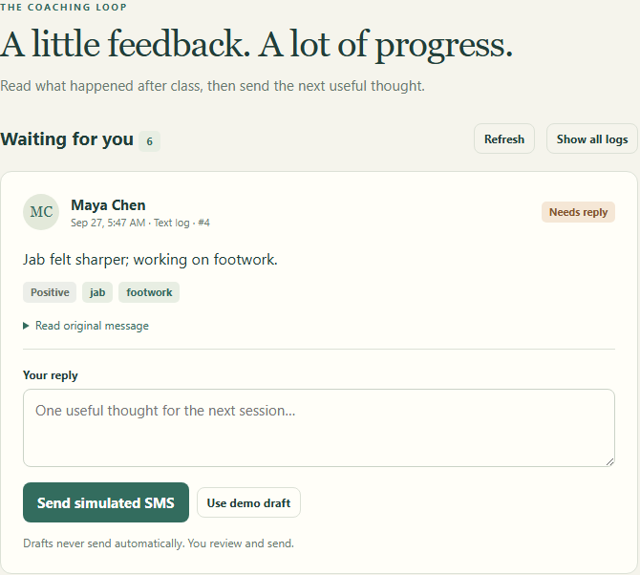
CORNERWORK / 03 / THE COACH
A queue the coach can act on.
Read the original.
Review the context.
Send one useful reply.
The coach stays responsible
for the advice.
A CLASS-TO-CLASS COACHING DEMO
05
Notes:
Open Coach inbox. Find the newly submitted log, expand the original, write a short reply and send. Show its simulated conversation in Demo tools. Rules-based summaries are aids only; the human coach decides what to send. Screenshot is from the local app with fictional seed data.

Slide 6
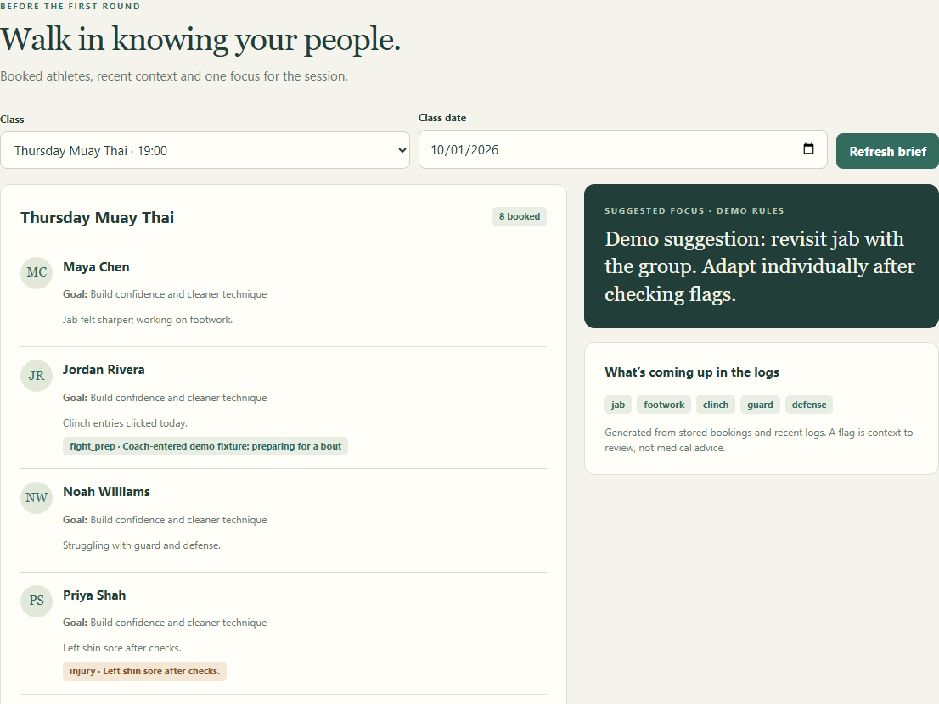
CORNERWORK / 04 / BEFORE THE NEXT CLASS
Walk in knowing what needs attention.
Who is coming?
What have they
been working on?
What should the
coach follow up on?
A CLASS-TO-CLASS COACHING DEMO
06
Notes:
Open Before class. Select the class the same athlete is booked into and refresh. Show their recent context, relevant flags and common themes. A new log does not enroll a member. The current brief uses recent logs from the last seven days and stored bookings, not live provider data. Shared clock and attendance connection are not implemented. Screenshot is actual local app, fictional athletes.

Slide 7
CORNERWORK / INTEGRATION TEST
Start with one gym. Prove the full loop.
GYMDESK FIRST
MINDBODY PATH
Check-In trigger via Zapier
Roster events + signed-in status
Confirm member, class and end time.
Then test one opted-in adult account.
Confirm access and event behavior.
Reuse the same coaching workflow.
Pass condition: one attended class → one delivered ping → reply → next-class context.
A CLASS-TO-CLASS COACHING DEMO
07
Notes:
Official sources accessed 2026-09-28: https://docs.gymdesk.com/en/help/docs/zapier (Check-In trigger, Get Bookings/Get Attendance); https://developers.mindbodyonline.com/WebhooksDocumentation (class roster events and SignedIn status). These are candidate integration paths, not connected integrations. Verify permission, identifiers, class-end data, retries, cancellations and timezone behavior using a partner gym and test adults before any live member rollout. Mindbody sandbox API availability does not prove live webhook access.

Slide 8
CORNERWORK / PROTOTYPE → PILOT
What you are seeing today.
WORKING LOCALLY
NEXT TO VERIFY LIVE
Member message → coach queue
Coach response → conversation
Recent logs → class brief
Attendance and message delivery
Real voice-note capture
Staff access and reliable scheduling
Voice, summaries and delivery are simulated in this demo.
A CLASS-TO-CLASS COACHING DEMO
08
Notes:
This slide is the clear scope boundary. Working locally: message intake, stored logs, coach queue and reply, computed class brief, explicit scheduled-job runner. Simulations: voice transcript, summaries and outbound messages. Before a live pilot: real attendance-only logic, SMS delivery and consent handling, actual audio intake/transcription, authentication and permission isolation, production scheduling and operational support. No retention lift or time-savings claims have been measured.

Slide 9
CORNERWORK / THE CONVERSATION
Would your coaches use this next week?
01
How do questions get handled after class today?
02
Which coach would own the queue?
03
What would make a short pilot worth paying for?
A CLASS-TO-CLASS COACHING DEMO
09
Notes:
Ask for a concrete example before pitching price: Tell me about the last member question that got lost after class. Who would own this queue? Would the next coach actually read the brief? Ask permission for a follow-up observation or a tightly scoped pilot; do not promise a start date or free period. If pricing comes up, $50–100 per gym per month is a hypothesis to test, not an approved offer. Optional $10 member resale needs its own demand and coach-labor test. Do not claim ten members means economic break-even.

Slide 10
CORNERWORK / TECH DETAILS / APPENDIX
Two connections. One coaching product.
FEASIBLE, WITH ONGOING INTEGRATION WORK
Build a separate connection for each platform. Both feed the same
member, class and attendance records into Cornerwork.
Gymdesk: start by testing its Zapier connection.
Mindbody: use its APIs and event updates, with approved access.
The hard part is reliable syncing: no-shows, duplicate updates,
permissions and platform changes. Neither is live in this demo.
A CLASS-TO-CLASS COACHING DEMO
10
Notes:
Feasibility assessment, not an implementation estimate. Proposed scope: read members, class rosters and verified attendance into a common internal model; retain conversations and coaching history in Cornerwork. Do not require payment, booking or membership write-back for the initial coaching loop. Gymdesk documents Zapier Check-In triggers and member/booking/attendance searches; verify class linkage, end time, filters, delivery timing and production-scale access with a cooperating gym. A public direct Gymdesk API is not assumed. Mindbody documents APIs and roster webhooks; live developer approval and business activation are required. Production work includes stable provider IDs per gym, deduplication, missed-event reconciliation, cancellations/no-shows, time zones, credential changes, access separation and monitoring. Validate API/Zapier costs and terms before committing to pricing or a launch date. Difficulty: a narrow proof of concept is manageable; dependable multi-gym operation is a substantial integration and maintenance effort. No live integration is implemented in the current demo. Sources verified 2026-09-28: https://docs.gymdesk.com/en/help/docs/zapier and https://developers.mindbodyonline.com/WebhooksDocumentation

