Slide 1

ARCHITECT TRANSFORMATION • FACILITATOR EDITION
Technical Architecture Research
& Future-State Design
Multi-Industry | Same Muscle, Same Structure
Practice architectural synthesis, hypothesis-building, and future-state design — with AI as accelerator, not crutch.
AI-First Architecting Value with AI | Technical Architecture Research & Future-State Design

Slide 2
Context & Goal
What this exercise is — and what it is not
The Setup
The Real Goal
Each team represents a different industry and is responsible for developing a credible, industry-appropriate technical architecture point of view for a representative company in that industry.
All teams run the same two-phase exercise. Only the industry and company change.
The goal is NOT to become industry experts.
The goal IS to practice architectural synthesis, hypothesis-building, and future-state design — using AI as an accelerator, not a crutch.
Treat all outputs as hypotheses, not facts. Clearly separate what is likely from what is confirmed.

Slide 3
Phase A | Technical Architecture Research
Current state — use Copilot to research and synthesize a probable architecture
Uncover the Tech Stack
Core platforms, cloud strategy, ERP, domain systems, data platforms, current AI/ML.
Identify Limitations
What modernization or AI operationalization challenges has the company faced?
Emerging Patterns
Modern reference architectures and design patterns rising in this industry.
Owners → Domains
Map executive/leadership roles to their architectural areas of focus.
Persona Profiles
Frontline, transformation leader, risk/compliance — goals, constraints, friction.
1
2
3
4
5
Treat outputs as hypotheses. Separate likely from confirmed. Cite sources where possible.
Quality bar for Phase A
• Every claim labeled as Hypothesis or Verified • Sources cited where they exist • Persona insights tied to actual workflows — not job titles

Slide 4
Phase A | Copilot Prompts
Use these as your starting point. Substitute <Company Name> and <Industry>.
Step | Copilot Prompt
1. Tech Stack | “Summarize <Company Name>’s digital transformation architecture, including core platforms, cloud strategy, enterprise systems (e.g., ERP), operational or domain-specific systems, data platforms, and current use of AI/ML — within the context of the <Industry> industry.”
2. Limitations | “What challenges has <Company Name> faced in modernizing its technology stack or operationalizing AI, given the constraints and realities of the <Industry> industry?”
3. Patterns | “What modern reference architectures and design patterns are emerging in the <Industry> industry to improve scalability, resilience, decision-making, or operational effectiveness?”
4. Owners | “Who at <Company Name> likely leads digital transformation, core operations, IT/platform engineering, and innovation? Map executive or leadership roles to their architectural areas of focus.”
5. Personas | “Create sample personas relevant to the <Industry> industry at <Company Name>, including one frontline/operational role, one digital/transformation leader, and one risk/compliance/sustainability role. Describe goals, constraints, and how technology supports or hinders their work.”

Slide 5
Phase B | Design Future-State Architecture
Synthesize your research into a cohesive future-state, grounded in your industry’s realities
Three Architecture Concept Diagrams
Cloud-centric platform · Edge + AI Agent operations · Data fabric / intelligence layer
Show how agentic AI could transform workflows, decisions, safety, reliability, or optimization — appropriate to the industry.
1
Persona-Driven Scenarios
What the AI agent does · Decisions it supports (not replaces) · Human + AI collaboration · New roles / hybrid interfaces
“An AI copilot that assists <persona> by synthesizing <data>, flagging <risks>, and recommending <actions> — while the human retains accountability.”
2
C-Suite Relevance (“So What?”)
CIO · Business / Operations Leader · Risk / Compliance / Sustainability Leader
Articulate the value of each architecture concept for each executive lens — in their language.
3

Slide 6
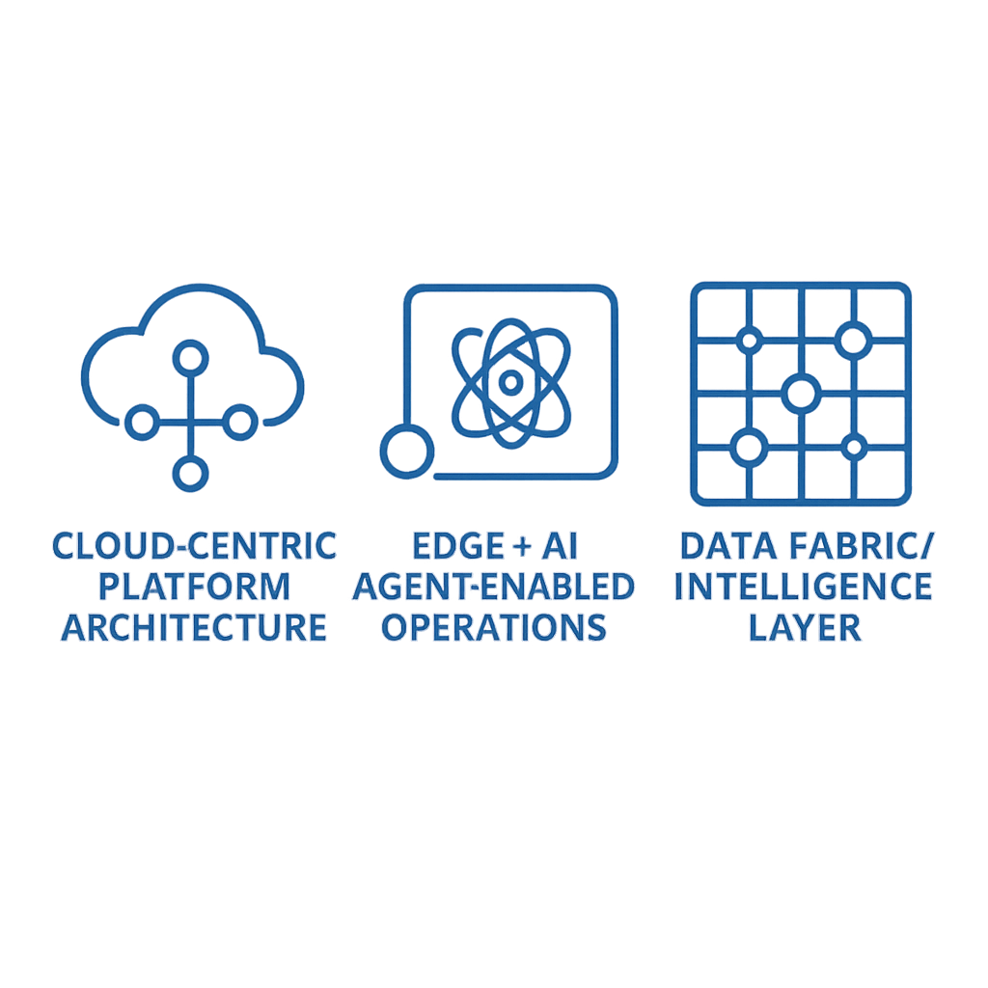
Deliverable 1 | Three Architecture Concept Diagrams
Deliverable 1 | Three Architecture Concept Diagrams
A. Concept
B. Concept
C. Concept
Cloud-Centric Platform Architecture
Modern data foundation, scalable services, governed AI/ML platform, integration backbone.
Edge + AI Agent-Enabled Operations
Decisioning at the edge, agentic workflows, human-in-the-loop control, latency- and safety-aware patterns.
Data Fabric / Intelligence Layer
Unified semantic layer, lineage + governance, AI-ready data products powering decisions across domains.
Show how agentic AI transforms workflows, decisions, safety, reliability, or optimization — appropriate to your industry.

Slide 7
Deliverable 2 | Persona-Driven Scenarios
For each architecture concept, describe how humans and AI work together
For each concept, describe:
What an AI agent or copilot would do
What decisions it supports (not replaces)
How humans and AI work together
What new roles, workflows, or hybrid interfaces emerge
Example framing template
“An AI copilot that assists <persona> by synthesizing <data>, flagging <risks>, and recommending <actions> — while the human retains accountability.”
Fill in your specifics:
• <persona> → ____________________________________________
• <data> → ____________________________________________
• <risks> → ____________________________________________
• <actions> → ____________________________________________

Slide 8
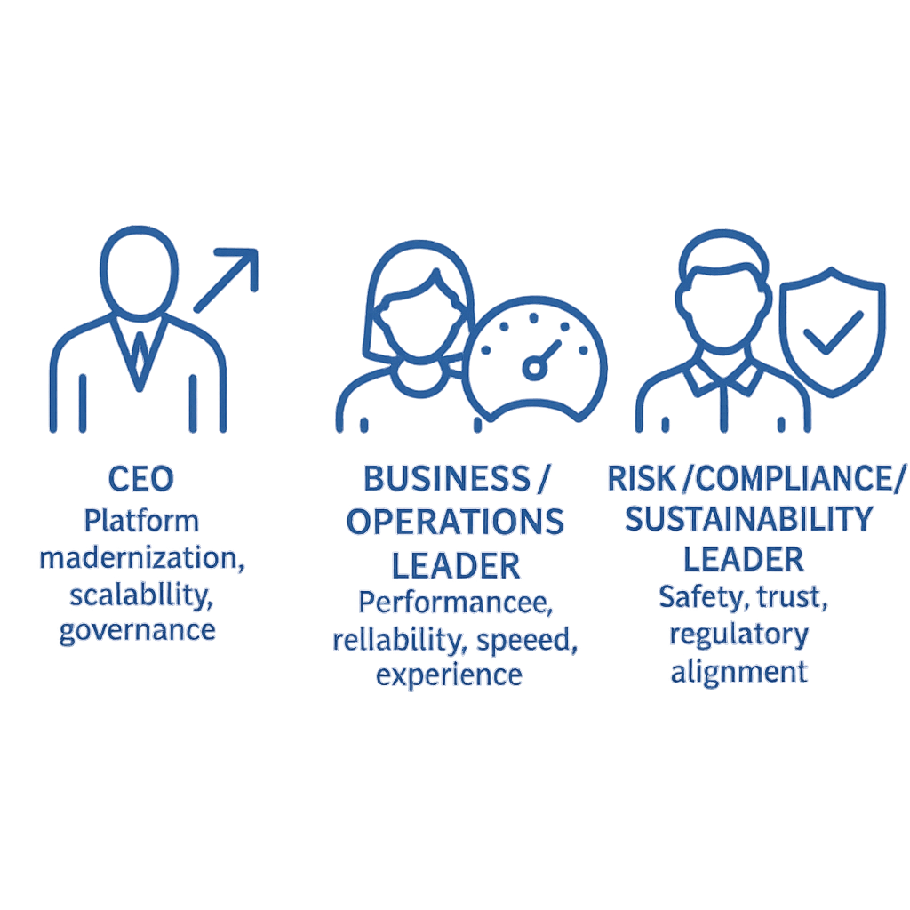
Deliverable 3 | C-Suite Relevance — “So What?”
Articulate the value of each architecture concept in each executive’s language
CEO
Platform modernization, scalability, governance
“Modernize fragmented legacy systems with a scalable data foundation and AI-enabled decision support.”
Business / Operations Leader
Performance, reliability, speed, experience
Translate the architecture into operational outcomes the business actually cares about.
Risk / Compliance / Sustainability Leader
Safety, trust, regulatory alignment
Show how the architecture strengthens controls, transparency, and defensibility.

Slide 9
Workshop Flow & Quality Bar
How teams move from research to defensible future-state
Workshop Flow
Phase A → Research current state — 5 prompts, 5 lenses
Synthesize → Separate hypotheses from facts; identify gaps
Phase B → Design 3 future-state concepts
Persona → Map AI + human collaboration per concept
So What? → Translate to CIO / Ops / Risk language
Present → Defend choices and tradeoffs to peer teams
Quality Bar
Hypotheses clearly labeled vs facts
Sources cited where they exist
Industry realities show through (not generic)
Personas tied to real workflows
AI augments — human accountability preserved
Each concept has a clear “So What?” per executive
Tradeoffs named, not hidden

Slide 10
Business Value Drivers in an AI First World
Business value drivers | Technology Capabilities | When Column 1 and Column 2 are aligned
Decision Velocity & Confidence | Automated insight generation Embedded Intelligence in workflows Scenario Modeling and Synthesis Scalable Data Integration Governed AI decision support | Technology capabilities are applied where they matter most AI changes how decisions are made and work is done Business leaders experience confidence, speed, and clarity ISD is seen as a strategic advisor
Workforce Productivity & Focus
Operational Resilience & Risk |  | When Column 1 and Column 2 are misaligned
Growth Enablement & Innovation |  | AI is implemented without clear value realization Capabilities are impressive but under‑adopted Risk, rework, or mistrust increases ISD is seen as an implementer, not a partner
AI does not create value on its own!
Business value is created when AI decisions are aligned to how the business works.
Work IQ → How intelligence shows up in daily work Foundry IQ → How insights, scenarios, and synthesis are created Fabric IQ → How data is unified, governed, and trusted
Notes:
Column 1
Decision Velocity & Confidence
Workforce Productivity & Focus
Operational Resilience & Risk
Growth Enablement & Innovation
What this column answers
“What must improve for this business to succeed?”
Key ISD guidance
This column is not negotiable — it belongs to the customer
Architects should start here, not with platforms or tools
If an item does not map to a value driver, it should not drive a solution decision
capabilities AI and platforms make possible, independent of any one product.
It is the translation layer between business intent and implementation.
Column 2
Automated insight generation
Embedded intelligence in workflows
Scenario modeling and synthesis
Scalable data integration
Governed AI decision support
Microsoft ISD mapping This is where Work IQ, Foundry IQ, and Fabric IQ naturally belong, but as enablers, not headlines.
Work IQ → How intelligence shows up in daily work
Foundry IQ → How insights, scenarios, and synthesis are created
Fabric IQ → How data is unified, governed, and trusted
What this column answers
“What must the technology enable to support the value driver?”
Key ISD guidance
This column is about capability, not configuration
column shows how business behavior, decisions, or outcomes actually change as a result of Columns 1 and 2 being aligned.
This is where value is realized or lost.
Typical entries in Column 3
Faster executive decision cycles
Reduced rework and downstream risk
Higher adoption and trust in AI outputs
Clearer tradeoffs and prioritization
Measurable movement on cost, speed, or growth
What this column answers
“What is different for the business because we made this technology decision?”

Slide 11
What this means for ISD Architects
Behavior | Who we aspire to be
Business‑Outcome Orientation | Architects anchor AI decisions to value drivers, not features
End‑to‑End Thinking | Work IQ, Foundry IQ, and Fabric IQ are positioned as a system, not silos
Judgment Over Execution | Emphasis shifts from “can we build it?” to “should we?”
Customer Co‑Creation | Value drivers frame collaborative decision‑making, not one‑way delivery
Speed with Safety | AI acceleration is paired with governance and risk awareness
Notes:
Listen for and coach toward the following behaviors after this slide is introduced:
Strong Signals
Architect explains why a Work IQ / Foundry IQ / Fabric IQ decision matters to the business
Tradeoffs are discussed in terms of risk, cost, speed, or adoption
AI is positioned as a means, not the outcome
Recommendations are framed around value drivers, not architecture diagrams
Coaching Opportunities
Architect leads with features or tools instead of business impact
“AI will help” statements without clarity on how work or decisions change
Limited discussion of risk, governance, or adoption implications
Over‑optimization for technical elegance at the expense of business clarity

