Slide 1

ARCHITECT TRANSFORMATION PROGRAM | TEAM EXERCISE
From Discovery to Delivery
SOW on Microsoft Paper
Translating Insight → Solution → Delivery Reality
Write a customer-ready SOW where every line item traces back to discovery.
AI-First Architecting Value with AI | From Discovery to Delivery — SOW on Microsoft Paper

Slide 2
Purpose & Guardrail
What this exercise tests — and the one rule that governs it
The rules
Translate customer discovery into a credible, outcome-driven SOW that reflects:
Clear business outcomes
A grounded solution approach
Realistic scope, roles, and effort estimates
Tests whether teams can move from
Insight → Solution → Delivery Reality

Slide 3
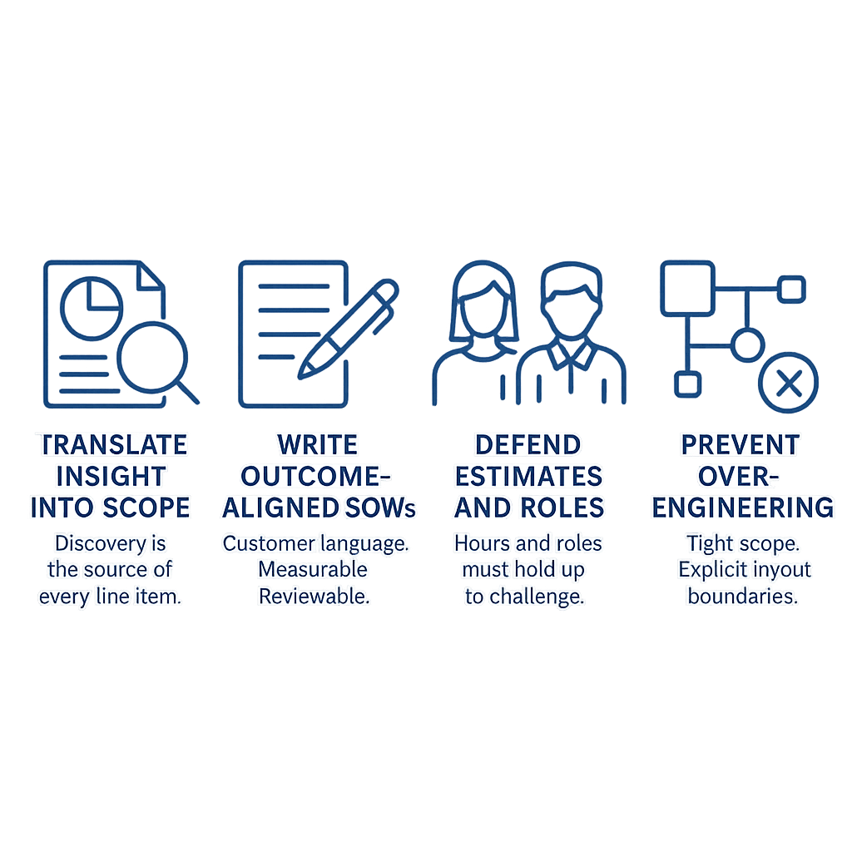

Why This Exercise Matters
Mirrors real Microsoft delivery expectations
Translate insight into scope
Discovery is the source of every line item.
Write outcome-aligned SOWs
Customer language. Measurable. Reviewable.
Defend estimates and roles
Hours and roles must hold up to challenge.
Prevent over-engineering
Tight scope. Explicit in / out boundaries.
Great architecture is inseparable from delivery reality.
A core theme of the Architect Transformation Program.

Slide 4
SOW Structure | 19 Required Sections
Every team’s SOW must include these. Same skeleton, different industry content.
 | Section title | Description
0 | Document Control | Title (Project / Program Name) Customer / Prepared for Provider (e.g., Microsoft ISD) | Version, date, status (Draft / Final) Work Order reference Validity / expiration terms
1 | Introduction | 1.1 Context Business environment / industry context Strategic initiative alignment (e.g., digital transformation, platform modernization, AI enablement) 1.2 Purpose of Engagement What the engagement delivers (solution, program, migration, platform, etc.) Nature of collaboration (joint delivery, co-innovation, transformation program) | 1.3 Engagement Model Explicit statement of: Agile / fixed capacity / variable scope Program vs project model Multi-project / pod / feature team structure (if applicable
2 | Objectives and Scope | 2.1 Business Objectives High-level customer outcomes (experience, consolidation, modernization, compliance, etc.) Non-guarantee clause: Objectives guide planning but are not guaranteed within capacity 2.2 Value Themes (Normalized Across Docs) Typical categories: Platform enablement Application consolidation / delivery Data & AI enablement | Security & governance Migration / modernization Operational efficiency 2.3 Scope Model Explicit definition: Variable scope governed by backlog prioritization Capacity-driven delivery constraint Ownership: Customer Product Owner prioritizes backlog Microsoft executes within capacity

Slide 5
SOW Structure | 19 Required Sections
Every team’s SOW must include these. Same skeleton, different industry content.
 | Section title | Description
3 | Structured Scope (Epics / Workstreams / Service Areas) | This is the core reusable structural layer 3.1 Common Epic Categories (Consistently observed across Caixa + B3 + OSU) Foundation / Baseline / Intake Discovery, assessment, architecture validation Architecture & Platform Reference architecture, DevOps, infrastructure Security & Identity Authentication, encryption, Zero Trust Core Build / Migration / Execution App build or data/platform migration Governance & Monitoring KPIs, telemetry, compliance, lifecycle mgmt | Scale / Expansion / Waves Migration waves or additional product increments Knowledge Transfer Documentation, training, enablement 3.2 Scope Characteristics Scope is: Non-fixed Continuously reprioritized Backlog drives: Sprint execution Delivery sequence
4 | Out of Scope | 4.1 General Pattern All documents include explicit exclusion tables. 4.2 Common Exclusions Product licenses and subscriptions Hardware / infrastructure provisioning Data cleansing or large-scale data migration (unless specified) | Third-party software implementation Organizational change management End-user training and communications Production support & operations Performance testing (often excluded or customer-owned) System integration beyond defined scope

Slide 6
SOW Structure | 19 Required Sections
Every team’s SOW must include these. Same skeleton, different industry content.
 | Section title | Description
5 | Delivery Approach | 5.1 Methodology Agile Scrum (primary model across all documents) Fixed capacity + variable scope 5.2 Core Mechanics Product backlog (central artifact) Sprint cycles (typically 2–4 weeks) Iterative delivery with continuous reprioritization | 5.3 Delivery Phases (Normalized) Initiation Baseline planning Delivery sprints Completion / closure
6 | Timeline and Capacity Model | Relative timeline (not fixed commitments) Defined during baseline planning Examples: Multi-month project (12–16 months) Multi-year program (OSU: up to 36 months) | Key principle: Timeline adapts to scope and capacity changes
7 | Organization and Roles | 7.1 Structural Model Common layering across all SOWs: Executive Steering Committee Program / Product Governance Layer (Product Council / Control Tower) Delivery Teams (Feature teams / Pods) | 7.2 Roles (Normalized) Customer Executive Sponsor Product Owner (critical role) Project / Program Manager Business stakeholders / SMEs Microsoft Delivery Management Executive Program / Project Manager Architect / Technical Lead Consulting Product Delivery Manager (CPdM) Engineers / Consultants

Slide 7
SOW Structure | 19 Required Sections
Every team’s SOW must include these. Same skeleton, different industry content.
 | Section title | Description
8 | Governance Framework | 8.1 Governance Bodies Executive Steering Committee Product Council / Program Governance (Optional) Architecture Review Board (OSU program) 8.2 Governance Functions Strategy alignment Backlog prioritization | Issue resolution Decision authority 8.3 Communication Model Status reports Sprint reviews Stakeholder reviews Communication plan
9 | Delivery Execution (Sprint Model) | 9.1 Sprint Activities Sprint planning Daily standups Implementation Testing Sprint review Retrospective | 9.2 Key Artifacts Product backlog Sprint backlog Sprint completion report Roadmaps / burn charts
10 | Testing and Quality Management | 10.1 Testing Types Functional testing System testing Non-functional testing User Acceptance Testing (UAT) | 10.2 Responsibility Model Microsoft: Feature-level validation, system testing Customer: UAT, performance testing (usually) 10.3 Defect Management Priority levels (P1–P4) Severity levels (S1–S4) Backlog-driven remediation

Slide 8
SOW Structure | 19 Required Sections
Every team’s SOW must include these. Same skeleton, different industry content.
 | Section title | Description
11 | Change Management | 11.1 Core Principle All changes must be formally approved 11.2 Trigger Conditions Capacity exhausted Scope expansion Timeline extension Resource changes | 11.3 Process Written request Impact analysis (cost/schedule/scope) Approval within defined SLA (commonly 3 business days)
12 | Risk and Issue Management | RAID log (Risks, Actions, Issues, Decisions) Continuous monitoring Escalation process
13 | Escalation Path | Typical hierarchy: Feature team Product / Project manager | Product owner / Program manager Product council / governance body Executive steering committee
14 | Work Products and Deliverables | 14.1 Typical Outputs Architecture and design documents Product backlog Sprint reports Roadmaps / metrics Migration/runbooks (B3) Knowledge transfer artifacts | 14.2 Acceptance Model Backlog items typically: Do not require formal sign-off Validated through sprint review

Slide 9
SOW Structure | 19 Required Sections
Every team’s SOW must include these. Same skeleton, different industry content.
 | Section title | Description
15 | Technical and Environment Requirements | 15.1 Common Stack Patterns Azure (core platform) DevOps / GitHub Databricks / AI (program-specific) Mobile frameworks (Super App case) | 15.2 Environment Model Dev / Test / Production Customer-owned Microsoft granted access
16 | Customer Responsibilities | Provide: Access to systems and environments SMEs and stakeholders Documentation and requirements UAT execution | Manage: External dependencies Organizational readiness Third-party interactions
17 | Assumptions | Typical categories: Resource availability Tooling readiness Continuous schedule (no breaks) | Remote or hybrid delivery Compliance/training affects capacity Agile variability acknowledged
18 | Program / Project Completion Criteria | Completion occurs when: Capacity is consumed | Timeline expires Backlog complete Contract terminated
19 | Appendices and Supporting Material | Definitions / acronyms Architecture diagrams Product backlog samples | Technology requirements Governance visuals

Slide 10
Worksheet A | SOW Header + Outcomes
Identify the engagement and the measurable outcomes it will deliver
Customer / Company
Industry
Team Members
Date
Business Outcomes (2–3)
Measurable. Customer-owned.
___________________________
___________________________
___________________________
In-Scope Boundaries (3)
What Microsoft will deliver.
___________________________
___________________________
___________________________
Out of Scope (3)
Prevent scope creep — say it explicitly.
___________________________
___________________________
___________________________

Slide 11
Worksheet B | Deliverables + Acceptance Criteria
If a deliverable has no acceptance criteria, it is not a deliverable.
Deliverable | Description (customer language) | Acceptance Criteria | Outcome Supported
Each deliverable must map to an outcome · Each must be reviewable, signable, or testable

Slide 12
Worksheet B | Deliverables + Acceptance Criteria
Estimate by work package first, then allocate hours to roles. Call out uncertainty as an assumption.
Work package / phase | Key activities | Role(s) | Est. hours | Notes / dependencies
Total estimated hours: ____________ Delivery duration (weeks): ____________ Top 3 assumptions: ____________________________________________
If a deliverable has no acceptance criteria, it is not a deliverable. · Include customer responsibilities (stakeholder time, data access, SMEs).

Slide 13
Default Roles & Estimation Guidance
Use as a starting point. Add or remove roles to fit the engagement.
Default Delivery Roles
Role | Responsibility
Engagement Lead | Overall delivery accountability, customer alignment
Solution Architect | End-to-end solution design tied to outcomes
Industry SME | Business context, industry validation
Delivery Consultant | Execution of defined work packages
Project Manager | Planning, cadence, risk management
Estimation Quick Rules
Estimate by work package first, then allocate hours to roles.
Show hours by role AND by work package — both must be present.
Include what drives the estimate (complexity, sites, data sources, environments).
Call out uncertainty explicitly as an assumption — do not hide it in the numbers.
Include customer responsibilities required to hit the plan.

Slide 14
“Microsoft Paper” Writing Checklist
Use as a starting point. Add or remove roles to fit the engagement.
Structure
Start with objective + outcomes in customer language (no internal jargon).
Short sections with headings: Objective, Scope, Deliverables, Workplan, Roles, Estimates, Assumptions.
Keep deliverables concrete — reviewable, signable, or testable.
Clarity
One idea per paragraph. Prefer bullets over long prose.
Define acronyms the first time they appear.
Avoid solutioning language in scope statements; describe outcomes and deliverables.
Estimation
Show hours by role AND by work package.
Include drivers (complexity, number of sites, data sources, environments).
Add an explicit assumptions list that makes the estimate true.
Delivery Realism + Finish
List customer responsibilities (access, SMEs, data, security reviews).
Add a “scope traps” callout for what could expand hours quickly.
Active voice, consistent tense; reads like a customer-facing document.

Slide 15
Scoring Rubric | 21 points total
Score each dimension 0–3. Use to compare teams and coach improvements.
Dimension | 0–1 Needs Work | 2 Good | 3 Excellent
Traceability to discovery | Scope feels invented; weak linkage to pressures/outcomes | Most elements map back; a few gaps | Every deliverable and hour ties to pressures / outcomes / constraints
Outcome clarity | Outcomes vague or unmeasurable | Outcomes measurable but incomplete | Outcomes measurable, prioritized, customer-owned
Scope discipline | Bloated scope; unclear boundaries | Reasonable scope; some ambiguity | Tight scope, explicit in/out, protects from creep
Deliverables + acceptance | Deliverables unclear; no acceptance criteria | Deliverables clear; criteria partial | Clear deliverables with testable acceptance criteria
Estimate realism | Hours/roles not credible or missing | Mostly credible; some under/over | Credible, role-based estimates with assumptions and drivers
Roles & responsibilities | Roles unclear; overlaps and gaps | Roles mostly clear; minor gaps | Roles crisp, accountable; customer responsibilities explicit
Risk & assumptions | Risks hidden; assumptions missing | Some assumptions stated | Key assumptions/risks explicit with mitigation/validation plan

Slide 16
Facilitator Debrief | Use After Present-Out
?
Five questions to surface coaching moments and reinforce the discipline
Is every element of the SOW traceable to discovery?
1
Are the outcomes customer-owned and measurable?
2
Do the roles and hours feel credible for the scope?
3
What assumptions create the highest delivery risk?
4
Where did the team over- or under-scope the work?
5
If a line in the SOW cannot point back to a line in discovery — it does not belong.

