Slide 1
Python Advanced Excercise

Slide 2
Ex1
Write a Python class which has two methods get_String and print_String. get_String accept a string from the user and print_String print the string in upper case.

Slide 3
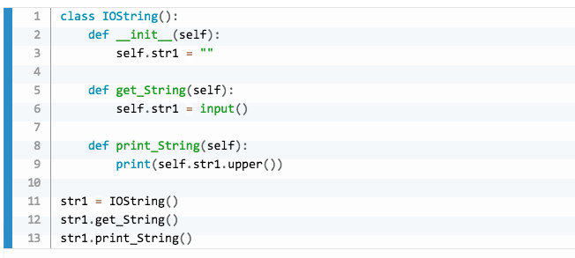

Slide 4
Ex1
Write a Python class to convert an integer to a roman numeral.

Slide 5
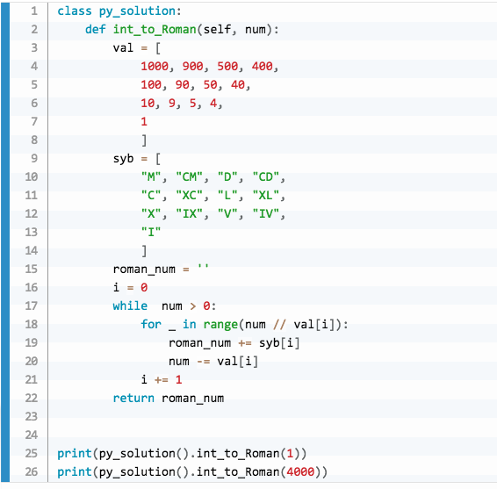

Slide 6
Ex2
Write a Python class to convert a roman numeral to an integer

Slide 7
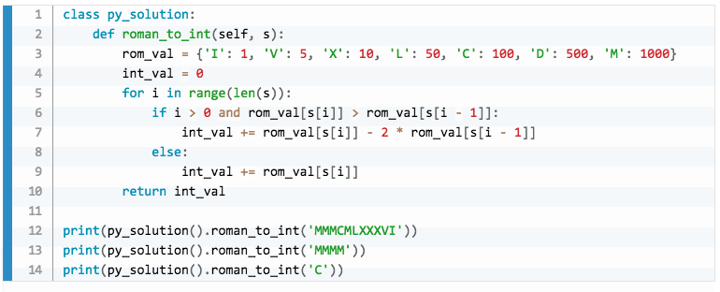

Slide 8
Ex3
Write a Python class to find validity of a string of parentheses, '(', ')', '{', '}', '[' and ']. These brackets must be close in the correct order, for example "()" and "()[]{}" are valid but "[)", "({[)]" and "{{{" are invalid.

Slide 9
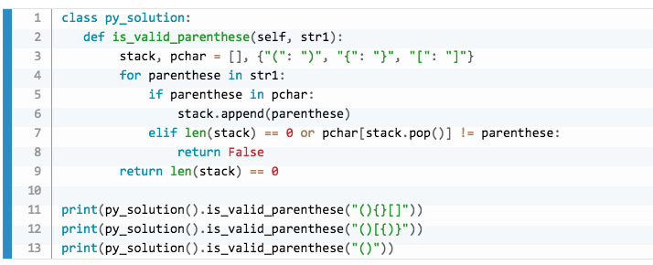

Slide 10
Ex4
Write a Python class to implement pow(x, n).

Slide 11
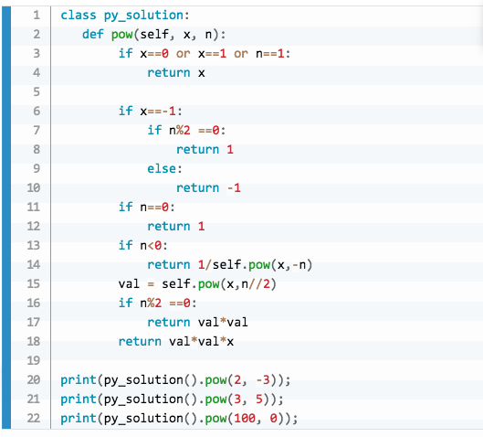

Slide 12
Ex6
Write a Python class program to reverse a string word by word.
Input:
hello world
Output
world hello
Hints:
split by space
reversed()
join by space
implement with class

Slide 13
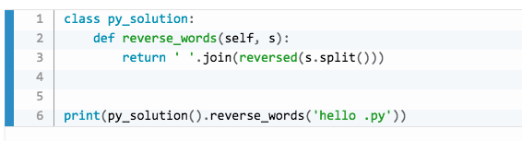

Slide 14
Ex7
Write a Python program that matches a string that has an a followed by zero or more b's.
Input
ac match
abc match
abbc match
aabbcc match

Slide 15
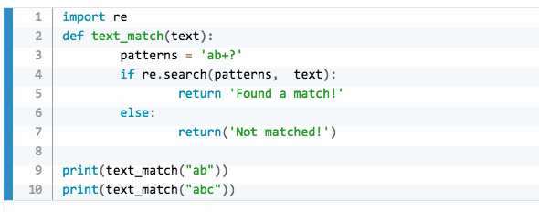

Slide 16
Ex7
Write a Python program that matches a string that has an a followed by zero or one 'b'.
Input
ab match
abc match
abbc match
aabbcc match

Slide 17
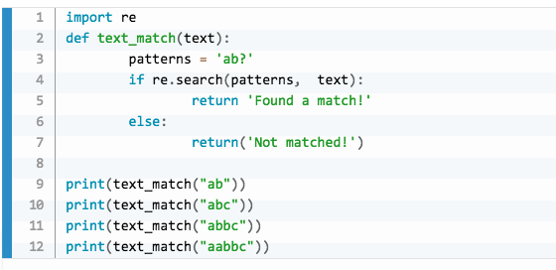

Slide 18
Ex8
Write a Python program that matches a string that has an a followed by three 'b’
Input
abbb match
abb not match
abbbbbb ????

Slide 19
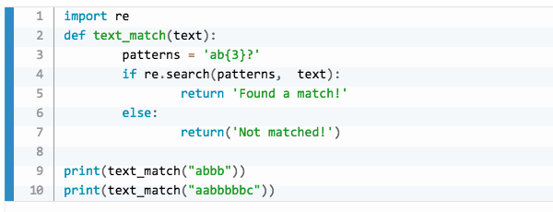

Slide 20
Ex11
Write a Python program to replace maximum 2 occurrences of space, comma, or dot with a colon.
Input:
Python Exercises, PHP exercises.
Output:
Python:Exercises: PHP exercises.

Slide 21


Slide 22
Write a python program to convert snake case string to camel case string.
Input:
python_exercises
Output:
PythonExercises

Slide 23
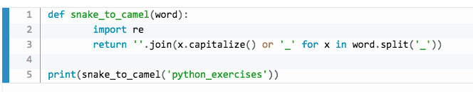

Slide 24
Mysql Excercise
Input:
[
{’first_name’:’ade’, ‘last_name’:’dodi’,’age’:20,’income’:4000,’sex’:’M’},
{’first_name’:’ayu’, ‘last_name’:’dodi’,’age’:40,’income’:4000,’sex’:’M’},
{’first_name’:’adi’, ‘last_name’:’dodi’,’age’:50,’income’:4000,’sex’:’M’},
{’first_name’:’dodo’, ‘last_name’:’dodi’,’age’:30,’income’:4000,’sex’:’M’},
{’first_name’:’edi’, ‘last_name’:’dodi’,’age’:24,’income’:4000,’sex’:’M’},
]
Output
Insert ke Tabel EMPLOYEE mysql

Slide 25
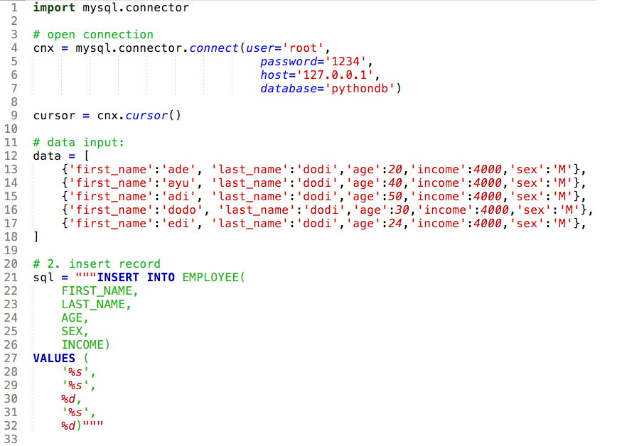

Slide 26
