Slide 1
Studi,
The smarter flashcards app
Karthik Gnanakumar and Akheel Shaik

Slide 2
System Description
1
Why did we build this app?

Slide 3

Quizlet!
Flashcard Management System
Goal: Active Recall
Problem: Keep practicing confident flashcards

Slide 4


Front End:
Back End:
Big Vision
React
I want a system that knows which cards I need to practice and when to practice them.
Strapi

Slide 5
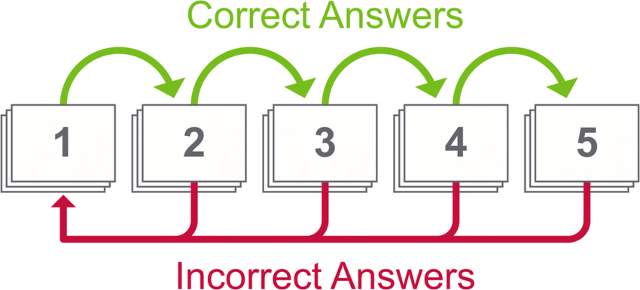
Instructions for use

Slide 6
Use Case Diagram
2
What are its features?

Slide 7

Use Case Diagram

Slide 8
Our Entity Relationship diagram & the RDBMS
3
How do these features interact with the database?

Slide 9
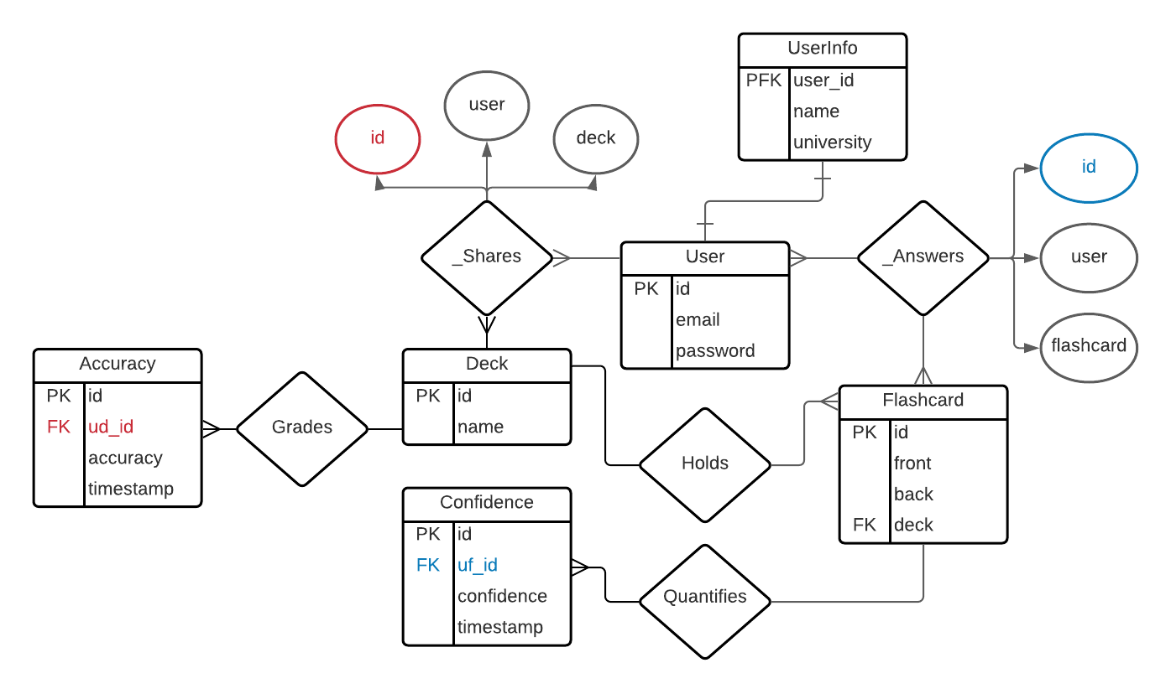

Slide 10
Implementation Details
4
How did we build this app?

Slide 11
You can also split your content
Next.js w/ TypeScript
Frontend
Material UI
Strapi
Backend
SQLite

Slide 12
Thanks!
Any questions?
Project Content: https://github.com/akheel-s/CSE-111-Project.git
Project Code: https://github.com/akheel-s/CSE-111-Project-Code.git

