Slide 1
Flashcards Application
Phase 1 with Karthik G. and Akheel S.

Slide 2
OBJECTIVE:
To develop a flashcards app
similar to the likes of Quizlet and Anki.

Slide 3
THE PROJECT REQUIRES...
A front-end capable of
Visualizing the database
Interacting with dataset
Extracting statistics
A back-end that
Stores user data
Implements CRUD functionality

Slide 4
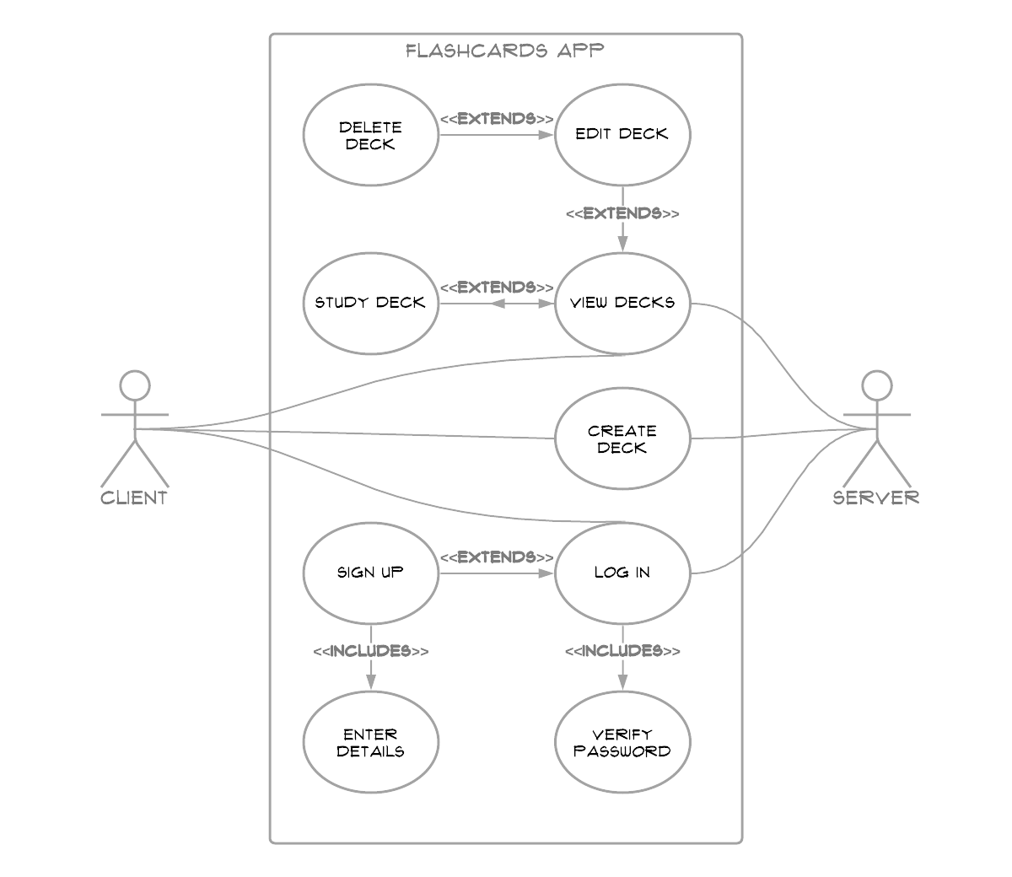
THE USE-CASE DIAGRAM

Slide 5
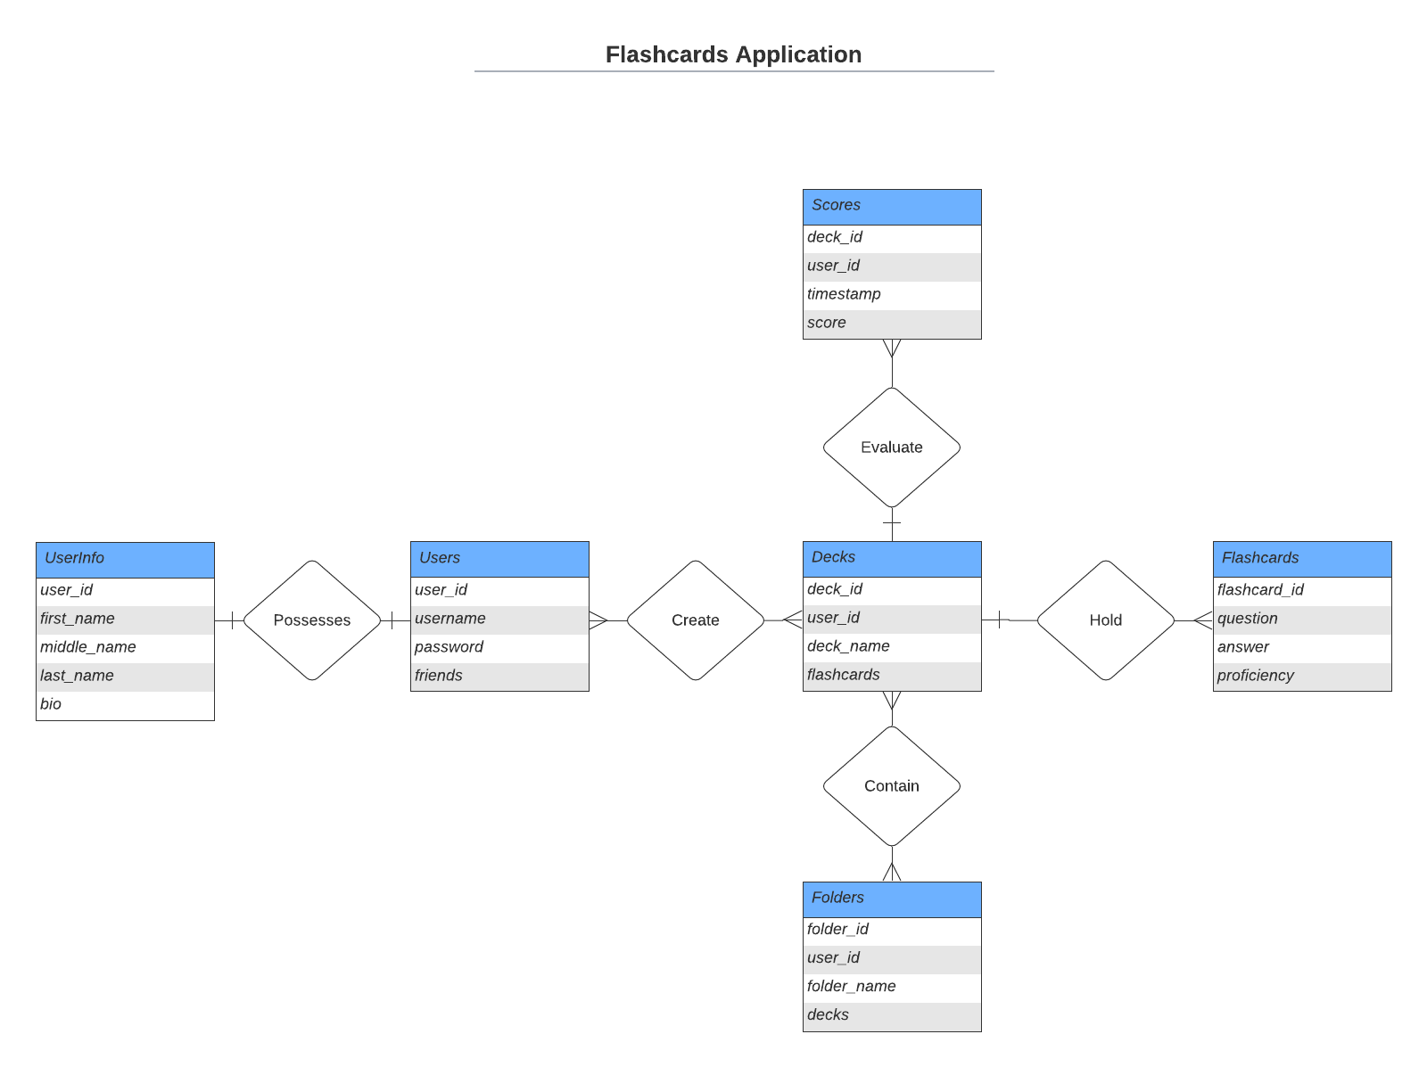
THE E/R DIAGRAM

Slide 6



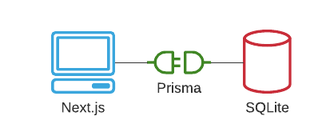

OUR PLAN, FRONT-AND-BACK

Slide 7
THANKS!
Any questions?

