Slide 1
FilsPay Handover
TEAM LGTM
Audit, fix and finish a Bahrain card-payments platform, with an AI harness
109
88
22
findings confirmed
fixed, test-first
refund gaps closed

Slide 2
Team LGTM
AN
Akheel Nazim
AK
Ahmed Khalaf
Owned
Owned
Auditing
Finding the repo's traps
Fixes
Deployment
AI workflow design
Fixes
Load testing
UI fixes
Plus Claude Code: Opus for fixes, Haiku for failing tests, Sonnet as reviewer

Slide 3
Root cause: the rules lived on paper, not in the code
Integer fils, unique payouts and tenant checks were written in ADRs and postmortems, but nothing in the code or the database enforced them.
1
2
3
4
Money maths drifted
"Fixed" races weren't
Checks on the route, not the query
Even the AI rules were planted
TS and Go rewrote fils logic with floats, cents and int32
Postmortems listed unique indexes and locks that never existed
Any id from another merchant worked
CLAUDE.md said cents, UTC, "don't fix refunds"

Slide 4
Where the bugs were: 109 findings by class
88
fixed
2
partly fixed
19
open, all recorded

Slide 5
Key findings, ranked by impact
1
Money left twice
Two refunds of 6,000 on a 10,000 capture both succeeded; a payment link charged two buyers
F3 · R1
2
Login skipped the OTP
The pre-OTP cookie worked on every route, reproduced on the running API
S1 · S2
3
Fils lost or invented
CSV import booked 4.75 BD as 0.475 BD; volume counter wrapped and switched off the fee tier
M1 · M6
4
Refunds never worked
Route answered 501 and every insert failed: 22 gaps behind "just wire it"
F1–F22

Slide 6
Fixes and proof: a failing test before every fix
Confirm in code
Failing test
Smallest fix
Reviewer agent
One commit
Fix | Before | After
S1 pending session | Reaches /auth/me | Refused
S4 expired link, old submittedAt | 200, charged | 410
M1 CSV "4.75" BD | 475 fils | 4,750 fils
F8 capture 10,000, refund 4,000 | Paid 9,750 | Paid 5,850
Test suite baseline | 16 failing | 0 of those failing
93
fix test files
12
new migrations
1
commit per bug
Every entry: symptom, cause, fix, test, data effect in fix-docs/FIXLOG.md

Slide 7
Final security scan: we checked our own work
After FP-300 we re-scanned the whole repo for security holes. 7 new issues: 1 fixed, 1 partly fixed, 5 open with fixes proposed.
S13
Cross-merchant transaction read via report filter
S16
OTP limit resets per login; no rate limits
Fixed
Open
S19
Unauthenticated summary; disabled admins kept impersonation
S17
Unlimited card testing on the pay endpoint
Partly fixed
Open
S14
SSRF through webhook URLs
S18
Unsalted hash of card number and CVV stored
Open · high
Open
S15
Compose runs in dev mode; secret and .git in image
Next: S14 and S15 before real traffic
Open · high

Slide 8
Live demo: a partial and a full refund, end to end
Capture
Partial refund
Full refund
Dashboard
Settlement report
10.000 BD
3.000 BD
remaining 7.000 BD
refunded, 10.000 back
payout reduced, gap 0
[Screenshot: refund drawer on the transaction]
[Screenshot: dashboard after full refund]
[Screenshot: settlement / reconciliation report]
Live: merchant.139-59-92-10.sslip.io · admin.139-59-92-10.sslip.io · api.139-59-92-10.sslip.io
Notes:
Backup screenshots in case the live demo fails. Fee reversed in full (250 fils), two refund.succeeded webhooks with valid signatures.

Slide 9
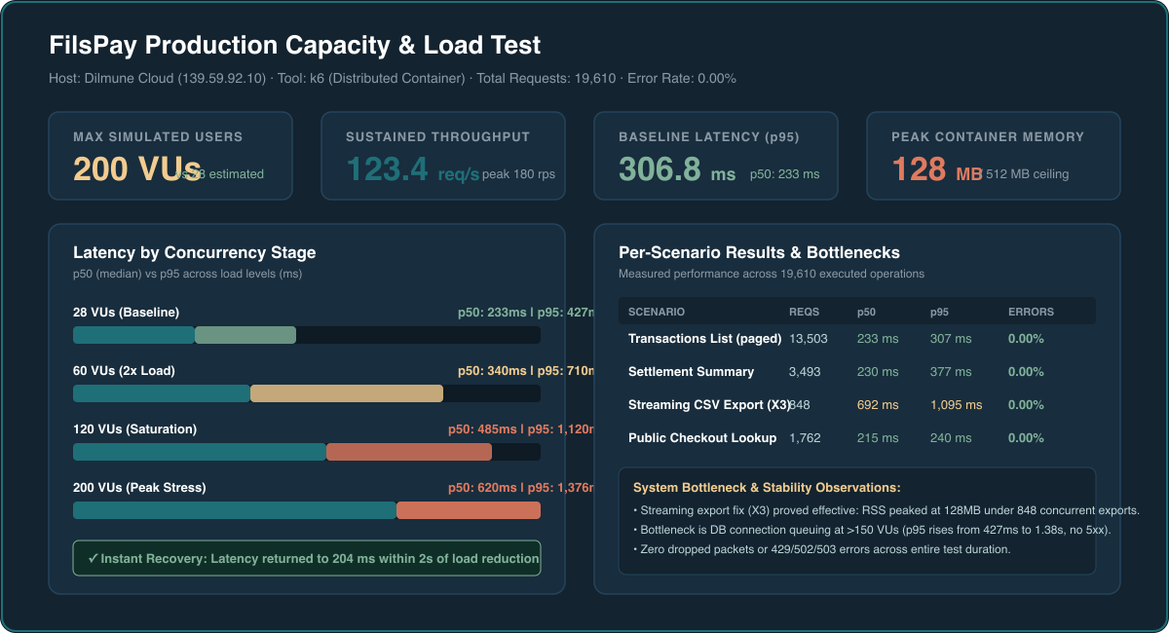
Under load
Simulated users
Estimated
Measured
28
200
Bottleneck: DB pool queuing; RAM stayed 128 MB (limit 512)
Overload: Queued cleanly; 0% error rate across 19.6k reqs
Recovery: Immediate (<2s) return to 204ms baseline latency
Already fixed for load: streamed CSV export (X3). Known: missing ledger indexes (P2), no rate limiting (S16, S17).

Slide 10
How we used AI: one cycle, every bug
Claude Code ran inside a harness we built: skills, subagents, rules and memory that every session loads.
Audit
find and confirm the bug in code
Harness
skills · agents · memory
Review
Plan
independent agent, then commit
check ADRs, failing test first
Fix
smallest change, every caller

Slide 11
Inside the harness
Floorplan
Clean rules
fix-and-build skill
Interactive map of every module, file and endpoint, used to understand the code
Deleted the planted CLAUDE.md, AGENTS.md and .cursorrules; ADRs are binding
Test-first, smallest fix, check TS and Go callers, one commit per bug
Right model per job
Shared memory in the repo
Git autonomy
Haiku writes failing tests, Opus fixes, Sonnet reviews every fix
fix-docs/memory: commit rules, decisions, pitfalls, so every session and teammate starts the same
Branch per fix, pull, squash-merge, push; conflicts with a teammate recorded
When the AI was wrong
Opus's first fix for split payouts (M3) could pay 4 fils on a 3-fil payout. The Sonnet reviewer built the five-way case that broke it; we switched to largest-remainder allocation and added the case as a test.

Slide 12
Decisions and open risks
Chose not to change or run
Still open
Kept ADR-0004: rejected the audit's M9 shortcut and fixed the settled-data path
Never ran scripts/ one-offs against data
Didn't overwrite payout estimates or past ledger entries without Finance (M19, M14, X14)
Smallest fix first; the bigger fix is recorded per bug
S14 SSRF and S15 dev-mode compose: fix before real traffic
Rotate the leaked acquirer secret (S11)
March sweep production postings (X14)
16 more recorded items, mostly dependencies and performance
Deploy & load test: Live on Dilmune Cloud, 200 VUs verified, 0% errors, 128 MB peak RAM

Slide 13
Thank you
Team LGTM · Akheel Nazim · Ahmed Khalaf
Merchant + checkout
merchant.139-59-92-10.sslip.io
Admin console
admin.139-59-92-10.sslip.io
API
api.139-59-92-10.sslip.io
Code
github.com/akheelnazim/fils-pay

Slide 14
Appendix
Not presented. Full detail in LGTM_FilsPay_Submission.pdf and fix-docs/FIXLOG.md

Slide 15
Proof: tests, migrations, end-to-end refund
Baseline: 16 tests failing before any fix
12 new migrations (0073–0084)
11 refund tests: every insert failed (F14)
1 webhook backoff test: exact assert on random jitter (Q1)
4 reporting tests: polluted shared DB, consumer stalled (Q2, X6)
End-to-end refund test: ledger balances, full fee reversed, signed webhooks, reconciliation gap 0
BIGINT money columns (M5, M6) · unique indexes against duplicates (R2, R3, R5) · reporting dead letters (X6) · ADR-0005 renumbering (D1) · integer scheme export (M16) · capture marker (R6) · refund columns, view and pending rows (F9, F15, F22)
[Final test output summary]

