Slide 1
Data Science Take-Home Project
Atefeh Kheirollahi
Dec 19nd, 2024

Slide 2

Methodology
Data Source
This dataset was collected from one of Poland's car advertisement platforms(Otomoto), featuring a wide range of car listings and offers.
The dataset contains 208,304 observations of 25 variables.
Car Characteristics (Mileage, Fuel type, Vehicle brand, Price etc.)
Advertisement Information (Offer publication date, Offer location etc.)

Slide 3

Customer Personality Analysis
Project Objective
Task 1:
Vehicle Segmentation: Cluster vehicles into distinct groups based on their specifications and identify meaningful patterns.
Task 2:
Anomaly Detection: Detect unusual or suspicious vehicle offers, such as those with outlier features or specifications.
Task 3:
Time-Based Analysis: Explore temporal trends in the data.

Slide 4
Methodology: Clustering
Split ads into distinct groups
Well-Separated
Group 0
Group 2
Group 1
Group 3

Slide 5
Methodology: Clustering
Algorithm selection approach: As the dataset contains outliers and is not in spherical form, the preferred model is the DBSCAN algorithm (Density-Based Spatial Clustering of Applications with Noise). Additionally, this algorithm does not force every data point into a cluster, further improving its robustness in the presence of outliers.
However, by applying this method, DBSCAN generated more than 20 clusters. After attempting to fine-tune its parameters for better results, the Kernel crashed, so the approach shifted to the K-Means algorithm.
Cluster Evaluation: Internal metrics applied as truth labels are not available. They provide a way to assess the quality of clustering based on the attributes of the data itself:
Within-cluster sum of squares(WCSS)
Silhouette Coefficient
Davies-Bouldin Index

Slide 6
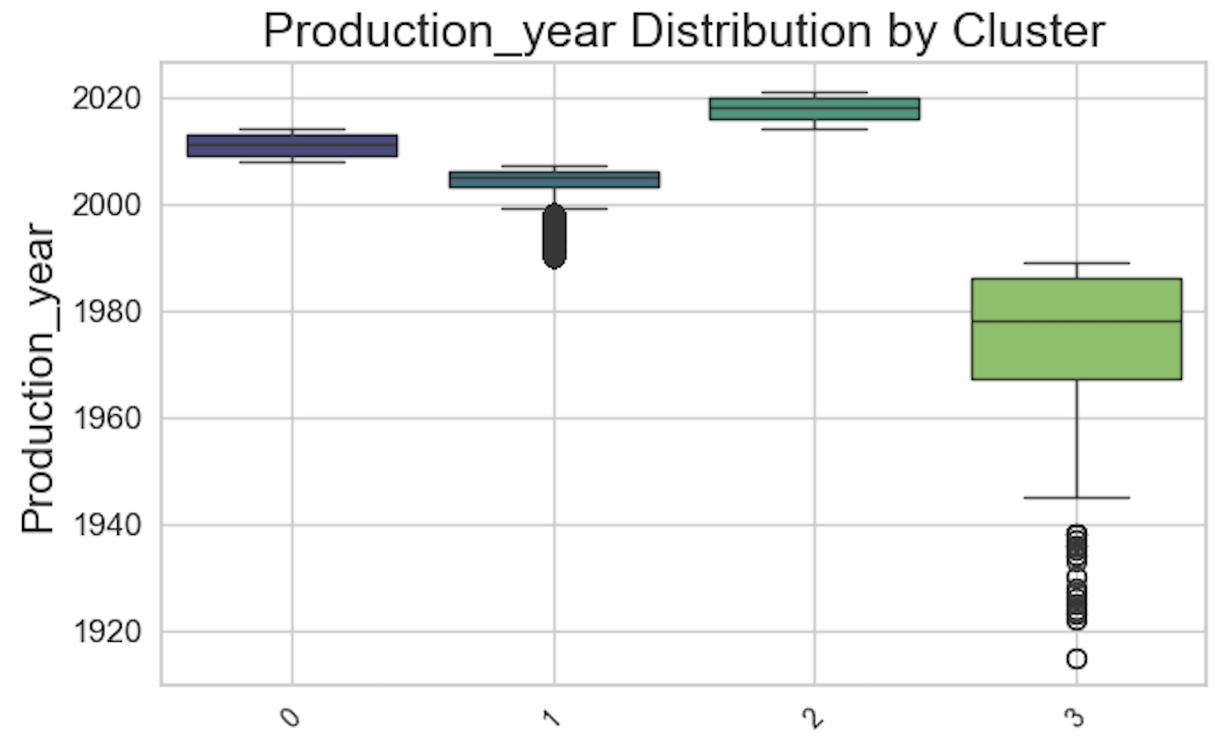
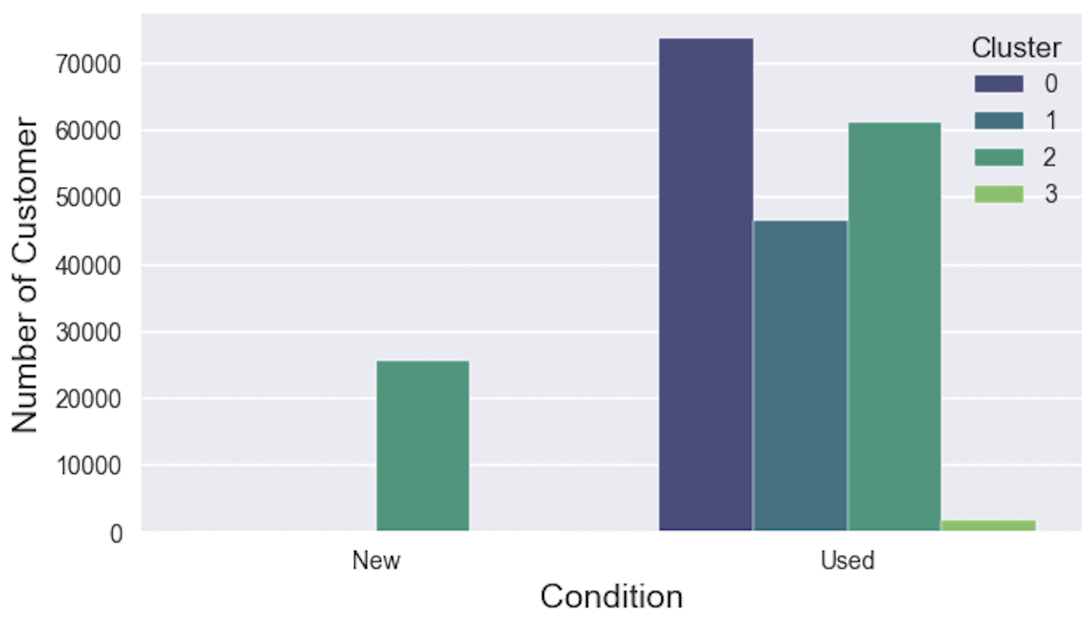
Methodology
Clustering Results:
Condition Distribution by Cluster
Number of Ads
Clusters
Cluster 2 comprises both used and new cars (condition). Cars in this category were primarily produced after the year 2015.
Cluster 3 consists of used cars, predominantly older models manufactured in the late 20th century.

Slide 7
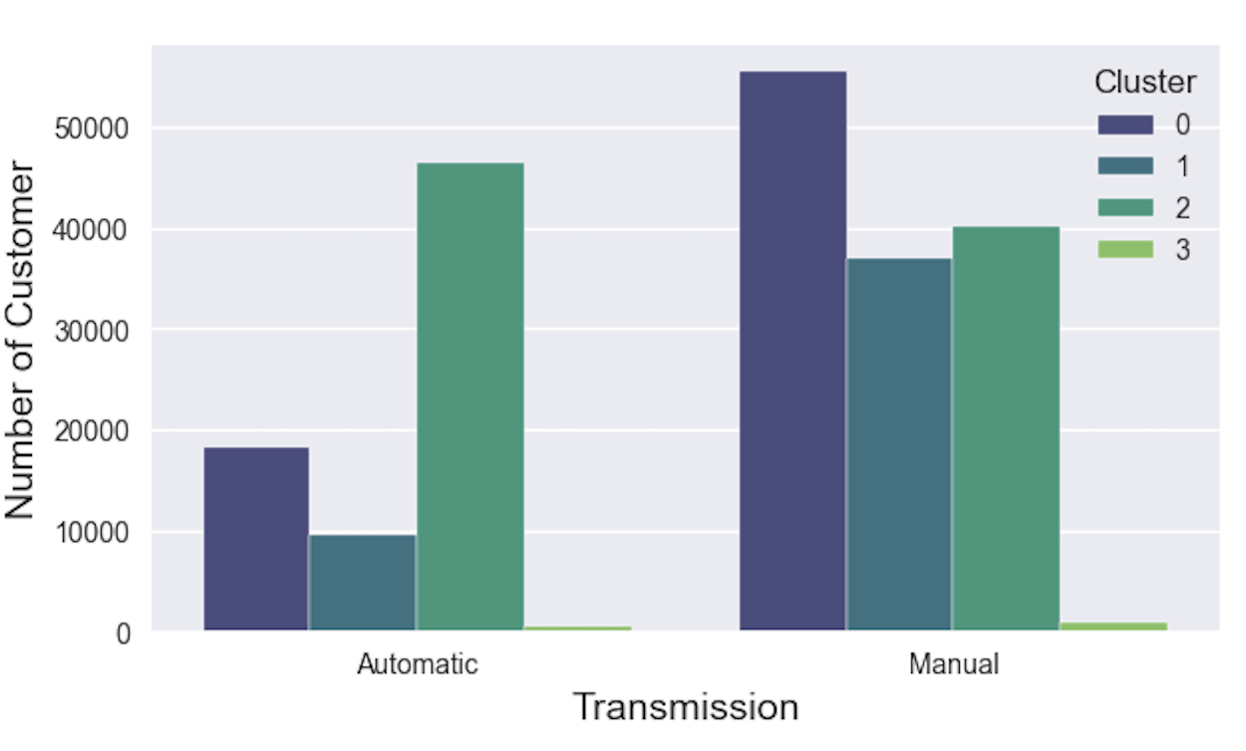
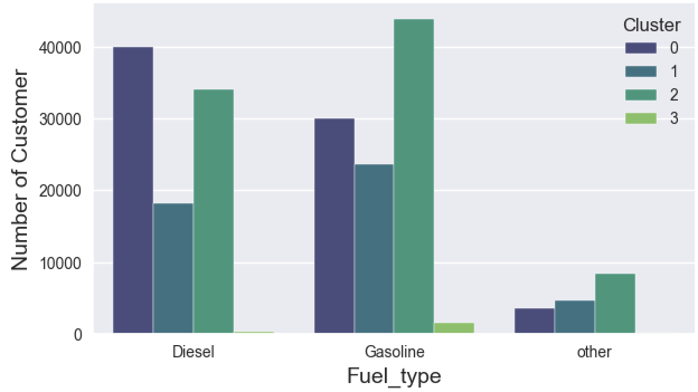
Methodology
Clustering Results:
Transmission Distribution by Cluster
Fuel Type Distribution by Cluster
Number of Ads
Number of Ads
In Cluster 2, Over 50% of cars have automatic transmission.
Most cars in cluster 3 (87%) are fueled by gasoline.

Slide 8
Methodology
Clustering Results:
Cluster 2 shows a strong preference for larger, versatile vehicles (e.g. SUVs and Station Wagons).
Rare or niche vehicles (e.g. Convertibles and other uncommon car types) play a major role in defining Cluster 3.

Slide 9
Cluster 0:
Moderately older cars, 1992-2008
Most of the car types in this cluster are compact and station wagon
Lowest price with 1,467 - 3,615 €
Cluster 1:
Moderately new cars, 2009-2015
Includes 42% of rare brands (Talbot, Vanderhall)
Mostly are sedans and station wagon
Cluster 2:
Contains both used and new cars (condition)
Highest price with 12,006.68 -29,841.42 €
Newer or recent cars, 2014-2021
Majority of the cars are SUV type
Mostly have automatic transmission
Cluster 3:
Old cars, 1985-1989
Majority of cars (87%) are fueled by gasoline
Rare colors and types
65% of the ads do not include any description
30% of the cars are Mercedes-Benzes

Slide 10
Cluster 0
Partnership with maintenance companies
Suggest affordable upgrades like modern systems to make these older models more appealing
Cluster 1
Show other car advertisement in this category
Cluster 2
Partner with financing and insurance companies to provide bundled offers
Cluster 3
Partner with insurance companies to offer specialized vintage car insurance for these models, with options like coverage for restoration projects or limited-use policies

Slide 11
Anomalies Detection
Identifying all unusual ads listing
Find characteristics of flagged ads
Flagging ads which not included in any clusters
Group similar unusual ads into clusters
Task 2: Detect unusual or suspicious vehicle offers, such as those with outlier features or specifications.

Slide 12
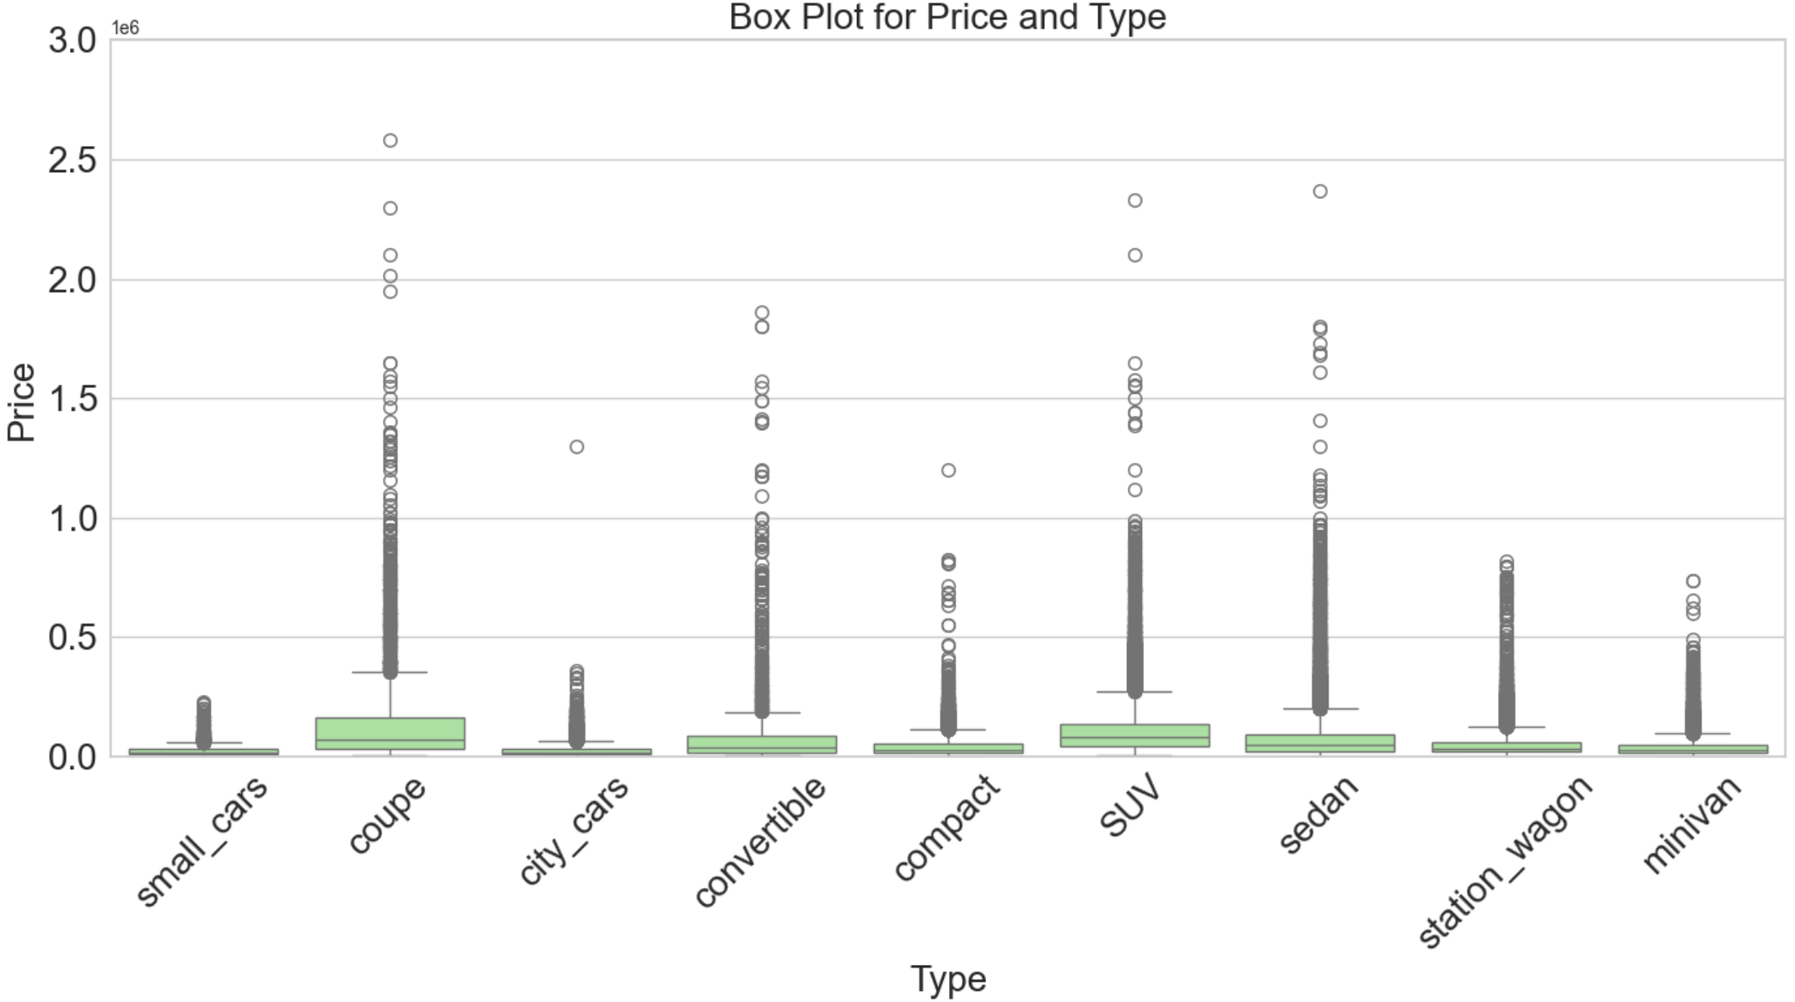
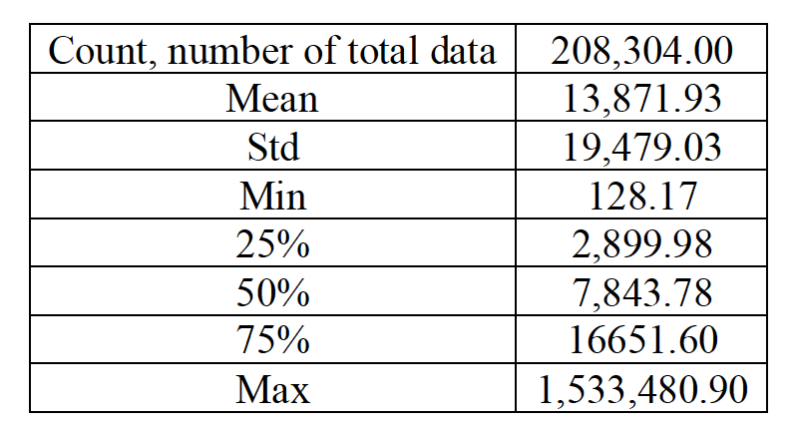
Anomalies Detection: Results
Most vehicles fall into the low-to-moderate price range; 75% of prices are below 16651.6 €.
The significant difference between the mean and median shows extremely high values pulling the mean upwards.
The Std and high max value confirm the presence of outliers or extreme variability in price distribution.
Coupe, Convertible, and SUVs have the widest price ranges and the highest concentration of outliers.

Slide 13
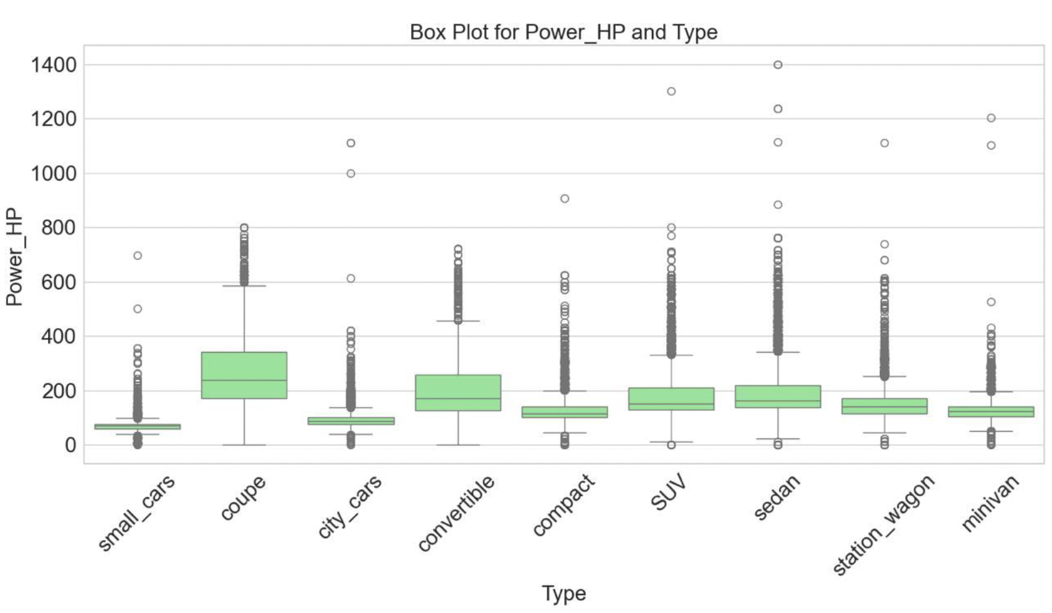
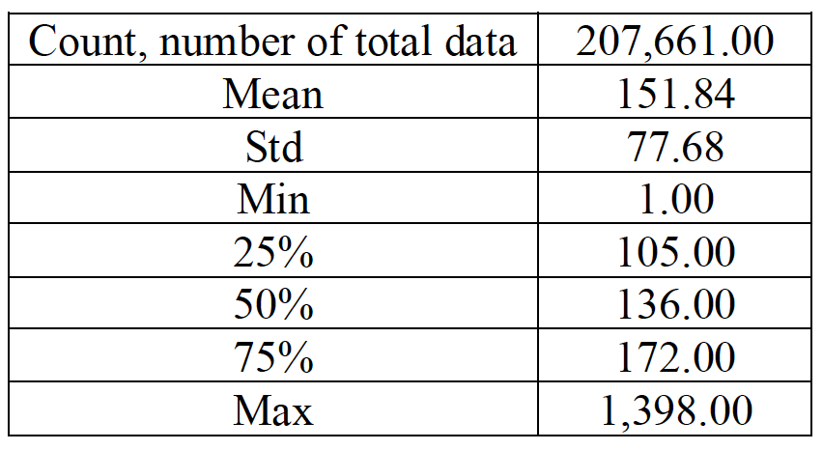
Anomalies Detection: Results
It mostly has moderate power values, 105-172 HP, which is typical for most passenger cars.
Categories such as coupes, convertibles, and SUVs exhibit several extreme values, suggesting the presence of powerful and niche vehicles in these groups.

Slide 14
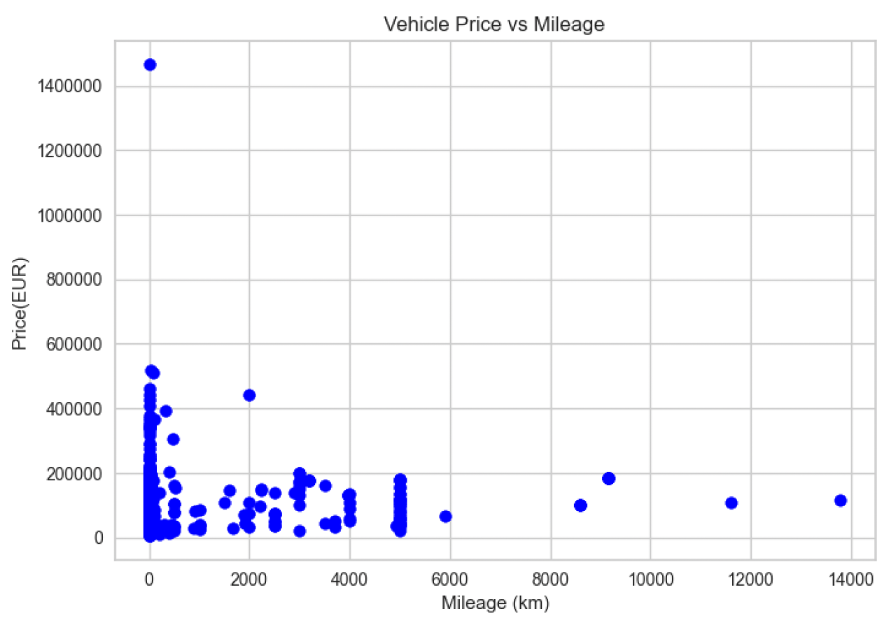
Anomalies Detection: Results
1,961 ads were identified as anomalies, with 80% of them representing new cars (2018-2021) featuring low mileage and high prices.
BMW and Mercedes-Benz had the highest frequencies, 25% and 16% of the ads, respectively.
Most of the new cars with anomalies were equipped with 4×4 drive modes (permanent or automatic).

Slide 15
Time Series Analysis: Results
Task 3:Explore temporal trends in the data.
Understanding the patterns of ad postings and predicting the number of ads for the next month.
Offer Publication Date
Month
Day
Day of Week

Slide 16
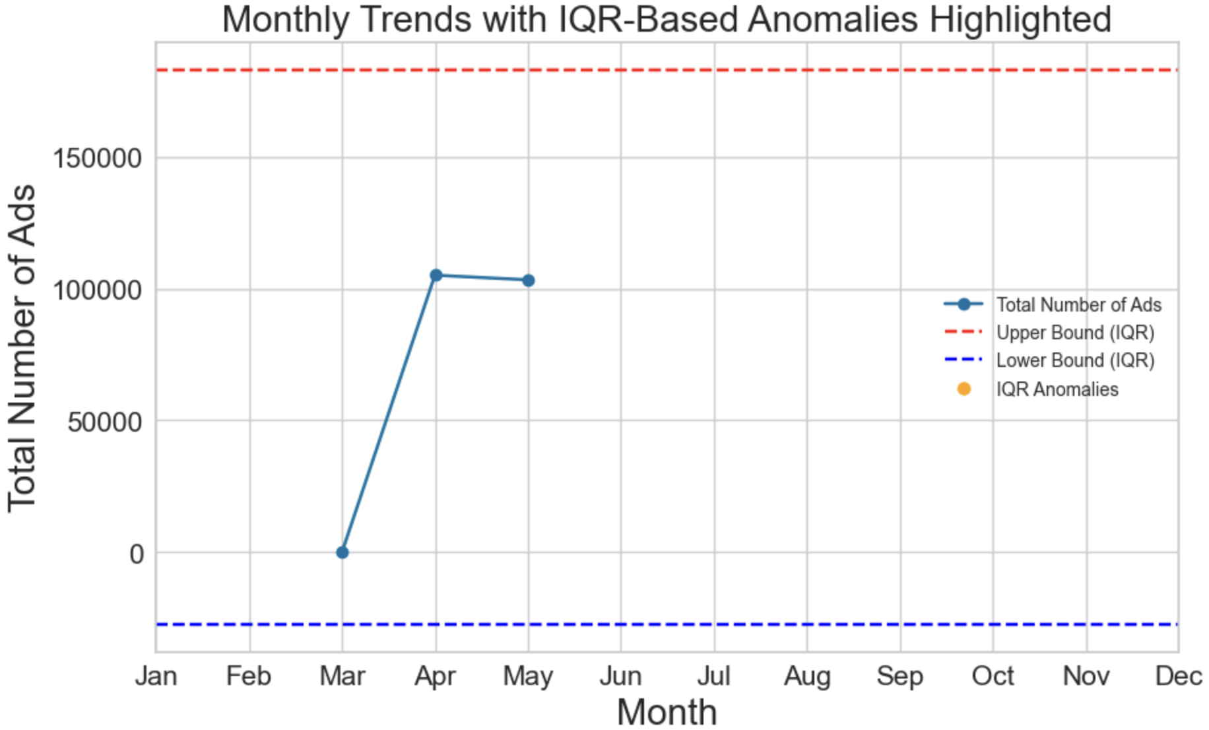
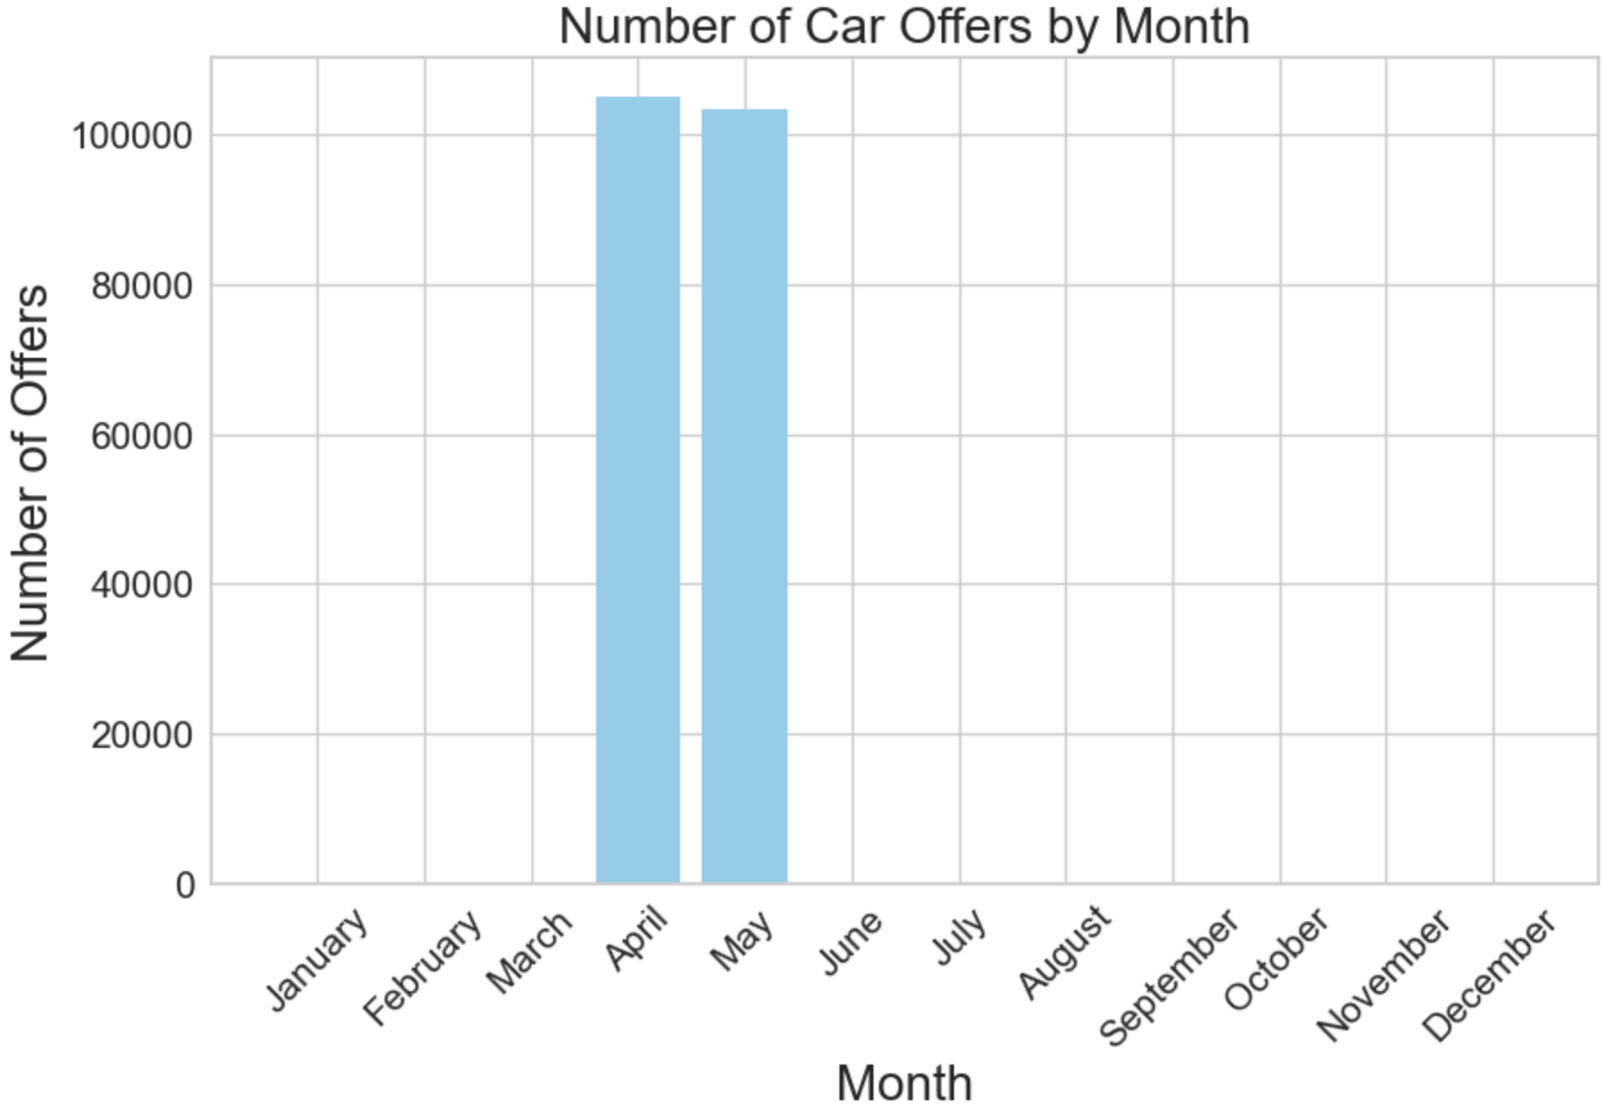
Time Series Analysis: Results
The number of car advertisements peaks significantly during April and May.
Ads follow a consistent seasonal pattern without any unusual deviations.

Slide 17
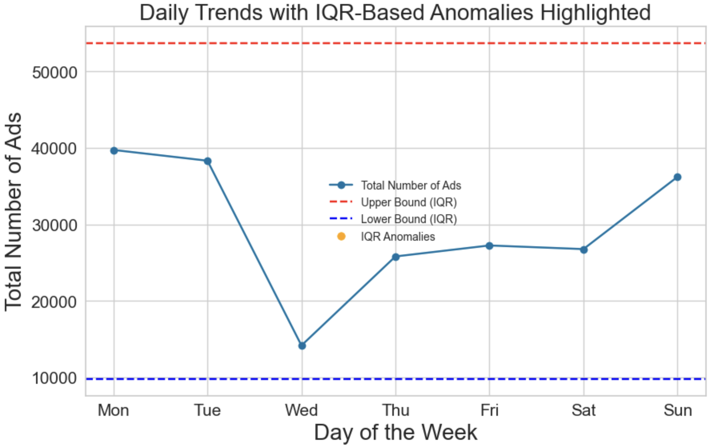
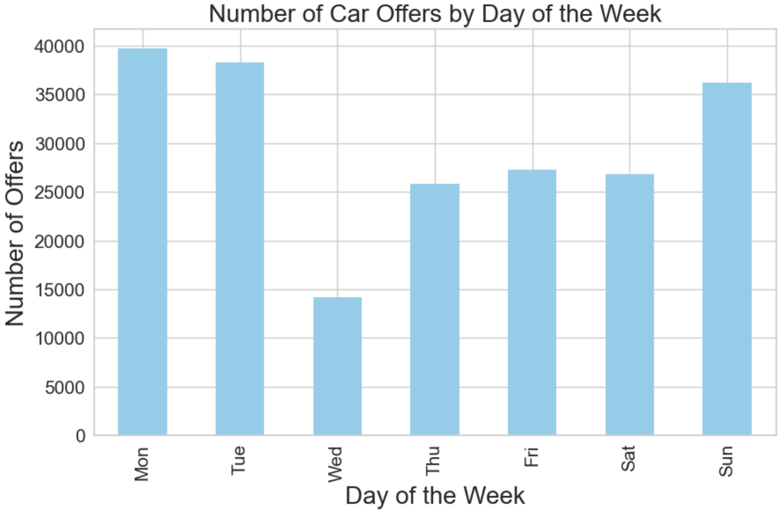
Time Series Analysis: Results
Mostly ads are posted at the beginning of the week, Monday and Tuesday, while fewer ads are posted on Wednesday.
Ads follow a consistent seasonal pattern without any unusual deviations.

Slide 18
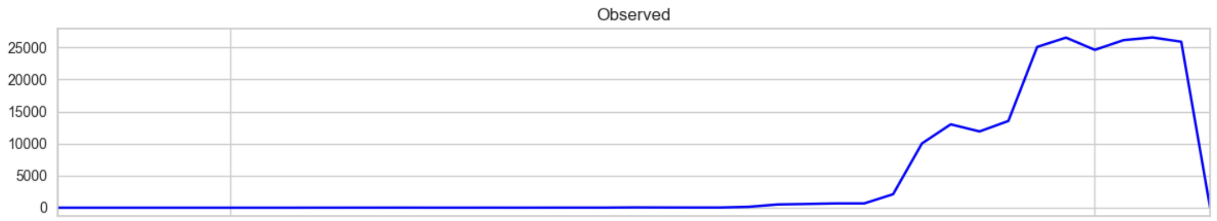
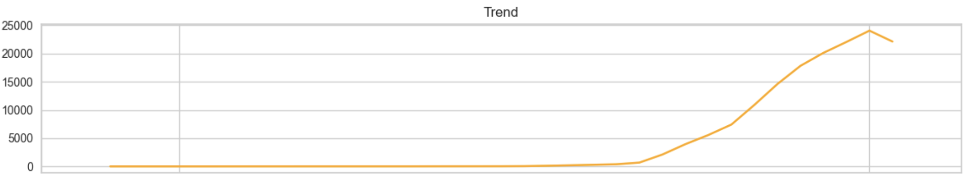
Time Series Analysis: Results

Slide 19
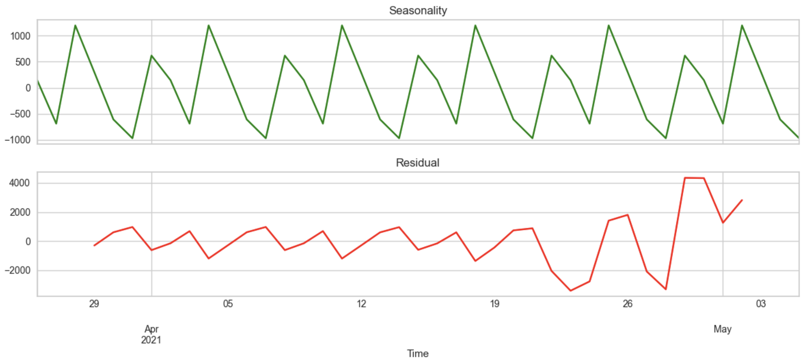
Time Series Analysis: Results
Weekly pattern in green line, the number of ads at the beginning of the week, Monday and Tuesday, is higher, while fewer ads are posted on Wednesday.
In the earlier late April, the residuals become larger, some days see unexpected spikes and dips in the number of ads.

Slide 20
Understand why late April sees an increase in ads (e.g. new car launches, or sudden event).
Allocate more resources (e.g., customer support, IT infrastructure) during peak days to handle increased activity efficiently and avoid disruptions.
Focus on marketing efforts at the beginning of the week. For instance, promotional emails can be sent to users on Mondays and Tuesdays.

Slide 21



Q and A
https://github.com/akheirollahi/DS-Project

