Slide 1

Industrial Presentation
On
EMPLOYEE MANAGEMENT SYSTEM
Department of Computer Science & Engineering
CENTRAL INSTITUTE OF TECHNOLOGY KOKRAJHAR
(A Centrally Funded Institute under Ministry of HRD, Govt. of India)
BTR, KOKRAJHAR, ASSAM: 783370
PRESENTED BY:
AKHER UDDIN AHMED [202102022100]

Slide 2
CONTENTS:
Internship Timeline.
Introduction.
System Architecture.
Login System.
Database Structure.
Adding a New Employee.
CRUD Operations.
Search and Filter.
Error Handling and Validations.
Conclusion and Future Scope.

Slide 3
INTERNSHIP TIMELINE:
Day 1: Introduction to IOCL Bongaigaon Operations
Overview of refinery processes.
Insight into the facility’s key functions and goals.
Day 2: Fire Safety Training
Briefing on fire safety protocols and emergency response.
Visit to the Fire Safety Department.
Remainder of Internship: Department Assignment
Placement in respective departments for hands-on learning.
Project work and application of skills in real-world tasks.

Slide 4
INTRODUCTION:
Developed a user-friendly application to manage employee records efficiently.
It features an user-friendly login and interface for easy access to employee data.
Add, update, delete, search, and view employee data with secure access.
Our application includes search and filter options to enhance data accessibility and quick decision making.
Using Python,CustomTkinter and MySQL.

Slide 5
SYSTEM ARCHITECTURE:
Key Components:
> Login System: Secure admin access.
>Employee Management Module: Handles adding, updating, deleting, and viewing records.
>Database (MySQL): Stores employee data.
>GUI (Custom Tkinter): User-friendly interface.
Data Flow:
> Input: Admin enters details.
>Process: Data validated and managed in Python.
>Storage: MySQL database for saving/retrieving records.
>Display: Organized data shown in the GUI.

Slide 6
LOGIN SYSTEM:
Purpose: Provides secure access to the Employee Management System.
Code Highlights:
Uses username and password fields for authentication.
Displays appropriate messages for successful or failed login.
GUI Design: Custom Tkinter layout with a background image and logos.

Slide 7
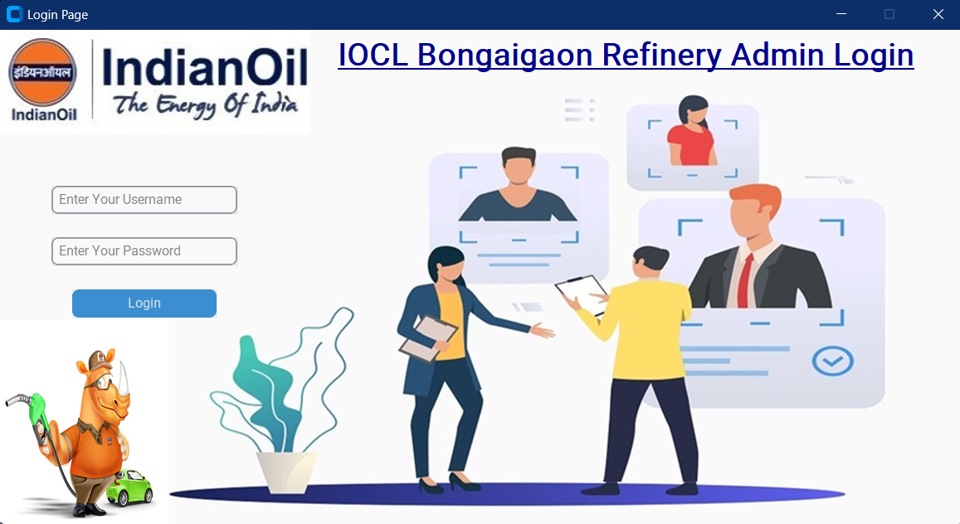
LOGIN PAGE:

Slide 8
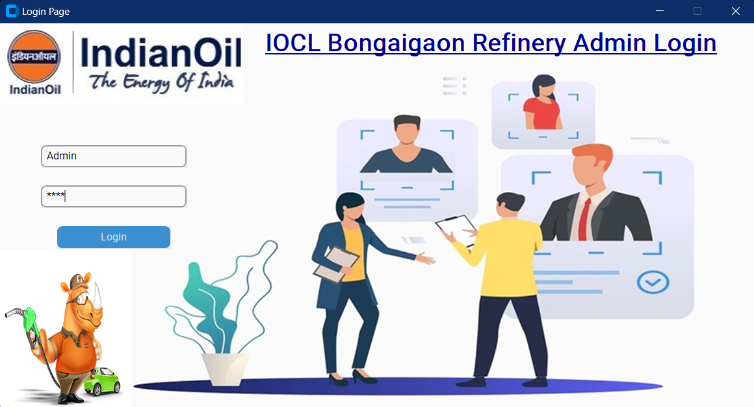
LOGIN PAGE:

Slide 9
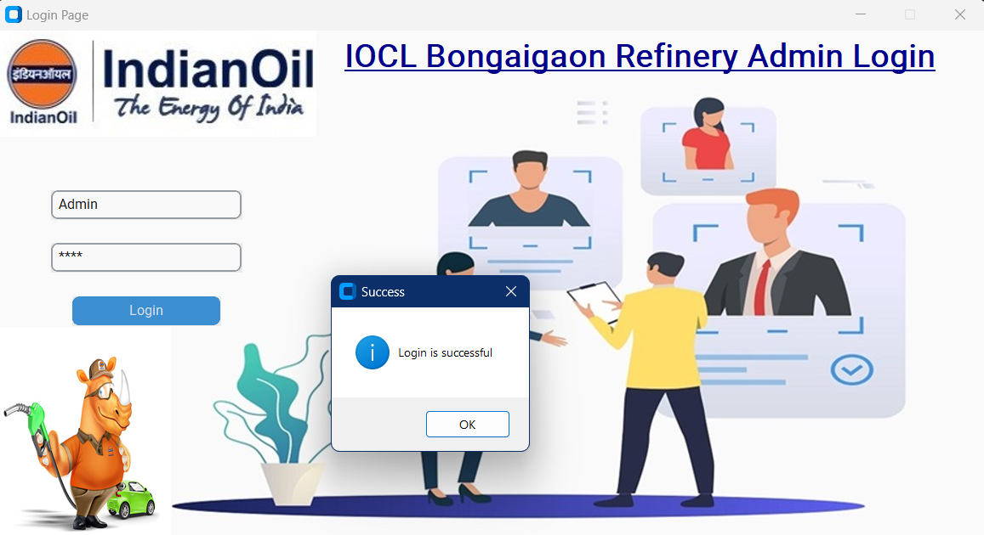
LOGIN PAGE:

Slide 10
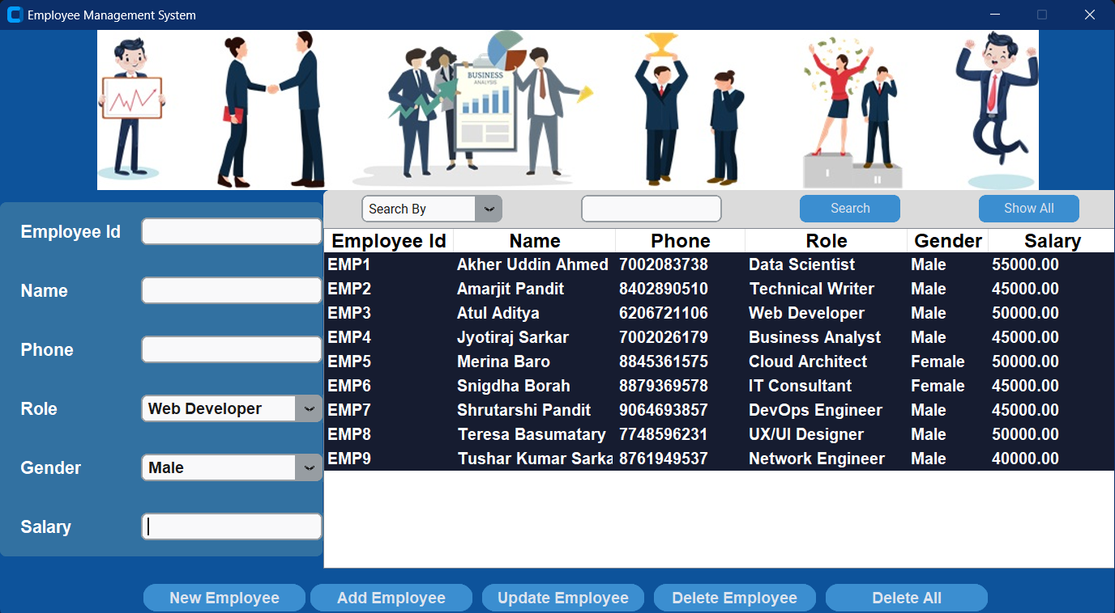
DATABASE STRUCTURE:

Slide 11
DATABASE STRUCTURE:
Database Name: employee_data
Table: data
Columns: Employee ID, Name, Phone, Role, Gender, Salary
MySQL Integration: Commands for creating and managing the database directly from Python.

Slide 12
ADDING A NEW EMPLOYEE:
Functionality:
Accepts user input for all fields (ID, Name, Phone, Role, Gender, Salary).
Validates if all fields are filled and checks for duplicate IDs.
Code: database.insert() function for adding records to MySQL.
Error Handling: Displays error if fields are empty or ID already exists.

Slide 13
CRUD OPERATIONS:
Create, Read, Update, Delete:
Create: Adds new employee records.
Read: Displays all records in the TreeView widget.
Update: Allows modifications to existing employee data.
Delete: Removes selected employee records.
GUI Layout: Each action is linked to buttons with distinct labels and icons.

Slide 14
SEARCH AND FILTER:
Functionality:
> Allows searching by fields like Employee ID, Name, Role, etc.
> Filters data based on search criteria.
Code Highlights: search_employee() function that dynamically fetches records based
on search input.

Slide 15
ERROR HANDLING AND VALIDATION:
Field Validation: Ensures all required fields are filled and checks for correct data types.
Duplicate Entry Check: Prevents duplicate employee IDs or phone numbers by alerting the user if a duplicate is detected.
Format and Range Checks: Validates phone numbers and salary ranges to ensure realistic and properly formatted inputs.
Deletion Confirmation: Prompts for confirmation before deleting records to prevent accidental data loss.
User-Friendly Error Messages: Displays clear error messages for invalid entries, helping users correct mistakes and maintain data accuracy.

Slide 16
CONCLUSION:
The EMS provides an efficient way to manage employee data, reducing manual effort and minimizing errors.
It offers essential functionalities like adding, updating, deleting, and searching for employee records, streamlining data handling.
The system improves administrative efficiency and enhances data security.
A user-friendly interface allows admins to easily manage details such as employee ID, name, role, and salary.
Overall, the EMS supports better organization, making HR operations more productive and focused on strategic tasks.

Slide 17
THANK YOU

